Slide 1
Dynamic Programming

Slide 2
Dynamic Programming
Dynamic programming (DP) refers to a collection of algorithms that can be used to compute optimal policies given a perfect model of the environment as a Markov decision process (MDP).
Classical DP algorithms are of limited utility in reinforcement learning both because of their assumption of a perfect model and because of their great computational expense, but they are still important theoretically.
We usually assume that the environment is a finite MDP.

Slide 3
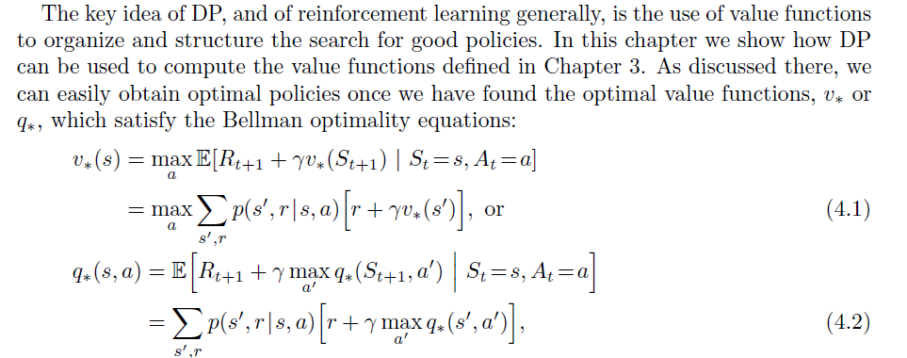
Value Functions

Slide 4
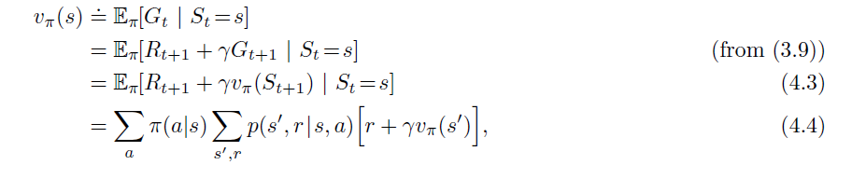
Policy Evaluation (Predictions)
Recall

Slide 5
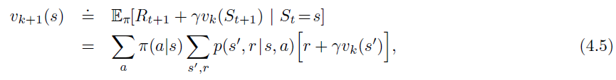
Policy Evaluations
Consider a sequence of approximate value functions v0, v1, v2, . . ., each mapping S+ to R (the real numbers). The initial approximation, v0, is chosen arbitrarily (except that the terminal state, if any, must be given value 0), and each successive approximation is obtained by using the Bellman equation for vπ as an update rule:

Slide 6
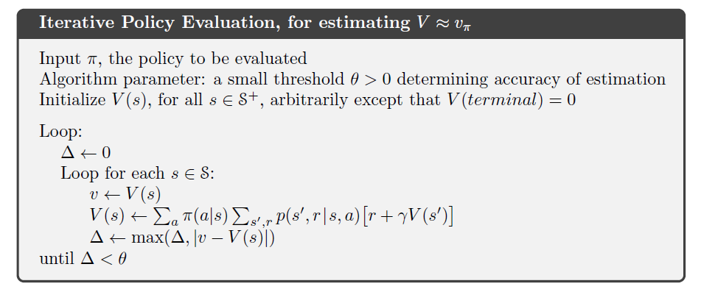
Iterative Policy Evaluation

Slide 7
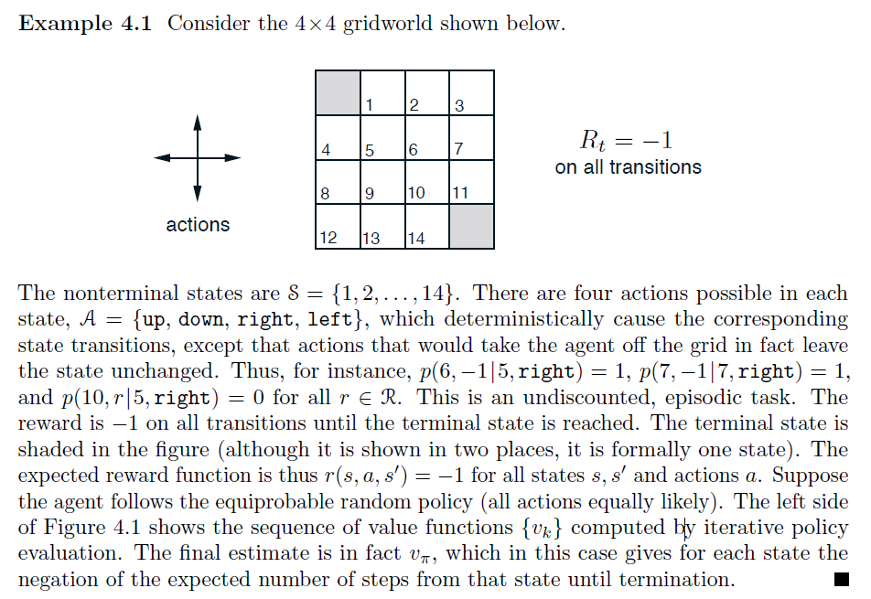
Example

Slide 8
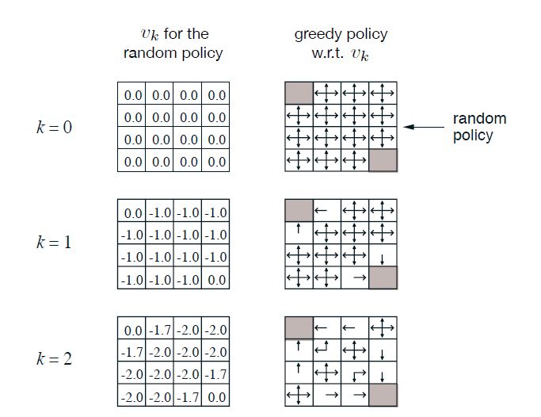
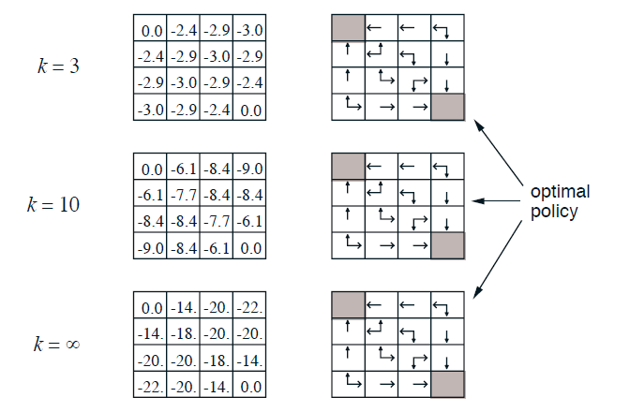
Example

Slide 9
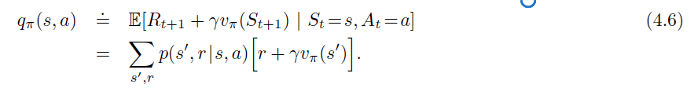
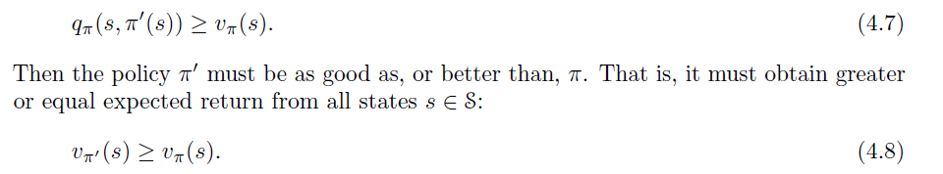
Policy Improvement
The value of this way of behaving is
Let π and π’ be any pair of deterministic policies such that, for all s (belongs to) S,

Slide 10
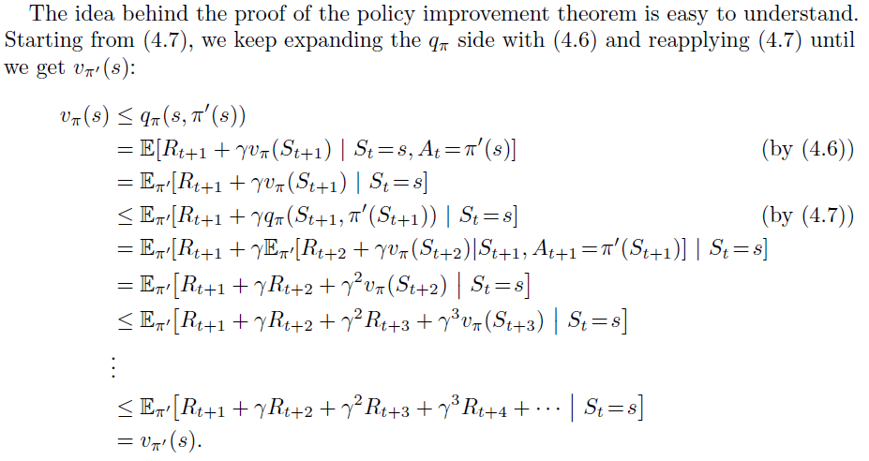
Policy Improvement

Slide 11
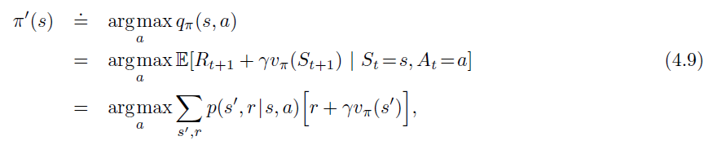
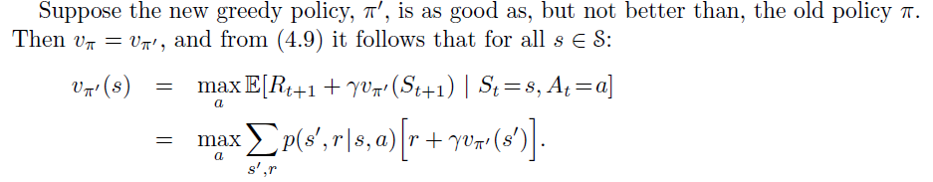
Policy Improvement
To consider the new greedypolicy, given by

Slide 12
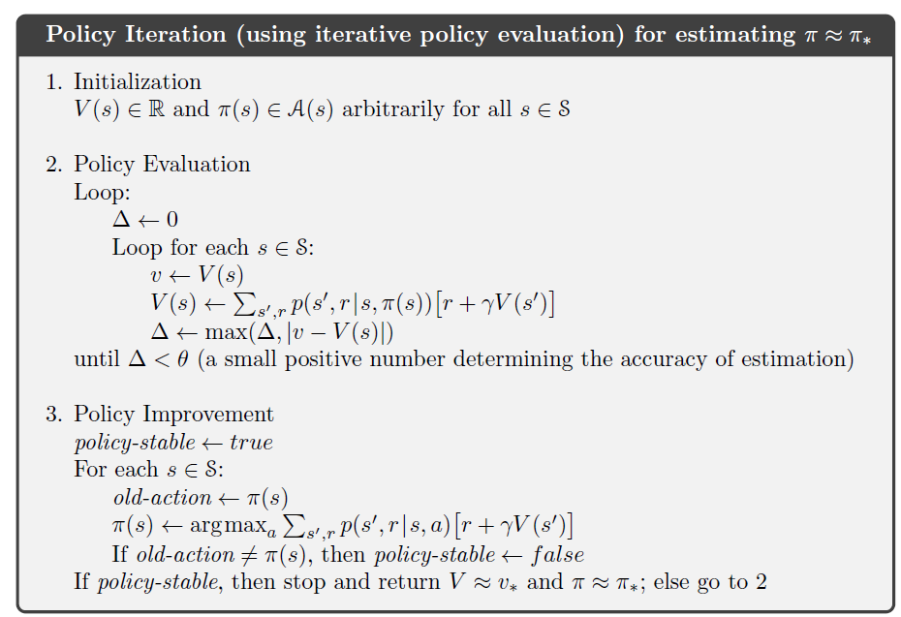
Policy Iteration

Slide 13
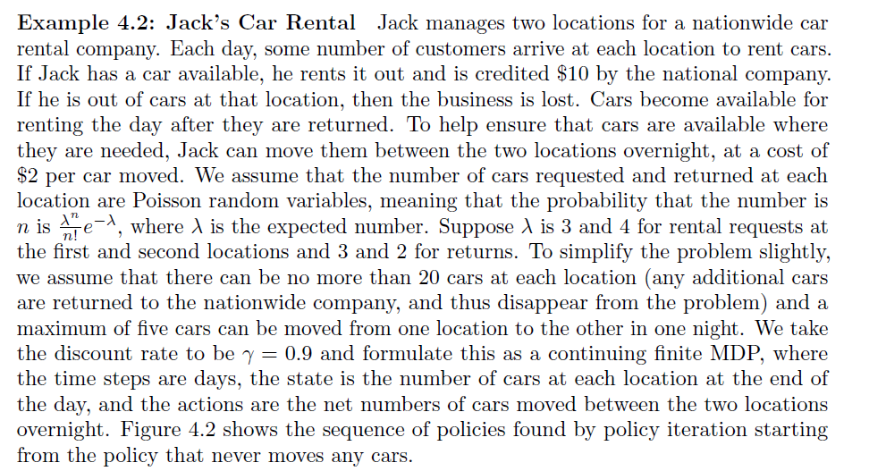
Example

Slide 14
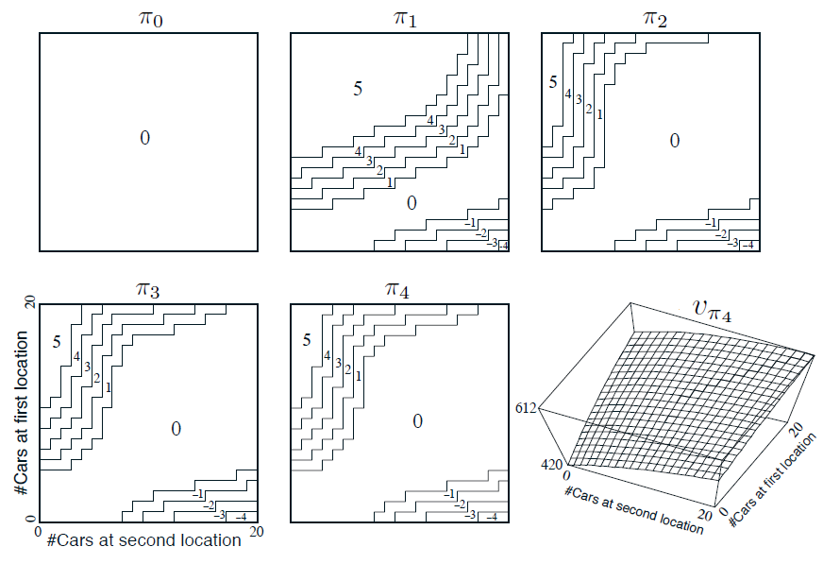
Example
Figure 4.2: The sequence of policies found by policy iteration on Jack’s car rental problem, and the final state-value function. The first five diagrams show, for each number of cars at each location at the end of the day, the number of cars to be moved from the first location to the second (negative numbers indicate transfers from the second location to the first). Each successive policy is a strict improvement over the previous policy, and the last policy is optimal.

Slide 15
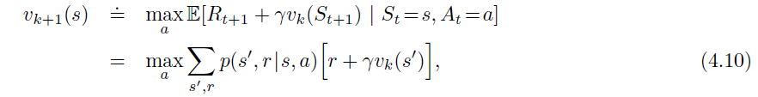
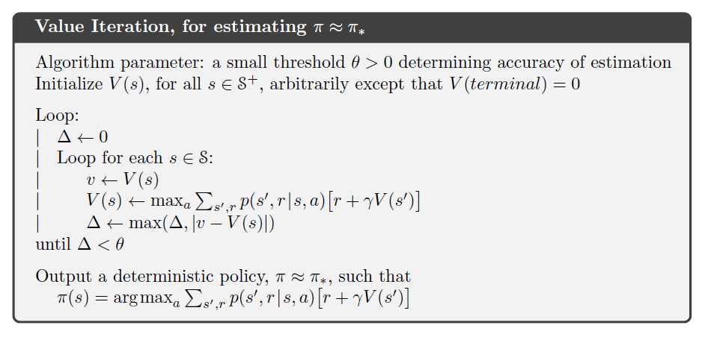
Value Iteration

Slide 16
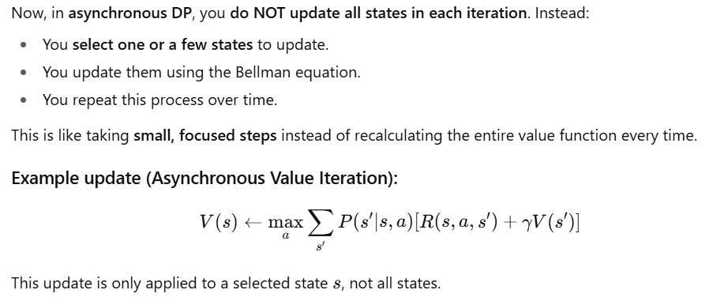
Asynchronous Dynamic Programming

Slide 17
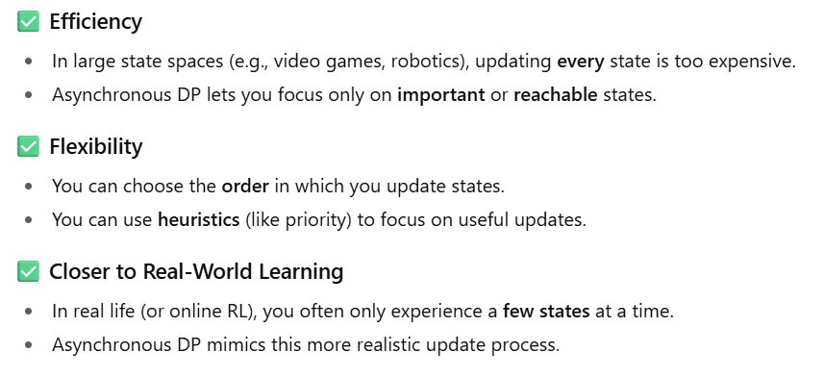
Why Use Asynchronous DP?

Slide 18
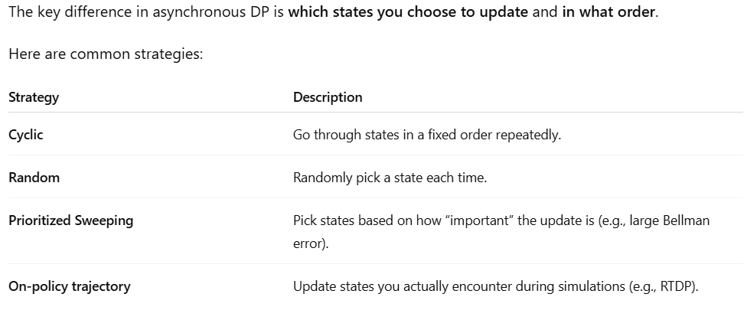
Strategies for State Selection

Slide 19
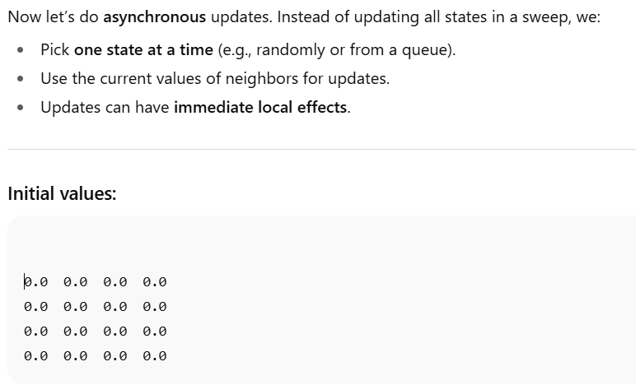
Asynchronous Value Iteration – Visualization

Slide 20
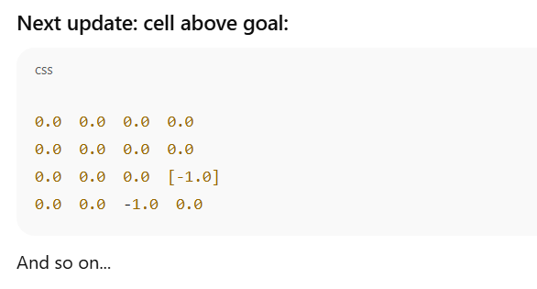
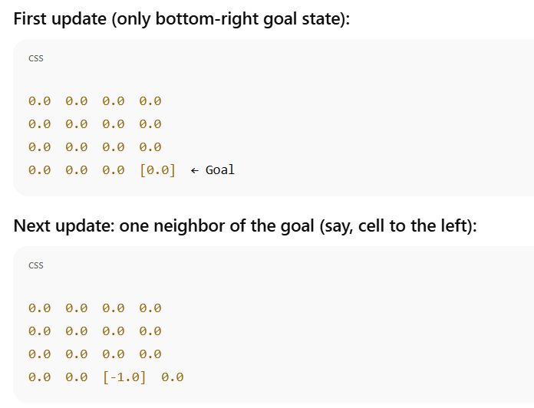
Example
Instead of all values changing at once, you see value gradually spreading from the goal through local updates.

