Slide 1
Introduction to Reinforcement Learning

Slide 2
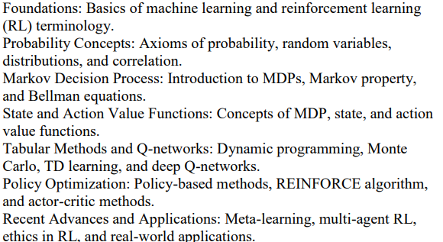
Syllabus

Slide 3
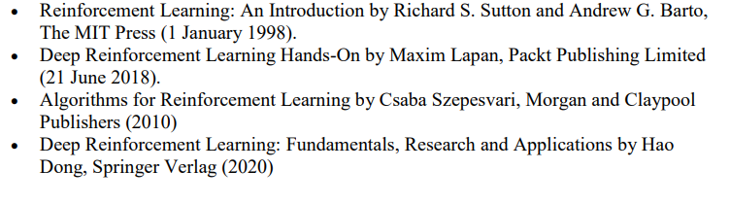
Suggested Readings

Slide 4
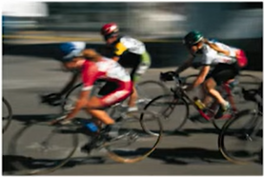
Learn to Control
Familiar models of Machine Learning
Supervised: Classification, Regression etc.
Unsupervised: Clustering, Frequent Patterns etc.
How did you learn the cycle?

Slide 5
Reinforcement Learning
A Trial-and-Error learning paradigm
Learn about a system through interaction
Inspired by behavioral psychology!
Pavlov’s dog

Slide 6
Reinforcement Learning
Learning about stimuli and actions based on rewards and punishments alone.
No detailed supervision available
Trial-and-Error learning
Delayed rewards
Sequence of actions required to obtain reward
Associative learning required
Need to associate actions to states
Learn about policies not just actions
Typically in a stochastic world

Slide 7
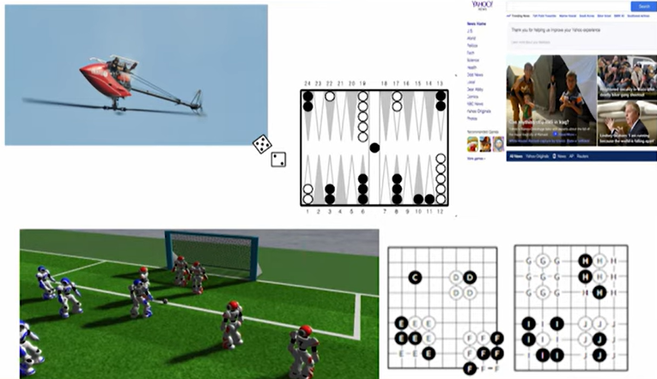
RL Applications

Slide 8
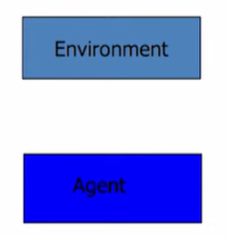
RL Framework
Learn from close interaction
Stochastic environment
Noisy delayed scalar evaluation
Maximize a measure of long term performance

Slide 9
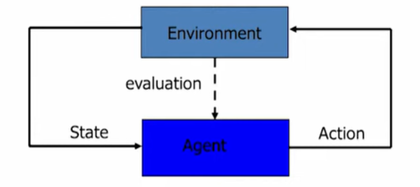
RL Framework
Learn from close interaction
Stochastic environment
Noisy delayed scalar evaluation
Maximize a measure of long term performance

Slide 10
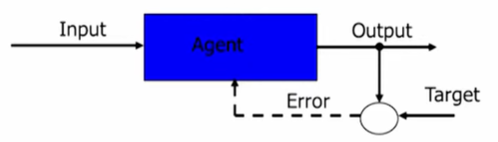
Not Supervised Learning!
Very sparse “Supervision”
No target output provided
No error gradient information available
Action chooses next state
Explore to estimate gradient – Trial and Error Learning

Slide 11
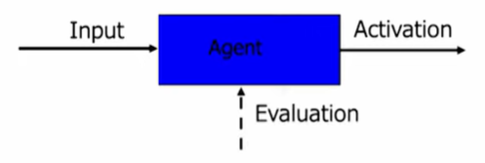
Not Unsupervised Learning!
Sparse “Supervision” available
Pattern detection not primary goal

Slide 12
RL Elements
Apart from Agent and Environment, It has other crucial components:
Policy
Reward signals
Value functions
Model of environment

Slide 13
Policy
Defines agent’s way of behaving at a given time
In psychology, it is called a set of Stimulus-Response rules or associations
May be a simple function or requires extensive computation

Slide 14
Reward Signals
Defines the goal in a RL Problem
Considered as a primary basis for altering the policy
In general, reward signals may be stochastic functions of the state of the environment and the actions taken

Slide 15
Value function
A value function defines what is good in the long run
Value of state = total amount of reward an agent can except to accumulate over the future

Slide 16
Model of Environment
Mimics the behavior of environment
Model are used for Planning
Methods for solving RL problems that use models and planning are called Model-based methods

Slide 17
Limitations and Scope
Most of the RL methods are structured around estimating the Value Functions
Evolutionary methods –
will be effective for sufficiently small space of policies, good policies are common and easy to find, or if a lot of time is available for searching.
Do not use the fact that policy they are searching for is a function from states to actions.
Policy gradient methods

Slide 18
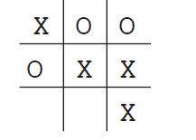
An Extended Example: Tic-Tac-Toe
Solutions:
Classical Techniques
Minimax
Dynamic programming
Evolutionary Methods
RL Method

Slide 19
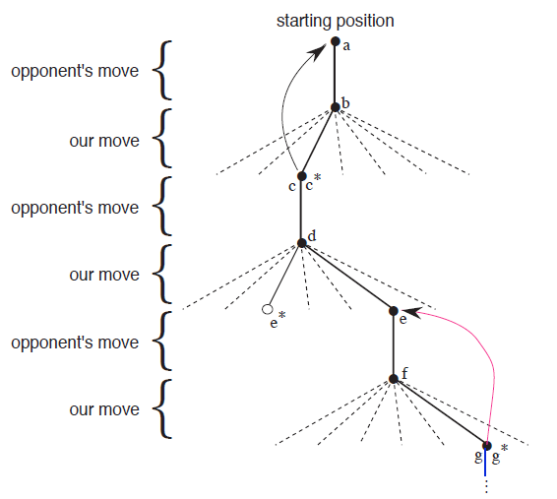
An Extended Example: Tic-Tac-Toe

Slide 20
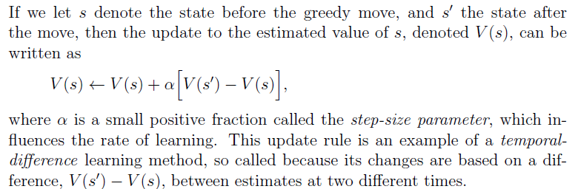
An Extended Example: Tic-Tac-Toe

Slide 21
Temporal Difference
Simple rule to explain complex behaviours
Intuition: Prediction of outcome at time t+1 is better than the prediction at time t. Hence use the later prediction to adjust the earlier prediction.
Has had profound impact in behavioral psychology and neuroscience!

Slide 22
Explore-Exploit Dilemma
One key Question- the dilemma between exploration and exploitation
Explore to find profitable actions
Exploit to act according to the best observations already made
Bandit problems encapsulate ‘Explore vs Exploit’

