Slide 1
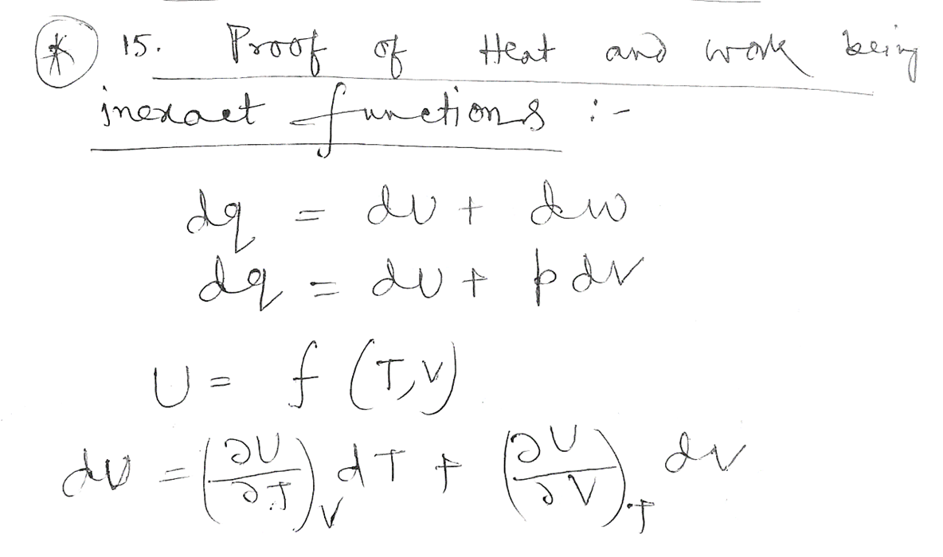
Proof of Heat (q) and Work (w) are path functions and dq and dw are inexact differential

Slide 2
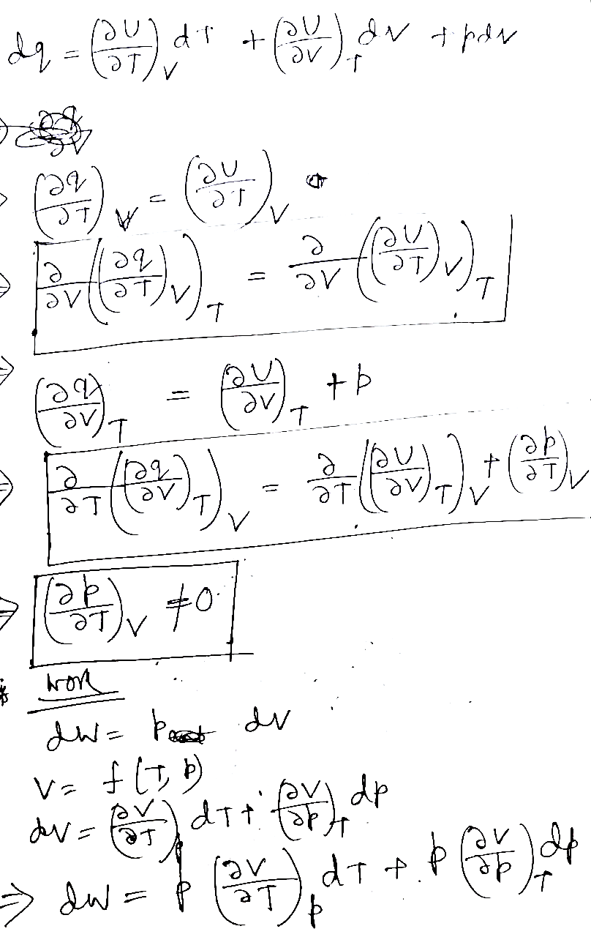

Slide 3
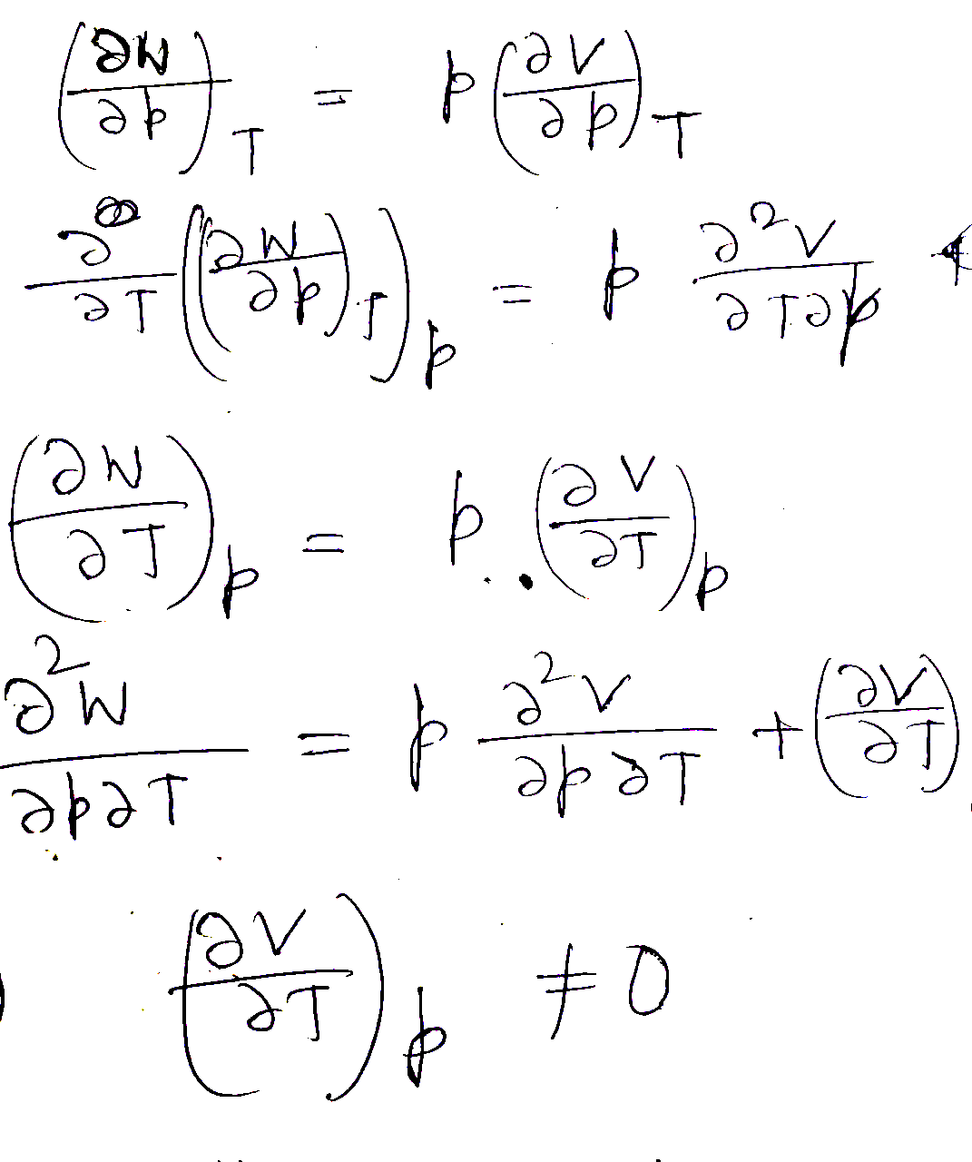

Slide 4
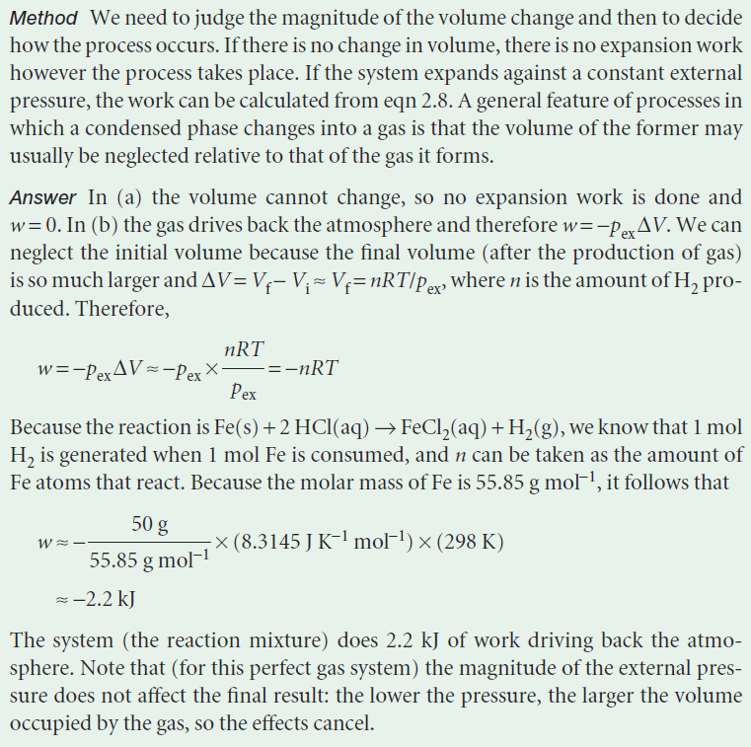
Atkins Book

Slide 5
Exercise to students
(Write on board and tell the students to solve)

