Slide 1
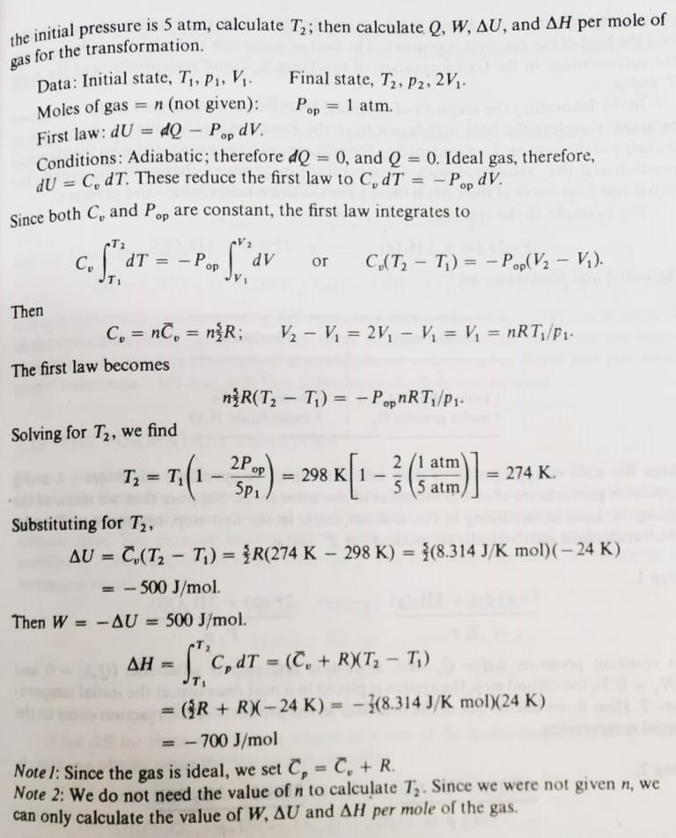
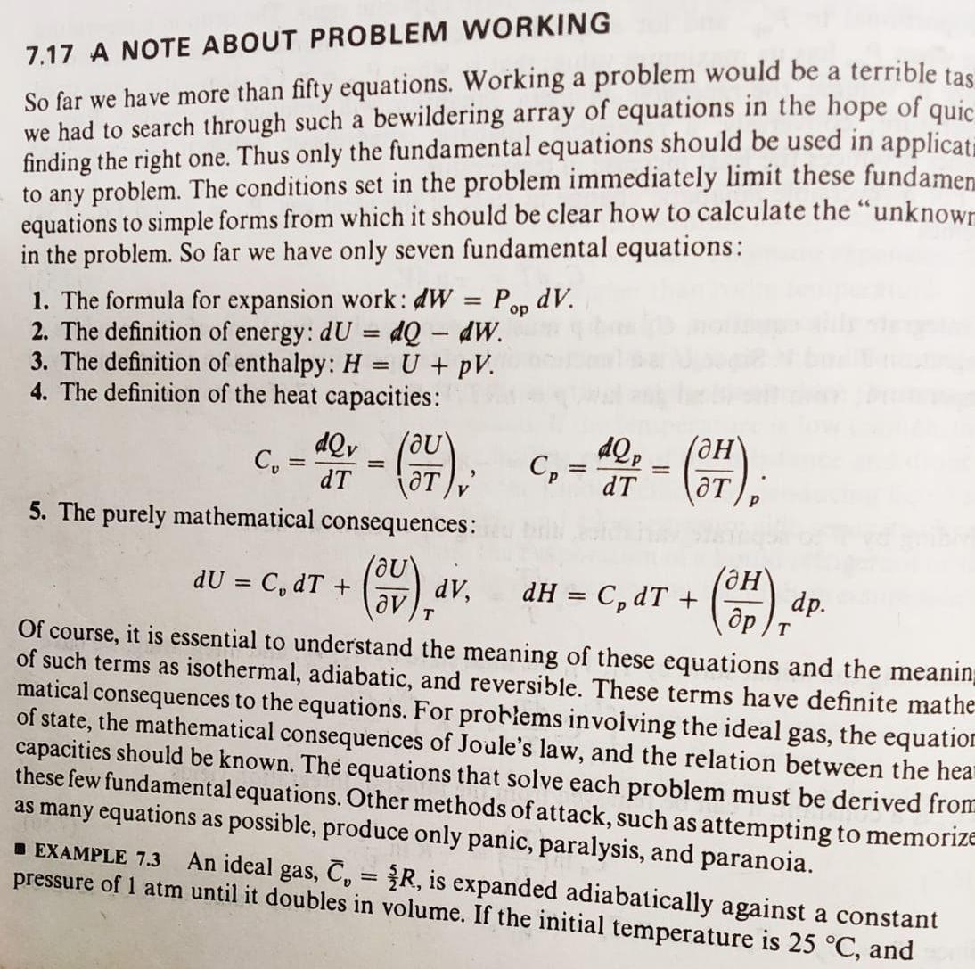
How to solve thermodynamical problems? An example.

Slide 2
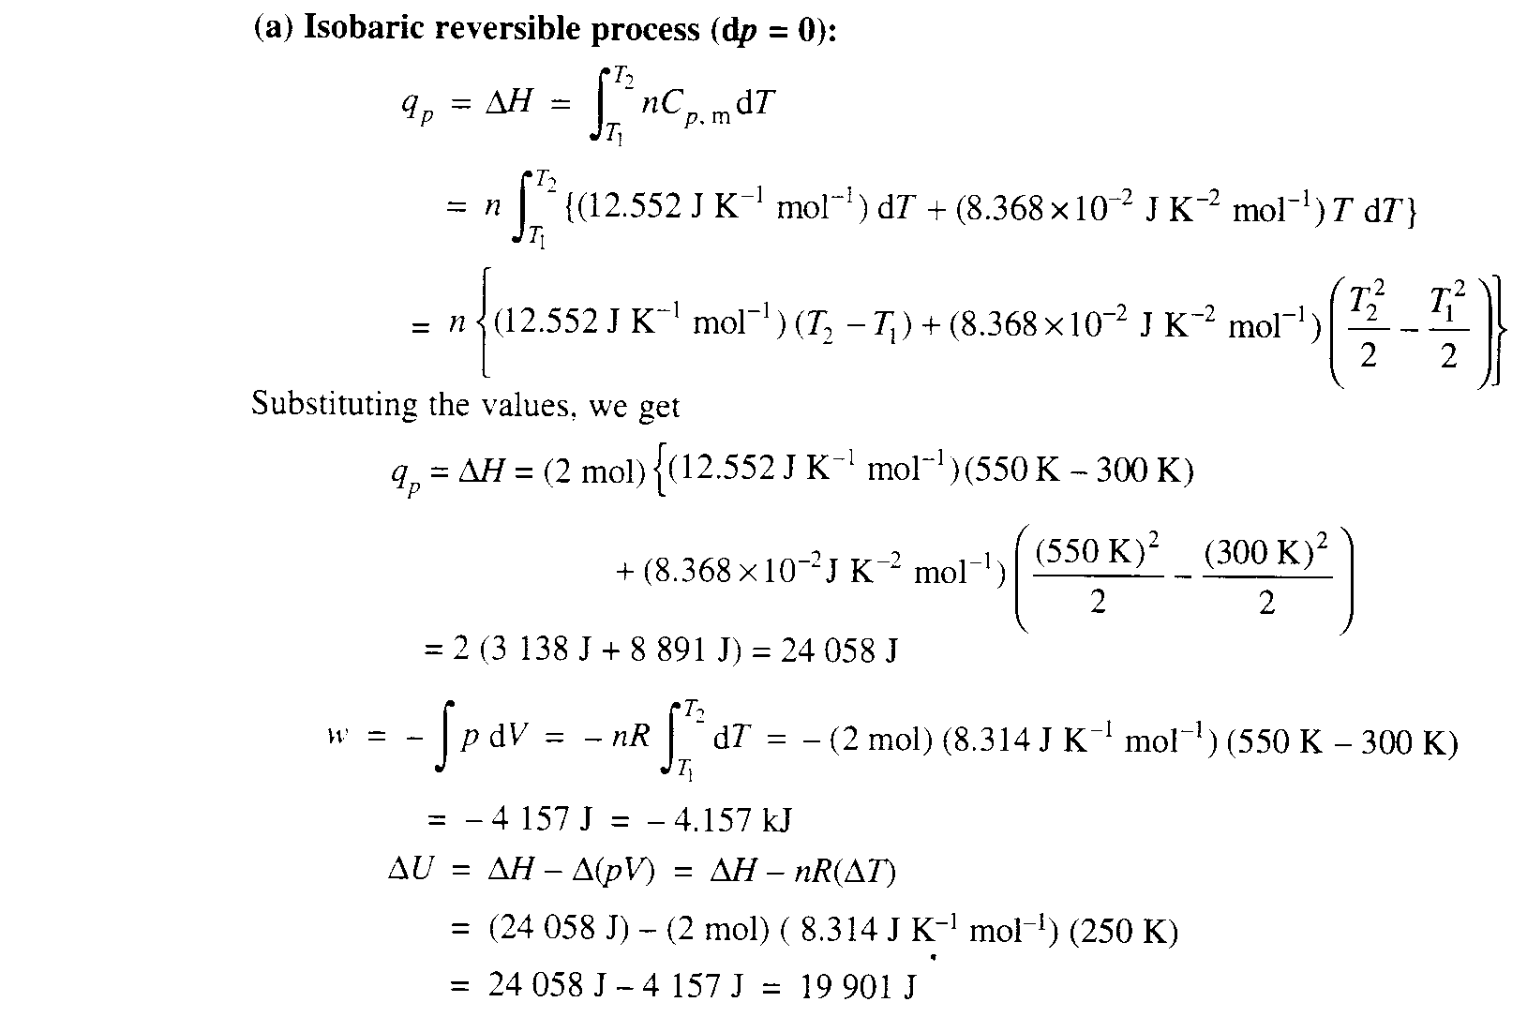
Another problem
A 32 g sample of CH₄ gas initially at 101.325 kPa and 300 K is heated to 550 K. C_{P} (J K⁻¹ mol⁻¹ = 12.552 + 8.368 × 10⁻² T/K). Assuming CH₄ behaves ideally, compute w, q, ΔU and ΔH for (a) an isobaric reversible process, and (b) an isochoric reversible process.

Slide 3
