Slide 1
Q1. At 27°C,two moles of an ideal monoatomic gas occupy a volume V. The gas is adiabatically expanded to a volume 2V.
a. Calculate the ratio of final pressure to the initial pressure. b. Calculate the final temperature. C. Change in internal energy.
[Given γ is 5/3]
Given n=2 T=27°C=300 K ,V₁=V,V₂=2V a. Now PV^{γ}=constant P₁V₁^{γ}=P₂V₂^{γ} P₂/P₂=(V₁/V₂) ^{γ} = 0.5^{5/3} b. T₁V₁^{γ-1}=T₂V₂^{γ-1} or T₂=300/2^{2/3}=189K c. Change in internal energy = nC_{v}ΔT For monoatomic gas C_{v}= 3R/2 Substituting all the values Change in internal energy= -2764J

Slide 2
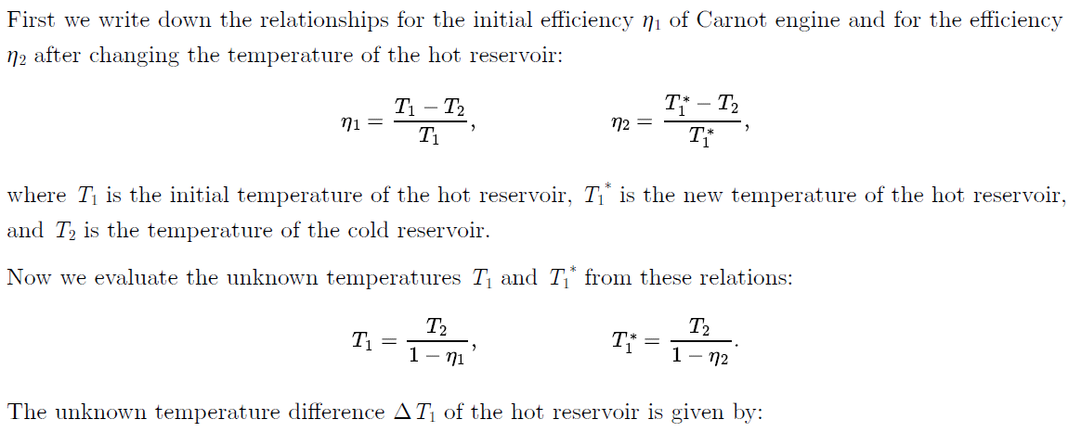
Q2. Carnot engine operates with efficiency of 40 %. How much must the temperature of the hot reservoir increase, so that the efficiency increases to 50 %? The temperature of the cold reservoir remains at 9 °C.
η₁ = 40 % = 0.4 initial efficiency of Carnot engine
η₂ = 50 % = 0.5 efficiency of Carnot engine after increasing the temperature of hot reservoir
t_{c}= 9 °C => T_{c} = 282 K temperature of cold reservoir
ΔT₁ = ?temperature increase of hot reservoir

Slide 3
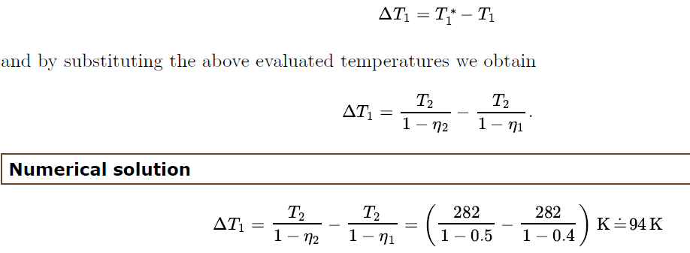

Slide 4
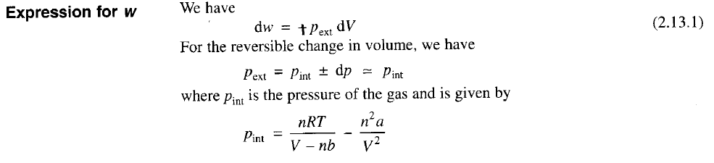
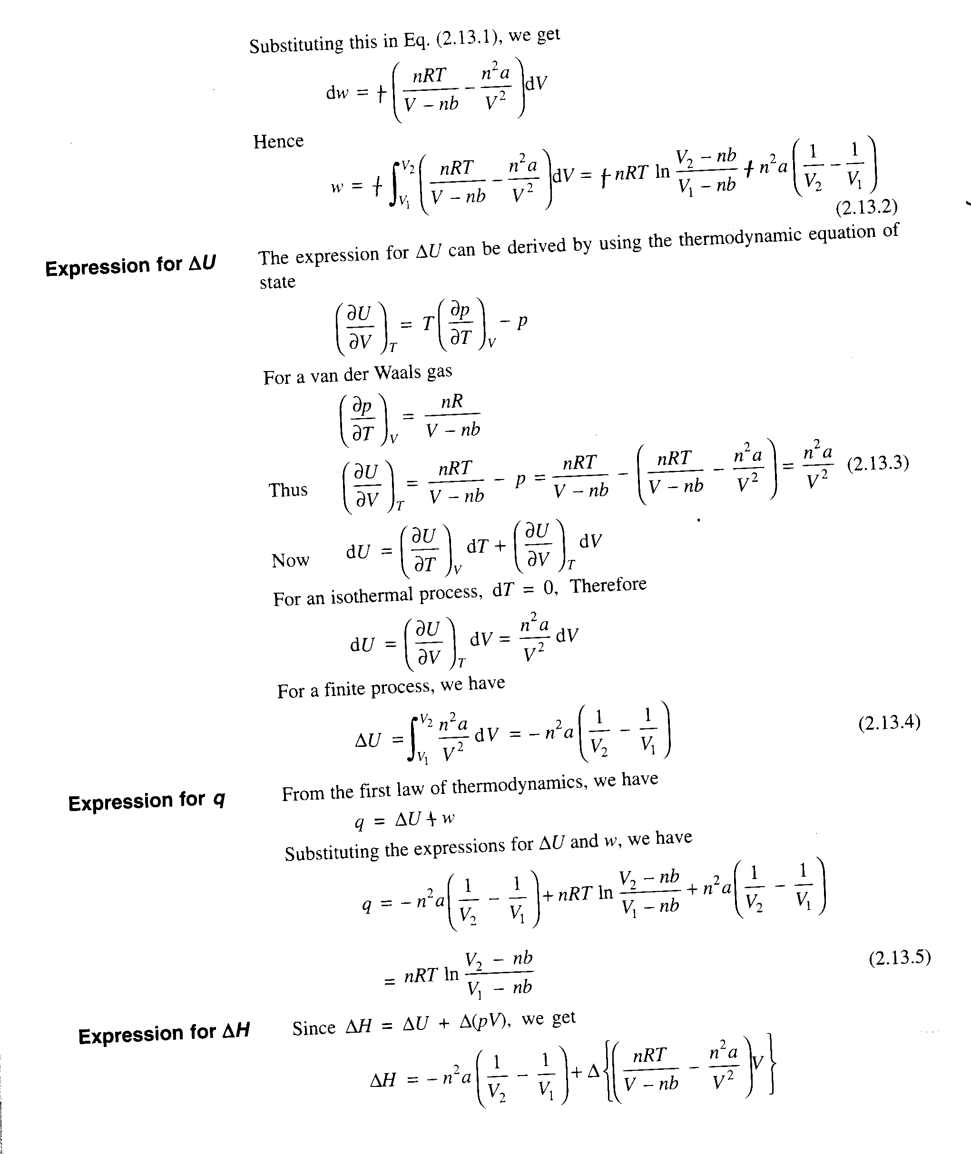
Q3. Derive the expressions of W, ΔU, q, and ΔH for isothermal expansion process for van der Waals gas.

