Slide 1
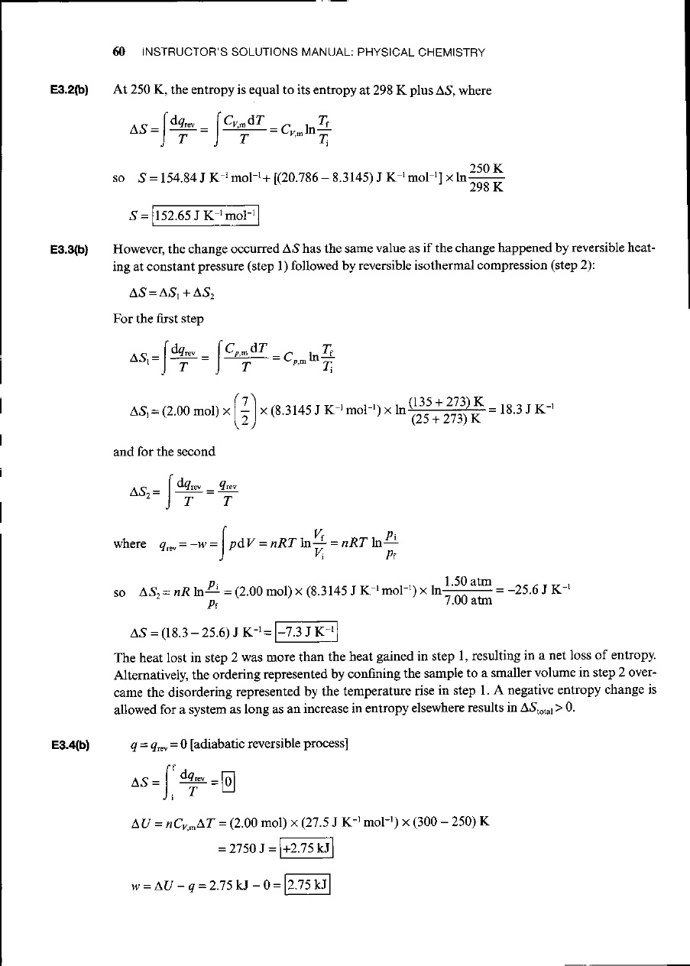
2. Calculate ΔS (for the system) when the state of 2.00 mol diatomic perfect gas molecules, for which C_{p,m} = 7/2R, is changed from 25°C and 1.50 atm to 135°C and 7.00 atm. How do you rationalize the sign of ΔS?

Slide 2
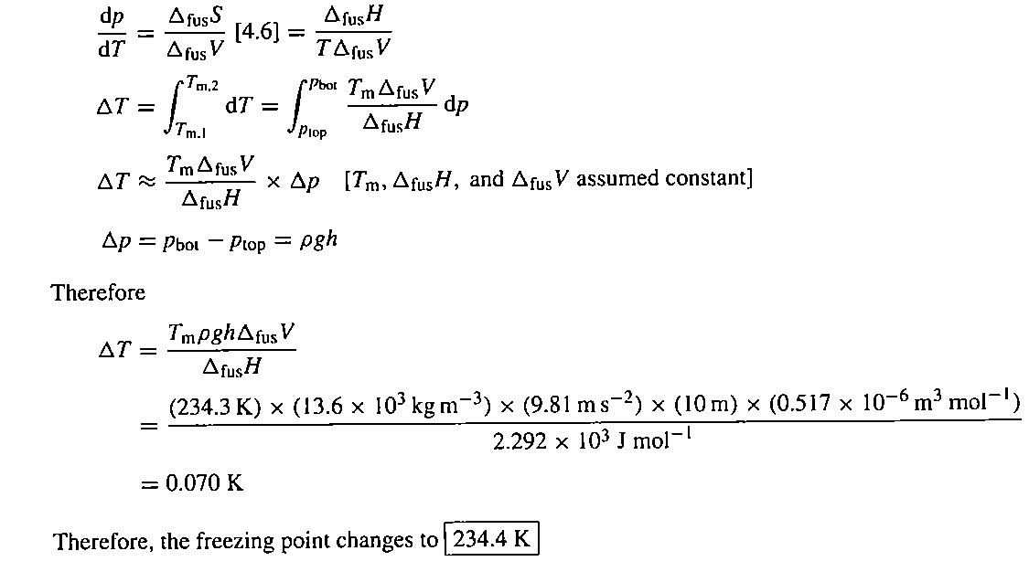
4. The enthalpy of fusion of mercury is 2.292 kJ mol⁻¹, and its normal freezing point is 234.3 K with a change in molar volume of +0.517 cm⁻³ mol⁻¹ on melting. At what temperature will the bottom of a column of mercury (density 13.6 g cm⁻³) of height 10.0 m be expected to freeze?

Slide 3

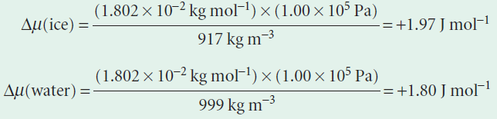
1. Calculate the effect on the chemical potentials of ice and water of increasing the pressure from 1.00 bar to 2.00 bar at 0°C. The density of ice is 0.917 g cm⁻³ and that of liquid water is 0.999 g cm⁻³ under these conditions.
Answer:
(1)
From Eq. 1, we know that the change in chemical potential of an incompressible substance when the pressure is changed by Δp is Δμ = V_{m} Δp. Therefore, to answer the question, we need to know the molar volumes of the two phases of water. These values are obtained from the mass density, ρ, and the molar mass, M, by using V_{m} =M/ρ. We therefore use the expression Δμ =MΔp/ρ.
We interpret the numerical results as follows: the chemical potential of ice rises more sharply than that of water, so if they are initially in equilibrium at 1 bar, then there will be a tendency for the ice to melt at 2 bar.

