Slide 1
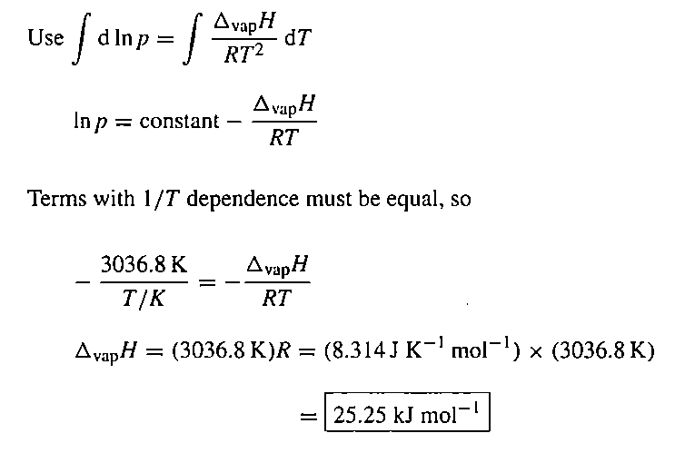
3. The vapour pressure of a liquid in the temperature range 200 K to 260 K was found to fit the expression ln(p/Torr) = 18.361 – 3036.8/(T/K). Calculate the enthalpy of vaporization of the liquid.

Slide 2
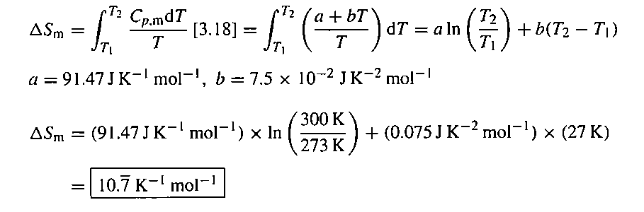
5. The heat capacity of chloroform (trichloromethane, CHCl₃) in the range 240 K to 330 K is given by Cp,m /(J K⁻¹ mol⁻¹) = 91.47 + 7.5 × 10⁻² (T/K). In a particular experiment, 1.00 mol CHCl₃ is heated from 273 K to 300 K. Calculate the change in molar entropy of the sample.
Answer

Slide 3
The change in the Gibbs energy of a certain constant-pressure process was found to fit the expression ΔG /J = -73.1 + 42.8(T/K). Calculate the value of DS for the process.

Slide 4

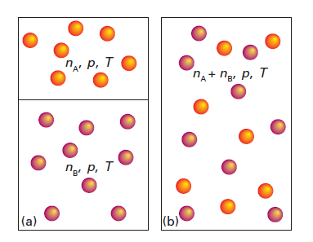

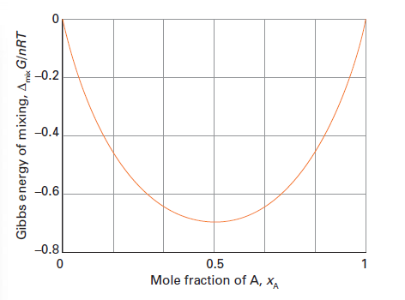


Mixing of gasses is spontaneous. Why?
Before Mixing:
After Mixing:

Slide 5
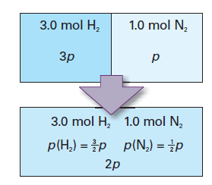

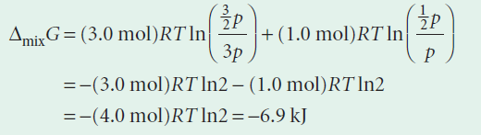





Entropy of Mixing:
Enthalpy of Mixing:
Enthalpy of mixing is zero indicates that there is not interaction b/n the molecules and no heat is given or taken from surroundings. Entropy change is surrounding is zero.
Entropy change is system is positive as mixed gas is more disordered

