Slide 1

HS201

Slide 2

A curve which gives us the same amount of output with various combinations of inputs is named as Isoquants in Microeconomics.
Iso- means- ‘Equal’
-’Quant’ is quantity
Isoquant – a line of equal quantity

Slide 3

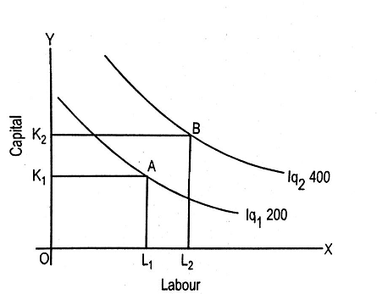
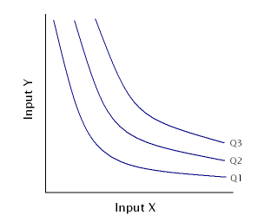

Slide 4

Isoquants are negatively inclined
An Isoquant lying above and to the right of one more stands for a advanced productivity level.
No Isoquants can intersect each other
Isoquants need not be corresponding since the rate of substitution amidst two factors is not essentially the same in all Isoquant programmes.

Slide 5

Amidst two Isoquants there can be a number of Isoquants presenting diverse levels of productivity which the mixture of the two aspects can capitulate.
Units of productivity presented on Isoquants are random or any other variables can be presented.
No Isoquants can touch either axis
Each Isoquant is convex to the origin

Slide 6

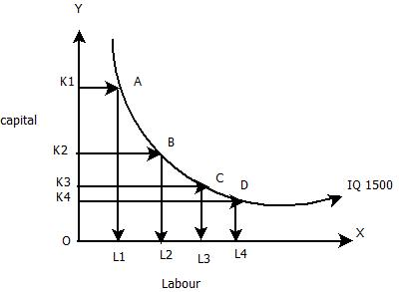
Rice
20
R*
IC₂
IC₁
IC₀
W*
10
Wheat

Slide 7

An Isoquant is equivalent to an indifference curve in a quantity of ways.
In it, two factors (labour and capital) reinstate two articles of consumption.
An Isoquant presents same amount of goods while in indifference curve gives same amount of contentment at all points.
The properties of Isoquants as we have discussed are are unerringly to those of indifference curves.
Nevertheless there are definite differences amidst the two which is being discussed in the next PPTs.

Slide 8

Indifference curve | Isoquant
Utility function | Production function
Goods | Inputs
Marginal rate of substitution | Marginal rate of technical substitution
Max utility | Max profits
Min expenditure | Minimize costs

Slide 9

Production Function may be written as
Q = F(K, L)
Where K = amount of capital used and
L = amount of labor.
Q = output, and
F are general symbols that mean output is a function of capital and labor.
The output, Q, from the production function is the maximum output that can be obtained form the inputs.

Slide 10
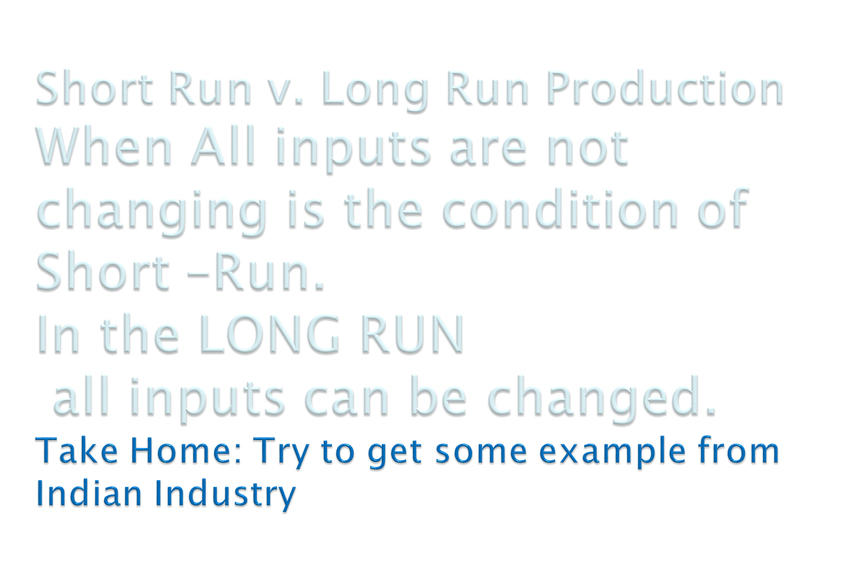

Slide 11

Capital
In the short run the firm would have a constraint of capital, say K+ here this leads the producer to produce along the dotted line, or maybe below it.
K+
Labor

Slide 12

Capital
In the all three curve shown in the PPT a different combinations of L and K that give the same amount of output on each Isoquants curve. Curves in the right hand side have more output.
Labor

Slide 13

Capital
Change in K
Change in L
Here the change is indicated with the use of a triangle.
slope =
Labor

Slide 14

The slope of the Isoquant curve at a point is
K/ L
The marginal product of an input is defined as the change in output divided by the change in the input, the slope can be manipulated to be:
K Q and since K = 1
L Q Q MP_{K}
So the slope is MP_{L}/MP_{K} which is also called as the MRTS (in absolute value) and it is a measure of the rate at which inputs can be substituted and output remains the same.

Slide 15
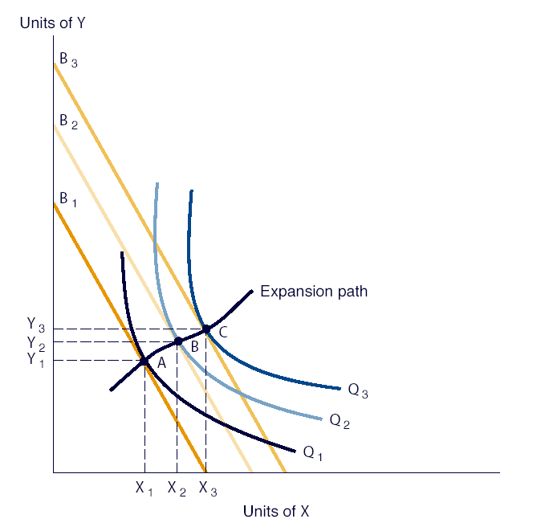

Slide 16

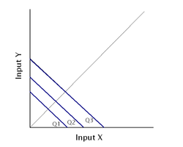
Two extreme cases show the possible range of input substitution in production
Perfect substitutes
  MRTS is constant at all points on isoquant
  Same output can be produced with a lot of capital or a lot of labor or a balanced mix

Slide 17

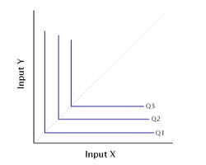
  Fixed proportions production function
  There is no substitution available between inputs
  The output can be made with only a specific proportion of capital and labor
  Cannot increase output unless increase both capital and labor in that specific proportion

