Slide 1

Oligopoly

Slide 2

Oligopoly
A market structure in which a small number of firms has the large majority of market share is named as an Oligopoly.
It is similar to a monopoly , except that rather than one firm, two or more firms dominate the market.
There is no exact upper limit to the number of firms in an oligopoly.
But the number of firms are low enough that the actions of one firm significantly impact and influence the others.

Slide 3
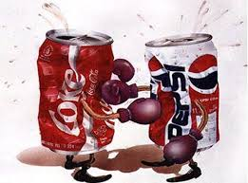

Oligopoly
few firms
either homogeneous or differentiated products
interdependence of firms - policies of one firm affect the other firms
substantial barriers to entry
examples: Soft drinks ,auto industry and cigarette industry

Slide 4
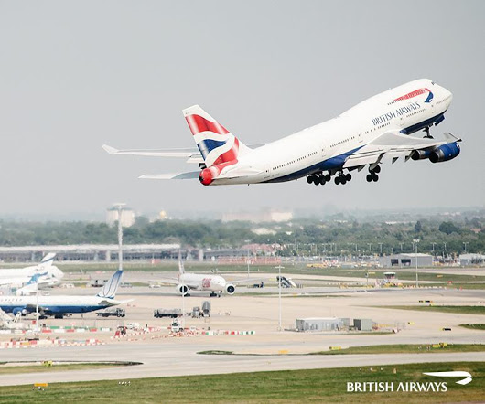
An example of Oligopoly
British Airways (BA) and Air France may be a good example of Oligopoly because these airlines operate their routes with only a few close competitors.

Slide 5
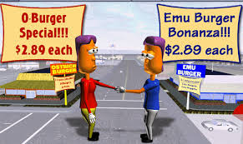
Collusion and Competition
Oligopoly firms may collude (act as a monopoly) and earn positive profits.
OR
Oligopolists may compete with each other and drive prices down to where profits are zero.

Slide 6

While it pays for firms to collude, in order to earn positive profits, it also pays to cheat on the collusive agreement.
If one firm cuts its price to slightly below the others, it could gain a lot of business.
If everyone cheats on the agreement, however, the agreement falls apart.

Slide 7

Collusive agreements less likely to succeed when
secret price cuts are difficult and costly to detect. (Quality changes are difficult to monitor.)
market conditions are unstable. (Differences in expectations make it difficult to reach an agreement.)
vigorous antitrust action increases the cost of collusion.

Slide 8
Some oligopolistic markets operate in a situation of price leadership.
A single firm sets industry price and the remaining firms charge the same price as the leader.

Slide 9
Sweezy’s kinked demand curve model of oligopoly
Assumptions:
1. If a firm raises prices, other firms won’t follow and the firm loses a lot of business.
So demand is very responsive or elastic to price increases.
2. If a firm lowers prices, other firms follow and the firm doesn’t gain much business.
So demand is fairly unresponsive or inelastic to price decreases.

Slide 10
The Kinked Demand Curve
$
P*
D
Q*
quantity

Slide 11
MR Curve for the top part of the Demand Curve
$
D
P*
MR
Q*
quantity

Slide 12
Drawing MR Curve for the bottom part of the Demand Curve
$
P*
MR
D
Q*
quantity

Slide 13
MR Curve for the bottom part of the Demand Curve
$
P*
MR
D
Q*
quantity

Slide 14
The Kinked Demand Curve and the MR Curve
$
P*
MR
D
Q*
quantity

Slide 15
The MC curve intersects the MR curve in the vertical segment.
$
MC
P*
MR
D
Q*
quantity

Slide 16
If costs shift up slightly, but MC still intersects MR in the vertical segment, there will be no
change in price. This price rigidity is seen in real world oligopoly markets.
$
MC’
MC
P*
D
Q*
MR
quantity

Slide 17
The ATC curve can be added to the graph. To show positive profits, part of ATC curve must lie under part of the demand curve.
$
MC
ATC
P*
D
Q*
MR
quantity

Slide 18
The ATC* value can be found on the ATC curve above Q*.
$
MC
ATC
P*
ATC*
D
Q*
MR
quantity

Slide 19
TC = ATC . Q
$
MC
ATC
P*
ATC*
D
Q*
MR
quantity

Slide 20
TR = P . Q
$
MC
ATC
P*
ATC*
D
Q*
MR
quantity

Slide 21
Profit = TR - TC
$
MC
ATC
P*
profit
ATC*
D
Q*
MR
quantity

Slide 22
To show a firm with a loss, the ATC curve must be entirely above the demand curve.
ATC
$
ATC*
MC
AVC
loss
P*
D
Q*
MR
quantity

Slide 23
To show a firm breaking even, the ATC curve must be tangent to the demand curve at the kink.
$
MC
ATC
ATC*= P*
D
Q*
MR
quantity

Slide 24
Profit Possibilities for the Oligopolist
short run:
positive profits, losses, or breaking even.
long run:
positive profits, or breaking even.

Slide 25
Four-Firm Concentration Ratio
percentage of total industry sales accounted for by the four largest firms of an industry.

Slide 26

Hertz
Avis
Example: The four largest firms in the car rental industry account for 94% of all car rentals in the U.S.
So, the four-firm concentration ratio for the car rental industry is 94.
National
Budget

Slide 27
Example
Suppose a market consists of seven firms with the following shares:
5 5 10 10 20 25 25
The four firm concentration ratio would be
CR = 25 + 25 + 20 + 10 = 80

Slide 28
Herfindahl Index (H)
measures the extent to which a market is dominated by a few firms.
H = s₁² + s₂² + s₃² + ... + s_{n}²
where s₁² is the square of the share of firm 1, and there are n firms.

Slide 29
The Herfindahl Index can be close to zero if there are many, very small firms in an industry.
The Herfindahl index for a monopolized industry is H = s₁² = 100 ² = 10,000.

Slide 30
Example
Consider again our seven-firm market.
(shares: 5 5 10 10 20 25 25 )
Then the Herfindahl Index would be
H = 5² + 5² + 10² + 10² + 20² + 25² + 25² = 1900

Slide 31

Justice Department Guidelines
A market is considered concentrated
if H > 1800.
A market is considered unconcentrated
if H < 1000.

Slide 32
Example
Our 7 firm case had a Herfindahl index of 1900.
The industry is concentrated since 1900 > 1800.

Slide 33
For concentrated markets:
a merger would be challenged by the antitrust division of the justice department if it would increase the Herfindahl index by 100 or more.
For unconcentrated markets:
a merger would be challenged by the antitrust division of the justice department if it would increase the Herfindahl index by 200 or more.

Slide 34
Example
Back to our 7 firms (shares: 5, 5, 10, 10, 20, 25, 25).
The industry was concentrated since 1900 > 1800.
Suppose the two firms with the 10% shares want to merge.
Then the shares would be 5, 5, 20, 20, 25, 25.
H = 5 ² + 5² + 20² + 20² + 25² + 25² = 2100
This is an increase of 200 in the Herfindahl index and the merger would be challenged by the antitrust division.

Slide 35
Three Types of Mergers

Slide 36
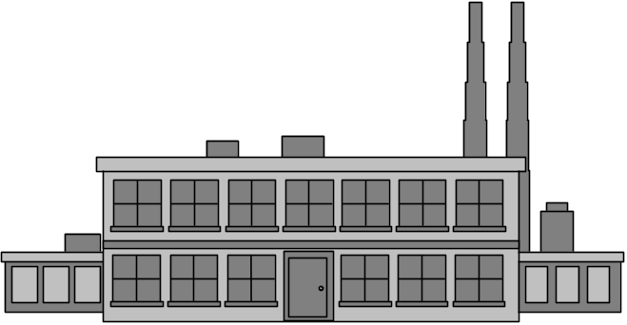
Horizontal Merger
the combination under one ownership of the assets of two or more firms engaged in the production of similar products
example: two steel manufacturing companies merging

Slide 37


Vertical Merger
the creation of a single firm from two firms, one of which was a supplier of the other
example: a lumber company and a builder merging

Slide 38

Conglomerate Merger
the combining under one ownership of two or more firms that produce unrelated products
example: a tire manufacturer and a coffee company merging

