Slide 1
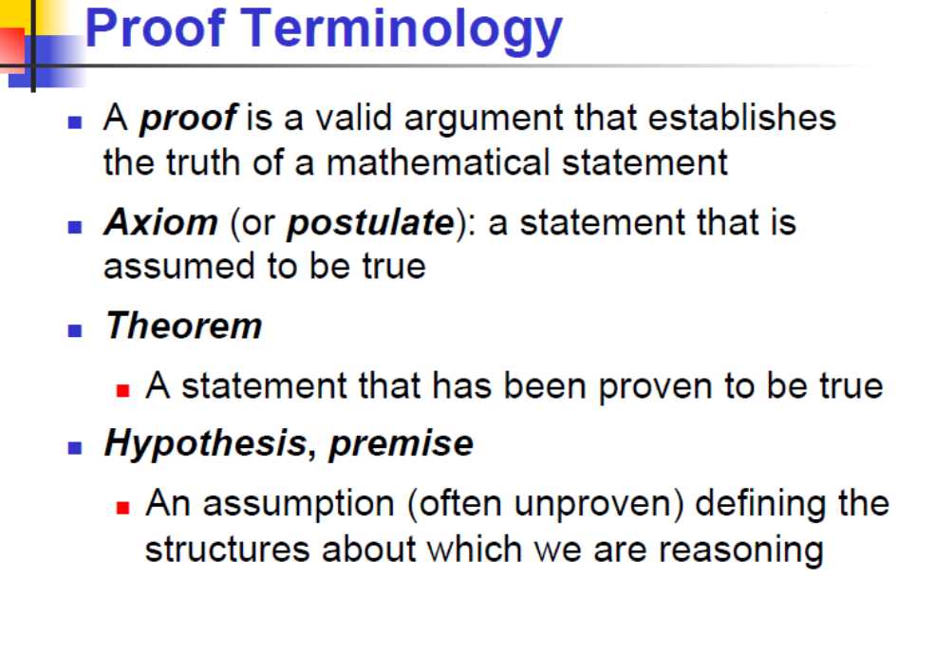


Slide 2
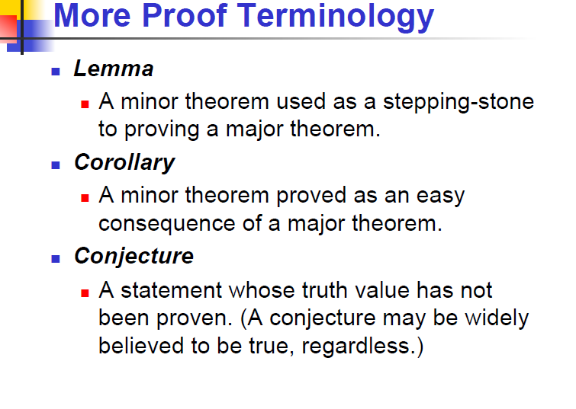

Slide 3
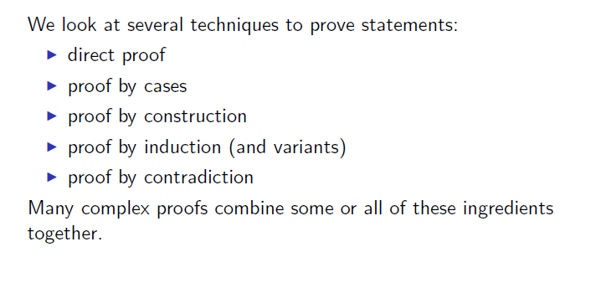
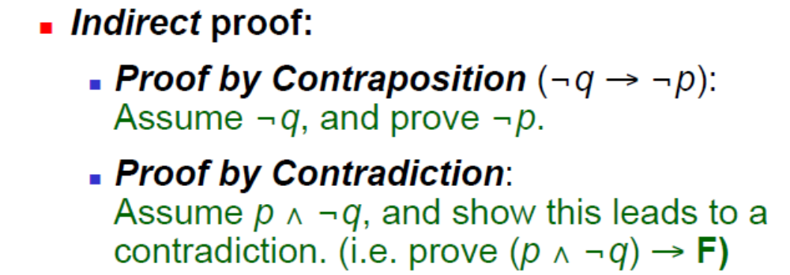
Methods of proof

Slide 4

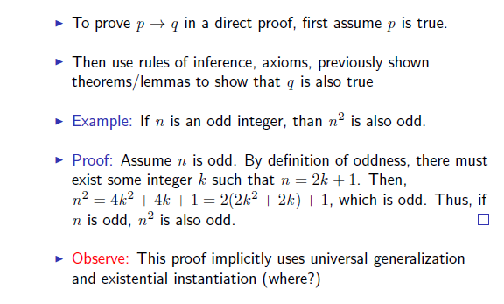
Direct Proof
--------------------------------------------------

Slide 5
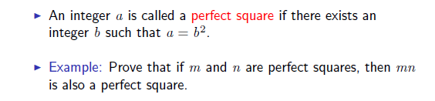
Direct Proof: another example

Slide 6
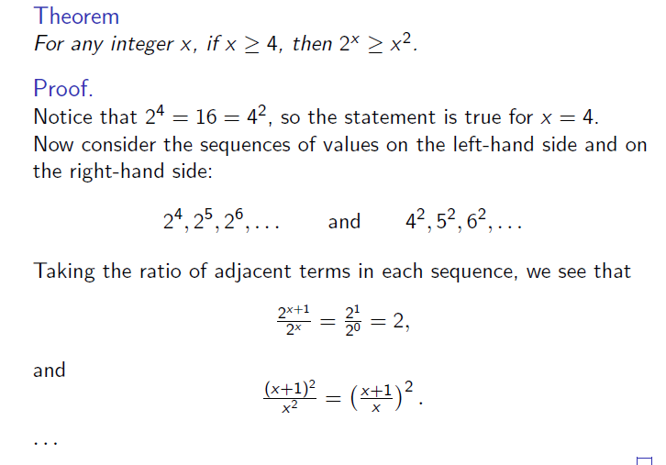
Direct Proofs: example

Slide 7
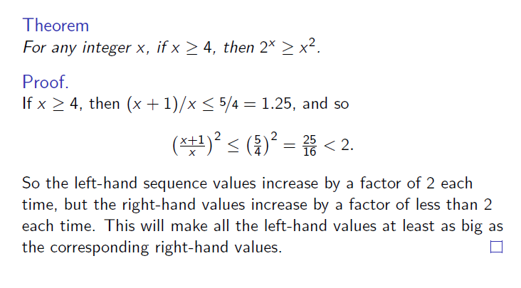
Direct Proofs: example

Slide 8
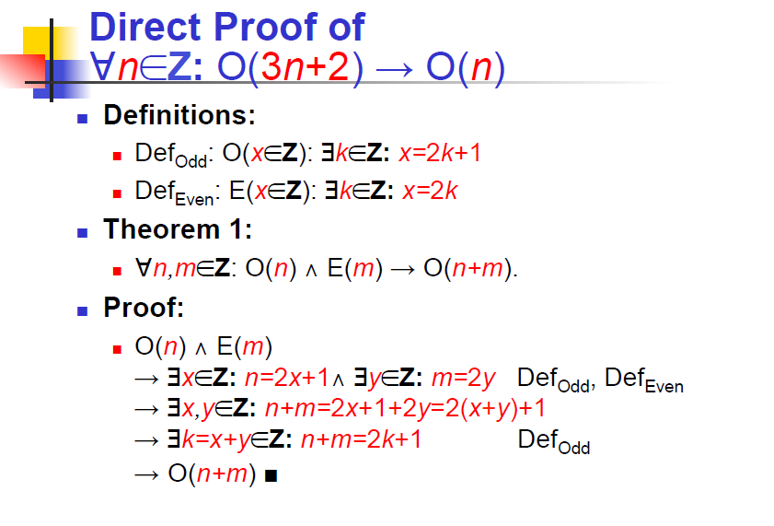

Slide 9
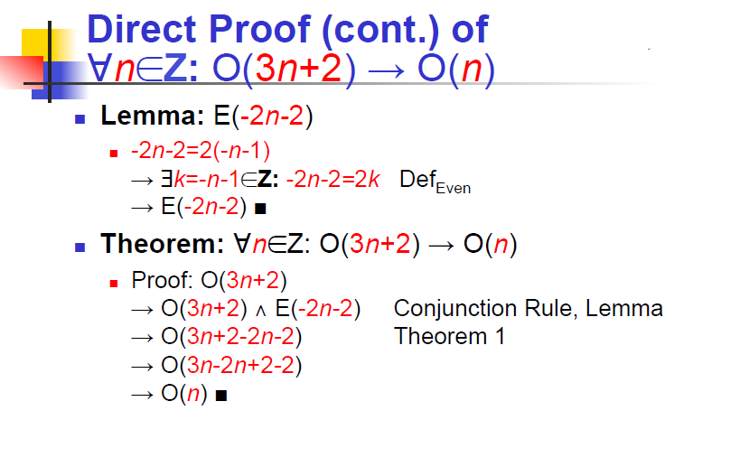

Slide 10
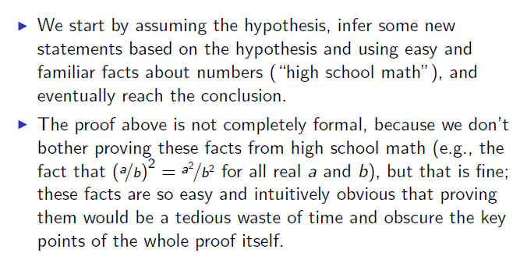
Direct Proofs: features

Slide 11
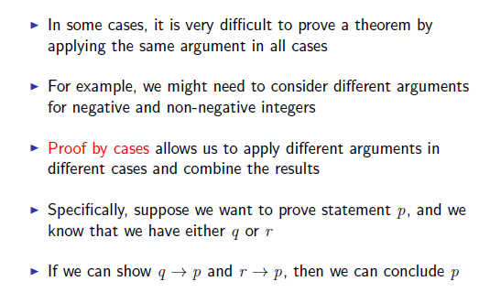
Proof by Cases

Slide 12
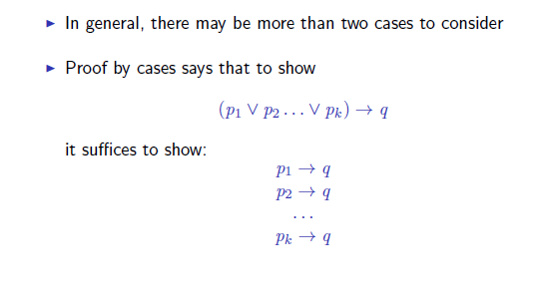
Proof by Cases

Slide 13
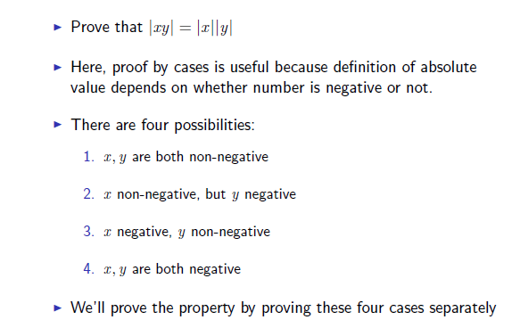
Proof by Cases: example 1

Slide 14
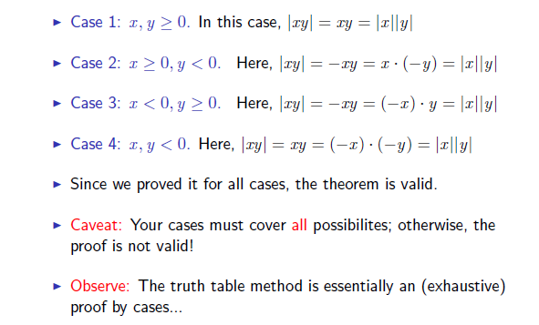
Proof by Cases: example 1

Slide 15
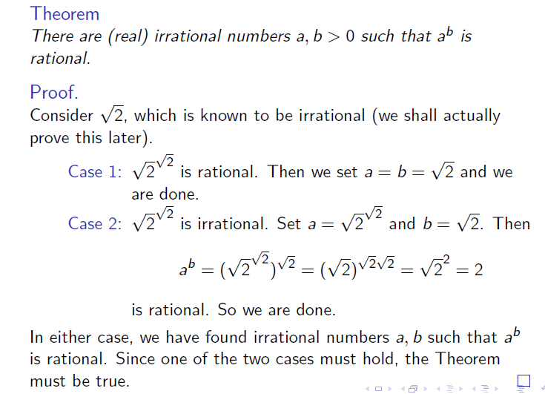
Proof by Cases: example 2

Slide 16
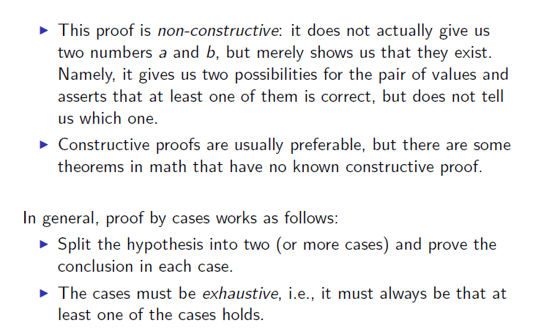
Proof by Cases: features

Slide 17
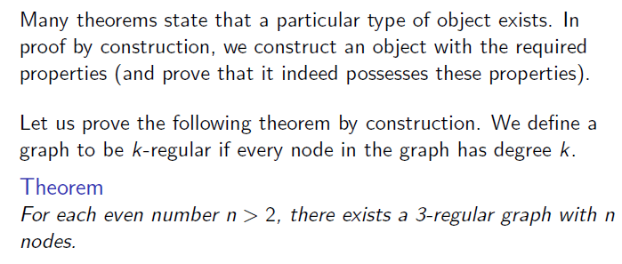
Proof by Construction

Slide 18
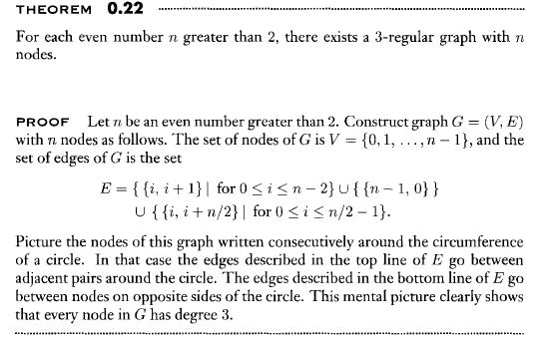
Proof by Construction: example

Slide 19
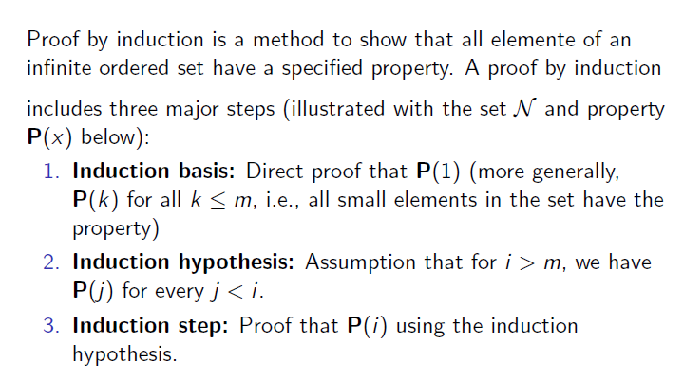
Proof by Induction

Slide 20
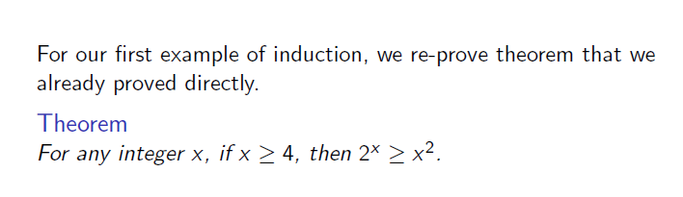
Proof by Induction: example 1

Slide 21
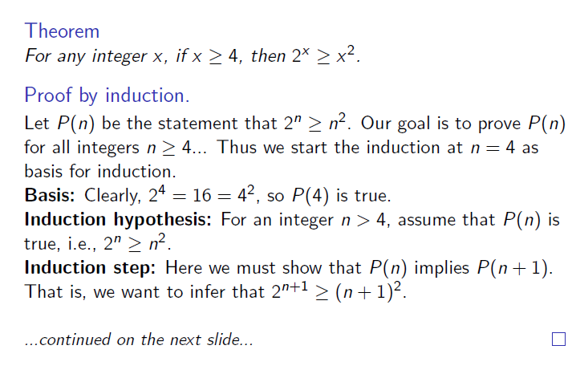
Proof by Induction: example 1

Slide 22
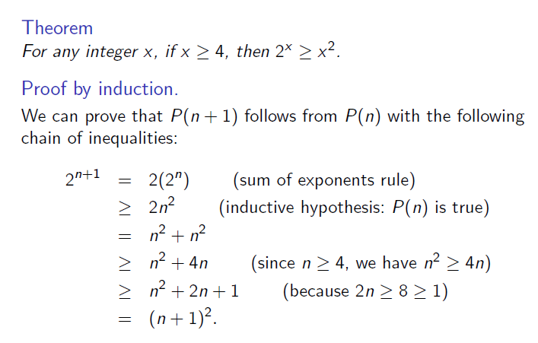
Proof by Induction: example 1

Slide 23
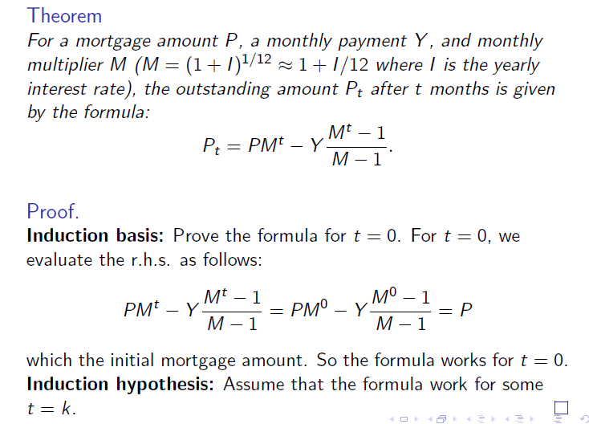
Proof by Induction: example 2

Slide 24
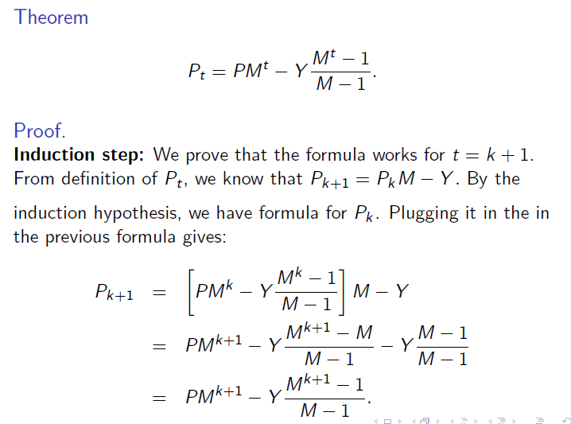
Proof by Induction: example 2

Slide 25
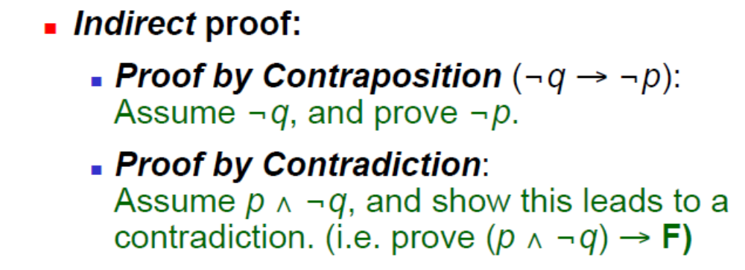

Slide 26
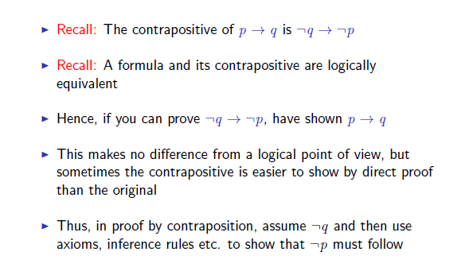
Proof by Contraposition
--------------------------------------------------

Slide 27
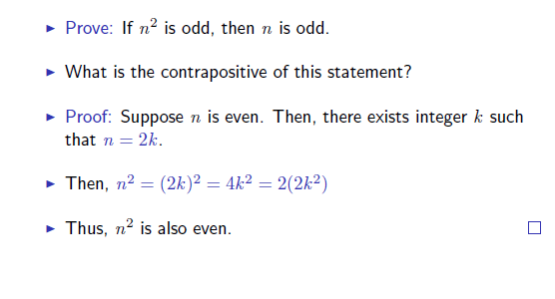
Proof by Contraposition: example

Slide 28
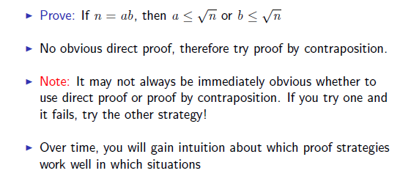
Proof by Contraposition: another example

Slide 29
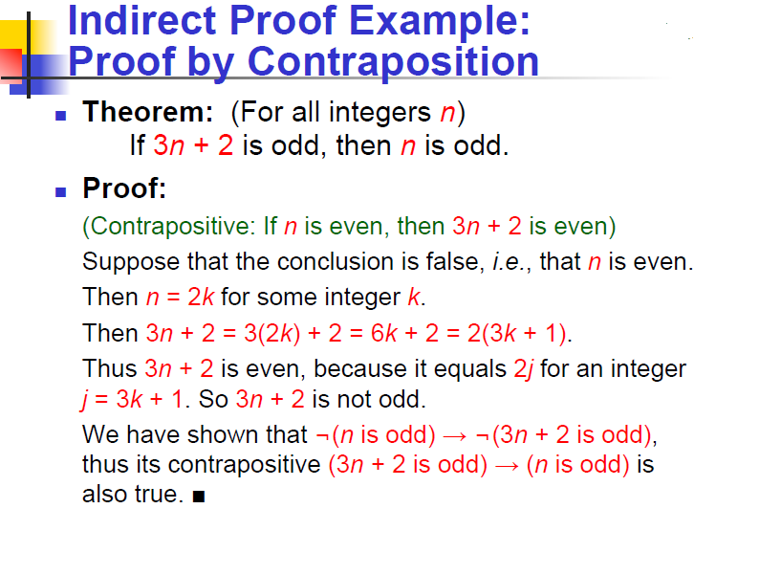

Slide 30
Proof by Contradiction
In one common form of argument for proving a theorem, we assume that the theorem is false and then show that this assumption leads to an obviously false consequence, called a contradiction.
We use this type of reasoning frequently in
everyday life, as in the following example.

Slide 31
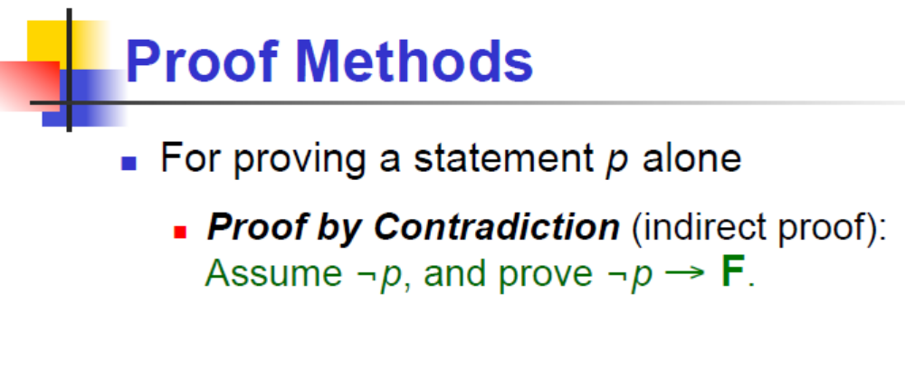
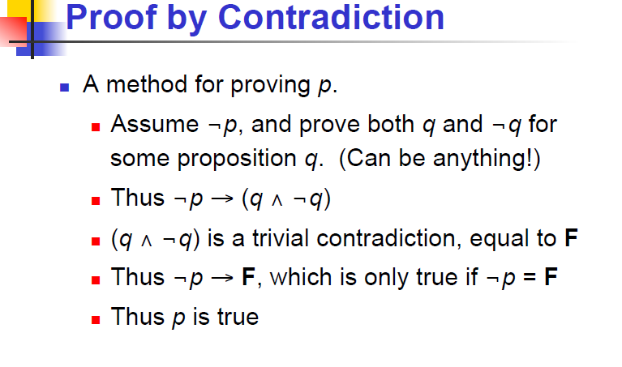

Slide 32
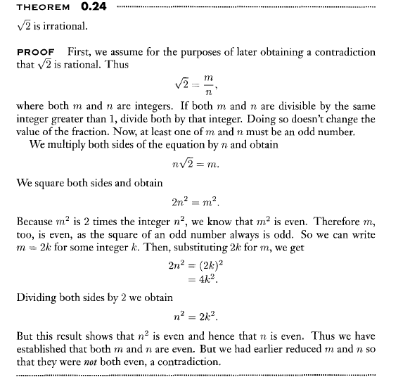

Slide 33
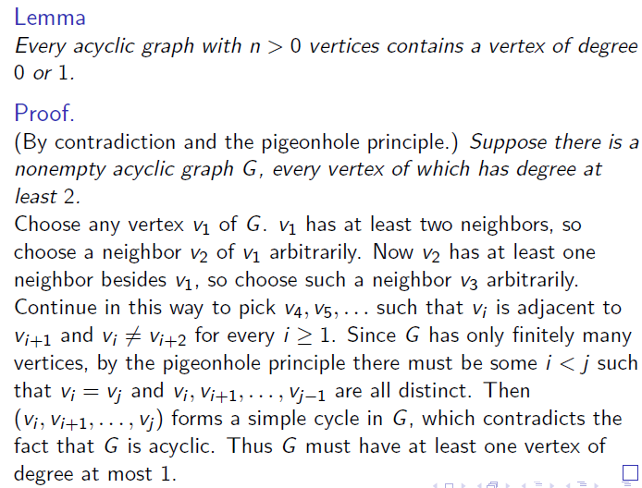
Proof by Contradiction: example 1

Slide 34
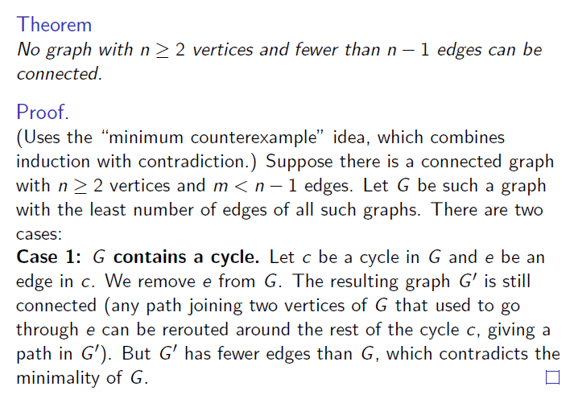
Proof by Contradiction: example 2

Slide 35
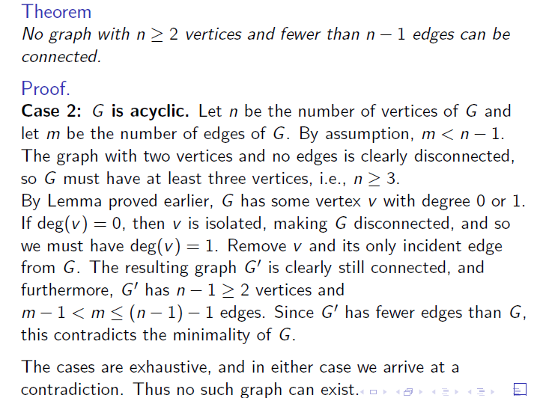
Proof by Contradiction: example 2

Slide 36
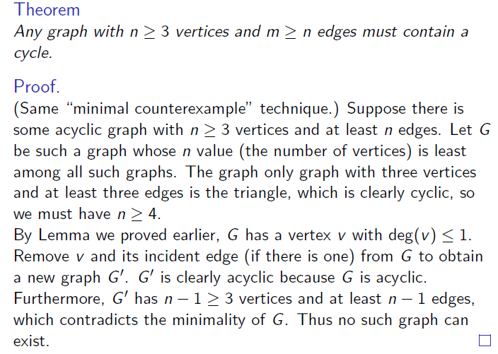
Proof by Contradiction: example 3

Slide 37
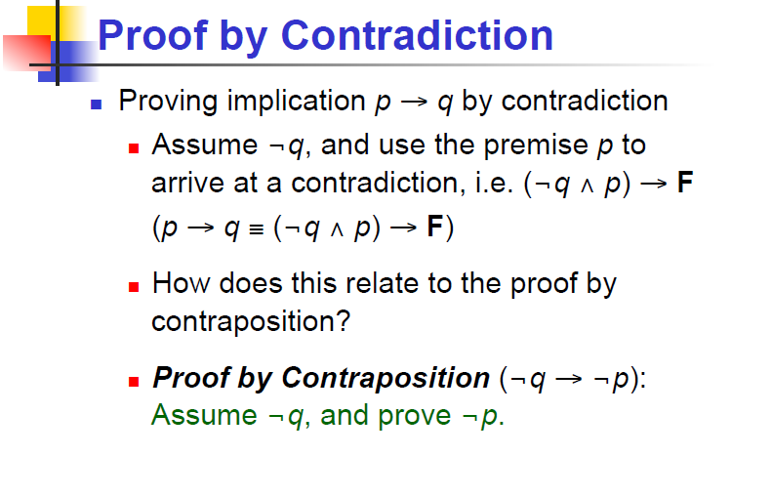

Slide 38
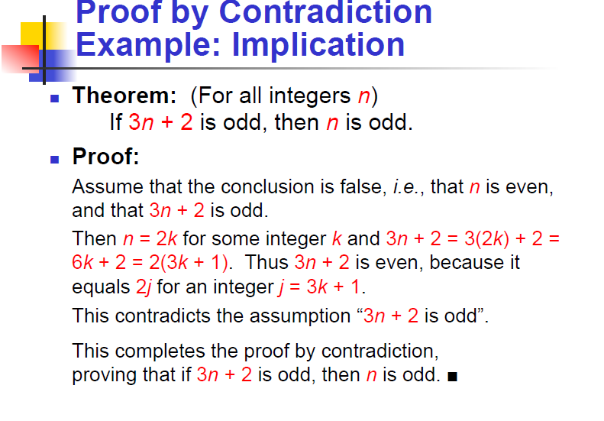

Slide 39
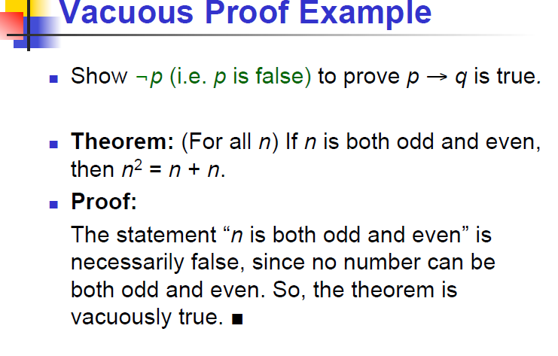

Slide 40
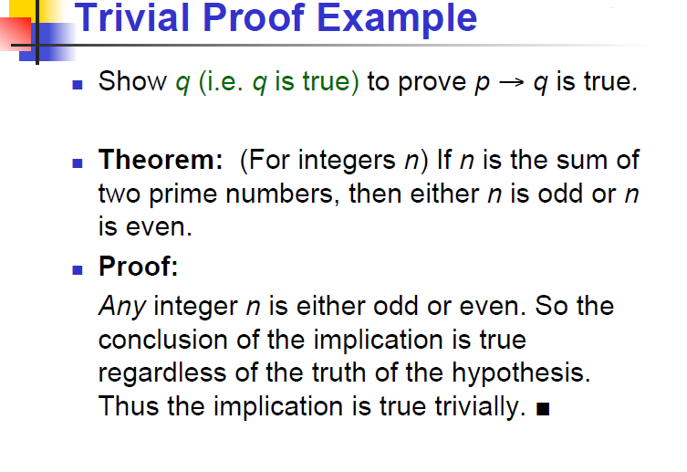

Slide 41
