Slide 1
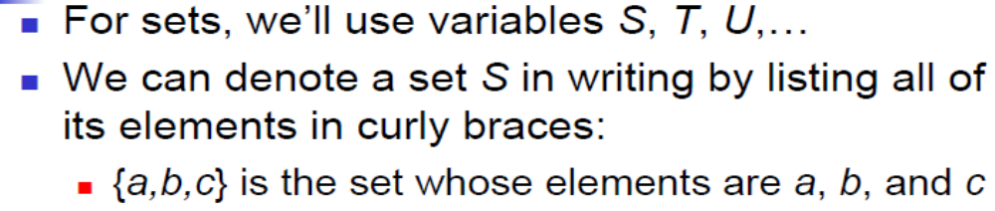
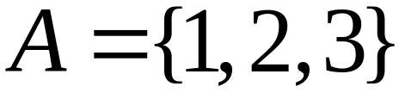

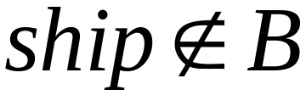
SETS
A set is a collection of elements
Membership

Slide 2
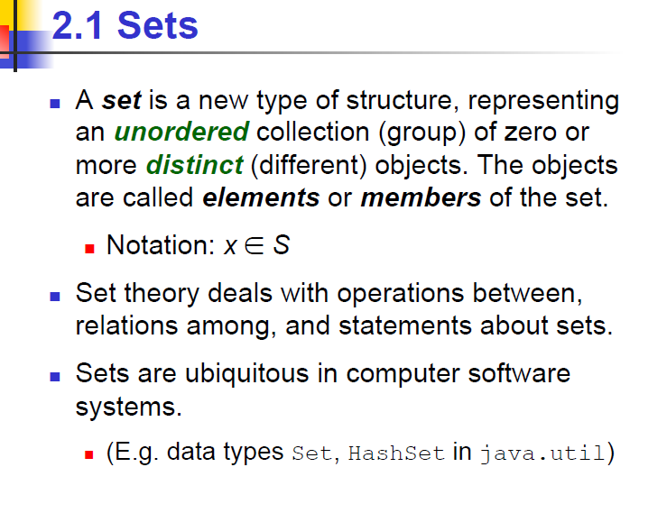


Slide 3
Set Representations
  C = { a, b, c, d, e, f, g, h, i, j, k }
  C = { a, b, …, k }
  S = { 2, 4, 6, … }
finite set
infinite set

Slide 4
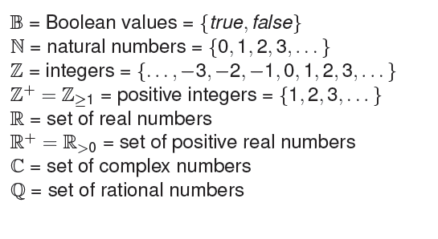
Some important sets

Slide 5
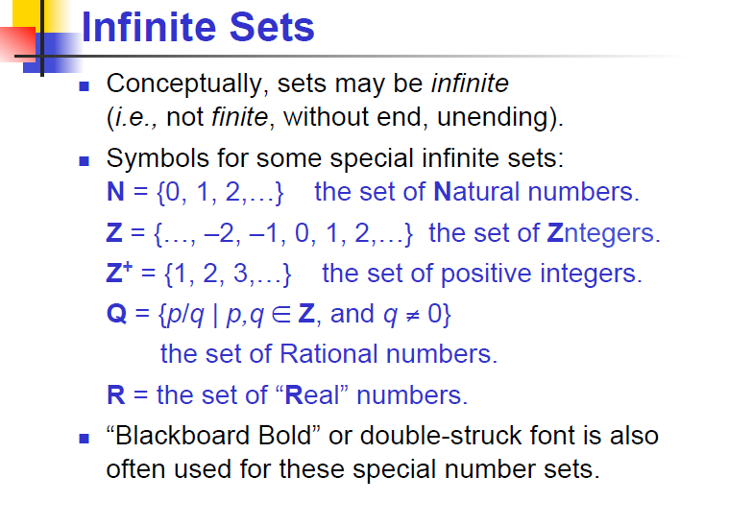

Slide 6
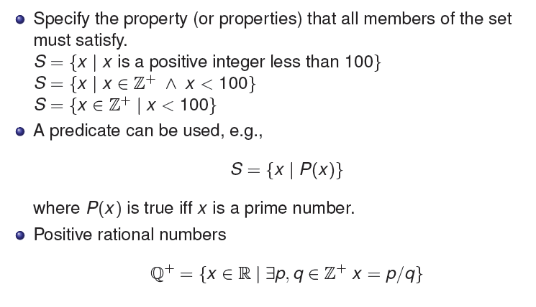
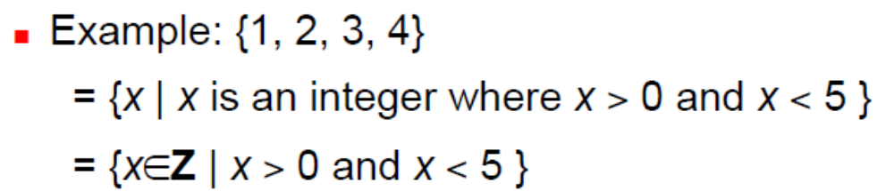
Set Representations

Slide 7
Set Representations
Order not important
S = {a, b, c, d} = {b, c, a, d}.
Listing more than once does not change the set.
S = {a, b, c, d} = {a, b, c, b, c, d}.

Slide 8
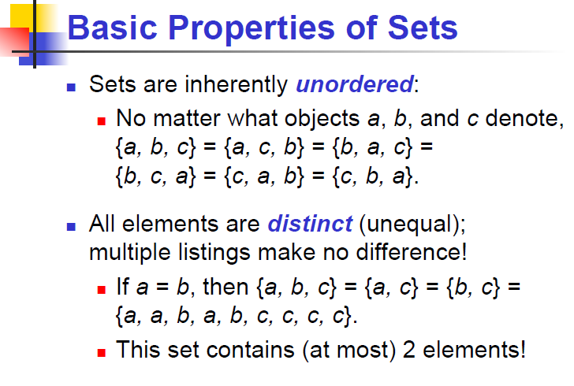

Slide 9
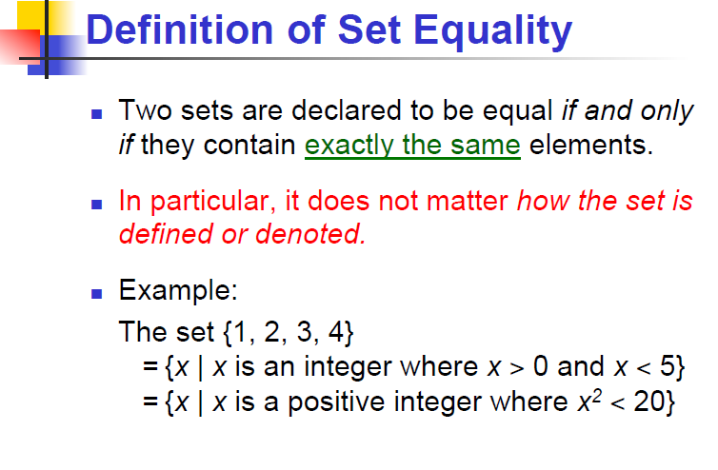

Slide 10
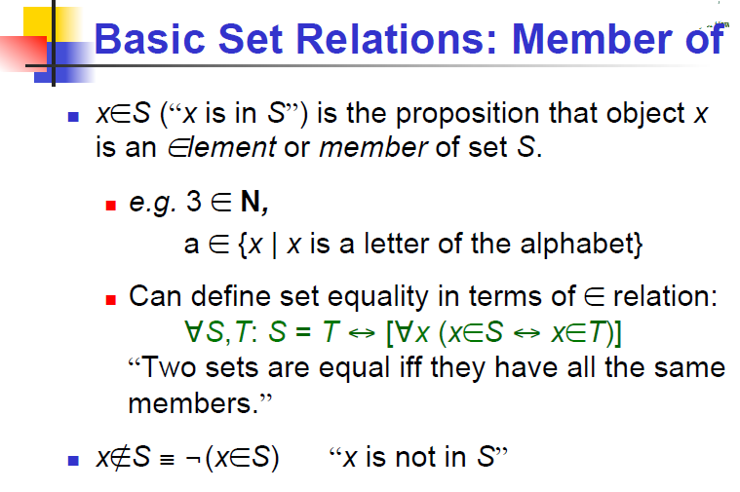

Slide 11
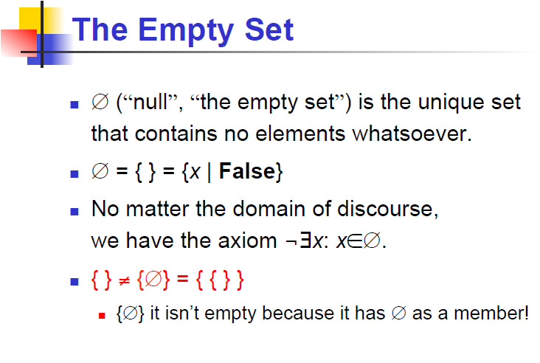

Slide 12
Universal Set
A universal set is the collection of all objects in a particular context or theory.
Depends the context or theory under consideration.
For example, we might define U as the set of all living things on planet earth. In that case, the set of all dogs is a subset of U, the set of all fish is another subset of U, and the set of all trees is yet another subset of U.

Slide 13
U = { 1 , … , 10 }
A = { 1, 2, 3, 4, 5 }
U
6
A
2
8
1
3
7
4
5
9
10

Slide 14
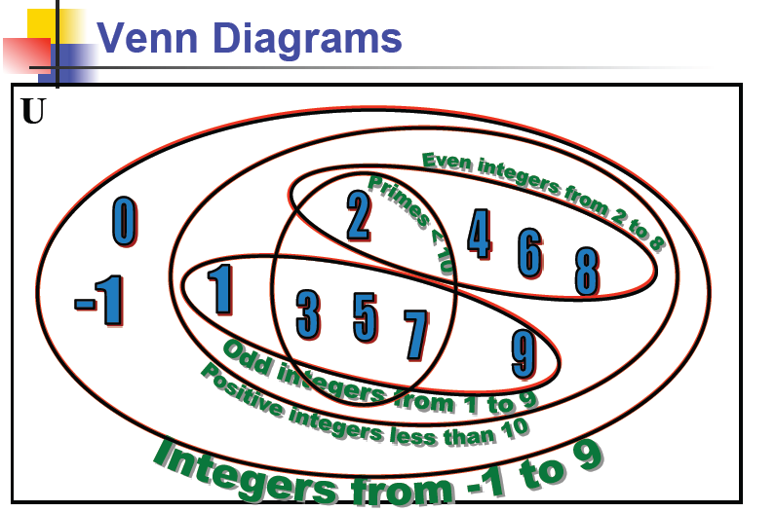

Slide 15
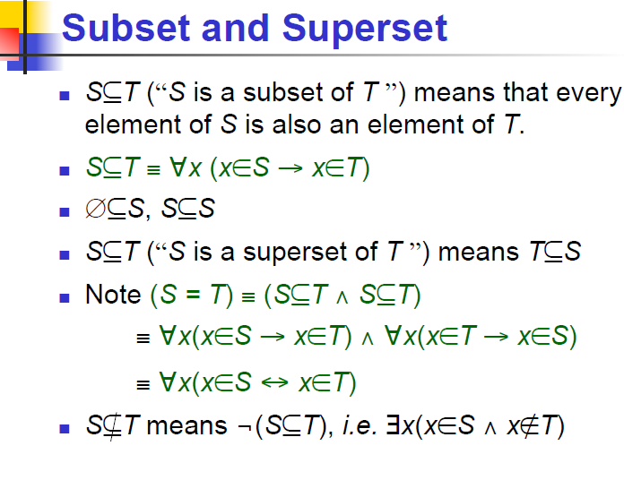

Slide 16
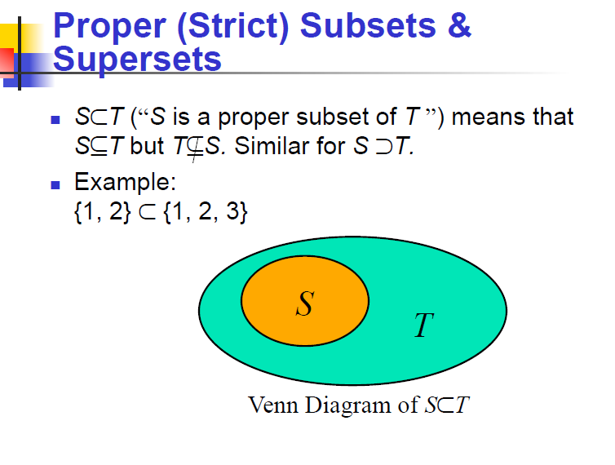

Slide 17
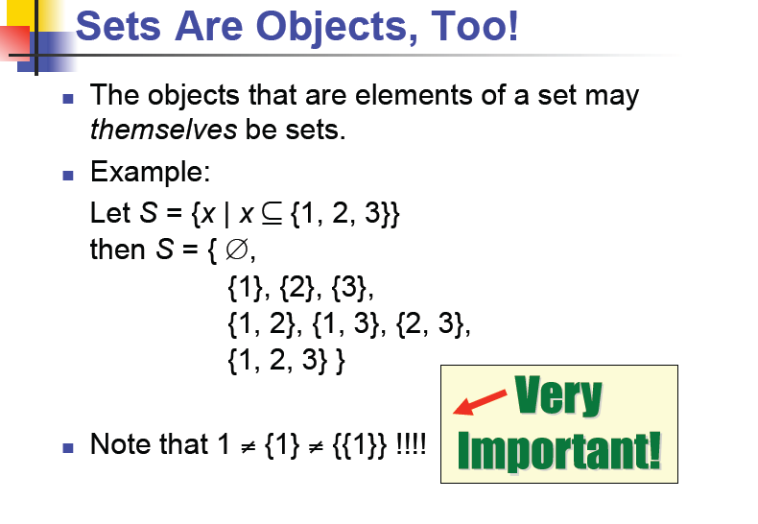

Slide 18
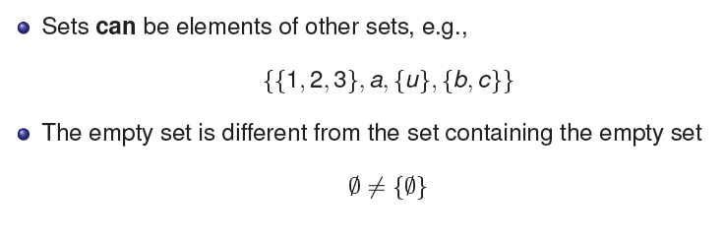
To Remember

Slide 19
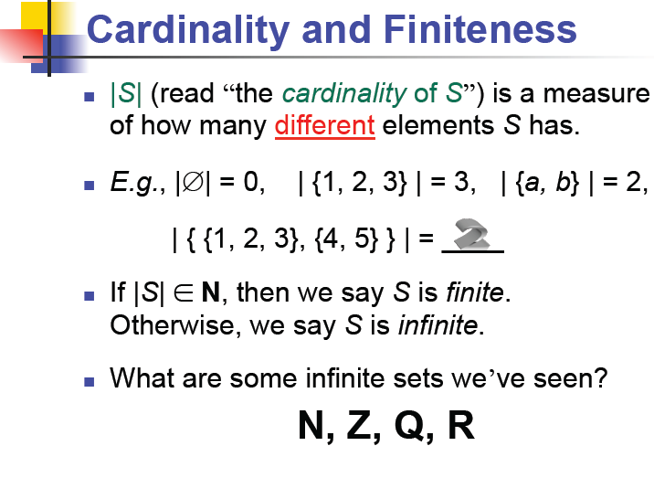

Slide 20
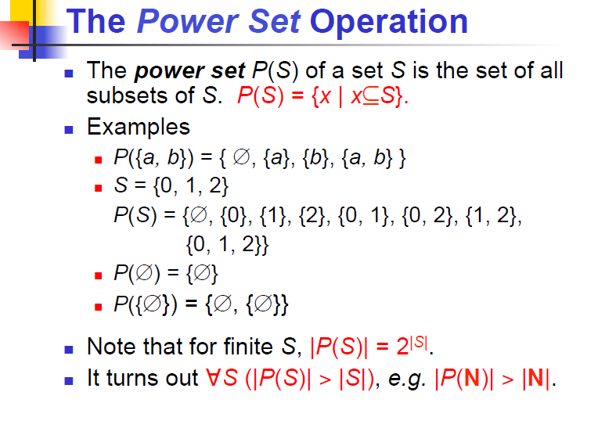

Slide 21
Powersets
A powerset is a set of sets
S = { a, b, c }
Powerset of S = the set of all the subsets of S
2^{S} = { , {a}, {b}, {c}, {a, b}, {a, c}, {b, c}, {a, b, c} }
Observation: | 2^{S} | = 2^{|S|} ( 8 = 2³ )

Slide 22
Cartesian Product
A = { 2, 4 } B = { 2, 3, 5 }
A X B = { (2, 2), (2, 3), (2, 5), ( 4, 2), (4, 3), (4, 5) }
|A X B| = |A| |B|
Generalizes to more than two sets
A X B X … X Z

Slide 23
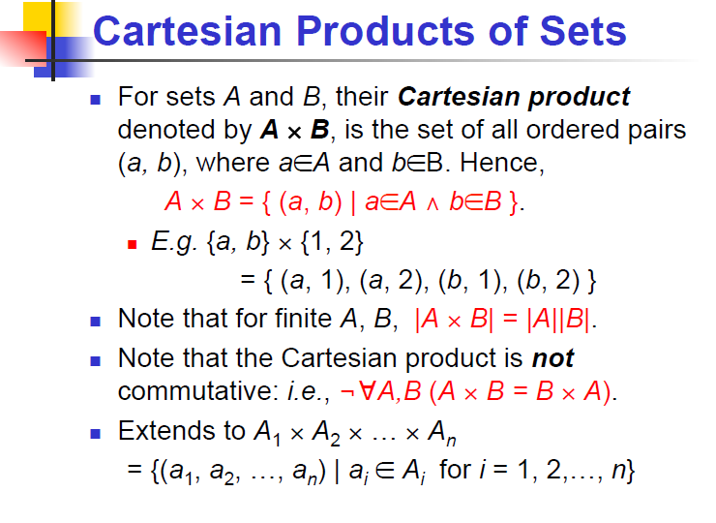

Slide 24
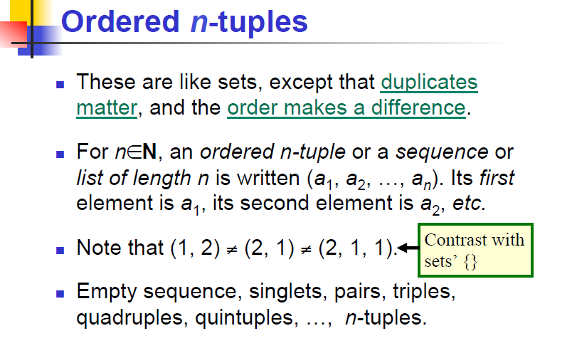

Slide 25
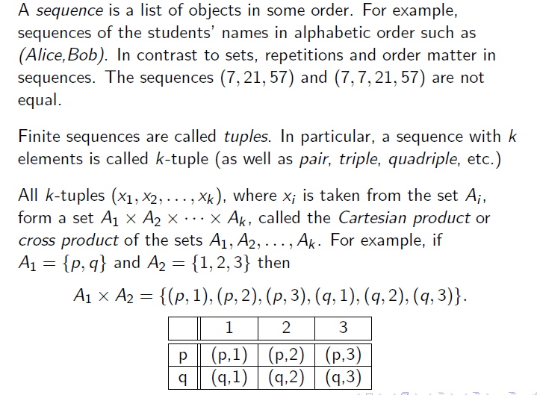
Sequences and Tuples

Slide 26
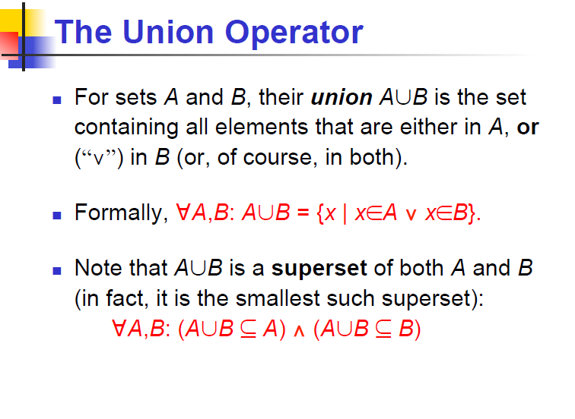

Slide 27
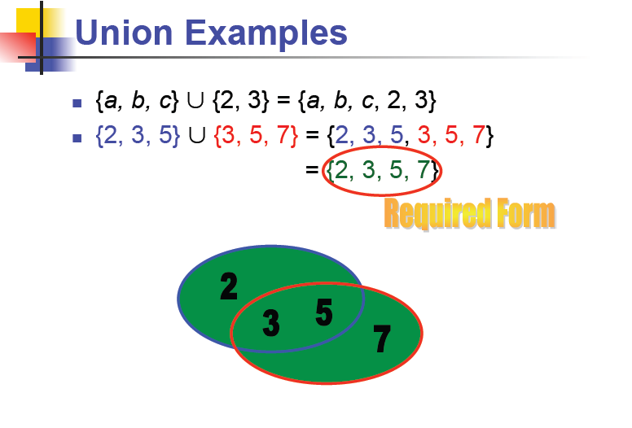

Slide 28
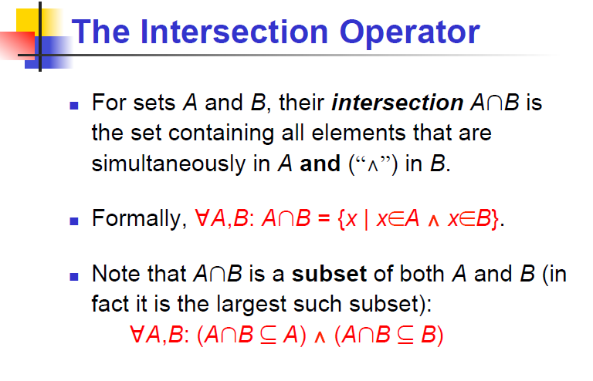

Slide 29
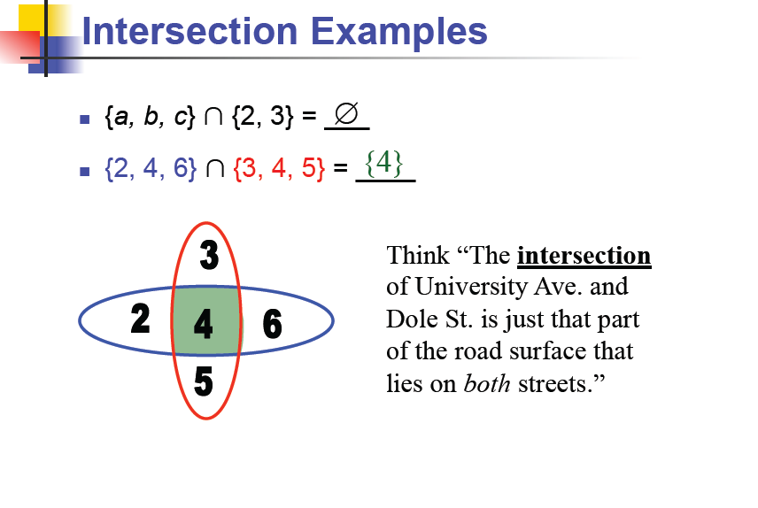

Slide 30
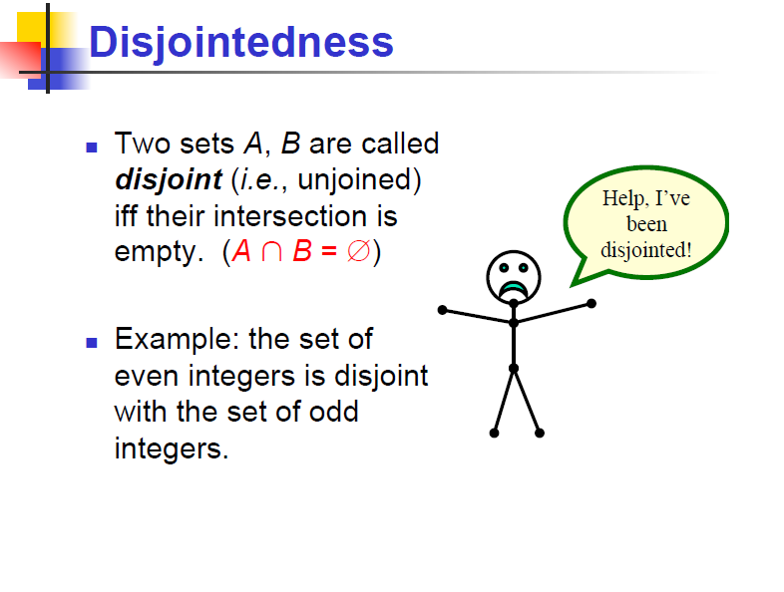

Slide 31
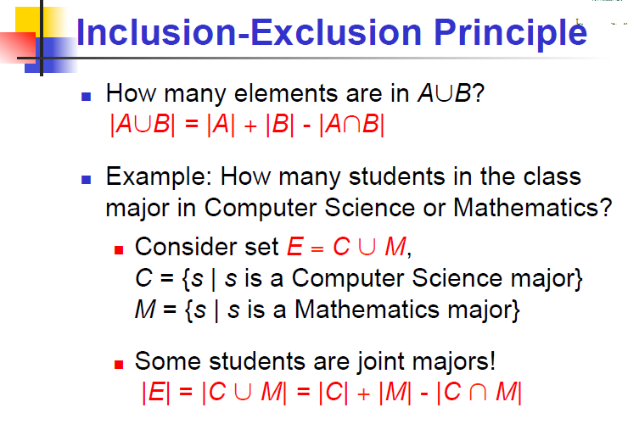

Slide 32
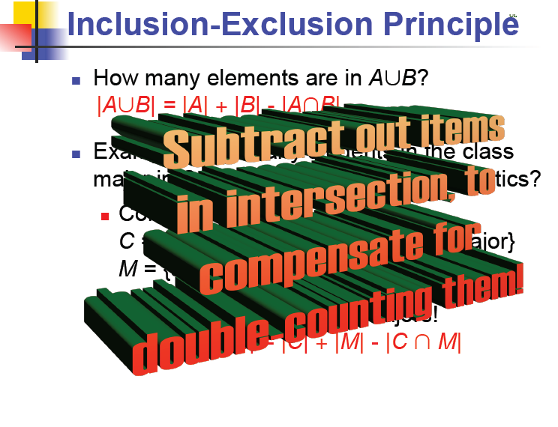

Slide 33
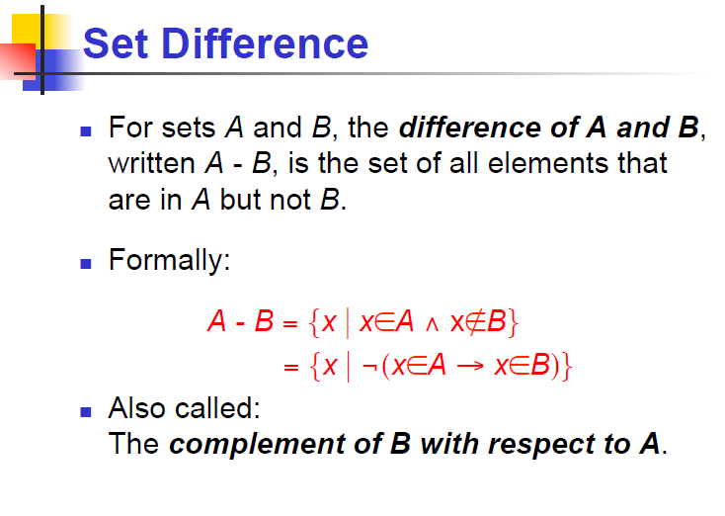

Slide 34
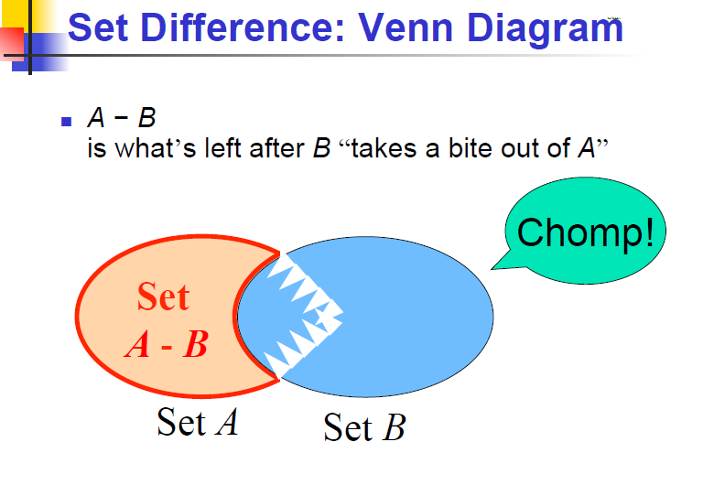

Slide 35
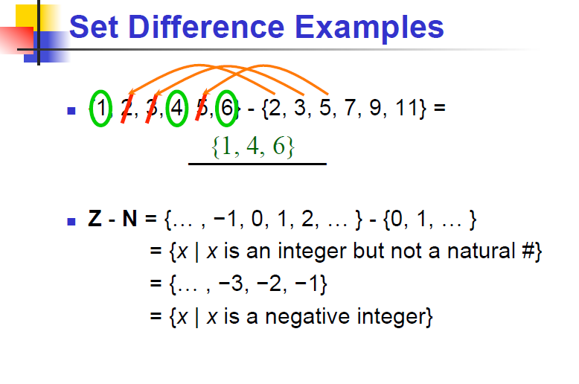

Slide 36
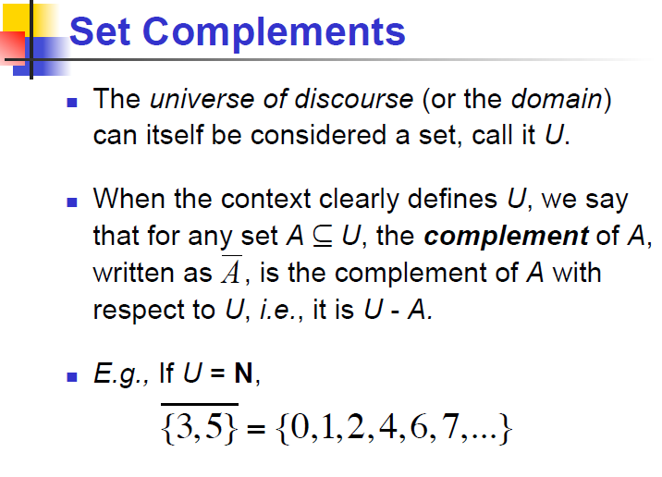

Slide 37
Complement
      Universal set = {1, …, 7}
      A = { 1, 2, 3 } A = { 4, 5, 6, 7}
4
A
A
6
1
3
2
5
7
A = A

Slide 38
{ even integers } = { odd integers }
Integers
1
odd
0
5
even
2
6
4
3
7

Slide 39
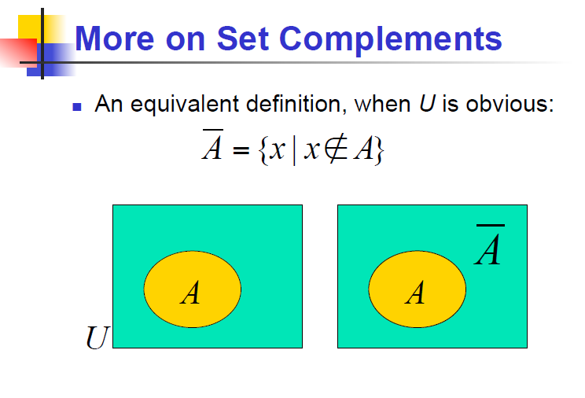

Slide 40
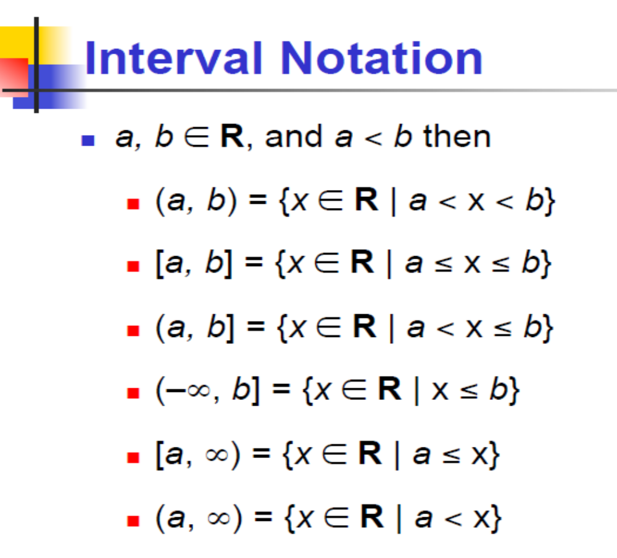

Slide 41
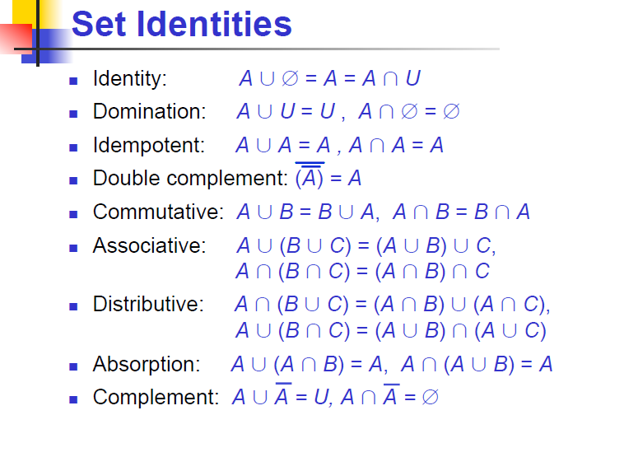

Slide 42
Empty, Null Set:
= { }
S U = S
S =
S - = S
- S =
U
= Universal Set

Slide 43
Singleton set
A singleton, also known as a unit set, is a set with exactly one element.
For example, the set {0} is a singleton.

Slide 44
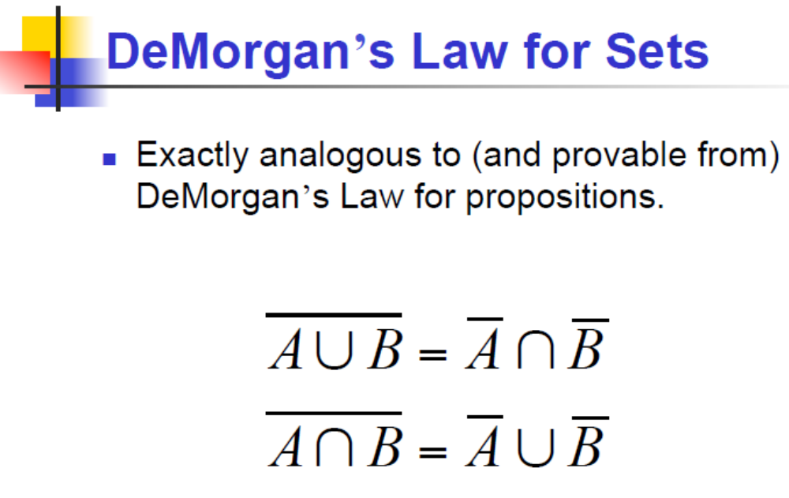

Slide 45
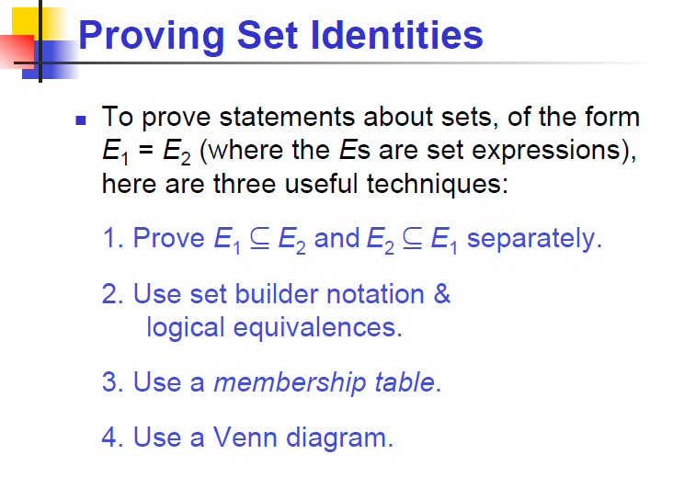

Slide 46
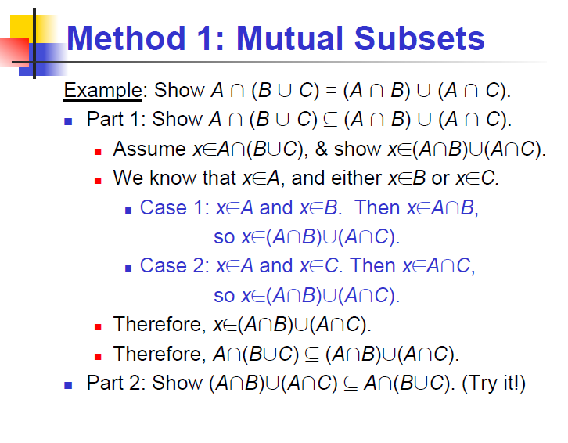

Slide 47
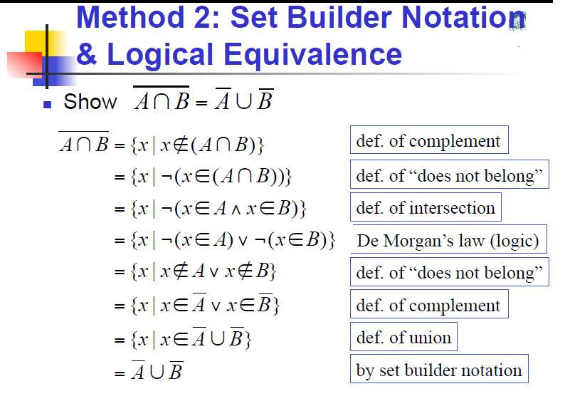

Slide 48
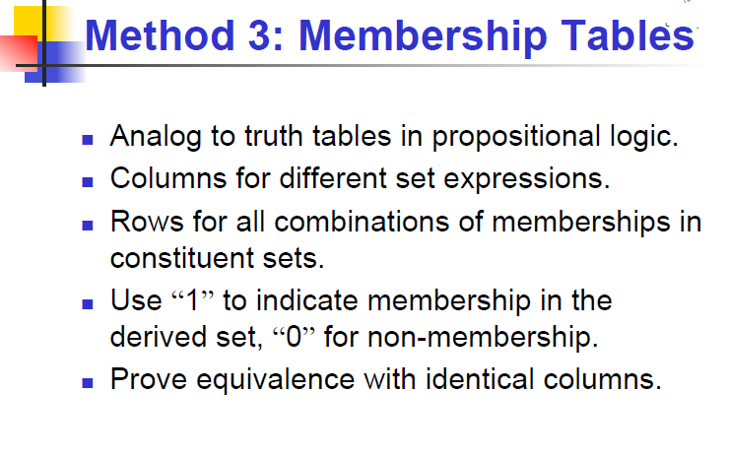

Slide 49
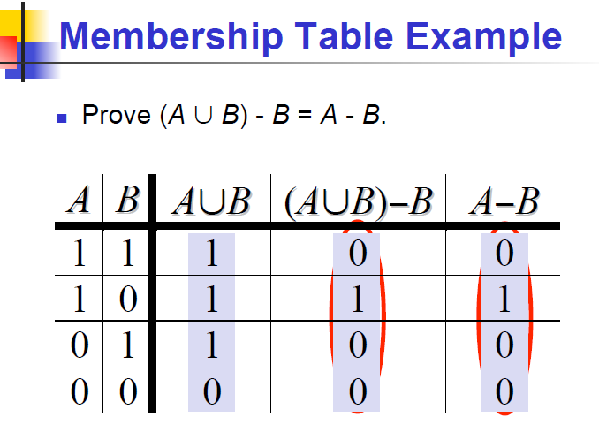

Slide 50
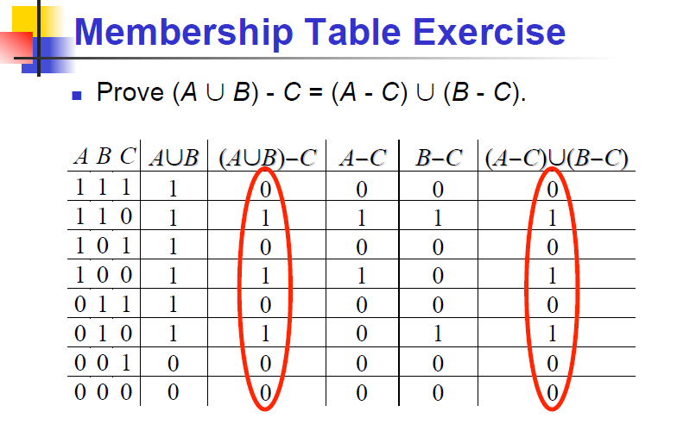

Slide 51
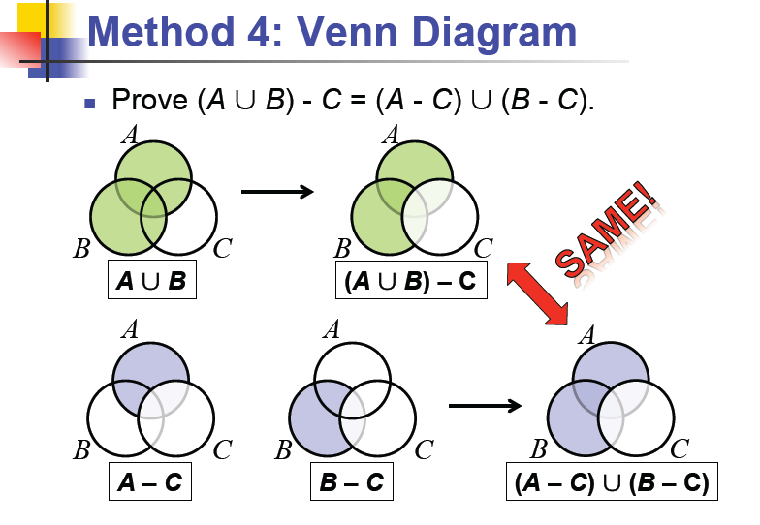

Slide 52
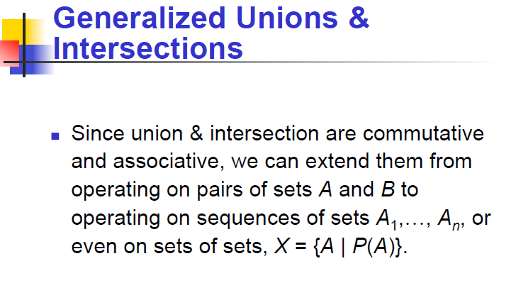

Slide 53
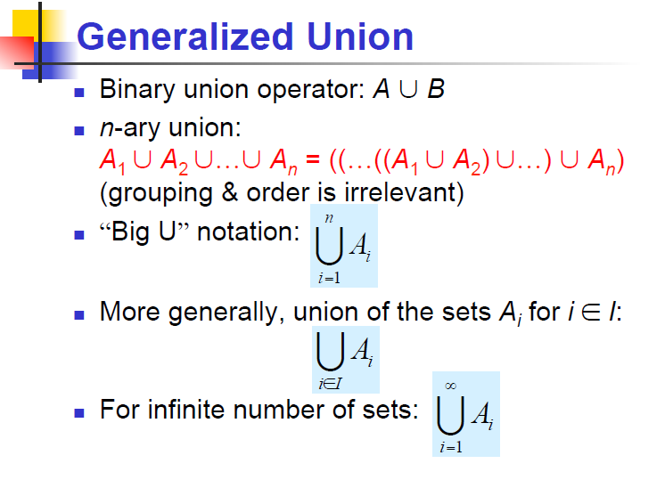

Slide 54
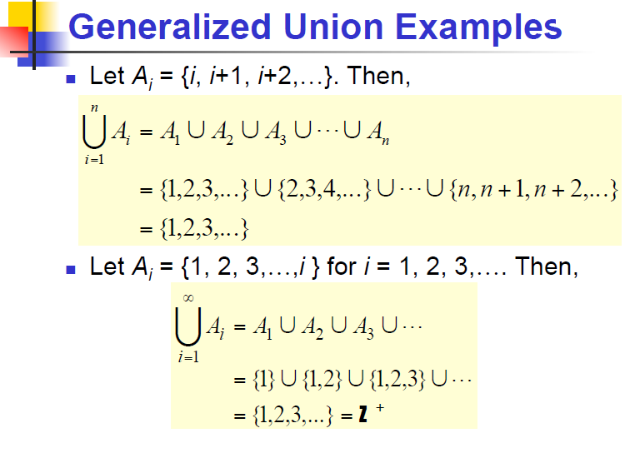

Slide 55
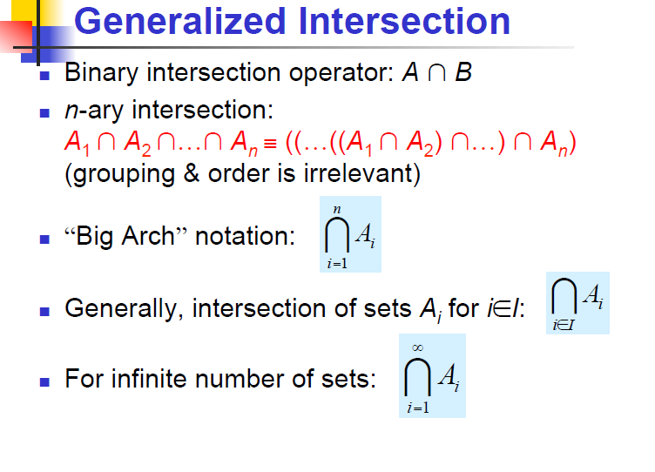

Slide 56
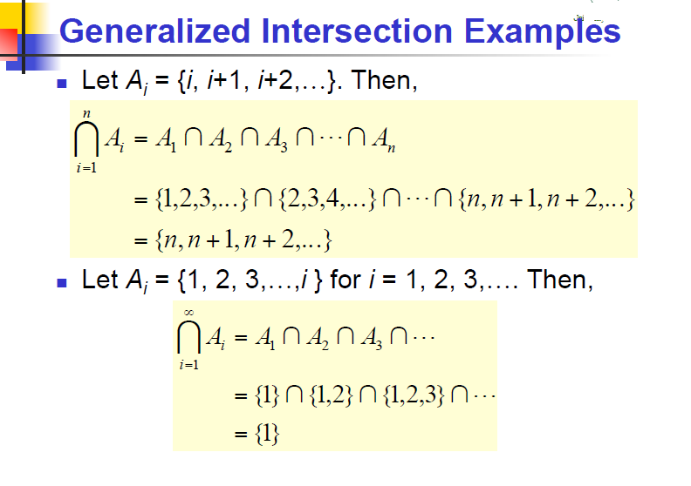

Slide 57
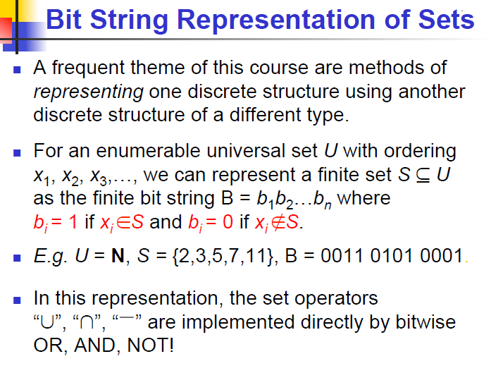

Slide 58


