Slide 1
Discrete Mathematical Structures
CS 23022
Prof. Johnnie Baker
jbaker@cs.kent.edu
Discrete Probability
Sections 6.1 - 6.2

Slide 2
Acknowledgement
Most of these slides were either created by Professor Bart Selman at Cornell University or else are modifications of his slides

Slide 3
6.1 Introduction to Discrete Probability
Finite Probability
Probability of Combination of Events
Probabilistic Reasoning – Car & Goats

Slide 4
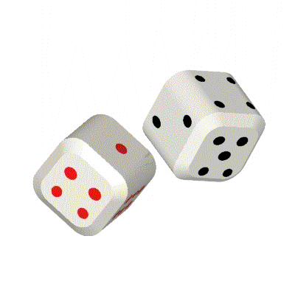
Terminology
Experiment
  A repeatable procedure that yields one of a given set of outcomes
  Rolling a die, for example
Sample space
  The set of possible outcomes
  For a die, that would be values 1 to 6
Event
  A subset of the sample experiment
  If you rolled a 4 on the die, the event is the 4

Slide 5
Probability
Experiment: We roll a single die, what are the possible outcomes?
{1,2,3,4,5,6}
The set of possible outcomes is called the sample space.
We roll a pair of dice, what is the sample space?
Depends on what we’re going to ask.
Often convenient to choose a sample space of equally likely outcomes.
{(1,1),(1,2),(1,3),…,(2,1),…,(6,6)}

Slide 6
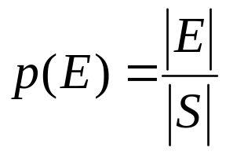
Probability definition:
Equally Likely Outcomes
The probability of an event occurring (assuming equally likely outcomes) is:
  Where E an event corresponds to a subset of outcomes.
  Note: E ⊆ S.
  Where S is a finite sample space of equally likely outcomes
  Note that 0 ≤ |E| ≤ |S|
    Thus, the probability will always between 0 and 1
    An event that will never happen has probability 0
    An event that will always happen has probability 1

Slide 7
Probability is always a value between 0 and 1
Something with a probability of 0 will never occur
Something with a probability of 1 will always occur
You cannot have a probability outside this range!
Note that when somebody says it has a “100% probability”
  That means it has a probability of 1

Slide 8
Dice probability
What is the probability of getting a 7 by rolling two dice?
  There are six combinations that can yield 7: (1,6), (2,5), (3,4), (4,3), (5,2), (6,1)
  Thus, |E| = 6, |S| = 36, P(E) = 6/36 = 1/6

Slide 9
Probability
Which is more likely:
Rolling an 8 when 2 dice are rolled?
Rolling an 8 when 3 dice are rolled?
No clue.

Slide 10
Probability
What is the probability of a total of 8 when 2 dice are rolled?
What is the size of the sample space?
36
How many rolls satisfy our property of interest?
5
So the probability is 5/36 ≈ 0.139.

Slide 11
Probability
What is the probability of a total of 8 when 3 dice are rolled?
What is the size of the sample space?
216
C(7,2)
How many rolls satisfy our condition of interest?
So the probability is 21/216 ≈ 0.097.

Slide 12
The game of poker
You are given 5 cards (this is 5-card stud poker)
The goal is to obtain the best hand you can
The possible poker hands are (in increasing order):
  No pair
  One pair (two cards of the same face)
  Two pair (two sets of two cards of the same face)
  Three of a kind (three cards of the same face)
  Straight (all five cards sequentially – ace is either high or low)
  Flush (all five cards of the same suit)
  Full house (a three of a kind of one face and a pair of another face)
  Four of a kind (four cards of the same face)
  Straight flush (both a straight and a flush)
  Royal flush (a straight flush that is 10, J, K, Q, A)

Slide 13
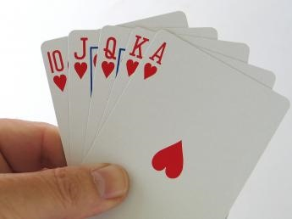
Poker probability: royal flush
What is the chance of
getting a royal flush?
  That’s the cards 10, J, Q, K,
  and A of the same suit
There are only 4 possible
royal flushes.
Possibilities for 5 cards: C(52,5) = 2,598,960
Probability = 4/2,598,960 = 0.0000015
  Or about 1 in 650,000

Slide 14
Poker probability: four of a kind
What is the chance of getting 4 of a kind when dealt 5 cards?
  Possibilities for 5 cards: C(52,5) = 2,598,960
Possible hands that have four of a kind:
  There are 13 possible four of a kind hands
  The fifth card can be any of the remaining 48 cards
  Thus, total possibilities is 13*48 = 624
Probability = 624/2,598,960 = 0.00024
  Or 1 in 4165

Slide 15
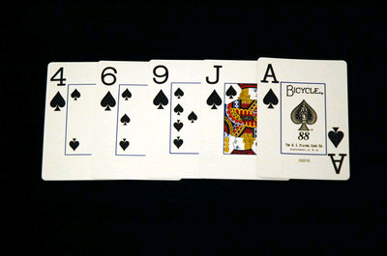
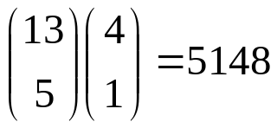
Poker probability: flush
What is the chance of
getting a flush?
  That’s all 5 cards of the same suit
We must do ALL of the
following:
  Pick the suit for the flush: C(4,1)
  Pick the 5 cards in that suit: C(13,5)
As we must do all of these, we multiply
the values out (via the product rule)
This yields
Possibilities for 5 cards: C(52,5) = 2,598,960
Probability = 5148/2,598,960 = 0.00198
  Or about 1 in 505
Note that if you don’t count straight flushes (and thus royal flushes) as a “flush”, then the number is really 5108

Slide 16
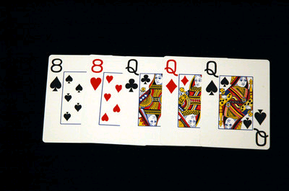
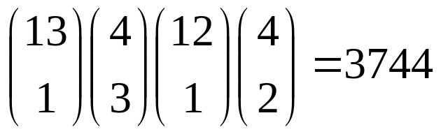
Poker probability: full house
What is the chance of getting a
full house?
  That’s three cards of one face and
  two of another face
We must do ALL of the following:
  Pick the face for the three of a kind: C(13,1)
  Pick the 3 of the 4 cards to be used: C(4,3)
  Pick the face for the pair: C(12,1)
  Pick the 2 of the 4 cards of the pair: C(4,2)
As we must do all of these, we multiply the values out (via the product rule)
This yields
Possibilities for 5 cards: C(52,5) = 2,598,960
Probability = 3744/2,598,960 = 0.00144
  Or about 1 in 694

Slide 17
Inclusion-exclusion principle
The possible poker hands are (in increasing order):
  Nothing
  One pair cannot include two pair, three of a kind,
  four of a kind, or full house
  Two pair cannot include three of a kind, four of a kind,
  or full house
  Three of a kind cannot include four of a kind or full house
  Straight cannot include straight flush or royal flush
  Flush cannot include straight flush or royal flush
  Full house
  Four of a kind
  Straight flush cannot include royal flush
  Royal flush

Slide 18
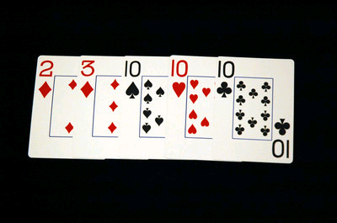
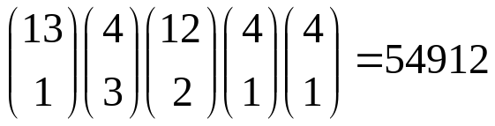
Poker probability: three of a kind
What is the chance of getting a three
of a kind?
  That’s three cards of one face
  Can’t include a full house or four of a
  kind
We must do ALL of the following:
  Pick the face for the three of a kind: C(13,1)
  Pick the 3 of the 4 cards to be used: C(4,3)
  Pick the two other cards’ face values: C(12,2)
    We can’t pick two cards of the same face!
  Pick the suits for the two other cards: C(4,1)*C(4,1)
As we must do all of these, we multiply the values out (via the product rule)
This yields
Possibilities for 5 cards: C(52,5) = 2,598,960
Probability = 54,912/2,598,960 = 0.0211
  Or about 1 in 47

Slide 19
Poker hand odds
The possible poker hands are (in increasing order):
  Nothing 1,302,540 0.5012
  One pair 1,098,240 0.4226
  Two pair 123,552 0.0475
  Three of a kind 54,912 0.0211
  Straight 10,200 0.00392
  Flush 5,108 0.00197
  Full house 3,744 0.00144
  Four of a kind 624 0.000240
  Straight flush 36 0.0000139
  Royal flush 4 0.00000154

Slide 20
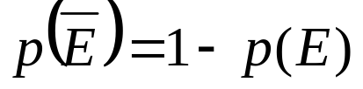
Event Probabilities
Let E be an event in a sample space S. The probability of the complement of E is:
Recall the probability for getting a royal flush is 0.0000015
  The probability of not getting a royal flush is
  1-0.0000015 or 0.9999985
Recall the probability for getting a four of a kind is 0.00024
  The probability of not getting a four of a kind is
  1- 0.00024 or 0.99976

Slide 21
Probability of the union of two events
Let E₁ and E₂ be events in sample space S
Then p(E₁ U E₂) = p(E₁) + p(E₂) – p(E₁ ∩ E₂)
Consider a Venn diagram dart-board

Slide 22
Probability of the union of two events
p(E1 U E2)
S
E₁
E₂

Slide 23
Probability of the union of two events
If you choose a number between 1 and 100, what is the probability that it is divisible by 2 or 5 or both?
Let n be the number chosen
  p(2 div n) = 50/100 (all the even numbers)
  p(5 div n) = 20/100
  p(2 div n) and p(5 div n) = p(10 div n) = 10/100
  p(2 div n) or p(5 div n) = p(2 div n) + p(5 div n) - p(10 div n)
  = 50/100 + 20/100 – 10/100
  = 3/5

Slide 24
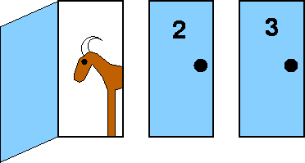
Probability
Monte Hall Puzzle
Choose a door to win a prize!
Suppose you're on a game show, and you're given the choice of three doors: Behind
one door is a car; behind the others, goats. You pick a door, say No. 3, and the host,
who knows what's behind the doors, opens another door, say No. 1, which has a goat.
He then says to you, "Do you want to pick door No. 2?“
Is it to your advantage to switch your choice? If so, why? If not, why not?

Slide 25
6.2 Probability Theory Topics
Assigning Probabilities: Uniform Distribution
Combination of Events - - - covered in 6.1
Conditional Probability
Independence
Bernoulli Trials and the Binomial Distribution
Random Variables – Added
The Birthday Problem – Added
Monte Carlo Algorithms – NOT ADDED
The Probabilistic Method: NOT ADDED - Use in creating non-constructive existence proofs

Slide 26
Probability:
General notion
(non necessarily equally likely outcomes)
Define a probability measure on a set S to be a real-valued function, Pr, with domain 2^{S} so that:
For any subset A in 2^{S}, 0 ≤ Pr(A) ≤ 1.
Pr(∅) = 0, Pr(S) = 1.
If subsets A and B are disjoint, then
Pr(A U B) = Pr(A) + Pr(B).
Pr(A) is “the probability of event A.”
A sample space, together with a probability measure, is called a probability space.
S = {1,2,3,4,5,6}
For A ⊆ S, Pr(A) = |A|/|S|
(equally likely outcomes)
Ex. “Prob of an odd #”
A = {1,3,5}, Pr(A) = 3/6
Aside: book first defines Pr per outcome.

Slide 27
Definition:
Suppose S is a set with n elements. The uniform distribution assigns the probability 1/n to each element of S.
The experiment of selecting an element from a sample space with a uniform a distribution is called selecting an element of S at random.
When events are equally likely and there a finite number of possible outcomes, the second definition of probability coincides with the first definition of probability.

Slide 28
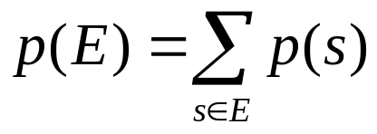
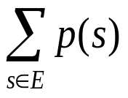
Alternative definition:
The probability of the event E is the sum of the probabilities of the outcomes in E. Thus
Note that when E is an infinite set, is a convergent infinite series

Slide 29
Probability
As before:
If A is a subset of S, let ~A be the complement of A wrt S.
Then Pr(~A) = 1 - Pr(A)
Inclusion-Exclusion
If A and B are subsets of S, then
Pr(A U B) = Pr(A) + Pr(B) - Pr(A ∩ B)

Slide 30
Conditional Probability
Let E and F be events with Pr(F) > 0. The conditional probability of E given F, denoted by Pr(E|F) is defined to be:
Pr(E|F) = Pr(E∩F) / Pr(F).
F
E

Slide 31
Example: Conditional Probability
A bit string of length 4 is generated at random so that each of the 16 bit possible strings is equally likely. What is the probability that it contains at least two consecutive 0s, given that its first bit is a 0?
So, to calculate:
Pr(E|F) = Pr(E∩F) / Pr(F).
where
F is the event that “first bit is 0”, and
E the event that “string contains at least two consecutive 0s”.
What is “the experiment”?
The random generation of a 4 bit string.
What is the “sample space”?
The set of all all possible outcomes, i.e., 16 possible
strings. (equally likely)

Slide 32
A bit string of length 4 is generated at random so that each of the 16 bit strings is equally likely. What is the probability that it contains at least two consecutive 0s, given that its first bit is a 0?
So, to calcuate:
Pr(E|F) = Pr(E∩F) / Pr(F).
where F is the event that first bit is 0 and E the event that string contains at least two consecutive 0’s.
Pr(F) = ?
1/2
Pr(E∩F)?
0000 0001 0010 0011 0100 (note: 1st bit fixed to 0)
Pr(E∩F) = 5/16
Pr(E|F) = 5/8
Why does it go up?
Hmm. Does it?
X X
So, P(E) = 8/16 = 1/2
1000 1001 1010 1011 1100

Slide 33
A bit string of length 4 is generated at random so that each of the 16 bit strings is equally likely. What is the probability that the first bit is a 0, given that it contains at least two consecutive 0s?
So, to calculate:
Pr(F|E) = Pr(E∩F) / Pr(E)
= (Pr(E|F) * Pr(F)) / Pr(E) Bayes’ rule
where F is the event that first bit is 0 and E the event that string contains at least two consecutive 0’s.
We had:
Pr(E∩F) = 5/16
So, P(F|E) = (5/16) / (1/2) = 5/8
= ((5/8) * (1/2)) / (1/2)
So, all fits together.
Pr(E|F) = 5/8
Pr(F) = 1/2
Pr(E) = 1/2

Slide 34
Sample space
F
E
E∩F)
0000
0001
0010
0011
0100
0101
0110
0111
1000
1001
1010
1011
1100
1101
1110
1111
0000
0001
0010
0011
0100
0101
0110
0111
0000
0001
0010
0011
0100
1000
1001
1100
0000
0001
0010
0011
0100
0000
0001
0010
0011
0100
0101
0110
0111
0000
0001
0010
0011
0100
1000
1001
1100
Pr(E∩F) = 5/16
P(F) = 1/2
P(E|F) = 5/8
P(E) = 1/2
P(F|E) = 5/8

Slide 35
Independence
The events E and F are independent if and only if
Pr(E∩F) = Pr(E) x Pr(F).
Note that in general: Pr(E∩F) = Pr(E) x Pr(F|E) (defn. cond. prob.)
So, independent iff Pr(F|E) = Pr(F).
(Also, Pr(F|E) = Pr(E ∩ F) / P(E) = (Pr(E)xPr(F)) / P(E) = Pr(F) )
Example: P(“Tails” | “It’s raining outside”) = P(“Tails”).

Slide 36
Independence
The events E and F are independent if and only if
Pr(E∩F) = Pr(E) x Pr(F).
Let E be the event that a family of n children has children of both sexes.
Lef F be the event that a family of n children has at most one boy.
Are E and F independent if
n = 2?
No
Hmm. Why?
S = {(b,b), (b,g), (g,b), (g,g)}, E = {(b,g), (g,b)}, and F = {(b,g), (g, b), (g,g)}
So Pr(E∩F) = ½ and Pr(E) x Pr(F) = ½ x ¾ = 3/8

Slide 37
Independence
The events E and F are independent if and only if Pr(E∩F) = Pr(E) x Pr(F).
Let E be the event that a family of n children has children of both sexes.
Let F be the event that a family of n children has at most one boy.
Are E and F independent if
n = 3?
Yes !!

Slide 38
Independence
The events E and F are independent if and only if Pr(E∩F) = Pr(E) x Pr(F).
Let E be the event that a family of n children has children of both sexes.
Lef F be the event that a family of n children has at most one boy.
Are E and F independent if
So, dependence / independence really depends on detailed
structure of the underlying probability space and events in
question!! (often the only way is to “calculate” the
probabilities to determine dependence / independence.
n = 4?
No
n = 5?
No

Slide 39
Bernoulli Trials
A Bernoulli trial is an experiment, like flipping a coin, where there are two possible outcomes. The probabilities of the two outcomes could be different.

Slide 40
Bernoulli Trials
A coin is tossed 8 times.
What is the probability of exactly 3 heads in the 8 tosses?
THHTTHTT is a tossing sequence…
C(8,3)
How many ways of choosing 3 positions for the heads?
What is the probability of a particular sequence?
.5⁸
In general: The probability of exactly k successes in n independent Bernoulli trials with probability of success p, is
C(n,k)p^{k}(1-p)^{n-k}

Slide 41
Bernoulli Trials and
Binomial Distribution
Bernoulli Formula: Consider an experiment which repeats a Bernoulli trial n times. Suppose each Bernoulli trial has possible outcomes A, B with respective probabilities p and 1-p. The probability that A occurs exactly k times in n trials is
C (n,k ) p ^{k} · (1-p)^{n-k}
Binomial Distribution: denoted by b(k;n;p) – this function gives the probability of k successes in n independent Bernoulli trials with probability of success p and probability of failure q = 1- p
b(k;n;p)= C (n,k ) p ^{k} · (1-p)^{n-k}

Slide 42
Bernoulli Trials
Consider flipping a fair coin n times.
A = coin comes up “heads”
B = coin comes up “tails”
p = 1-p = ½
Q: What is the probability of getting exactly 10 heads if you flip a coin 20 times?
Recall: P (A occurs k times out of n)
= C (n,k ) p ^{k} · (1-p)^{n-k}

Slide 43
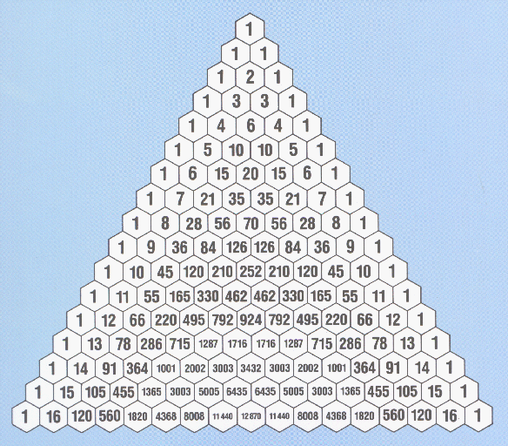
Bernoulli Trials: flipping fair coin
A: (1/2)¹⁰ · (1/2)¹⁰ ·C (20,10)
= 184756 / 2²⁰
= 184756 / 1048576
= 0.1762…
Consider flipping a coin n times.
What is the most likely number of
heads occurrence?
n/2
What probability?
C(n, n/2) . (1/2)^{n}
What is the least likely number?
0 or n
What probability?
(1/2)^{n} (e.g. for n = 100 … it’s “never”)

Slide 44
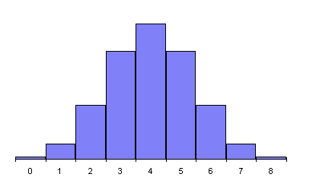
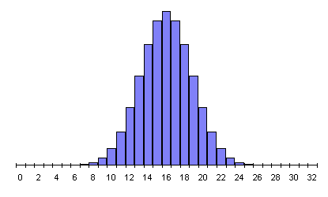
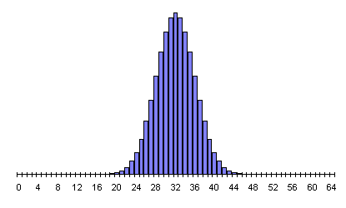
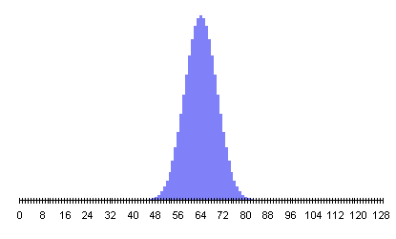
What’s the “width”? …
O(sqrt(n))

Slide 45
Suppose a 0 bit is generated with probability 0.9 and a 1 bit is generated with probability 0.1., and that bits are generated independently. What is the probability that exactly eight 0 bits out of ten bits are generated?
b(8;10;0.9)= C(10,8)(0.9)⁸(0.1)² = 0.1937102445

Slide 46
Bernoulli Trials
A game of Jewel Quest is played 5 times. You clear the board 70% of the time. What is the probability that you win a majority of the 5 games?
Sanity check: What is the probability the result is WWLLW?
.7³.3²
Assumes independent trials
In general: The probability of exactly k successes in n independent Bernoulli trials with probability of success p, is
C(n,k)p^{k}(1-p)^{n-k}
C(5,3)0.7³0.3² + C(5,4)0.7⁴0.3¹ + C(5,5)0.7⁵0.3⁰

Slide 47
Random Variables & Distributions
Also Birthday Problem
Added from Probability Part (b)

Slide 48
Random Variables
For a given sample space S, a random variable (r.v.) is any real valued
function on S, i.e., a random variable is a function that assigns a real
number to each possible outcome
Numbers
Sample space
-2
0
2
S
Suppose our experiment is a roll of 2 dice. S is set of pairs.
Example random variables:
X = sum of two dice. X((2,3)) = 5
Y = difference between two dice. Y((2,3)) = 1
Z = max of two dice. Z((2,3)) = 3

Slide 49
Random variable
Suppose a coin is flipped three times. Let X(t) be the random variable that equals the number of heads that appear when t is the outcome.
X(HHH) = 3
X(HHT) = X(HTH)=X(THH)=2
X(TTH)=X(THT)=X(HTT)=1
X(TTT)=0
Note: we generally drop the argument! We’ll just say the
“random variable X”.
And write e.g. P(X = 2) for “the probability that the random variable X(t) takes on the value 2”.
Or P(X=x) for “the probability that the random variable X(t) takes on the value x.”

Slide 50
Distribution of Random Variable
Definition:
The distribution of a random variable X on a sample space S is the set of
pairs (r, p(X=r)) for all r ∈ X(S), where p(X=r) is the probability that X
takes the value r.
A distribution is usually described specifying p(X=r) for each r ∈ X(S).
A probability distribution on a r.v. X is just an allocation of
the total probability mass, 1, over the possible values of X.

Slide 51
Random Variables
Example: Do you ever play the game Racko?
Suppose you are playing a game with cards labeled 1 to 20, and you draw 3 cards. We bet that the maximum card has value 17 or greater. What’s the probability we win the bet?
Let r.v. X denote the maximum card value. The possible values for X are 3, 4, 5, …, 20.
i | 3 | 4 | 5 | 6 | 7 | 8 | 9 | … | 20
Pr(X = i) | ? | ? | ? | ? | ? | ? | ? |  | ?
Filling in this box would be a pain. We look for a general formula.

Slide 52
Random Variables
X is value of the highest card among the 3 selected. 20 cards are labeled 1 through 20.
We want Pr(X = i), i = 3,…20.
20
6840
60
1140
I’m not telling.
Denominator first: How many ways are there to select the 3 cards?
C(20,3)
How many choices are there that result in a max card whose value is i?
C(i-1,2)
Pr(X = i) = C(i-1, 2) / C(20,3)
We win the bet is the max card, X is 17 or greater. What’s the probability we win?
Pr(X = 17) + Pr(X = 18) + Pr(X = 19) + Pr(X = 20)
≈0.51

Slide 53
The Birthday Paradox

Slide 54
Birthdays
A: 23
How many people have to be in a room to assure that the probability that at least two of them have the same birthday is greater than 1/2?
23
183
365
730
Let p_{n} be the probability that no people share a birthday among n people in a room.
For L options
answer is in
the order
of sqrt(L) ?
Then 1 - p_{n} is the probability that 2 or more share a birthday.
We want the smallest n so that 1 - p_{n} > 1/2.
Informally, why??
Hmm. Why does such an n exist? Upper-bound?

Slide 55
Birthdays
Assumption:
Birthdays of the people are independent.
Each birthday is equally likely and that there are 366 days/year
Let p_{n} be the probability that no-one shares a birthday among n people in a room.
What is p_{n}? (“brute force” is fine)
Assume that people come in certain order; the probability that the second person
has a birthday different than the first is 365/366; the probability that the third person
has a different birthday form the two previous ones is 364/366.. For the jth person
we have (366-(j-1))/366.

Slide 56
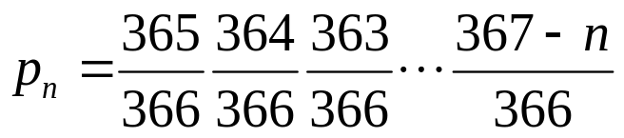
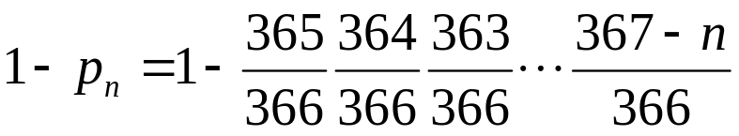
So,
After several tries, when n=22 1= p_{n} = 0.475.
n=23 1-p_{n} = 0.506
Relevant to “hashing”. Why?

Slide 57
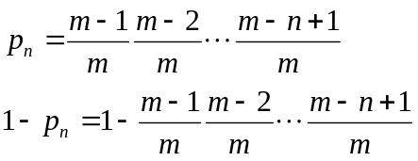

From Birthday Problem to
Hashing Functions
Probability of a Collision in Hashing Functions
A hashing function h(k) is a mapping of the keys (or records, e.g., SSN, around
300x 10⁶ in the US) to a much smaller storage location. A good hashing fucntio
yields few collisions. What is the probability that no two keys are mapped
to the same location by a hashing function?
Assume m is the number available storage locations, so the probability
of mapping a key to a location is 1/m.
Assuming the keys are k1, k2, kn, the probability of mapping the jth record to a
free location is after the first (j-1) records is (m-(j-1))/m.
Given a certain m, find the smallest n
Such that the probability of a collision
is greater than a particular threshold p.
It can be shown that for p>1/2,
n ≈1.177
m = 10,000, gives n = 117. Not that many!

Slide 58
END OF SLIDES
END OF DISCRETE PROBABILITY SLIDES FOR SECTIONS 6.1-6.2

Slide 59
Remaining topics in Probability Chapter
Sections 6.3 – 6.4
Some of these are covered in later slide sets by Selman
Next slides indicate where some of the remaining topics are covered in Selman’s slide sets Part (b) – Part (e)

Slide 60
Section 6.3: Bayes’ Theorem
Topics covered in slides in Selman’s Part (b) Slides
Bayes’ Theorem and the Generalized Bayes Theorem
Bayesian Spam Filters

Slide 61
Section 6.4: Expected Value and Variance
Partially covered in slides for Part c and Part d
Expected Values
Linearity of Expectation
Average-Case Computational Complexity
The Geometric Distribution
Independent Random Variables
Variance
Chebyshev’s Inequality

