Slide 1
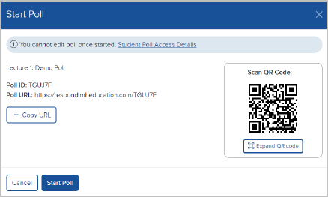
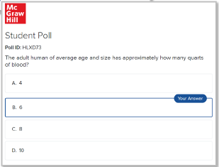
Polling Tool in McGraw Hill Connect®
Every learner has unique needs. Uncover where and when you’re needed with the new Polling tool in McGraw Hill Connect®! Polling allows you to discover where students are in real time. Engage students and help them create connections with your course content while gaining valuable insight during lectures. Leverage polling data to deliver personalized instruction when and where it is needed most. All at no additional cost.
For tips on how to get you and your students started with polling, please access the Instructor Guide here.
This deck includes slides that may be converted to polling questions in Connect. Slides designed to convert are indicated by a bar on the left side that reads “Polling Question.”

Slide 2
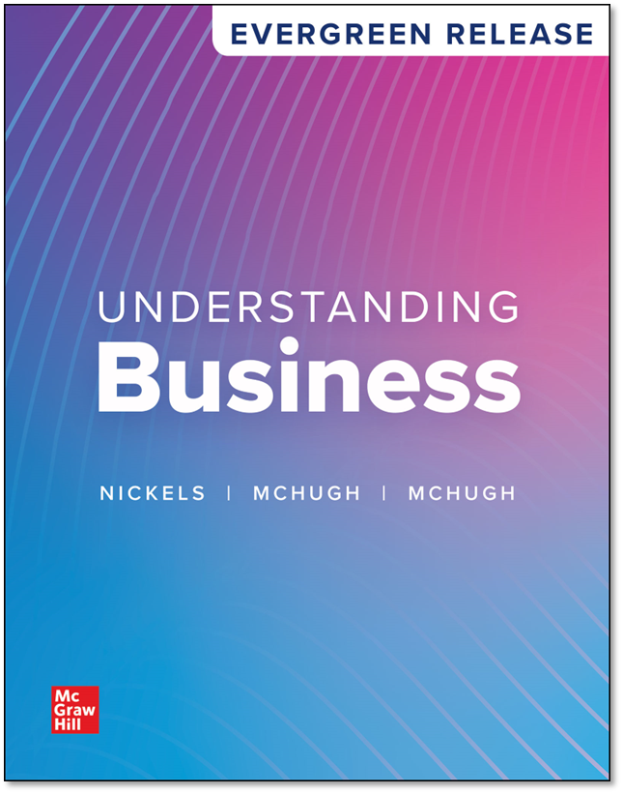
Chapter 1
Taking Risks and Making Profits within the Dynamic Business Environment
© McGraw Hill LLC. All rights reserved. No reproduction or distribution without the prior written consent of McGraw Hill LLC.

Slide 3
Chapter Contents
Business and Wealth Building
The Importance of Entrepreneurs to the Creation of Wealth
The Business Environment
The Evolution of U.S. Business

Slide 4
Learning Objectives 1
LO 1-1 Describe the relationship between profit and risk, and show how businesses and nonprofit organizations can raise the standard of living for all.
LO 1-2 Explain how entrepreneurship and the other factors of production contribute to the creation of wealth.
LO 1-3 Analyze the effects of the economic environment and taxes on businesses.
LO 1-4 Describe the effects of technology on businesses.

Slide 5
Learning Objectives 2
LO 1-5 Demonstrate how businesses can meet and beat competition.
LO 1-6 Analyze the social changes affecting businesses.
LO 1-7 Identify what businesses must do to meet global challenges, including war and terrorism.
LO 1-8 Review how past trends are being repeated in the present and what those trends mean for tomorrow’s college graduates.

Slide 6
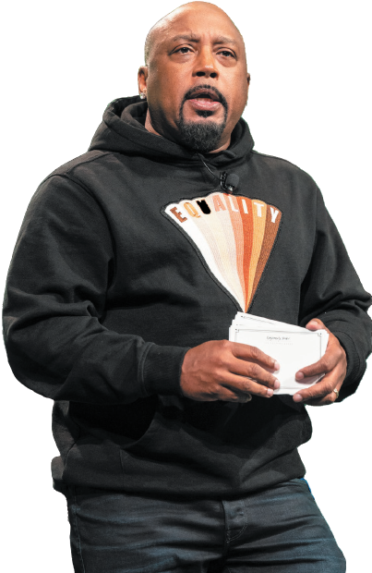
GETTING TO KNOW Daymond John: Founder and CEO of FUBU
Started FUBU in 1989 when he noticed people paying high prices for an easily-made hat. He made the hats himself and sold them at a lower price.
In 1992, relaunched the company with his partners and focused on putting their clothes in the hands of celebrities such as LL Cool J.
He eventually established FUBU as one of the hottest fashion labels in the U.S. and has made more than $6 billion in worldwide sales.
He has invested $15 million of his own money in more than 100 start-ups.
Jim Bennett/WireImage/Getty Images
Notes:
Sources: Jair Hilburn, “Daymond John Is on a Mission,” Forbes, forbes.com, January 17, 2022; Christian Massa, “How Daymond John Went from Selling T-Shirts on the Street to Running a $350 Million Company,” Entrepreneur, entrepreneur.com, March 23, 2022; Jeff Conway, “‘Shark Tank’ Investor Daymond John Is Creating Better Opportunities for Others with Black Entrepreneurs Day,” Forbes, forbes.com, October 6, 2022; Daron Pressley, “‘Learn How to Pitch’: Daymond John Talks to Black Enterprise ahead of Black Entrepreneurs Day,”Black Enterprise, October 22, 2022; Octavio Blanco, “Daymond John on Hip-Hop, His Mom and Making It Big,” CNN, cnn.com, accessed February 2023.

Slide 7

Name that Company
THIS KOREA-BASED COMPANY is building new EV and battery manufacturing facilities in Bryan County, Georgia.
Notes:
Answer: Hyundai

Slide 8
Business and Wealth Building 1
Business
Any activity that seeks to provide goods and services to others while operating at a profit
Goods — Tangible products such as computers, food, clothing, cars, and appliances
Services — Intangible products (that can’t be held in your hand) such as education, health care, insurance, recreation, and travel and tourism
Notes:
See Learning Objective 1: Describe the relationship between profit and risk, and show how businesses and nonprofit organizations can raise the standard of living for all.
It is important that students understand the difference between goods and services. Emphasize that goods are tangible (can be held or touched) like Nike shoes, while services are intangible (cannot be held in your hand) like a haircut.

Slide 9
Business and Wealth Building 2
Successfully filling a market need means you could make money for yourself.
Entrepreneur — A person who risks time and money to start and manage a business
Notes:
See Learning Objective 1: Describe the relationship between profit and risk, and show how businesses and nonprofit organizations can raise the standard of living for all.
In the United States, the entrepreneur is held in high regard. Most students have heard of Sam Walton and Michael Dell, but it often adds to the classroom experience if they understand how these entrepreneurs started their businesses. Sam Walton started Walmart with just one store in Arkansas in the 1960s. Michael Dell got his start building computers in his University of Texas dorm room, ultimately leading to the creation of Dell, Inc.

Slide 10
______ refers to the total amount of money a business takes in during a given period.
A. Profit
B. Loss
C. Revenue
D. Risk
Notes:
Answer: C
Instructors: This slide can be converted to an interactive poll using Polling in McGraw Hill Connect®. Instructions on how to convert this question to a poll can be found on the first slide of this presentation. When converting this slide, be sure to create a multiple choice question.

Slide 11
Business and Wealth Building 3
Revenues, Profits, and Losses
Revenue — Total amount of money a business takes in during a given period by selling goods and services
Profit — Amount of money a business earns above and beyond what it spends for salaries and other expenses
Loss — When a business’s expenses are more than its revenues
Notes:
See Learning Objective 1: Describe the relationship between profit and risk, and show how businesses and nonprofit organizations can raise the standard of living for all.
Approximately 50 percent of small businesses close in the first five years.

Slide 12
Business and Wealth Building 4
Matching Risk with Profit
Risk — The chance an entrepreneur takes of losing time and money on a business that may not prove profitable.
Not all enterprises make the same amount of profit.
All businesses take risks, but taking big risks could earn a company big profits.
Notes:
See Learning Objective 1: Describe the relationship between profit and risk, and show how businesses and nonprofit organizations can raise the standard of living for all.
Elon Musk, the CEO and an early investor of Tesla, is now one of the richest people in the world. Big risk, big profit.

Slide 13
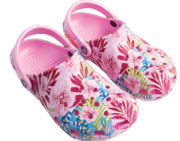
Risk and Reward
When Scott Seamans showed Lyndon “Duke” Hanson and George Boedecker a pair of foam boating clogs he helped design, his two friends initially reacted with skepticism towards their pal’s taste in footwear. Once they set style aside, though, they were won over by the shoe’s comfort, slip-resistance, and ability to float. The trio soon went into business together as Crocs, a company that now earns billions of dollars in annual sales. What risks and rewards did these three entrepreneurs face when starting their business?
Alejandro_Munoz/Shutterstock
Notes:
See Learning Objective 1: Describe the relationship between profit and risk, and show how businesses and nonprofit organizations can raise the standard of living for all.

Slide 14
Business and Wealth Building 5
Standard of Living and Quality of Life
Standard of living — The amount of goods and services people can buy with the money they have
The United States has a high standard of living largely because of the wealth created by its businesses.
Prices for goods and services in some locations are higher than in others, so people in those places can’t buy as much with the same amount of money.
Notes:
See Learning Objective 1: Describe the relationship between profit and risk, and show how businesses and nonprofit organizations can raise the standard of living for all.
Workers in Los Angeles might make more money than workers in Albuquerque, but they also might pay 70% more for a single bedroom apartment.

Slide 15
Business and Wealth Building 6
Quality of life — The general well-being of a society in terms of its political freedom, natural environment, education, health care, safety, amount of leisure, and rewards that add to the satisfaction and joy that other goods and services provide
High quality of life requires combined efforts of businesses, nonprofits, and government agencies
Notes:
See Learning Objective 1: Describe the relationship between profit and risk, and show how businesses and nonprofit organizations can raise the standard of living for all.
The more money businesses create, the more is available to improve the quality of life for all citizens.

Slide 16
Business and Wealth Building 7
Responding to the Various Business Stakeholders
Stakeholders — All the people who stand to gain or lose by the policies and activities of a business and whose concerns the business needs to address
A primary challenge is to recognize and respond to the needs of stakeholders.
Notes:
Learning Objective 1: Describe the relationship between profit and risk, and show how businesses and nonprofit organizations can raise the standard of living for all.
See Figure 1.1 for a list of stakeholders.

Slide 17
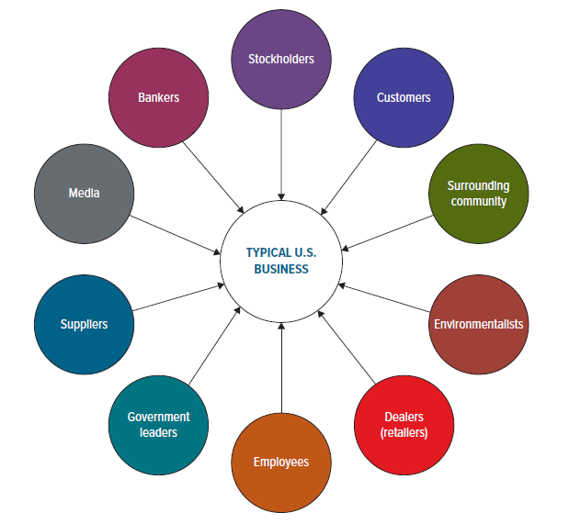
Figure 1.1: A Business and Its Stakeholders
Often the needs of a firm’s various stakeholders will conflict. For example, paying employees more may cut into stockholders’ profits. Balancing such demands is a major role of business managers.
Notes:
See Learning Objective 1: Describe the relationship between profit and risk, and show how businesses and nonprofit organizations can raise the standard of living for all.
Often the needs of a firm’s various stakeholders will conflict. For example, paying employees more may cut into stockholders’ profits. Balancing such demands is a major role of business managers.

Slide 18
Business and Wealth Building 8
Outsourcing — Contracting with other companies (often in other countries) to do some functions of a firm, like production or accounting.
Many foreign companies are opening design and production facilities in the United States, called insourcing.
Notes:
See Learning Objective 1: Describe the relationship between profit and risk, and show how businesses and nonprofit organizations can raise the standard of living for all.
Outsourcing is the contracting with other companies to do some of the firm’s functions. As the slide states, these companies are often in other countries. For example, Dell Computers and many other companies outsource support services to call centers in India and other Asian nations. This can be an emotional issue and one that students often do not understand. When discussing this topic with students, it is important for students to understand that outsourcing has occurred for years and does not always involve a company from the United States locating jobs in another country.
Once students understand outsourcing, the concept of insourcing can be discussed. For example, Hyundai operates plants in the United States. Its engineering headquarters are in Detroit, and they produce cars in Montgomery, Alabama. All of which employ American workers. Insourcing benefits the American worker, such as Honda producing cars in the United States rather than in Japan.

Slide 19
Business and Wealth Building 9
Using Business Principles in Nonprofit Organizations
Nonprofit organization — An organization whose goals do not include making a personal profit for its owners or organizers.
Nonprofit organizations use financial gains to meet social or educational goals.
Notes:
See Learning Objective 1: Describe the relationship between profit and risk, and show how businesses and nonprofit organizations can raise the standard of living for all.
Nonprofits use the same principles and skills you will learn in this class.

Slide 20

Management in Nonprofit Organizations
The goals of nonprofit organizations are social and educational, not profit-oriented. The American Red Cross, for example, provides assistance to millions of people annually, from refugees to victims of natural disasters like floods. Why do good management principles apply equally to profit-seeking businesses and nonprofit organizations?
Andrew Theodorakis/Getty Images News/Getty Images
Notes:
See Learning Objective 1: Describe the relationship between profit and risk, and show how businesses and nonprofit organizations can raise the standard of living for all.

Slide 21
What Employees Want
Employees are seeking more value from their jobs, namely:
Deeper connections. Feeling understood through family and community connections, not just work relationships
Radical flexibility. Feeling autonomous in all aspects of work, not just when and where it gets done
Personal growth. Feeling valued through growth as a person, not just as a professional
Holistic well-being. Feeling cared for by ensuring holistic well-being offerings are used, not just available
Shared purpose. Feeling invested in the organization by taking concrete action on purpose, not just through corporate statements
Beyond the Text
Source: https://www.gartner.com/en/articles/employees-seek-personal-value-and-purpose-at-work-be-prepared-to-deliver, accessed January 2024.
Notes:
See Learning Objective 1: Describe the relationship between profit and risk and show how businesses and nonprofit organizations can raise the standard of living for all.
Gartner calls this “The Human Deal.” Employers should be more sensitive to pay disparities, offer acknowledgment and growth opportunities, and treat employees with respect, trust, and empowerment.

Slide 22
TESTPREP 1
What is the difference between revenue and profit?
What is the difference between standard of living and quality of life?
What is risk, and how is it related to profit?
What do the terms stakeholders, outsourcing, and insourcing mean?
Notes:
1. Revenue is the total amount of money a business takes in during a given period of time. Profit is the amount of money a business earns above and beyond what it spends for salaries and other expenses during a given period.
2. Standard of living is the amount of good and services a person can buy with the money they have. Quality of life refers to the general well-being of society in terms of its political freedom, natural environment, education, health care, safety, amount of leisure, and rewards that add to the satisfaction and joy that other goods and services provide.
3. Risk is the chance an entrepreneur takes in losing time and money on a business that may not prove profitable. Usually, entrepreneurs willing to take the most risk make the highest profit.
4. Stakeholders are all the people who stand to gain or lose by the policies and activities of a business and whose concerns the business needs to address. Outsourcing is contracting with other companies (often in other countries) to do some or all the functions of a firm, like its production or accounting tasks. Insourcing is when foreign companies set up design and production facilities in the United States.

Slide 23
The Importance of Entrepreneurs to the Creation of Wealth 1
Positives to Being an Entrepreneur
Freedom to succeed
Make own decisions
Possible wealth
Negatives to Being an Entrepreneur
Freedom to fail
No paid vacations
No health insurance
Notes:
See Learning Objective 2: Explain how entrepreneurship and the other factors of production contribute to the creation of wealth.

Slide 24
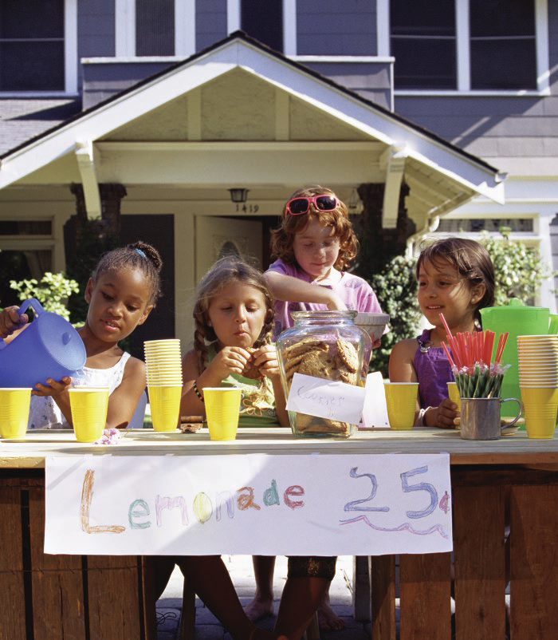
Importance of Entrepreneurs
To create wealth for its citizens, a country requires more than natural resources. It needs the efforts of entrepreneurs and the skill and knowledge to produce goods and services. How can government support entrepreneurship and the spread of knowledge?
Burke/Triolo Productions/The Image Bank/Getty Images
Notes:
See Learning Objective 2: Explain how entrepreneurship and the other factors of production contribute to the creation of wealth.

Slide 25
Women in the Workforce
The labor force participation rate for women was at an all time high in June, 2023, after recovering from a downturn during the pandemic.
February 2020 – 77%
April 2020 – 73.5%
June 2023 – 77.8%
However, women are still making far less than men. For every dollar a man earned, women earned:
1982 – 65 cents
2002 – 80 cents
2022 – 82 cents
Beyond the Text
https://www.cnn.com/2023/07/07/economy/women-labor-force-participation/index.html, accessed January 2024.
Notes:
See Learning Objective 2: Explain how entrepreneurship and the other factors of production contribute to the creation of wealth.

Slide 26
The Importance of Entrepreneurs to the Creation of Wealth 2
The Five Factors of Production
Factors of production — The five resources used to create wealth:
Land (or natural resources)
Labor (workers)
Capital
Entrepreneurship
Knowledge
What makes rich countries rich today is entrepreneurship and knowledge.
Notes:
See Learning Objective 2: Explain how entrepreneurship and the other factors of production contribute to the creation of wealth.

Slide 27
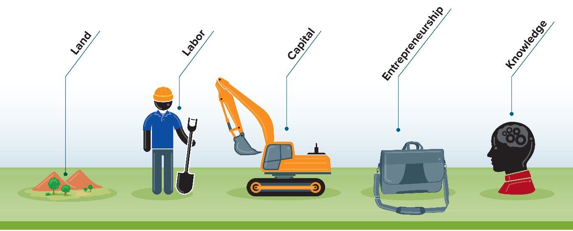
Figure 1.2: The Five Factors of Production
Source: Drucker Institute, druckerinstitute.com, April 2017.
Notes:
See Learning Objective 2: Explain how entrepreneurship and the other factors of production contribute to the creation of wealth.

Slide 28
TESTPREP 2
What are some of the advantages of working for others?
What benefits do you lose by being an entrepreneur, and what do you gain?
What are the five factors of production? Which ones seem to be the most important for creating wealth?
Notes:
1. When working for others, someone else assumes the entrepreneurial risk and provides you with benefits (life health insurance, vacation time, etc.).
2. As an entrepreneur you have the freedom to make your own decisions and the potential for creating wealth, while sacrificing the benefits that working for others often provides.
3. The factors of production are land, labor, capital, entrepreneurship, and knowledge. Of these, entrepreneurship and knowledge seem to be the most important for creating wealth.

Slide 29
The Business Environment 1
Business Environment
The surrounding factors that either help or hinder the development of businesses.
Five elements:
Economic and legal environment
Technological environment
Competitive environment
Social environment
Global business environment
Notes:
See Learning Objective 2: Explain how entrepreneurship and the other factors of production contribute to the creation of wealth.

Slide 30
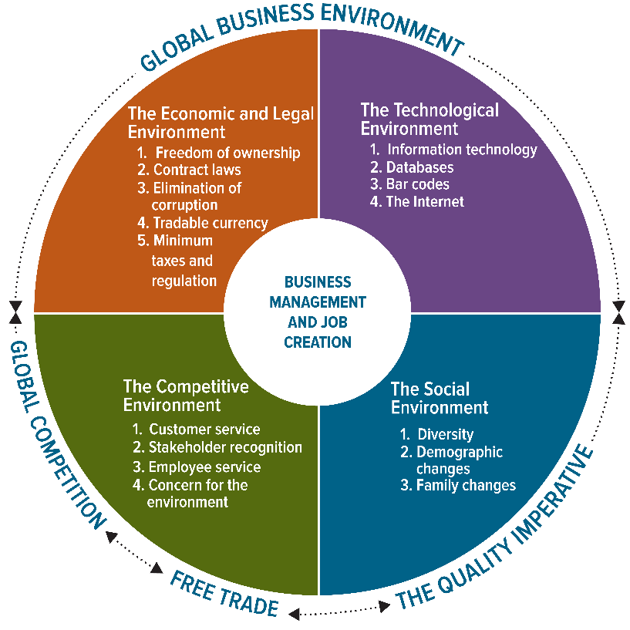
Figure 1.3: Today’s Dynamic Business Environment
Notes:
See Learning Objective 2: Explain how entrepreneurship and the other factors of production contribute to the creation of wealth.

Slide 31
The Business Environment 2
The Economic and Legal Environment
Government can promote entrepreneurship by:
Allowing private ownership of businesses.
Minimizing interference with the free exchange of goods and services.
Passing laws that enable businesspeople to write enforceable contracts.
Establishing a currency that’s tradable in world markets.
Minimizing corruption.
Notes:
See Learning Objective 3: Analyze the effects of the economic environment and taxes on businesses.

Slide 32
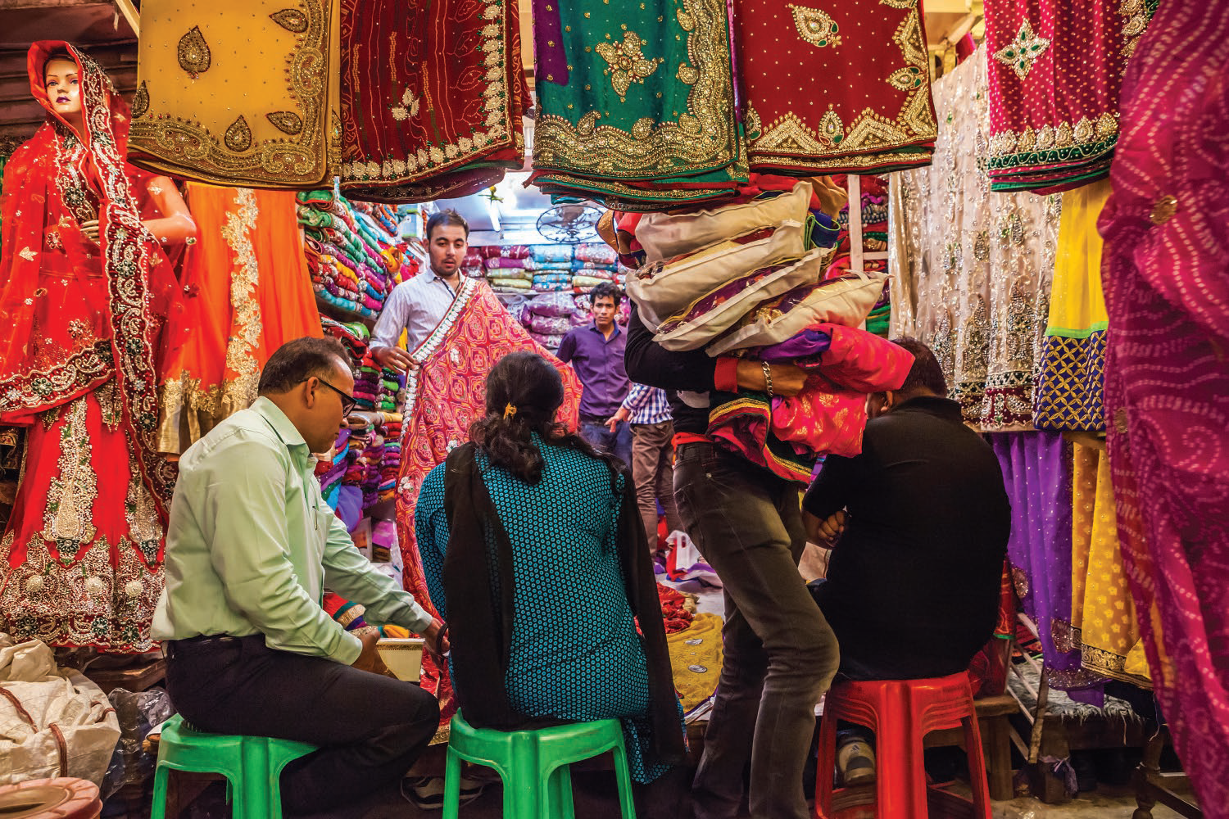
Differences Between Countries
Starting a business is more difficult in some countries than in others. In India, for example, it takes a time-consuming and bureaucratic process to obtain government permission. Nonetheless, new businesses can become a major source of wealth and employment. This sari shop is one small example. What do you think would be the effect of a little more freedom to create business opportunities in this country of more than 1.4 billion people?
TMI/Alamy Stock Photo
Notes:
See Learning Objective 3: Analyze the effects of the economic environment and taxes on businesses.

Slide 33
The Business Environment 3
How Technology Benefits Workers and You
Technology — from phones to computers, mobile devices, medical imaging machines, robots, the Internet, artificial intelligence, social media, and the various software programs and apps that make business processes more effective, efficient, and productive
Productivity — The amount of output you generate given the amount of input (for example, hours worked)
Notes:
See Learning Objective 4: Describe the effect of technology on businesses.
Technology affects people in all industries.

Slide 34
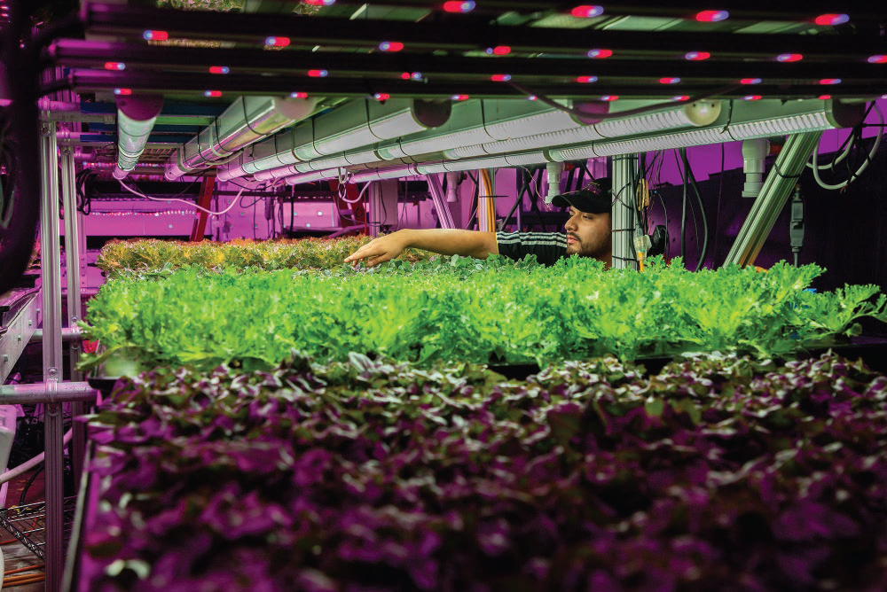
Maintaining Cycles of Sustainability with a Circular Economy
People around the world create a lot of waste.
To combat this problem of global proportions, companies are created that depend on a circular economy — keeping products in the value circle.
The aim is to produce no waste as every material is either recycled or reused in some capacity.
The Plant in Chicago is an indoor farm irrigated with rainwater and power generated by solar panels. It helps more than 20 companies thrive without creating unnecessary waste.
Zbigniew Bzdak/McClatchy-Tribune/Alamy Stock Photo
Notes:
See Learning Objective 4: Describe the effect of technology on businesses.
Sources: Rachael Dottle and Jackie Gu, “The Global Glut of Clothing Is an Environmental Crisis,” Bloomberg, bloomberg.com, February 23, 2022; Natalie Obiko Pearson, Ekow Dontoh, and Dhwani Pandya, “FastIndoor Farming,” Food Technology Magazine, ift.org, October 1, 2022; Jane Margolies, “Destined for the Dump, Construction Waste Gets New Life in the Garden,” The New York Times, nytimes.com, November 29, -Fashion Waste Is Choking Developing Countries with Mountains of Trash,” Bloomberg, bloomberg.com, November 2, 2022; Dale Buss, “The Bountiful Promise of 2022; Earth Angel, earthangelsets.com, accessed February 2023; Ellen McArthur Foundation, ellenmacarthurfoundation.org, accessed February 2023; The Plant, www.insidetheplant. com, accessed February 2023.

Slide 35
The Business Environment 4
The Growth of E-Commerce
E-commerce — The buying and selling of goods online
Business-to-consumer (B2C)
Business-to-business (B2B)
Notes:
See Learning Objective 4: Describe the effect of technology on businesses.

Slide 36
The Business Environment 5
Using Technology to Be Responsive to Customers:
Database — An electronic storage file for information
Identity theft — The obtaining of individuals’ personal information, such as Social Security and credit card numbers, for illegal purposes
Notes:
See Learning Objective 4: Describe the effect of technology on businesses.

Slide 37

Using Technology for Customers
Walt Disney World’s MagicBand provides an all-in-one way for guests to connect with the various vacation choices they made online before their trip. Using RFID technology, the MagicBand serves as a park ticket, hotel room key, and payment system that also gives guests access to extras like Disney’s PhotoPass. Do you think the MagicBand encourages visitors to make more purchases in the park?
Jeff Gritchen/MediaNews Group/Orange County Register/Getty Images
Notes:
See Learning Objective 4: Describe the effect of technology on businesses.

Slide 38
The Business Environment 6
The Competitive Environment
Competing by Exceeding Customer Expectations
Customers want good quality products at low prices with great customer service.
Competing by Restructuring and Empowerment
Because business is more customer-driven, some managers give frontline employees more decision-making power.
Empowerment — Giving frontline workers the responsibility, authority, freedom, training, and equipment they need to respond quickly to customer requests
Notes:
See Learning Objective 5: Demonstrate how businesses can meet and beat competition.

Slide 39
With the definition of empowerment in mind, do you think you were empowered in your most recent job?
A. Yes
B. No
Notes:
Answer: [opinion—no correct answer]
Instructors: This slide can be converted to an interactive poll using Polling in McGraw Hill Connect®. Instructions on how to convert this question to a poll can be found on the first slide of this presentation. When converting this slide, be sure to create a multiple choice question.

Slide 40
The Business Environment 7
The Social Environment
Demography — The statistical study of the human population with regard to its size, density, and other characteristics such as age, race, gender, and income.
Managing Diversity:
Diversity has grown from just recruiting and retaining people of ethnic or racial minorities and female employees.
Creating a workplace that promotes inclusion and belonging.
Notes:
See Learning Objective 6: Analyze the social changes affecting businesses.

Slide 41
Resident Population of the United States by Race, 2022
The White alone, non-Hispanic group accounted for 57.8% of the total population, 60.8% of the 18-and-over population, and only 47.3% of the population under age 18.
The Hispanic or Latino group was 18.7% of the total population, 16.8% of the adult population, and 25.7% of the under-18 population.
The Black or African American alone, non-Hispanic group was 12.1% of the total population, 11.7% of adults, and 13.2% of the younger population.
Beyond the Text
Source CENSUS.GOV, accessed January 2024.
Notes:
See Learning Objective 6: Analyze the social changes affecting businesses.

Slide 42
The Business Environment 8
The Increase in the Number of Older Citizens
People aged 75 and over are currently the richest demographic group.
Retired people will be draining the economy of wealth due to Social Security.
The Increase in the Number of Single-Parent Families
Growth of single-parent households has encouraged businesses to implement programs such as family leave and flextime.
Notes:
See Learning Objective 6: Analyze the social changes affecting businesses.
When discussing how demographic changes experienced in this country over the past 30 years have affected businesses, it often helps to use the grocery store as an example. The grocery store has evolved from a market selling primarily raw materials used to produce a meal into stores that now serve pre-made products that simply involve “heating and eating.” Why? Some would argue this change has more to do with the two-income and single-parent household than any other environmental factor. Engaging students in this discussion is often useful to their understanding of how businesses must adapt to changing demographic circumstances.

Slide 43

Diversity in Age
The United States boasts enormous ethnic and racial diversity. Its workforce is also widely diverse in terms of age, which means that managers must adapt to the generational demographics of the workplace. What are some challenges of working with someone much younger or much older than you?
Shutterstock
Notes:
See Learning Objective 6: Analyze the social changes affecting businesses.

Slide 44
Who Will Support Social Security?
Beyond the Text
Source: https://www.federalbudgetinpictures.com/social-security-recipient-worker-ratio/, accessed January 2024.
Notes:
See Learning Objective 6: Analyze the social changes affecting businesses.
The number of workers per retiree has dropped dramatically since 1960.
Ask the students: What impact will the decline of the number of workers per retiree have in the future? (In the future, government might have to raise taxes and reduce benefits for individuals or use a means test in an effort to prevent Social Security payments from bankrupting the government.)

Slide 45

Single-Parent Families
More and more working families consist of single parents who must juggle the demands of a job and the responsibilities of raising children. What can managers do to try to retain valued employees who face such challenges?
AleksandarNakic/E+/Getty Images
Notes:
See Learning Objective 6: Analyze the social changes affecting businesses.

Slide 46
The Business Environment 9
The Rise of Gen Z’s Economic Influence
Generation Z were born between 1995 and 2009.
They will be the largest group of consumers in the world, so marketers need to capture their attention and engage them.
Notes:
See Learning Objective 6: Analyze the social changes affecting businesses.

Slide 47

Companies Compete for the Online Attention of Gen Z
Generation Z spends a ton of time on social media and companies need to find ways to reach and appeal to them.
Gen Zers depend on TikTok for nearly everything online, including product recommendations.
One proven strategy is to enlist influencers to act as brand ambassadors.
Many companies choose to directly purchase space on TikTok for ads.
Notes:
See Learning Objective 6: Analyze the social changes affecting businesses.
Sources: Norah Mulinda and Amina Niasse, “Gen Z Uses TikTok Like Google, Upsetting the Old Internet Order,” Bloomberg, bloomberg.com, July 29, 2022; Suzanne Vranica and Liza Lin, “TikTok Grabs More Ad Dollars, as Marketers Look to Attract Gen Z and Millennials,” The Wall Street Journal, wsj.com, June 21, 2022; Jeff Fromm, “As Gen Z’s Buying Power Grows, Businesses Must Adapt Their Marketing,” Forbes, forbes.com, July 20, 2022; “70+ Statistics on Gen Z Spending Habits for 2023,” Lexington Law, lexingtonlaw. com, March 7, 2023.

Slide 48
The Business Environment 10
The Global Environment
Globalization has grown due to efficient distribution systems and communication systems such as the Internet.
War and Terrorism:
They have drained trillions of dollars from the U.S. economy.
Money was diverted to the Ukraine war effort.
Increased unrest creates uncertainty, which may be the biggest risk in business.
Notes:
See Learning Objective 7: Identify what businesses must do to meet global challenges, including war and terrorism.
Ask the students: Can terrorism and an economic crisis decrease economic cooperation and free trade among nations? (This question is at the same time alarming and thought provoking. Given recent events, asking students this question will get them thinking about how the world and events in far away places can impact their lives.)

Slide 49
The Business Environment 11
How Global Changes Affect You
As businesses expand to serve global markets, new jobs will be created.
Rapid changes create a need for continuous learning.
Notes:
See Learning Objective 7: Identify what businesses must do to meet global challenges, including war and terrorism.

Slide 50
The Business Environment 12
The Ecological Environment
Climate change — The movement of the temperature of the planet up or down over time
Greening — The trend toward saving energy and producing products that cause less harm to the environment
Notes:
See Learning Objective 7: Identify what businesses must do to meet global challenges, including war and terrorism.

Slide 51
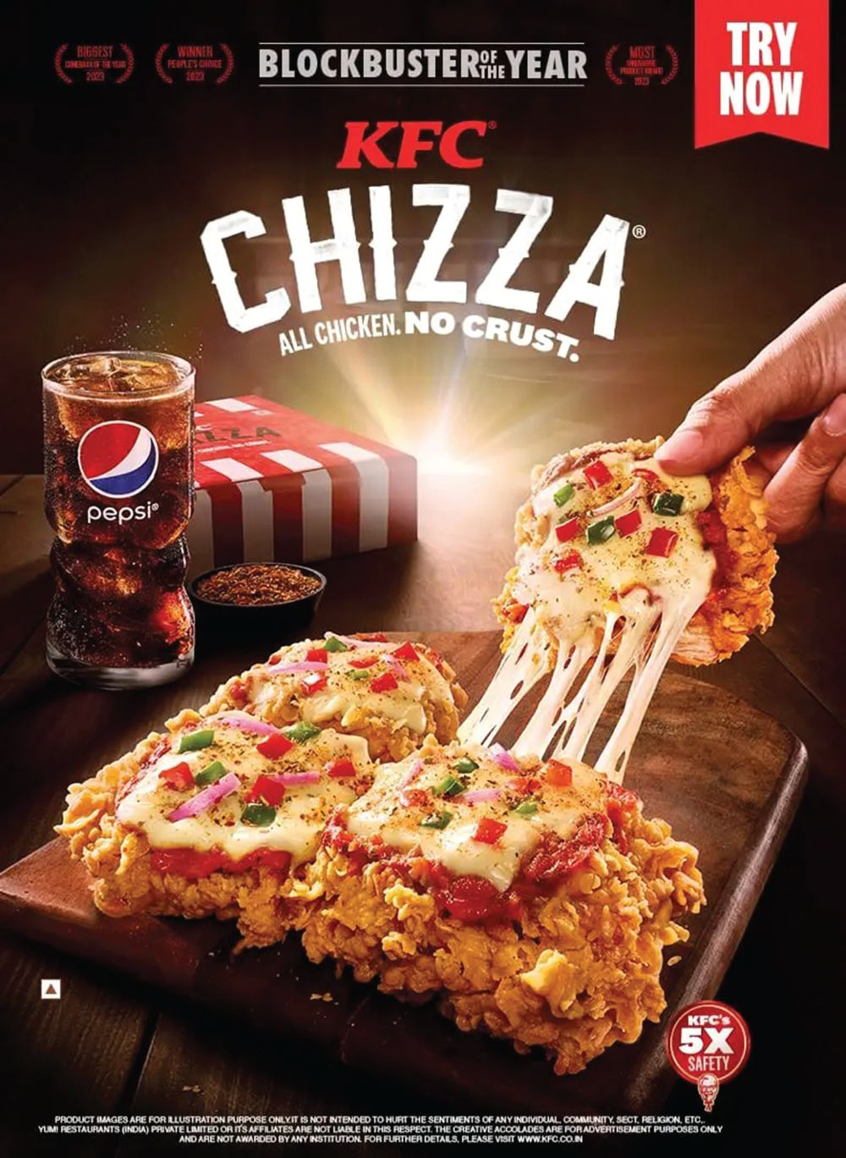
KFC’s Finger-Lickin’ Good Global Offerings
KFC offers far more than fried chicken.
Different regions include different menu items. The Zinger was created in Trinidad and Tobago and has since become a global hit. Another innovative item is the “Chizza,” a pizza with a fried chicken crust sold in the Philippines
18 food innovation teams are located throughout the world.
These teams follow regional trends and develop dishes based on local tastes, which may not always appeal to everyone.
KFC Corporation
Notes:
See Learning Objective 7: Identify what businesses must do to meet global challenges, including war and terrorism.
Sources: Alicia Kelso, “A Look at the Menu Innovation Driving KFC Global’s Sales Momentum,” Forbes, forbes.com, July 22, 2019; Jiyoung Sohn, “Mint Chocolate on Fried Chicken? A Food Craze Has Everyone Taking Sides,” The Wall Street Journal, wsj.com, October 5, 2022; Chris Heasman, “International KFC Menu Items You Won’t Find in the U.S.,” Mashed, mashed.com, February 2, 2023.

Slide 52
TESTPREP 3
What are four ways the government can foster entrepreneurship?
What is the difference between effectiveness, efficiency, and productivity?
What is empowerment?
What are some of the major issues affecting the economy today?
Notes:
1. The government can foster entrepreneurship by:
• Allowing private ownership of business.
• Passing laws that enable businesses to write enforceable contracts.
• Establishing a currency that is tradable in world markets.
• Minimizing corruption in business and in its own ranks.
2. Effectiveness means producing the desired results. Efficiency means producing goods and services using the least amount of resources. Productivity is the amount of output you generate given the amount of input, such as the number of hours you work.
3. Empowerment is allowing workers to make decisions essential to producing high-quality goods and services.
4. Technology changes, identity theft, changing demographics, diversity, climate change, war, and terrorism are just several issues affecting the economy today.

Slide 53
The Evolution of U.S. Business 1
Progress in the Agricultural and Manufacturing Industries
In the 1800s, the agricultural industry led economic development.
Technology like the harvester and modern improvements to such equipment made large-scale farming successful.
This led to fewer farmers with larger farms.
Industrialization in the 19th and 20th centuries moved jobs from farms to factories.
As technology improved productivity, fewer workers were needed in factories.
Notes:
See Learning Objective 8: Review how past trends are being repeated in the present and what those trends mean for tomorrow’s college graduates.
Agriculture was the leading industry in the U.S. in the 1800s. Technology has made farming so efficient, the number of farmers has dropped from about 33 percent of the population to about 1 percent. However, it is still a major industry in the U.S.

Slide 54
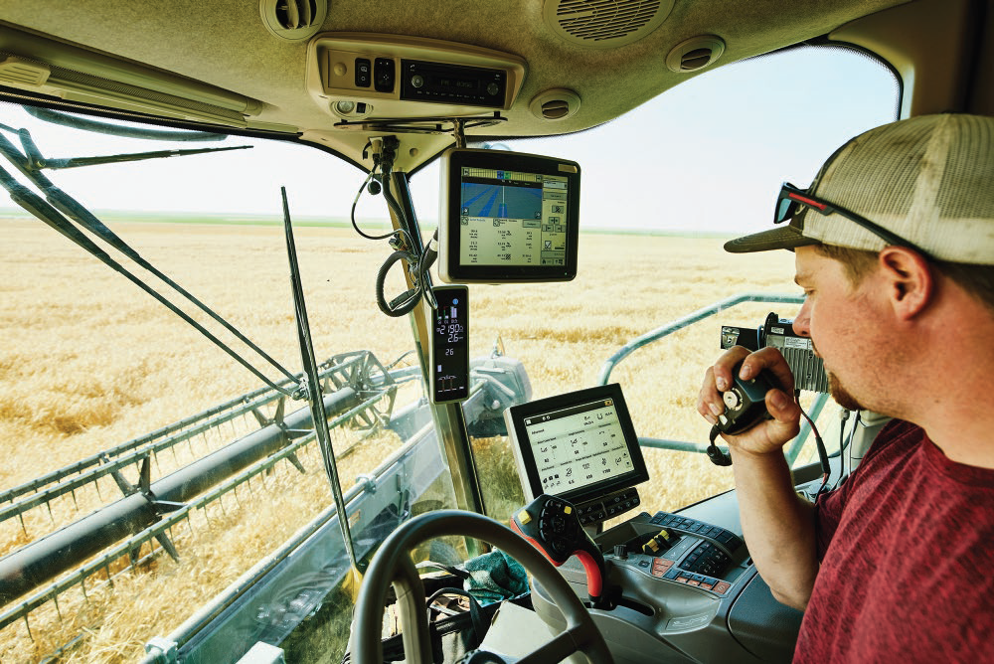
Technology and Agriculture
Agriculture is one of the largest and most important industries in the United States. Over the years technology has increased productivity and made farmers more efficient, allowing for larger farms. While this trend helps stabilize the prices of some foods for consumers, it has also greatly reduced the number of small, family-run farms. How do you think smaller farms could use agricultural technology to compete?
Thomas Barwick/DigitalVision/Getty Images
Notes:
See Learning Objective 8: Review how past trends are being repeated in the present and what those trends mean for tomorrow’s college graduates.

Slide 55
The Evolution of U.S. Business 2
Progress in Service Industries
Since the mid-19 80s, the service industry generated almost all the increases in employment.
There are more high-paying jobs in service industries.
Notes:
See Learning Objective 8: Review how past trends are being repeated in the present and what those trends mean for tomorrow’s college graduates.

Slide 56
The Evolution of U.S. Business 3
Progress in the Information Age
Information-based global and technical revolution is altering all sectors of the economy.
A significant portion of a company's value is based on its intellectual capital.
Innovation is encouraged.
Notes:
See Learning Objective 8: Review how past trends are being repeated in the present and what those trends mean for tomorrow’s college graduates.

Slide 57
The Evolution of U.S. Business 4
Your Future in Business
This book will introduce you to concepts that make leadership possible.
Notes:
See Learning Objective 8: Review how past trends are being repeated in the present and what those trends mean for tomorrow’s college graduates.

Slide 58
TESTPREP 4
What major factor caused people to move from farming to manufacturing and from manufacturing to the service sector?
What does the future look like for tomorrow’s college graduates?
Notes:
1. Efficiencies in agriculture led to the reduction in farms and growth in industry that caused workers to leave the farm and come to the cities. The growth of efficiencies in production had the same effect as in agriculture. As factories became more efficient and technologically driven, workers migrated to the service sector.
2. The information-based global revolution will alter all sections of the economy. It will be an interesting opportunity for college graduates.

Slide 59
End of Main Content
© McGraw Hill LLC. All rights reserved. No reproduction or distribution without the prior written consent of McGraw Hill LLC.

