Slide 1

Manhattan to the Brooklyn bridge in 10?
ZenDrive
We Have Seen The Future!

Slide 2

Jack Perloff Darshan Golchha Vardaan Kapoor

Slide 3

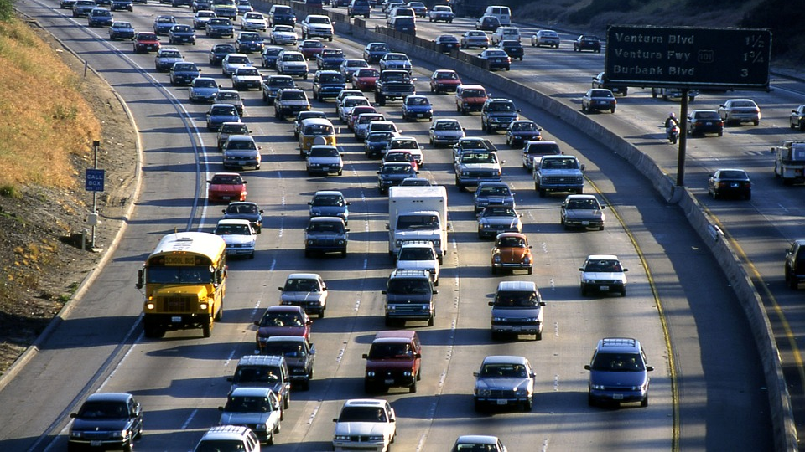
NEW YORKERS SPEND 92 HOURS per year ROTTING IN CONGESTED CITY HIGHWAYS !

Slide 4

PROPOSITION
A genuine city congestion tracking platform whose
robustness applauds the city traffic data collecting centers to predict real time speed mappings of a rider at any location in cosmopolitan hubs during any hour of the day.

Slide 5
INSPIRATION
Google's Dynamically configurating maps conforming to driver's preferences and environmental constraints.
Busy Life
Sick of radio jockeys predicting traffic on an abandoned boulevard.

Slide 6

WE LIBRARIES!!!
SKLEARN
TENSORFLOW
PANDAS
KERAS

Slide 7
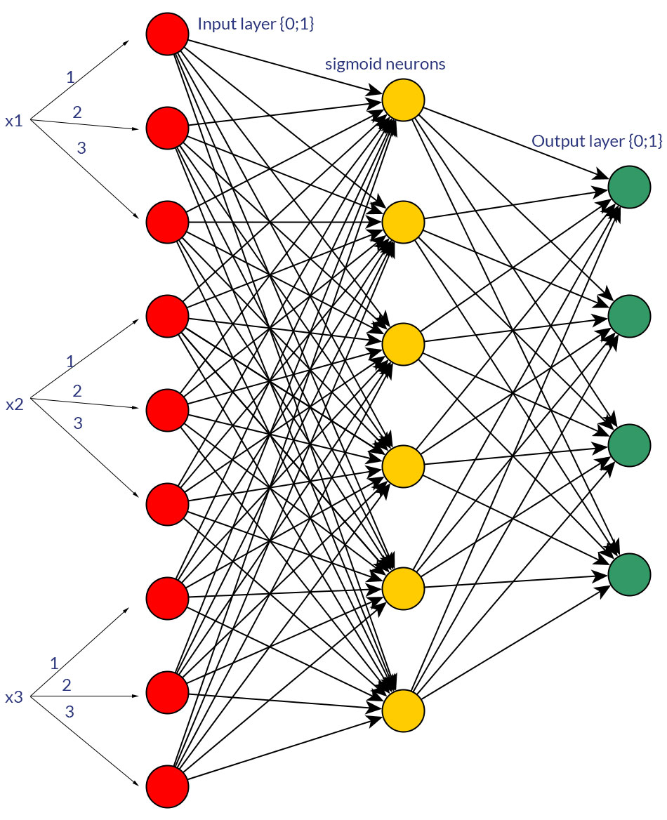
THE NERDY PICTURESQUE
.

Slide 8
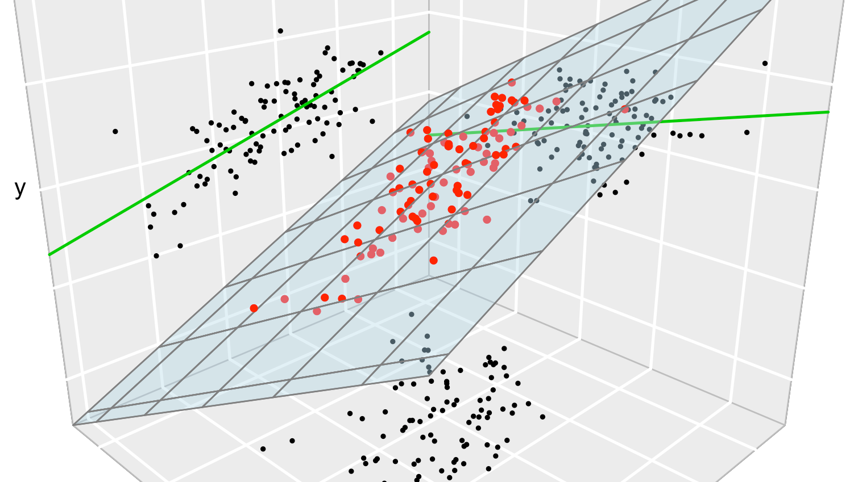
HAIL
LINEAR REGRESSION

Slide 9
FACETS AND FASCINATION
Linear regression attempts to model the relationship between two variables by fitting a linear equation to observed data. One variable is considered to be an explanatory variable, and the other is considered to be a dependent variable. For example, a modeler might want to relate the weights of individuals to their heights using a linear regression model.
Before attempting to fit a linear model to observed data, a modeler should first determine whether or not there is a relationship between the variables of interest. This does not necessarily imply that one variable causes the other (for example, higher SAT scores do not cause higher college grades), but that there is some significant association between the two variables.
^{y(x) = p0 + p1 * x}
y = output variable. Variable y represents the continuous value that the model tries to predict.
x = input variable. In machine learning, x is the feature, while it is termed the independent variable in statistics. Variable x represents the input information provided to the model at any given time.
p0 = y-axis intercept (or the bias term).
p1 = the regression coefficient or scale factor. In classical statistics, p1 is the equivalent of the slope of the best-fit straight line of the linear regression model.
^{pi = weights (in general).}

Slide 10
VALOR OF ANN
Neural networks, also known as artificial neural networks (ANNs) or simulated neural networks (SNNs), are a subset of machine learning and are at the heart of deep learning algorithms. Their name and structure are inspired by the human brain, mimicking the way that biological neurons signal to one another.
Artificial neural networks (ANNs) are comprised of a node layers, containing an input layer, one or more hidden layers, and an output layer. Each node, or artificial neuron, connects to another and has an associated weight and threshold. If the output of any individual node is above the specified threshold value, that node is activated, sending data to the next layer of the network. Otherwise, no data is passed along to the next layer of the network.
∑wixi + bias = w1x1 + w2x2 + w3x3 + bias
output = f(x) = 1 if ∑w1x1 + b>= 0; 0 if ∑w1x1 + b < 0
Once an input layer is determined, weights are assigned. These weights help determine the importance of any given variable, with larger ones contributing more significantly to the output compared to other inputs. All inputs are then multiplied by their respective weights and then summed. Afterward, the output is passed through an activation function, which determines the output. If that output exceeds a given threshold, it “fires” (or activates) the node, passing data to the next layer in the network. This results in the output of one node becoming in the input of the next node. This process of passing data from one layer to the next layer defines this neural network as a feedforward network.

Slide 11
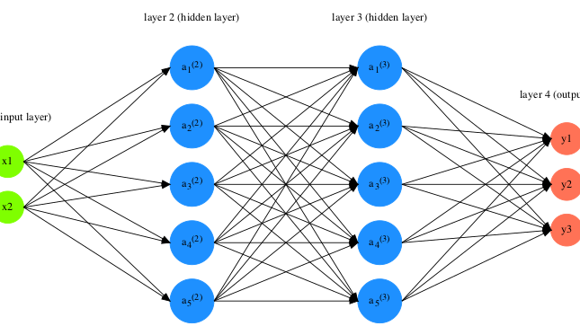
IMPLEMENTATION
Used Machine Learning Libraries to structure an Artificial Neural Network Model which harnesses the in-depth complexity and niche genuineness of its inter-branching layers to map different facets of the traffic data collected in form of a CSV file.
More than 2.6 million data entries of different years of traffic data from cities like San Francisco, New York City, and others were fed to the model to contiguously train It and mark changes in its ever-growing efficiency over time.
The ANN model builds connections between dynamic variables of uncertainty like current traffic, road signs, initial location, destination constraints, and many more to predict the most accurate average speed the rider would experience in the city.
This Photo by Unknown author is licensed under CC BY-SA.

Slide 12
COMPARISON HOOKS
STANDARD MEDIAN OF EXPECTED OUTPUT OF SPEEDS AGAINST THE PREDICTED CORRESPONDING STATS BY THE MODEL
RELATIVE ACCURACY EXPONENTIALLY INCREASES AS DATA FED TO THE MODEL AGGREGATES FOR A PARTICULAR CITY

Slide 13

FINDINGS

Slide 14
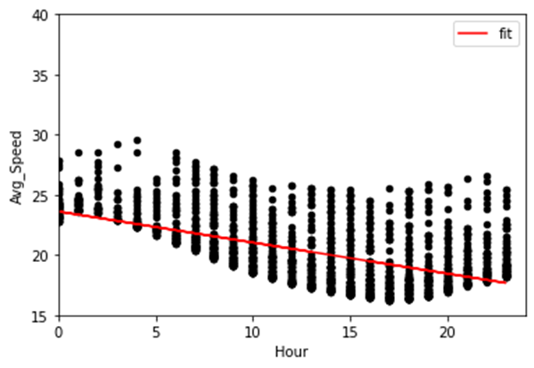
NEW YORK CITY

Slide 15
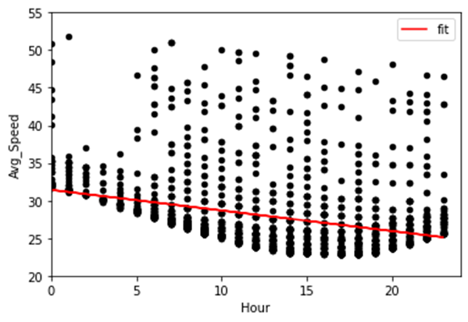
SAN FRANCISCO

Slide 16
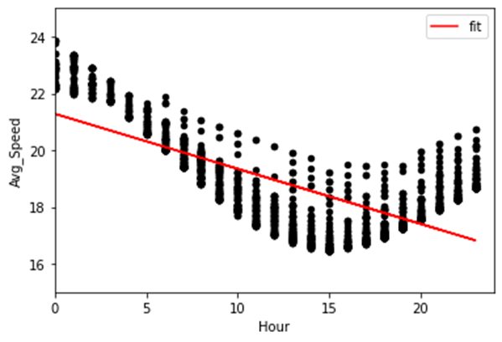
LONDON

Slide 17
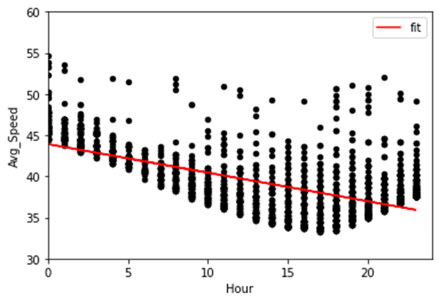
BERLIN

Slide 18
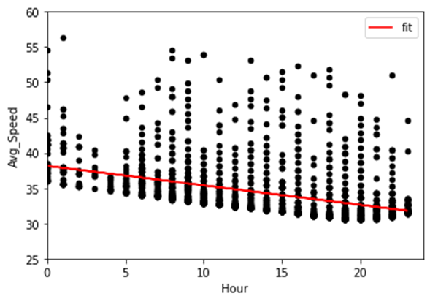
SEATTLE

Slide 19
INFERENCE
As the vehicle population of a city increases and the data collected aggrandizes, the model's learning curve exponentiates.
Comparing same amount of data values for different cities predicts how the model is independent of the "nature" of data bullets collected.
Cities with lesser population had faster average times seen around the whole day
Model's predictions were compatible with the hypothesis that traffic congestion is linked to population and if external variables are constant, linear regression model flourishes.

Slide 20

THE LEAP FORWARD
This Photo by Unknown author is licensed under CC BY-ND.

Slide 21
IT IS A JOURNEY...
Deploy a dynamically "alternating" application in the market which tracks user's current traffic location and data to provide information about fastest nearby routes and compare possible routes tracing the same destination against their approximate "waiting" times.
Collect live satellite images of the user's surroundings and map them concurrently with the data values the model is learning to "reinforce" the learning speed of the model and aid visuals.
Incorporate more cities' traffic congestion data and use more unpredictable variables to robustly train and test the model.
Use Google Maps API and data from traffic regional traffic control centers around the globe.

Slide 22

IMPACT
This project has the potential to significantly impact urban areas by accurately predicting traffic congestion in real-time. It can help drivers choose alternative routes, reduce emissions, and improve infrastructure. This project could ultimately improve the daily commute for millions of people and make cities more efficient, sustainable, and livable.

Slide 23

THANK YOU

