Slide 1
COP-5725
MIDTERM REVIEW
Chapters 1 – 5, 19
M. Amanda Crick
(Uses slides from Fernando Farfan and Eduardo J. Ruiz

Slide 2
Chapter 1: Overview of DBMSs
Concepts:
DBMS
Relational Model
Levels of Abstraction
Data Independence

Slide 3
Exercise 1.1
Problem
Why would you choose a database system instead of simply storing data in operating system files? When would it make sense not to use a database system?

Slide 4
Exercise 1.1
Solution
Data independence and efficient access.
  Physical, logical independence
  Efficient storage and data retrieval
Reduced application development time.
  Data storage aspect of application already written and debugged; only need to write application code
Data integrity and security.
  Database prevents changes that violate integrity constraints. Views and authorization mechanism.

Slide 5
Exercise 1.1
Solution
Data administration.
  Maintenance and data administration made easier.
Concurrent access and crash recovery
  Transactions prevent two conflicting operations from being carried out concurrently.
  Keeps a log of changes to data, so that the system can recover from a crash.

Slide 6
Exercise 1.4
Problem
Explain the difference between external, internal, and conceptual schemas. How are these different schema layers related to the concepts of logical and physical data independence?

Slide 7
Exercise 1.4
Solution
External schemas:
  Allow data access to be customized at the level of individual users or groups of users using different VIEWS of the same conceptual schema.
  Views are not stored in DBMS but they generated on-demand.
Conceptual (logical) schemas:
  Describes all the data in terms of the data model. In a relational DBMS, it describes all relations stored.
  While there are several views for a given database, there is exactly one conceptual schema to all users.

Slide 8
Exercise 1.4
Solution
Internal (physical) schemas:
  Describes how the relations described in the conceptual schema are actually stored on disk (or other physical media).

Slide 9
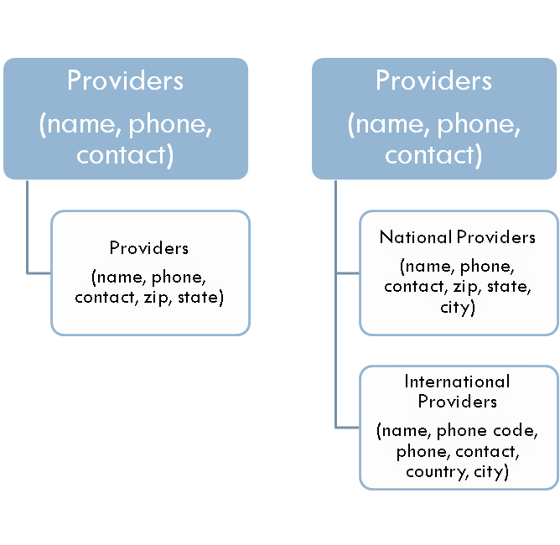
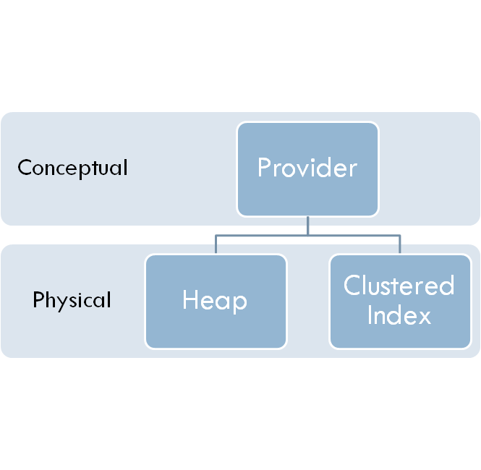
Exercise 1.4
Solution

Slide 10
Exercise 1.4
Solution
The logical schema protects outside programs and users from changes to the database relational schema.
The physical schema protects programs and users from changes to the way database files are stored.

Slide 11
Chapter 2: Database Design
Concepts:
Domain
Attribute
Entity (Set)
Relationship(Set)
Primary Key
Participation Constraint
Key Constraint
Aggregation
Overlap Constraint
Descriptive Attribute
Roles
One-to-Many
Many-to-May
Weak Entity Set
Identifying Owner/Relationship

Slide 12
Exercise 2.2
Problem
A university database contains information about professors (identified by social security number, or SSN) and courses (identified by courseid). Professors teach courses; each of the following situations concerns the Teaches relationship set. For each situation, draw an ER diagram that describes it (assuming no further constraints hold). Draw an ER diagram that captures this information.

Slide 13
Exercise 2.2
Problem
A university database contains information about professors (identified by social security number, or SSN) and courses (identified by courseid). Professors teach courses; each of the following situations concerns the Teaches relationship set. For each situation, draw an ER diagram that describes it (assuming no further constraints hold). Draw an ER diagram that captures this information.

Slide 14
Exercise 2.2
Problem
Professors can teach the same course in several semesters, and each offering must be recorded.
Solution
Semester
semesterid
ssn
courseid
Teaches
Professor
Course

Slide 15
Exercise 2.2
Problem
Professors can teach the same course in several semesters, and only the most recent such offering needs to be recorded. (Assume this condition applies in all subsequent questions.)
Solution
semesterid
ssn
courseid
Teaches
Professor
Course

Slide 16
Exercise 2.2
Problem
Every professor must teach some course.
Solution
ssn
semester
courseid
Teaches
Professor
Course

Slide 17
Exercise 2.2
Problem
Every professor teaches exactly one course (no more, no less).
Solution
ssn
semester
courseid
Teaches
Professor
Course

Slide 18
Exercise 2.2
Problem
Every professor teaches exactly one course (no more, no less), and every course must be taught by some professor.
Solution
ssn
semester
courseid
Teaches
Professor
Course

Slide 19
Exercise 2.2
Problem
Now suppose that certain courses can be taught by a team of professors jointly, but it is possible that no one professor in a team can teach the course. Model this situation, introducing additional entity sets and relationship sets if necessary.

Slide 20
Exercise 2.2
Solution
ssn
gid
memberof
Professor
Group
teaches
semester
courseid
Course

Slide 21
Chapter 3: Relational Model
Concepts:
Table/Relation
Relation Schema
Attributes/Domain
Relation Instance
Tuple/Records
Degree/Arity
Cardinality
DDL
Primary Key
Superkey
Candidate Key
Foreign Key

Slide 22
Exercise 3.12
Problem
Consider the scenario from Exercise 2.2, where you designed an ER diagram for a university database. Write SQL statements to create the corresponding relations and capture as many of the constraints as possible. If you cannot capture some constraints, explain why.

Slide 23
Exercise 3.12
Problem 1
Semester
semesterid
ssn
courseid
Teaches
Professor
Course

Slide 24
Exercise 3.12
Solution to (1)
CREATE TABLE Teaches
( ssn CHAR(10),
courseId INTEGER,
semester CHAR(10),
PRIMARY KEY (ssn, courseId, semester),
FOREIGN KEY (ssn) REFERENCES Professor,
FOREIGN KEY (courseId) REFERENCES Course )
FOREIGN KEY (semester) REFERENCES Semester )
Since all of the entity table can be created similarly, the definition for Course is given below.
CREATE TABLE Course ( courseId INTEGER,
PRIMARY KEY (courseId) )

Slide 25
Exercise 3.12
Problem 2
semesterid
ssn
courseid
Teaches
Professor
Course

Slide 26
Exercise 3.12
Solution to (2)
CREATE TABLE Teaches
( ssn CHAR(10),
courseId INTEGER,
semester CHAR(10),
PRIMARY KEY (ssn, courseId),
FOREIGN KEY (ssn) REFERENCES Professor,
FOREIGN KEY (courseId) REFERENCES Course )
Professor and Course can be created as they were in the solution to (1).

Slide 27
Exercise 3.12
Problem 3
ssn
semester
courseid
Teaches
Professor
Course

Slide 28
Exercise 3.12
Solution to (3)
The answer to (2) is the closest answer that can be expressed for this section.
Without using assertions or check constraints, the total participation constraint between Professor and Teaches cannot be expressed.

Slide 29
Exercise 3.12
Problem 4
ssn
semester
courseid
Teaches
Professor
Course

Slide 30
Exercise 3.12
Solution to (4)
CREATE TABLE Professor_ teaches
( ssn CHAR(10),
courseId INTEGER,
semester CHAR(10),
PRIMARY KEY (ssn),
FOREIGN KEY (courseId)
REFERENCES Course )
CREATE TABLE Course ( courseId INTEGER,
PRIMARY KEY (courseId) )
Since Professor and Teacher have been combined into one table, a separate table is not needed for Professor.

Slide 31
Exercise 3.12
Problem 5
ssn
semester
courseid
Teaches
Professor
Course

Slide 32
Exercise 3.12
Solution to (5)
CREATE TABLE Professor_teaches
( ssn CHAR(10),
courseId INTEGER,
semester CHAR(10),
PRIMARY KEY (ssn),
FOREIGN KEY (courseId)
REFERENCES Course )
Since the course table has only one attribute and total participation, it is combined with the Professor_teaches table.

Slide 33
Exercise 3.12
Solution
ssn
gid
memberof
Professor
Group
teaches
semester
courseid
Course

Slide 34
Exercise 3.12
Solution to (6)
CREATE TABLE Teaches
( gid INTEGER,
courseId INTEGER,
semester CHAR(10),
PRIMARY KEY (gid, courseId),
FOREIGN KEY (gid) REFERENCES Group,
FOREIGN KEY (courseId) REFERENCES Course )
CREATE TABLE MemberOf
( ssn CHAR(10),
gid INTEGER,
PRIMARY KEY (ssn, gid),
FOREIGN KEY (ssn) REFERENCES Professor,
FOREIGN KEY (gid) REFERENCES Group )

Slide 35

Exercise 3.12
Solution to (6)
CREATE TABLE Group ( gid INTEGER,
PRIMARY KEY (gid) )
CREATE TABLE Professor ( ssn CHAR(10),
PRIMARY KEY (ssn) )

Slide 36
Chapter 4: Relational Algebra and Calculus
Concepts:
Selection
Projection
Join

Slide 37
Exercise 4.2
Problem
Given two relations R1 and R2, where R1 contains N1 tuples, R2 contains N2 tuples, and N2 > N1 > 0, give the min and max possible sizes for the resulting relational algebra expressions:

Slide 38
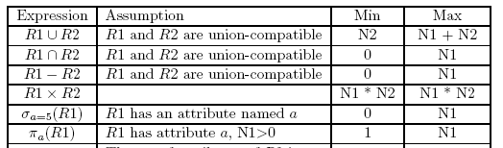
Exercise 4.2
Solution

Slide 39
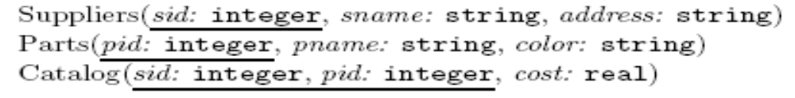
Exercise 4.4
Problem
Consider the Supplier-Parts-Catalog schema. State what the following queries compute:

Slide 40
Exercise 4.4
Problem
Find the Supplier names of the suppliers who supply a red part that costs less than 100 dollars.
Solution

Slide 41
Exercise 4.4
Problem
This Relational Algebra statement does not return anything because of the sequence of projection operators. Once the sid is projected, it is the only field in the set. Therefore, projecting on sname will not return anything.
Solution

Slide 42
Exercise 4.4
Problem
Find the Supplier names of the suppliers who supply a red part that costs less than 100 dollars and a green part that costs less than 100 dollars.
Solution

Slide 43
Exercise 4.4
Problem
Find the Supplier ids of the suppliers who supply a red part that costs less than 100 dollars and a green part that costs less than 100 dollars.
Solution

Slide 44
Exercise 4.4
Problem
Find the Supplier names of the suppliers who supply a red part that costs less than 100 dollars and a green part that costs less than 100 dollars.
Solution

Slide 45
Chapter 5: SQL, Null Values, Views
Concepts:
DML
DDL
Query
Nested Query
Aggregation

Slide 46
Exercise 5.2
Problem
Consider the following relational schema:
  Suppliers(sid: integer, sname: string, address: string)
  Parts(pid: integer, pname: string, color: string)
  Catalog(sid: integer, pid: integer, cost: real)
The Catalog relation lists the prices charged for parts by Suppliers. Write the following queries in SQL:

Slide 47
Exercise 5.2
Problem
  Suppliers(sid: integer, sname: string, address: string)
  Parts(pid: integer, pname: string, color: string)
  Catalog(sid: integer, pid: integer, cost: real)
For every supplier that only supplies green parts, print the name of the supplier and the total number of parts that she supplies.

Slide 48
Exercise 5.2
Solution for (10)
SELECT S.sname, COUNT(*) as PartCount
FROM Suppliers S, Parts P, Catalog C
WHERE P.pid = C.pid AND C.sid = S.sid
GROUP BY S.sname, S.sid
HAVING EVERY (P.color=’Green’)

Slide 49
Exercise 5.2
Problem
  Suppliers(sid: integer, sname: string, address: string)
  Parts(pid: integer, pname: string, color: string)
  Catalog(sid: integer, pid: integer, cost: real)
For every supplier that supplies a green part and a red part, print the name and price of the most expensive part that she supplies.

Slide 50
Exercise 5.2
Solution for (11)
SELECT S.sname, MAX(C.cost) as MaxCost
FROM Suppliers S, Parts P, Catalog C
WHERE P.pid = C.pid AND C.sid = S.sid
GROUP BY S.sname, S.sid
HAVING ANY ( P.color=’green’ ) AND ANY ( P.color = ’red’ )

Slide 51
Exercise 5.4
Problem
Consider the following relational schema. An employee can work in more than one department; the pct_time field of the Works relation shows the percentage of time that a given employee works in a given department.
  Emp(eid: integer, ename: string, age: integer, salary: real)
  Works(eid: integer, did: integer, pct_time: integer)
  Dept(did: integer, dname: string, budget: real, managerid: integer)
Write the following queries in SQL:

Slide 52
Exercise 5.4
Problem
  Emp(eid: integer, ename: string, age: integer, salary: real)
  Works(eid: integer, did: integer, pct_time: integer)
  Dept(did: integer, dname: string, budget: real, managerid: integer)
If a manager manages more than one department, he or she controls the sum of all the budgets for those departments. Find the managerids of managers who control more than $5 million.

Slide 53

Exercise 5.4
Solution for (6)

Slide 54
Exercise 5.4
Problem
  Emp(eid: integer, ename: string, age: integer, salary: real)
  Works(eid: integer, did: integer, pct_time: integer)
  Dept(did: integer, dname: string, budget: real, managerid: integer)
Find the managerids of managers who control the largest amounts.

Slide 55
Exercise 5.4
Solution for (7)
SELECT DISTINCT tempD.managerid
FROM (SELECT DISTINCT D.managerid,
SUM (D.budget) AS tempBudget
FROM Dept D
GROUP BY D.managerid ) AS tempD
WHERE tempD.tempBudget = (SELECT MAX (tempD.tempBudget)
FROM tempD)

Slide 56
Chapter 19: Normal Forms
Concepts:
Redundancy
Functional Dependency
BCNF
3NF

Slide 57
Exercise 19.2
Problem
Consider a relation R with five attributes ABCDE. You are given the following dependencies:
A → B, BC → E, and ED → A.
List all keys for R
Solution
CDE, ACD, BCD

Slide 58
Exercise 19.2
A → B, BC → E, and ED → A.
Problem
Is R in 3NF?
Solution
R is in 3NF because B, E and A are all parts of keys.

Slide 59
Exercise 19.2
A → B, BC → E, and ED → A.
Problem
Is R in BCNF?
Solution
R is not in BCNF because none of A, BC and ED contain a key.

Slide 60
Exercise 19.8
Problem 1
Consider the attribute set R = ABCDEGH and the FD set F =
  {AB → C,
  AC → B,
  AD → E,
  B → D,
  BC → A,
  E → G}.

Slide 61
Exercise 19.8
Problem 1
For each of the following attribute sets, do the following:
  (i) Compute the set of dependencies that hold over the set and write down a minimal cover.
  (ii) Name the strongest normal form that is not violated by the relation containing these attributes.
  (iii) Decompose it into a collection of BCNF relations if it is not in BCNF.

Slide 62
Exercise 19.2
F = {AB →C, AC → B, AD → E, B → D, BC → A, E → G}.
Problem
ABC
Solution
R1 = ABC: The FD’s are AB → C, AC → B, BC → A.
This is already a minimal cover.
This is in BCNF since AB, AC and BC are candidate keys for R1. (In fact, these are all the candidate keys for R1).

Slide 63
Exercise 19.2
F = {AB →C, AC → B, AD → E, B → D, BC → A, E → G}.
Problem
ABCD
Solution
R2 = ABCD: The FD’s are AB → C, AC → B, B → D, BC → A.
This is already a minimal cover.
The keys are: AB, AC, BC. R2 is not in BCNF or even 2NF because of the FD, B → D (B is a proper subset of a key!) However, it is in 1NF. Decompose as in: ABC, BD. This is a BCNF decomposition.

Slide 64
This is the end of the lecture!
I hope you enjoyed it.

