Slide 1


The Shield Option
Derivatives and Structured Products
Ervin Gan
Francesc Naya
Jahja Rrustemi

Slide 2
The Product
‘Variable’ coupons
Linked to the average credit rating of an industry
Payoff increases when perceived credit risk rises → Rating rises
Attractive product to hedge against this risk

Slide 3
The Underlying – The “Industry Rating”
Converted Ratings
S&P ratings converted to numerical values
Industry Rating: average rating of a basket of 60
companies from the same industry

Slide 4
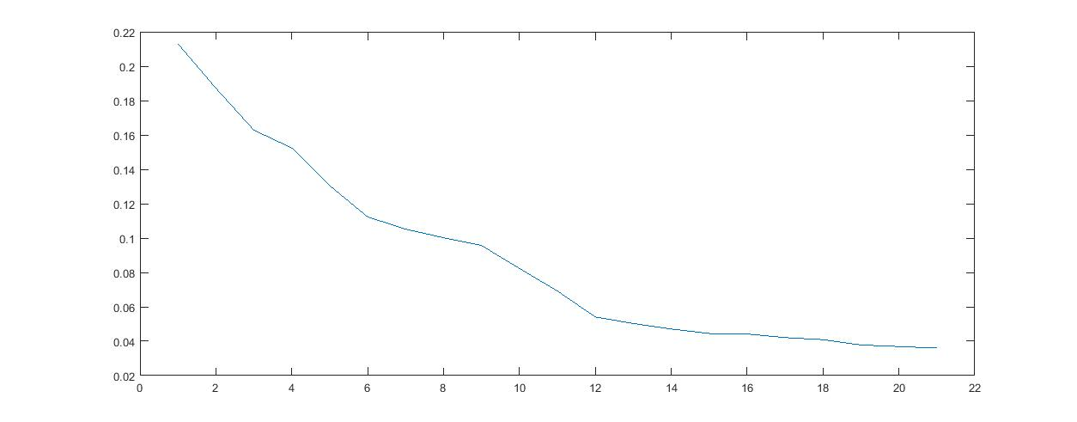
Payoff Structure – Yields & Ratings
Yields & Ratings
Maturity (T) of 5 years
Compute an average yield of corporate bonds
with same rating

Slide 5
Payoff Structure – Yield Spreads & Ratings
Payoffs
 | AAA | AA+ | AA- | A+ | A | A- | BBB+ | BBB | BBB- | BB+ | BB | BB- | B+ | B | B- | CCC+ | CCC | CCC- | CC | C | D
AAA | 0
AA+ | 0.09 | 0
AA- | 0.18 | 0.09 | 0
A+ | 0.49 | 0.4 | 0.31 | 0
A | 0.82 | 0.73 | 0.64 | 0.33 | 0
A- | 0.85 | 0.76 | 0.67 | 0.36 | 0.03 | 0
BBB+ | 1.11 | 1.02 | 0.93 | 0.62 | 0.29 | 0.26 | 0
BBB | 1.43 | 1.34 | 1.25 | 0.94 | 0.61 | 0.58 | 0.32 | 0
BBB- | 1.61 | 1.52 | 1.43 | 1.12 | 0.79 | 0.76 | 0.5 | 0.18 | 0
BB+ | 1.81 | 1.72 | 1.63 | 1.32 | 0.99 | 0.96 | 0.7 | 0.38 | 0.2 | 0
BB | 3.32 | 3.23 | 3.14 | 2.83 | 2.5 | 2.47 | 2.21 | 1.89 | 1.71 | 1.51 | 0
BB- | 4.63 | 4.54 | 4.45 | 4.14 | 3.81 | 3.78 | 3.52 | 3.2 | 3.02 | 2.82 | 1.31 | 0
B+ | 5.97 | 5.88 | 5.79 | 5.48 | 5.15 | 5.12 | 4.86 | 4.54 | 4.36 | 4.16 | 2.65 | 1.34 | 0
B | 6.42 | 6.33 | 6.24 | 5.93 | 5.6 | 5.57 | 5.31 | 4.99 | 4.81 | 4.61 | 3.1 | 1.79 | 0.45 | 0
B- | 6.92 | 6.83 | 6.74 | 6.43 | 6.1 | 6.07 | 5.81 | 5.49 | 5.31 | 5.11 | 3.6 | 2.29 | 0.95 | 0.5 | 0
CCC+ | 7.63 | 7.54 | 7.45 | 7.14 | 6.81 | 6.78 | 6.52 | 6.2 | 6.02 | 5.82 | 4.31 | 3 | 1.66 | 1.21 | 0.71 | 0
CCC | 9.45 | 9.36 | 9.27 | 8.96 | 8.63 | 8.6 | 8.34 | 8.02 | 7.84 | 7.64 | 6.13 | 4.82 | 3.48 | 3.03 | 2.53 | 1.82 | 0
CCC- | 11.6 | 11.6 | 11.5 | 11.2 | 10.8 | 10.8 | 10.5 | 10.2 | 10 | 9.83 | 8.32 | 7.01 | 5.67 | 5.22 | 4.72 | 4.01 | 2.19 | 0
CC | 12.7 | 12.6 | 12.5 | 12.2 | 11.9 | 11.8 | 11.6 | 11.3 | 11.1 | 10.9 | 9.36 | 8.05 | 6.71 | 6.26 | 5.76 | 5.05 | 3.23 | 1.04 | 0
C | 15.1 | 15 | 14.9 | 14.6 | 14.3 | 14.3 | 14 | 13.7 | 13.5 | 13.3 | 11.8 | 10.5 | 9.15 | 8.7 | 8.2 | 7.49 | 5.67 | 3.48 | 2.44 | 0
D | 17.7 | 17.6 | 17.5 | 17.2 | 16.9 | 16.9 | 16.6 | 16.3 | 16.1 | 15.9 | 14.4 | 13.1 | 11.7 | 11.3 | 10.8 | 10.1 | 8.25 | 6.06 | 5.02 | 2.58 | 0
Payoff: Difference between
the yield spreads when
the rating at T is lower
than its initial value
Optional: Derivative with
barriers

Slide 6
Target Clients
HEDGERS | SPECULATORS
Protect against the increase of the perceived credit risk of an overal company Companies from the industry and other stakeholders | Make profits by betting on the future risk of the industry or mispricing issues Investment banks, hedge funds, wealth managers, asset managers…
We can clear the market when they take opposite positions

Slide 7
Pricing - Data
60 companies in the industrials sector from Bloomberg between 1994 and 2015
45 investment grade companies and 15 high yield companies
CDS spread for each credit rating from Bloomberg

Slide 8
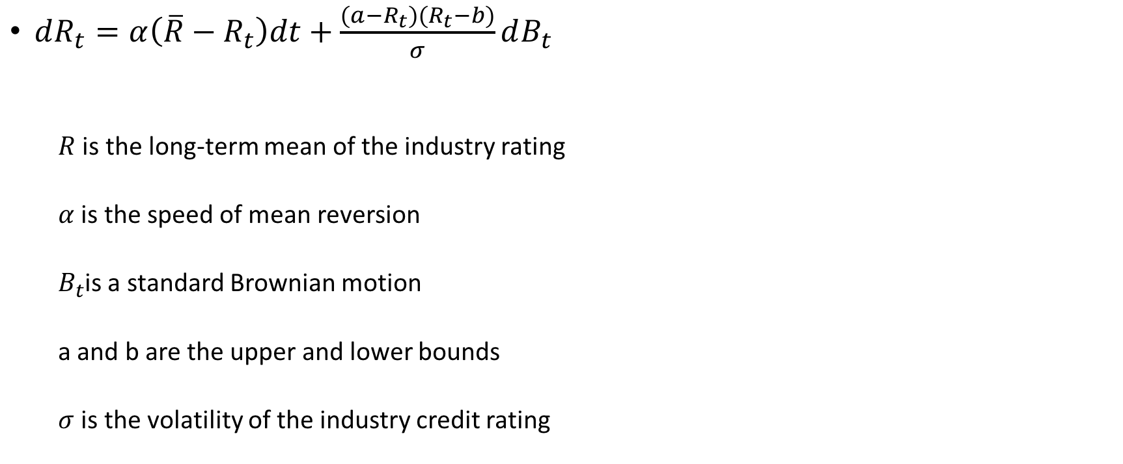
Pricing – Process Description
$dR_{t}=α\left(\overline{R}−R_{t}\right)dt+\frac{(a−R_{t})(R_{t}−b)}{σ}dB_{t}$
$R$ is the long-term mean of the industry rating
$α$ is the speed of mean reversion
$B_{t}$is a standard Brownian motion
a and b are the upper and lower bounds
$σ$ is the volatility of the industry credit rating

Slide 9

Pricing – Process Description
The process under $ℚ$:
$dR_{t}=α\left(θ−R_{t}\right)dt+\frac{(a−R_{t})(R_{t}−b)}{σ}dB_{t}^{ℚ}$
where $θ= \overline{R}− \frac{\left(a−R_{t}\right)\left(R_{t}−b\right)}{σ}∗ \frac{δ}{α}$
$δ$ is the market price of risk

Slide 10
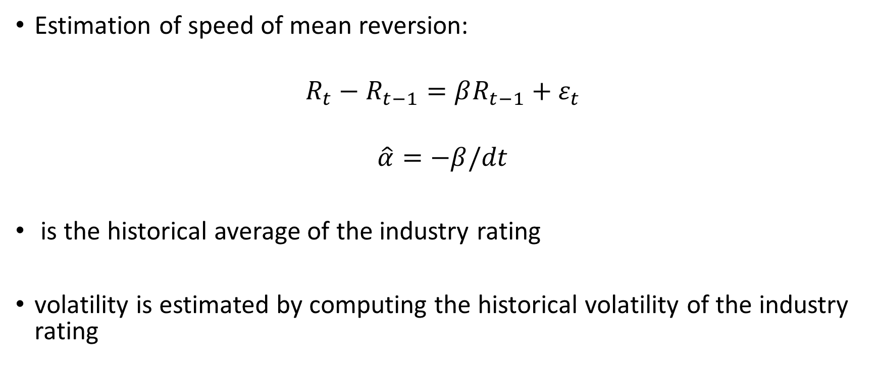
Pricing – Estimation of the Parameters
Estimation of speed of mean reversion:
$$R_{t}−R_{t−1}=βR_{t−1}+ε_{t}$$
$$\hat{α}=−β/dt$$
is the historical average of the industry rating
volatility is estimated by computing the historical volatility of the industry rating

Slide 11
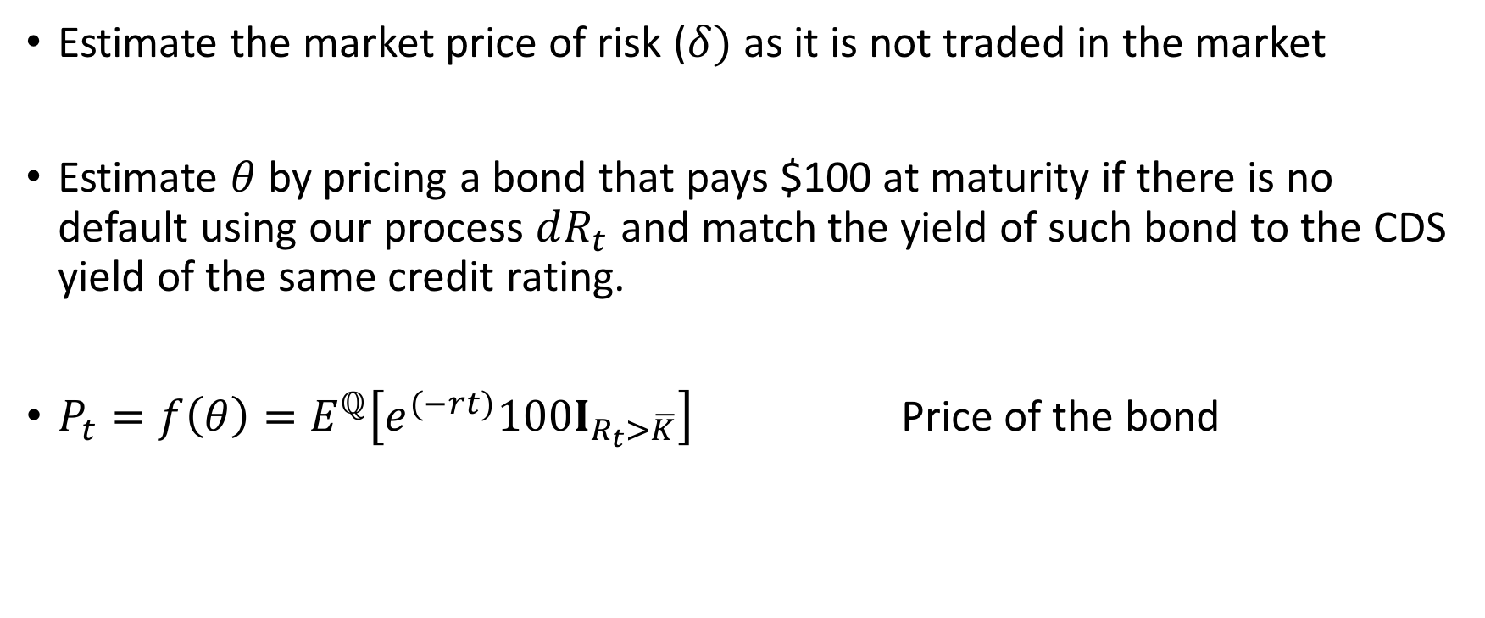
Pricing – Estimation of the Parameters
Estimate the market price of risk ($δ)$ as it is not traded in the market
Estimate $θ$ by pricing a bond that pays $100 at maturity if there is no default using our process $dR_{t}$ and match the yield of such bond to the CDS yield of the same credit rating.
${P_{t}=f\left(θ\right)=E}^{ℚ}\left[e^{(−rt)}100I_{R_{t}>\overline{K}}\right]$ Price of the bond

Slide 12
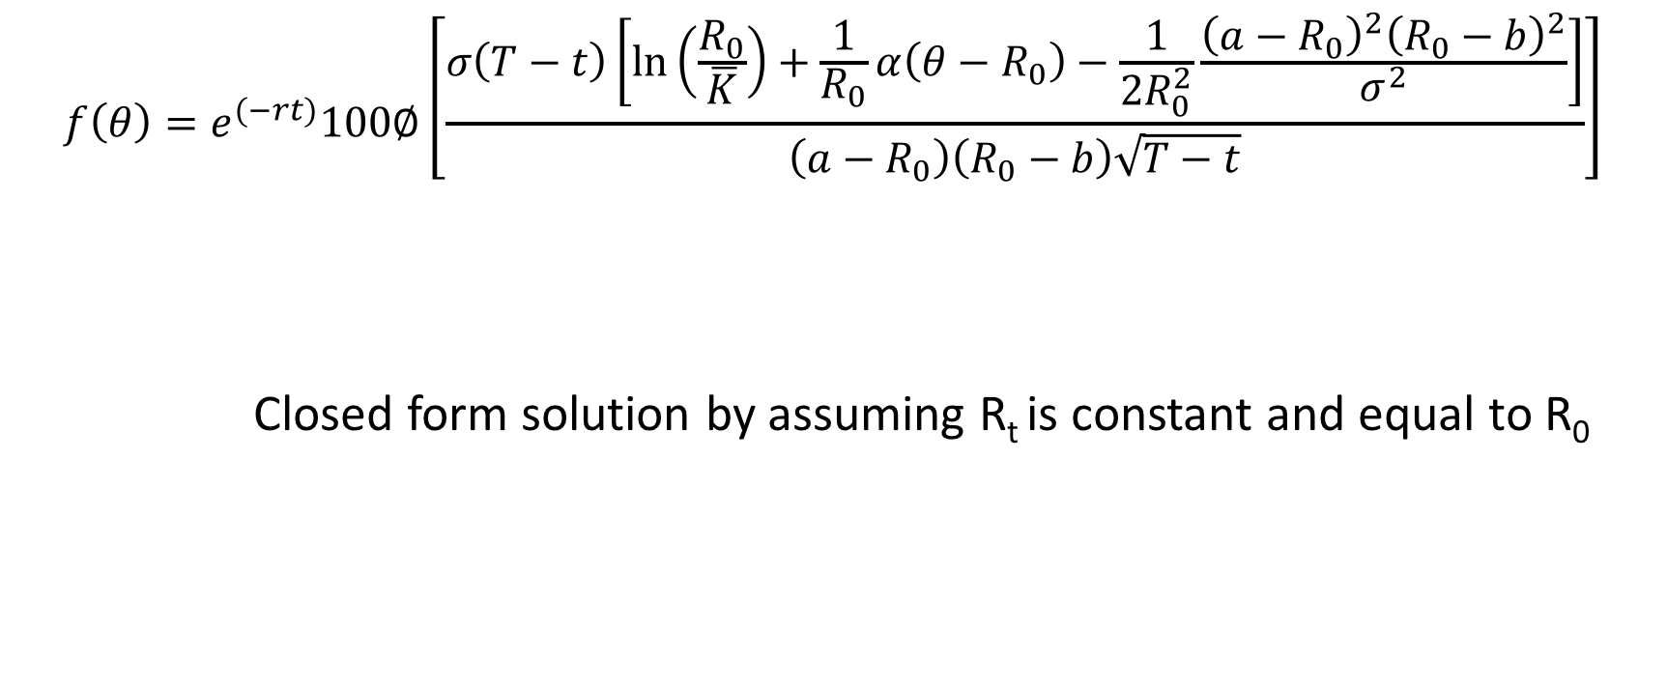
Pricing - Methodology
$$f\left(θ\right)=e^{\left(−rt\right)}100∅\left[\frac{σ\left(T−t\right)\left[\ln\left(\frac{R_{0}}{\overline{K}}\right)+\frac{1}{R_{0}}α\left(θ−R_{0}\right)−\frac{1}{{2R}_{0}^{2}}\frac{{\left(a−R_{0}\right)}^{2}{\left(R_{0}−b\right)}^{2}}{σ^{2}}\right]}{\left(a−R_{0}\right)\left(R_{0}−b\right)\sqrt{T−t}}\right]$$
Closed form solution by assuming R_{t} is constant and equal to R₀

Slide 13

Pricing - Methodology
The yield is equal to:
$f\left(θ\right)∗\exp\left(yield∗T\right)=100$ yield = $\frac{ln\left(\frac{100}{f\left(θ\right)}\right)}{T}$
Match numerically this yield with the CDS spread yield until the good $θ$ is found

Slide 14
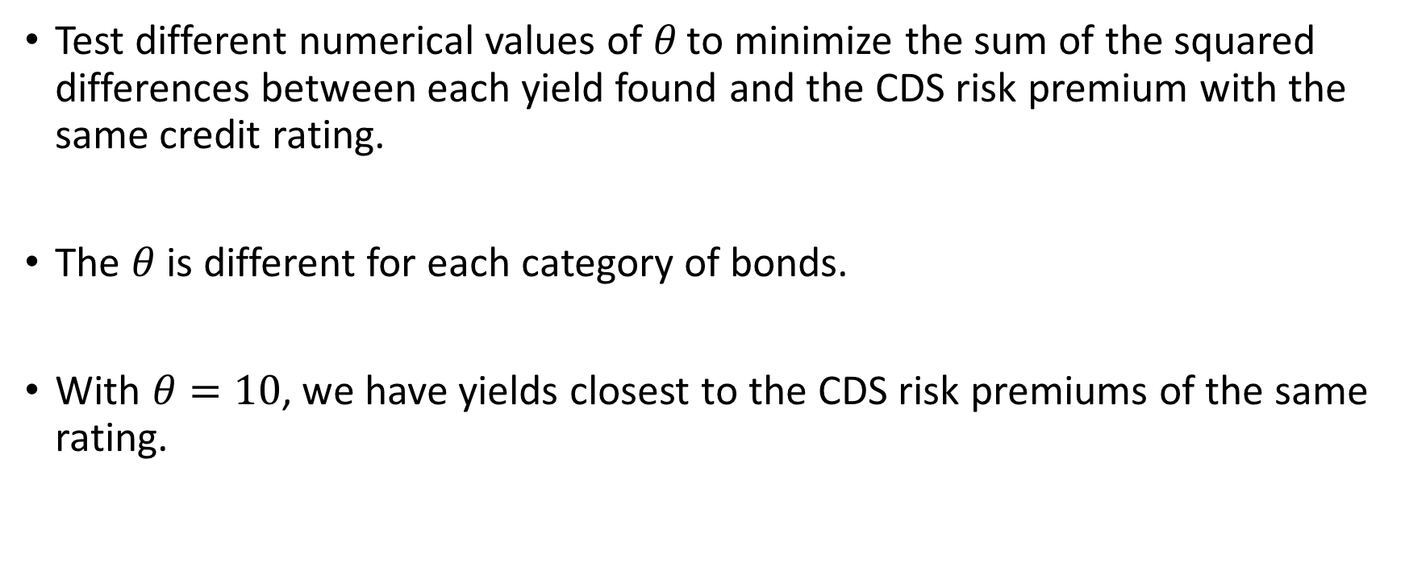
Pricing - Methodology
Test different numerical values of $θ$ to minimize the sum of the squared differences between each yield found and the CDS risk premium with the same credit rating.
The $θ$ is different for each category of bonds.
With $θ=10$, we have yields closest to the CDS risk premiums of the same rating.

Slide 15

Monte-carlo simulation
Discretization of the process:
$$R_{t+h}=R_{t}+α\left(θ−R_{t}\right)h+\frac{\left(a−R_{t}\right)\left(R_{t}−b\right)}{σ}\sqrt{h}Z$$
Number of steps = 60
Number of simulations = 1000

Slide 16
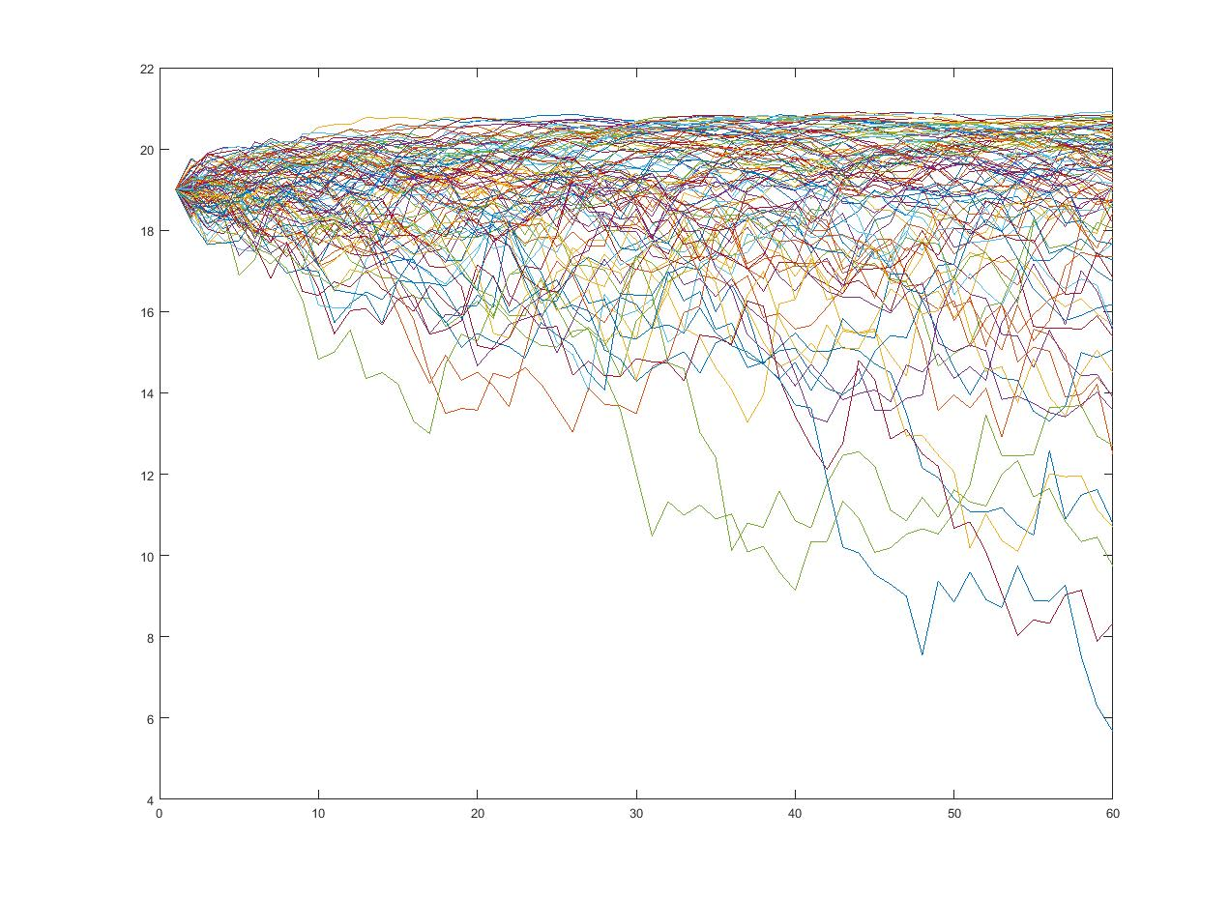

Slide 17
Pricing - Results
We create six categories of the option, according to the initial industry rating
Price of each category

Slide 18
Pricing - Results
Options with different levels of protection
Initial rating: AAA
Initial rating: A
Initial rating: BBB
Initial rating: BB

Slide 19
Hedging Strategy
The deltas differ depending on the initial rating
There are two issues when delta hedging:
Our underlying is not a traded instrument → Use bonds or CDSs index as a proxy
Bonds and CDSs do not behave exactly according to changes in credit ratings
Hedge by taking offsetting positions

Slide 20
Conclusions
Our derivative compensates the agent for the increased cost of capital following a downgrade in the credit rating
Two effects found in the prices of the derivative:
Chance of default
Set of payoffs
There may be low dependence between the industry rating and ratings at the company level → Difficult to know when to buy the derivative

