Slide 1

Squid Software Systems
Barge Brain
Introduction
Rotterdam, 19 February 2026

Slide 2
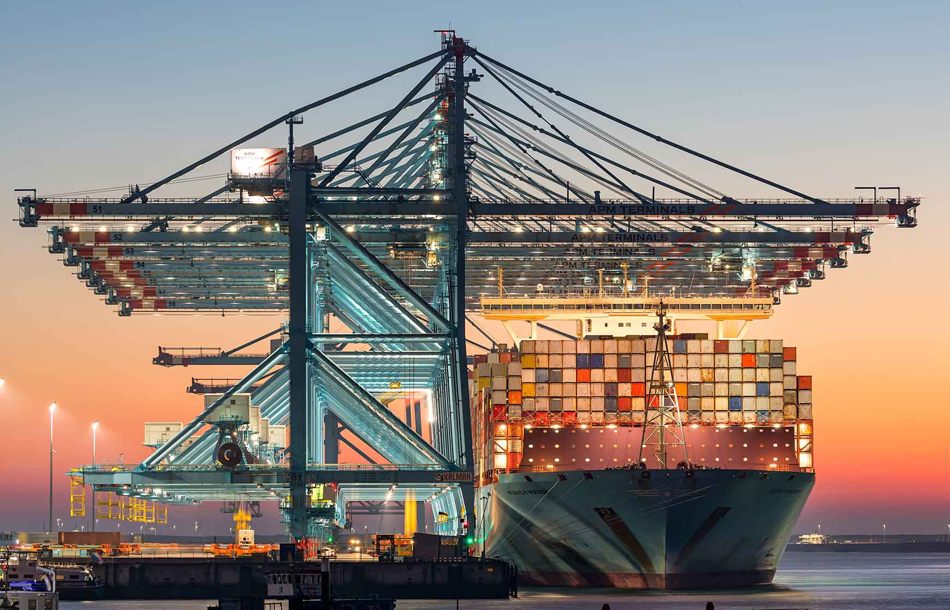
Notes:
What do you guys know about container logistics?

Slide 3
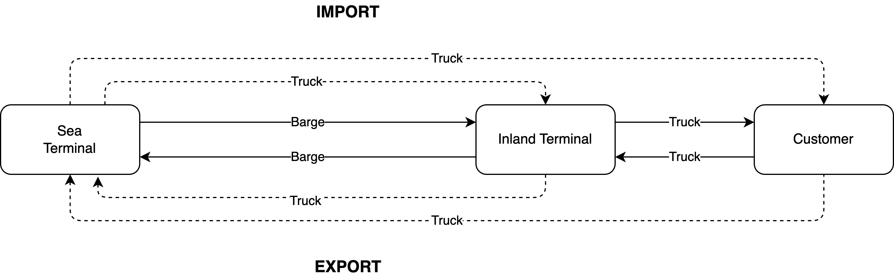
Inland container logistics
Notes:
Typical round trip of a container.
Omitting rail on purpose.
Do a Google Maps zoom of terminal locations

Slide 4
Inland container logistics
Pickup window
Delivery datetime
Cargo window
Notes:
Typical round trip of a container.
Omitting rail on purpose.
Do a Google Maps zoom of terminal locations

Slide 5
Planning puzzle
Capacity:
Barges
Cargo capacity (TEU, weight, …
Existing schedule
Reserved slots
Terminals
Handling capacity
Stacking capacity
Waterways:
Bridges
Obstructions
Currents
Demand:
Containers:
Origin
Destination
Size
Weight
Hazmat
Reefer
Pickup window
Delivery datetime
Cargo window

Slide 6
What’s a good planning?
Optimise over multiple factors:
Maximise transport capacity utilisation
Maximise on-time performance
Minimise cost
Minimise emissions
Maximise shipper satisfaction
Notes:
Note: Trucks pick up the slack!

Slide 7
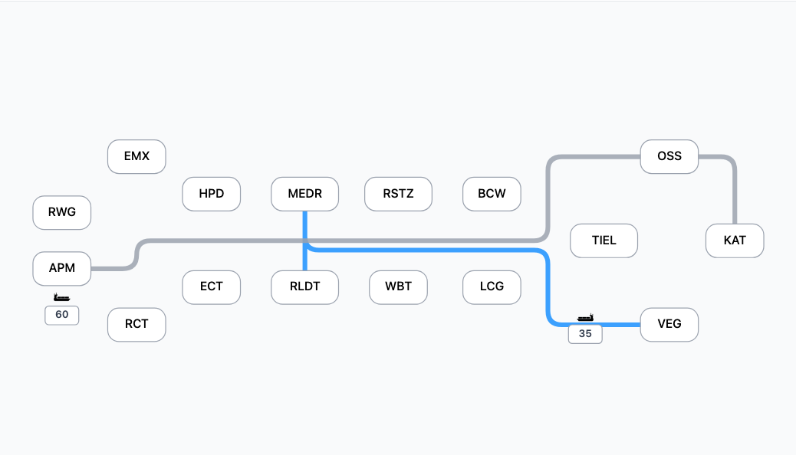
Network of Van Berkel Logistics
Notes:
Fleet size:
- 4 inland terminals
- 9 barges
- 100 trucks
Serving 10+ terminals in Rotterdam and Antwerp

Slide 8
What’s our problem?
Hard to obtain the current status of operations
Lack of insight of what barge goes where
Hard to find out what the effects are of a delay
Hard to detect when things are (about to go) wrong
Convoluted planning process:
Decisions are based on filtering containers
No easy insight in capacity utilisation between terminals
No easy insight in containers that are at the wrong terminals
Difficult to work with transfers over a hub
Notes:
Van Berkel runs on a legacy ERP system that does not really do a good job at supporting their operational processes.

Slide 9
Terminology
Rotation | Incoming + outgoing voyage. Used to communicate estimated arrival and departure times to the port authority.
Voyage | Either incoming or outgoing. Defined as Rotterdam to a single inland terminal (incoming) and vice versa (outgoing)
Voyage elements | Other inland terminals you may visit during your voyage
Barge visits | Terminals at the port you intend to visit
Incoming voyage | RTM | TIEL | KAT | OSS
Outgoing voyage |  |  | KAT | OSS | TIEL | RTM

Slide 10
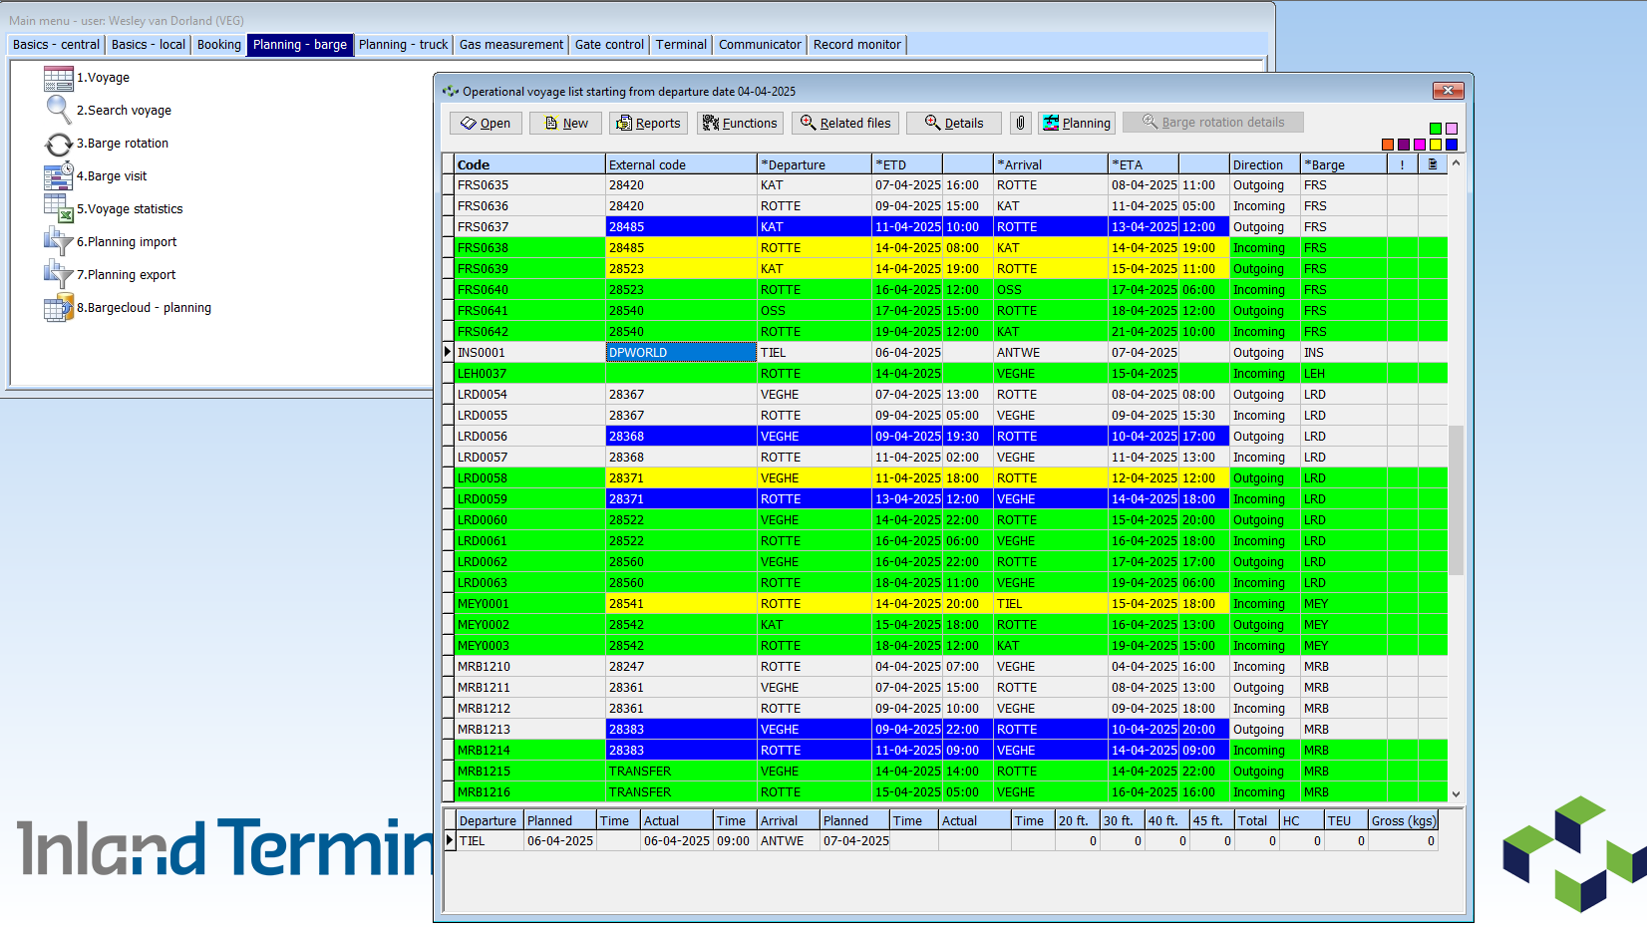
Voyage list

Slide 11
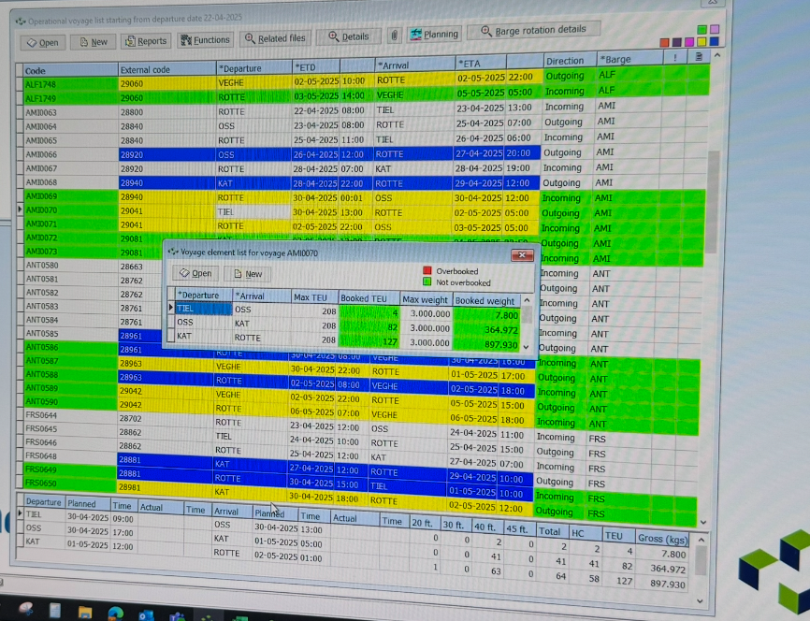
Voyage element list

Slide 12
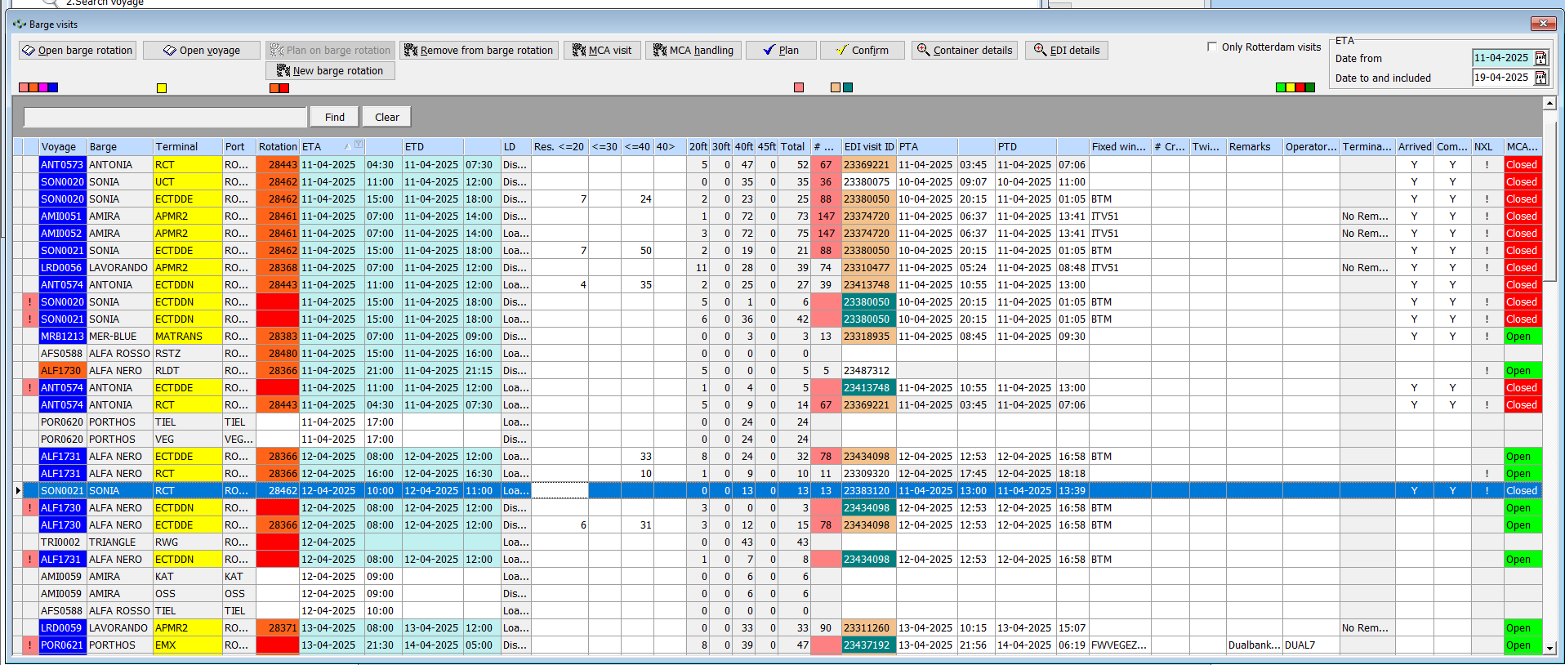
Barge visits

Slide 13
Somehow we need to track which barge is meant to do what when at which location and keep track of what we still need to do

Slide 14
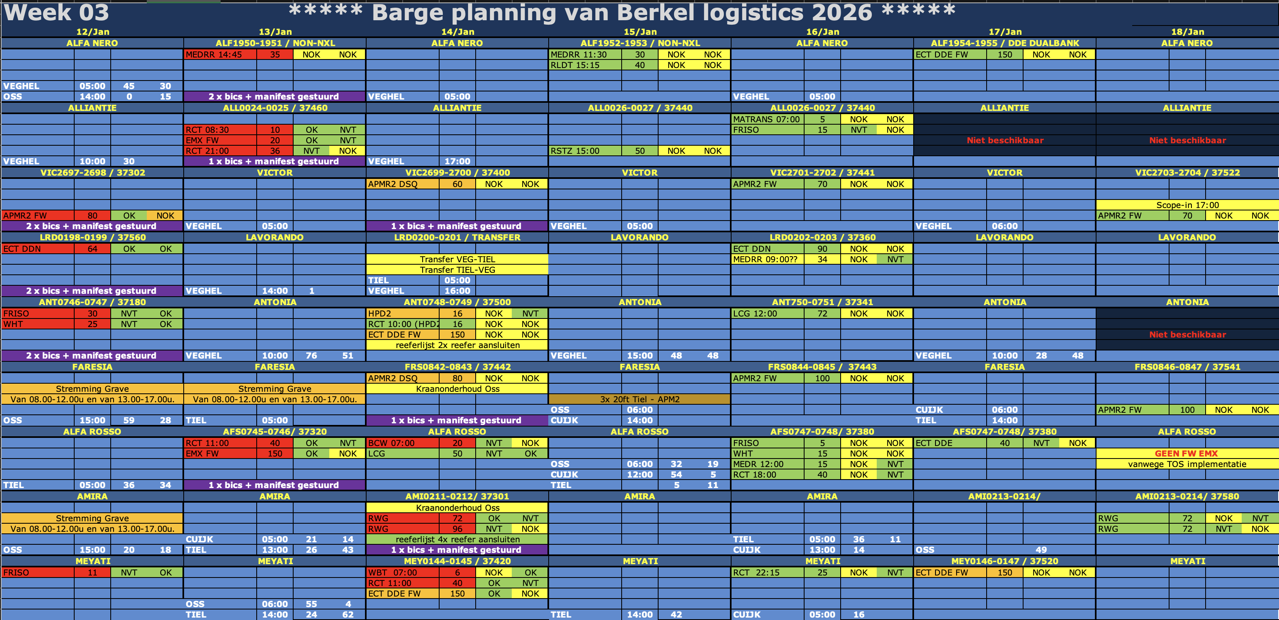
Notes:
So the planners came up with this

Slide 15
What’s in that Excel
Barges
Barge availability
Terminals to visit
Expected arrivals
Number of containers to discharge
Number of containers to load
Whether load/discharge lists are OK or NOK
Whether BICS + Manifest + Reefer list are send to the shipper
Obstructions in the waterway
Problems at terminals
Notes:
None of it is automated
Error prone
Logistics is dynamic!

Slide 16
Problem 2: Planning
Container based planning
Schedule based planning
Network planning

Slide 17
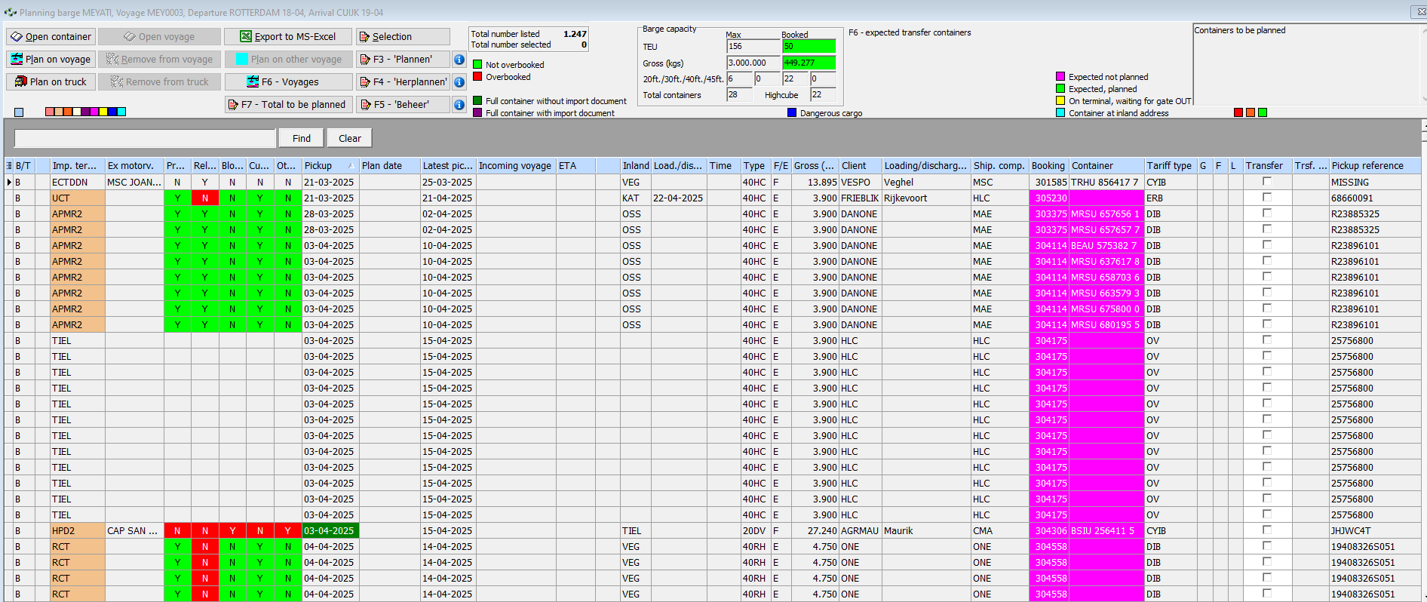
Incoming container list

Slide 18
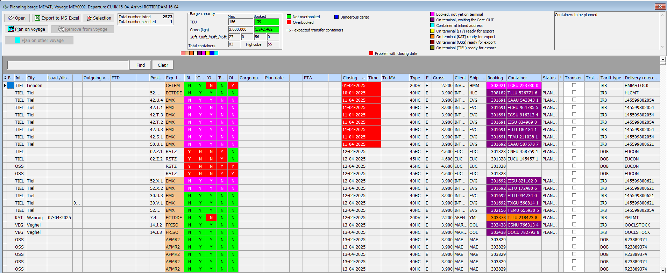
Outgoing container list

Slide 19
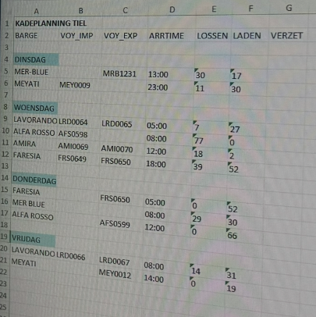
But about terminal capacity?

Slide 20
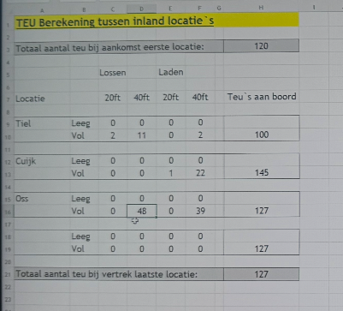
How to optimise capacity utilisation?

Slide 21
But what about transfers?
Incoming voyage | RTM | TIEL | KAT | OSS
Outgoing voyage |  |  | KAT | OSS | TIEL | RTM

Slide 22
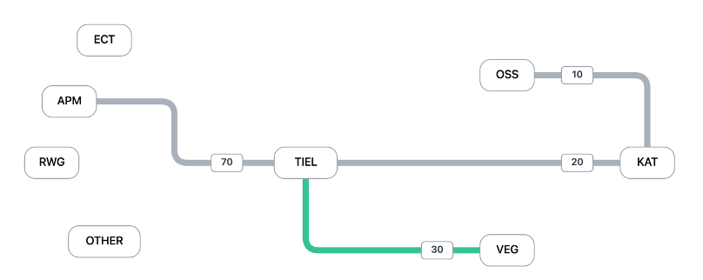
TIEL serving as a hub

Slide 23
Remember this?
Incoming voyage | RTM | TIEL | KAT | OSS
Outgoing voyage |  |  | KAT | OSS | TIEL | RTM

Slide 24
Solution Fake trucks…
Incoming voyage | RTM | TIEL | KAT | OSS
Outgoing voyage |  |  | KAT | OSS | TIEL | RTM

Slide 25
And then the world changes…
NextLogic is in charge of slot times
Ocean liners may arrive early or late
Bad weather causes terminals to close
Waterway obstructions
Problems at terminals
Changes in delivery times

Slide 26
Your assignment
1. Help planners understand the status of their network
2. Help planners to identify where intervention is needed
3. Help planners deal with change
(4. Help planners plan and optimise their planning)
(5. Propose what to do next)
(6. Demonstrate robustness to change)
Notes:
Convert raw data to something more sensible?

