Slide 1
Forms
Angular forms are used to handle user's input. We can use Angular form in our application to enable users to log in, to update profile, to enter information, and to perform many other data-entry tasks

Slide 2
Angular forms
There are 2 types of forms in angular
Template-driven forms – most of the code are written in component template
Easy to use and similar to angularjs forms
Provide Two way data binding with ngmodel directive
Bulky html and minimal component code.
Unit testing is challenging
Readability decreases with complex forms validation
Reactive forms – most of the code is written in component class.
No 2 way binding
Well suited for complex scenaiors
Dynamic form fields
Custom validations
So when complex forms to be developed & need unit testing then go with reactive forms.

Slide 3
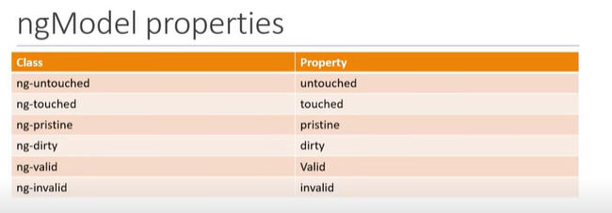
Template Driven forms
We need to create reference for the form using ngform #userFom="ngForm"
There are different properties with form available in angular to check errors
The control has been visited (if ture- ng-touched else ng-untoched)
The controls value has changed (if true ng-dirty else ng-pristine)
The controls value is valid (if true ng-valid else ng-invalid)
To use template driven form we need to import FormsModule in angular application.
Reactive forms
We need to import ReactiveFormsModule
In component we need import FormControl, FormGroup to work with forms
Other way we can create form is using FormBuilder
And to create dynamic form we use FormArray
Validators is used to have validation in reactive forms
AbstractControl is used to create custom validation

