Slide 1
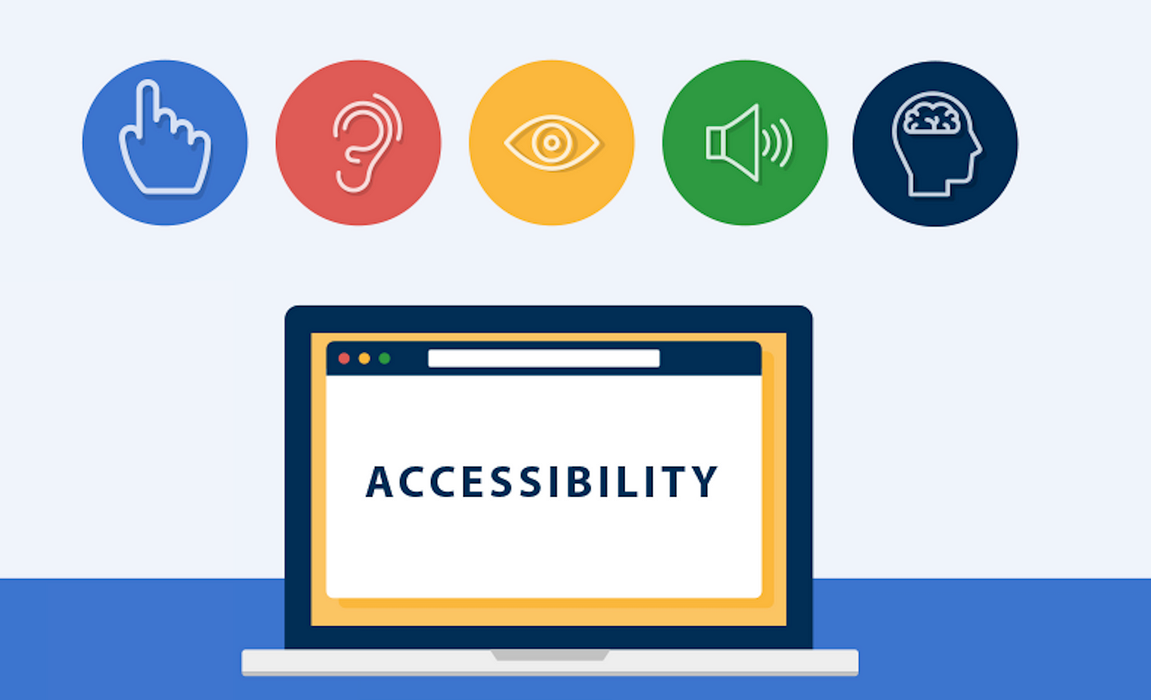
Agenda
What is Accessibility?
Tools to validate accessibility?
Keyboard Navigation?
Colors & Contrast?
Page Structure?
Some Common types of Accessibility Issue?
Solution for Common Accessibility Issue?
By Vijay Kumar: Senior Associate Front-end

Slide 2
What is Accessibility?
The goal of accessibility is to ensure that individuals with disabilities have equal access to information and functionality online, just as those without disabilities do. It involves removing barriers and providing accommodations to enable people with disabilities to perceive, understand, navigate, and interact with digital content effectively.
Accessibility also called A11y
Web Content Accessibility Guidelines (WCAG) provide a set of internationally recognized standards for web accessibility. These guidelines cover various aspects, including text alternatives for non-text content (like images), keyboard navigation, clear and consistent navigation, and more.

Slide 3
Tools to validate accessibility?
There are various tools, extension and website to test the accessibility of the website. Some of they are mentioned below.
Web Evaluation Tool (Google Chrome Extension)
Accessibility Insights for Web (Google Chrome Extension)
Achecker (Website url: https://achecks.org/checker/)

Slide 4
Keyboard Navigation?
Many people with disabilities, as well as some users without disabilities, use keyboards as their primary means of interacting with the web. Here are key considerations for keyboard navigation in accessibility:
Keyboard Focus
Logical Tab Order
Interactive Elements
Keyboard Shortcuts
Forms and Form Fields
ARIA Roles and Attributes

Slide 5
Colors & Contrast ?
Color and contrast play a crucial role in web accessibility. They are essential factors in ensuring that digital content, including websites and applications, can be used effectively by individuals with visual impairments and other disabilities.
We can verify Color and Contrast from below website url.
Color & Contrast Checker URL: https://webaim.org/resources/contrastchecker/

Slide 6
Page Structure?
A well-structured page ensures that users, including those with disabilities, can easily navigate, understand, and interact with the content. Here are key considerations for page structure in accessibility.
Use heading elements (h1, h2, h3, etc.) to outline the structure of your page. The <h1> element should represent the main heading of the page, followed by subheadings using <h2>, <h3>, and so on, as needed.
Semantic HTML Elements
Accessible Form Structure
Accessible Tables
Responsive Design
Logical Reading Order / Logical Tab Order
Consistent Navigation

Slide 7
Some Common Type of Accessibility Issue?
Language missing or invalid
Contrast Error
Alternative text missing
Empty heading
Empty button
Missing form label & Empty
Form Label
Empty link
Linked image missing alternative text
Spacer image missing alternative text
Missing form label(Google Captcha)

Slide 8
Solution for Common types of Accessibility Issue?
I have created a live demo of solution common type of accessibility issue. Will provide demo of it one by one.
Solution Code Repo URL: https://github.com/ervkgithub/web-accessibility

Slide 9
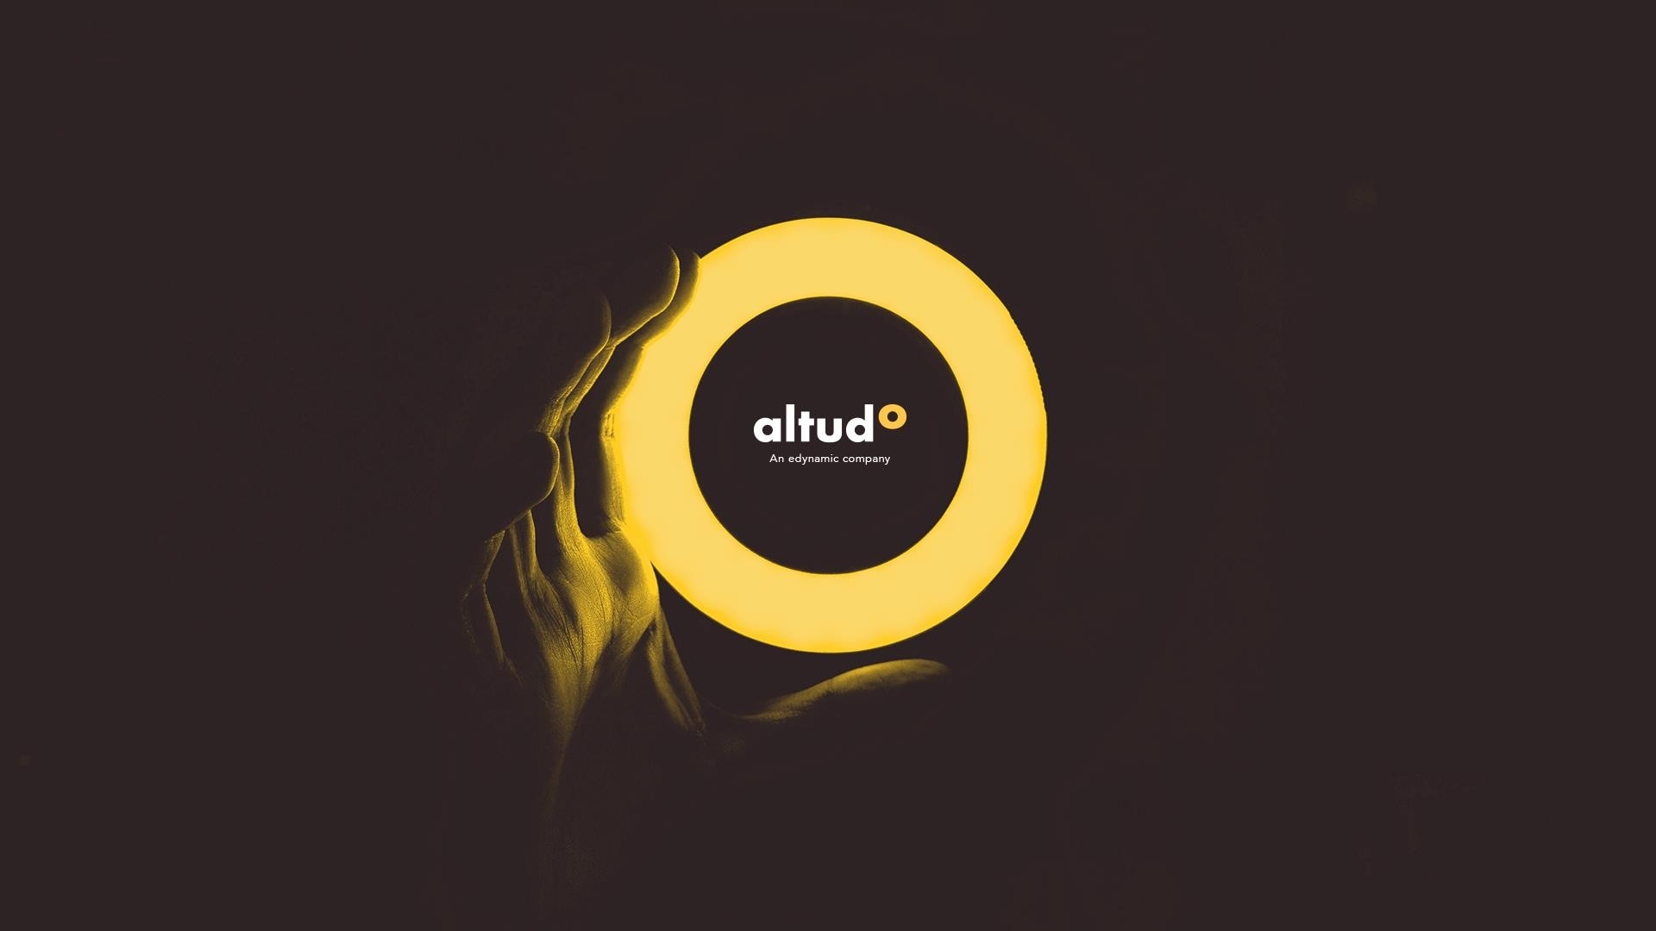


Thank You
Thank You
39
39

