Slide 1
PhD report > Figures
Erwan SCHILD

Slide 2
example-dataset

Slide 3
example-clustering

Slide 4
example-sampling

Slide 5
example-constraints-transitivity-must-link
(a)
(b)
(c)

Slide 6
example-constraints-transitivity-cannot-link
(a)
(b)
(c)

Slide 7
example-constraints-transitivity
(1)
(2)
(a)
(a)
(b)
(b)
(c)
(c)
(3)
(4)
(a)
!
(b)
(c)

Slide 8
example-constraints-components

Slide 9
example-constraints-conflict
(a)
!
(b)
(c)

Slide 10
example-constraints

Slide 11
example-constrained-clustering

Slide 12
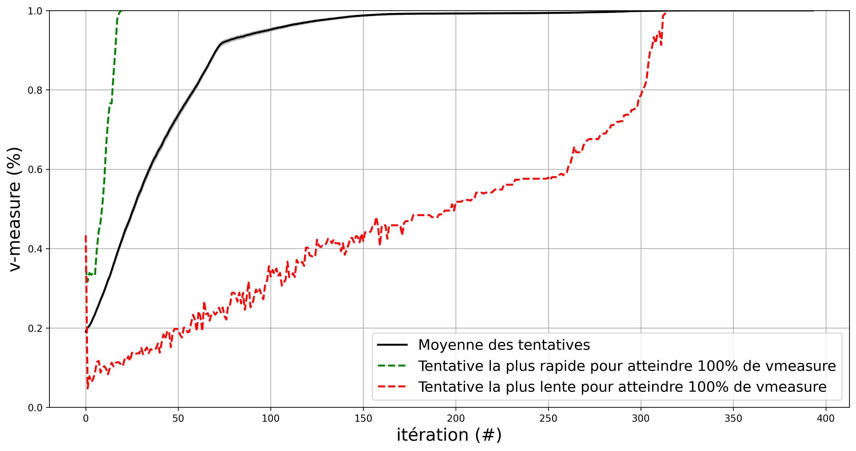
etude-convergence-evolution-moyenne-0par-iteration

Slide 13
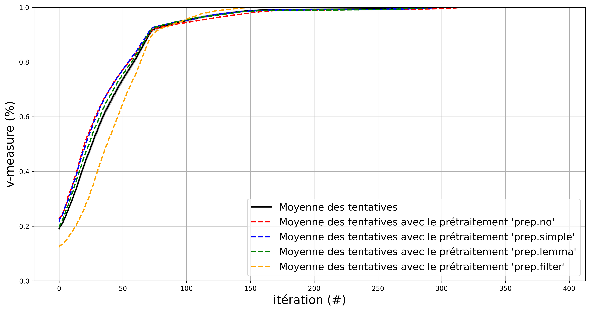
etude-convergence-evolution-moyenne-1preprocessing-par-iteration

Slide 14
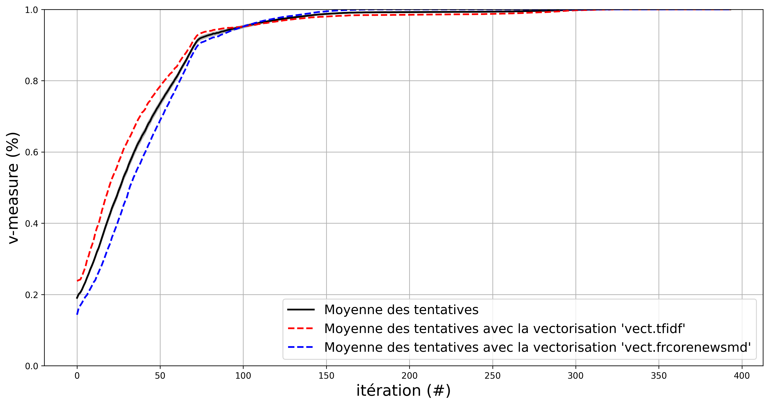
etude-convergence-evolution-moyenne-2vectorization-par-iteration

Slide 15
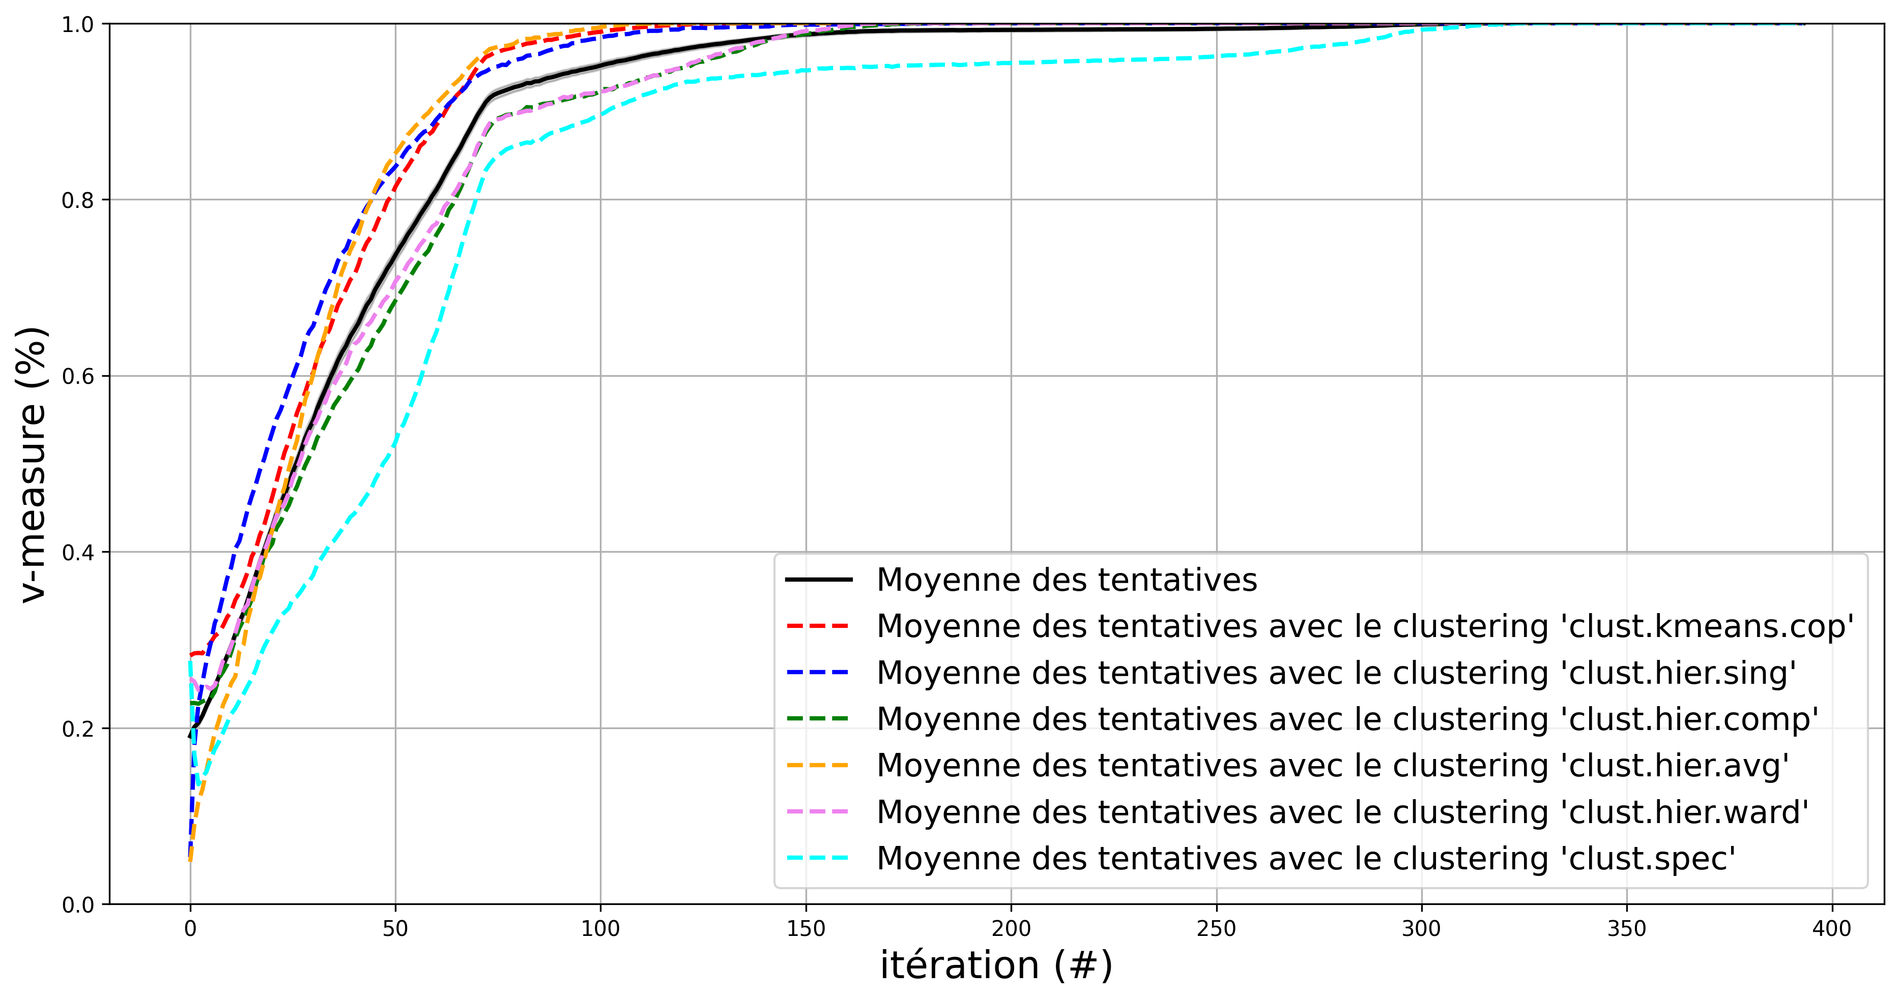
etude-convergence-evolution-moyenne-3clustering-par-iteration

Slide 16
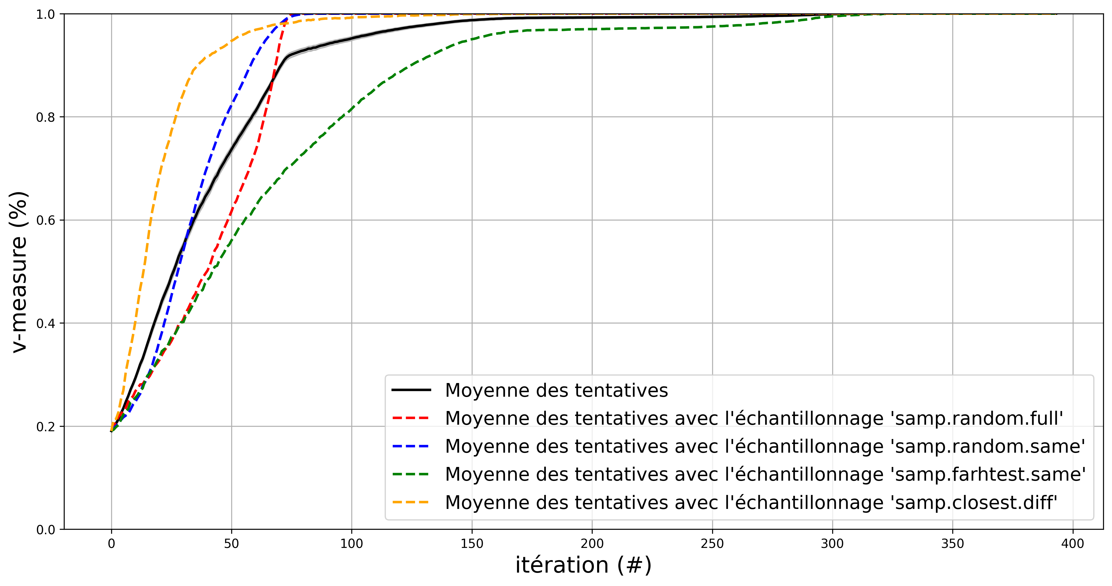
etude-convergence-evolution-moyenne-4sampling-par-iteration

Slide 17
etude-convergence-evolution-moyenne-par-iteration-par-facteur
(1)
(2)
(3)
(4)

