Slide 1
Interactive Clustering GUI > Figures
Erwan SCHILD

Slide 2
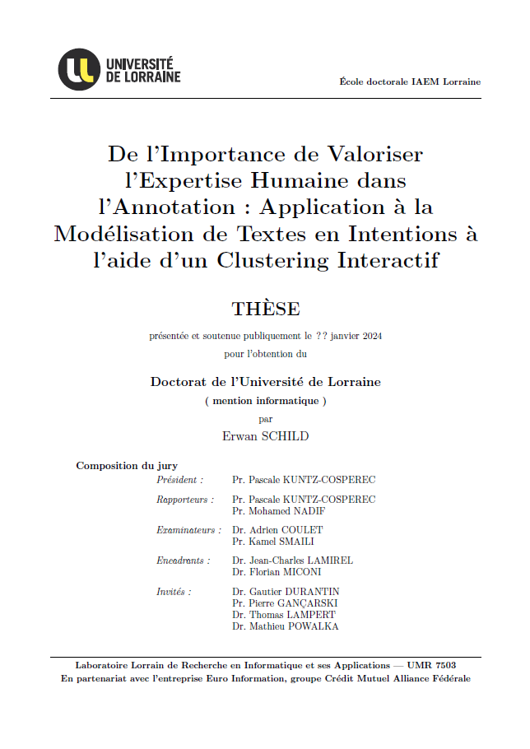
phd-report-first-page

Slide 3
interactive-clustering-comparative-study
performance
(vmeasure)
groundtruth
(1b) Efficiency
(optimization)
(1a) Effectiveness
(convergence)
(7,8,9) Robustness
(error simulation)
(5) Relevance
(business value)
(6) Rentability
(benefits vs costs)
iterations
(nb of annotations)
(2,3,4) Cost
(needed time)

Slide 4
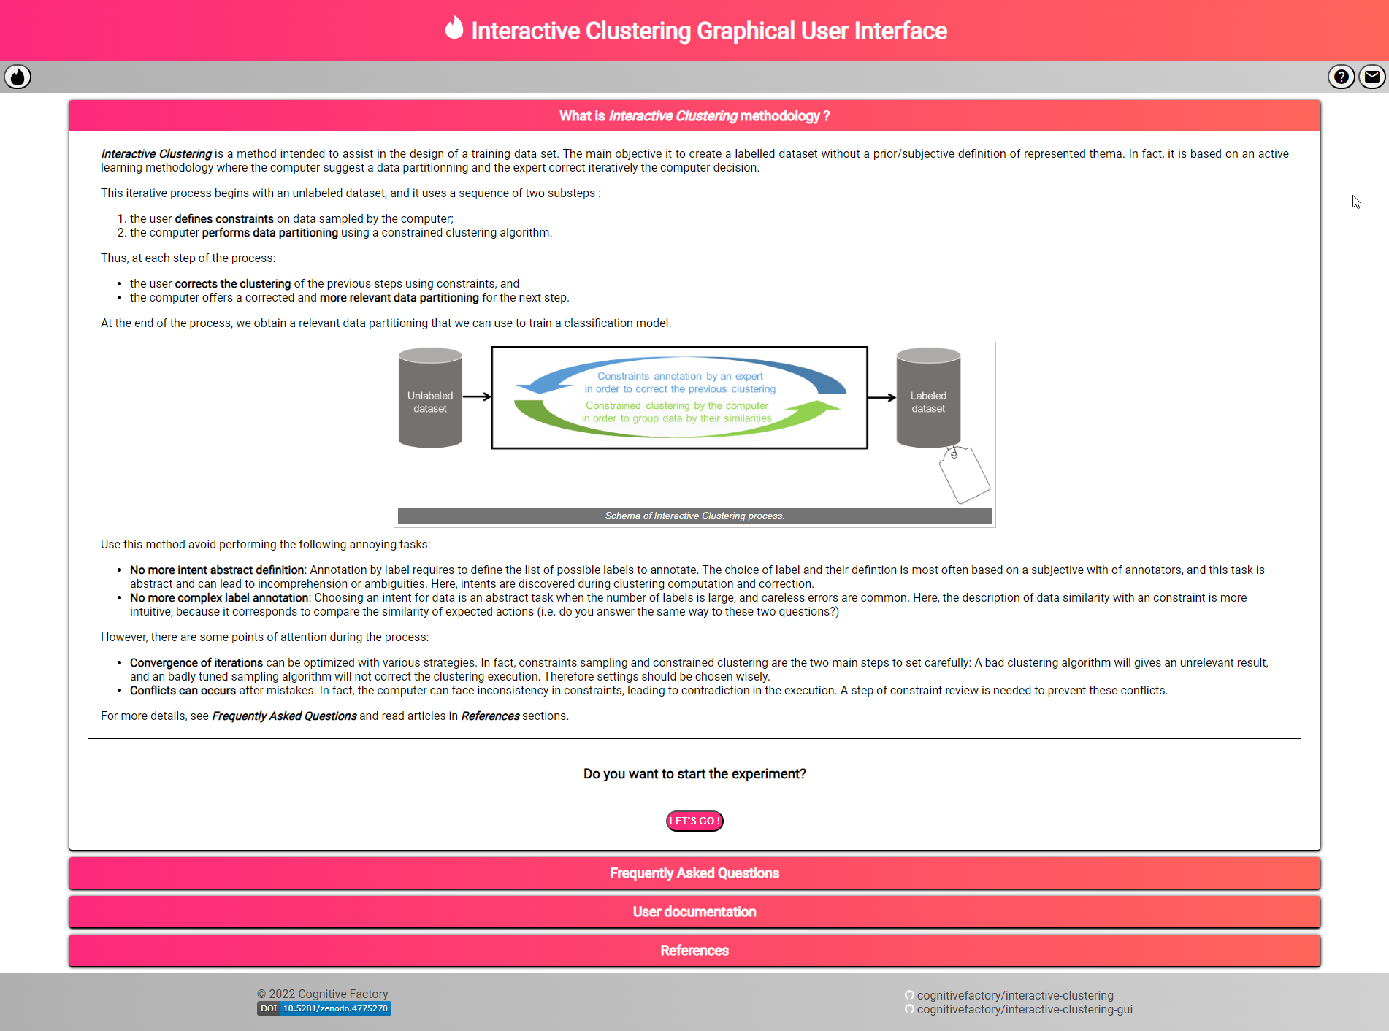
interactive-clustering-gui-welcome-page

