Slide 1
The tutorial of OpenGL ES Shading language
Yashi Huang
2013/11/28
Notes:
1..自介/語言/初步認識/編寫

Slide 2
Outline
Shader and shading lanuage
  What’s shader?
  What’s shader language?
Variables & operations
  Variables declaration
  Operations & Constructor
Examples
  A simple rotating & color changing cube
    Matrix & vector operation
Reference Links
Q &A
Notes:
2.變數與運算 / 3.簡單的範例，使用第2章的矩陣/向量運算

Slide 3
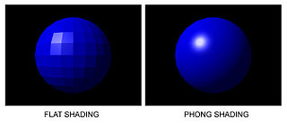

Shader and shading lanuage
What’s shader?
  Shader(著色器)
    A computer program that is used to do shading –
      Production of lighting
      Special effect & postprocessing
Notes:
1.打光/點與點更細緻/表面光滑
From wikipedia – shader http://en.wikipedia.org/wiki/Shader
Phong shading - http://cg2010studio.wordpress.com/2011/11/01/flat%E3%80%81gouraud%E3%80%81phong-shading%E7%9A%84%E5%B7%AE%E5%88%A5-comparison-flat-gouraud-phong-shading/

Slide 4
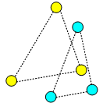
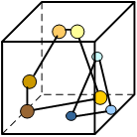
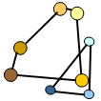
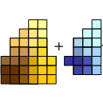

Shader and shading lanuage
    Programmable shader in Opengl es 2.0 pipline
API
Primitive
Processing
Geometry Processor (GP)
Vertex
Shader
Primitive
Assembly
Rasterizer
Vertex Buffer
Objects
Pixel Processor (PP)
Fragment
Shader
Depth
Stencil
Colour
Buffer Blend
Dither
Frame Buffer
*Fragment http://en.wikipedia.org/wiki/Fragment_(computer_graphics)
**Opengl es 2.0 pipeline
http://en.wikibooks.org/wiki/OpenGL_Programming/OpenGL_ES_Overview
Notes:
Detail / shader在流水線的位置 / 作用 vertex:頂點位置、法向量 ->轉換成fragment(構成pixel所需的資訊) ->fragment shader:決定fragment(pixel)顏色、貼圖
From opengl es 2.0 pipeline

Slide 5
Shader and shading lanuage
Shaders in OpenGL ES 2.0
  Vertex shader
    Transformation
      Scaling
      Rotate
      Lighting*
  Fragment shader
    Draw pixel
      Blending
      Lighting
  *Blending
  User can also use glBlendfunc.
  **Lighting:
  http://www.opengl.org/sdk/docs/tutorials/ClockworkCoders/lighting.php

Slide 6
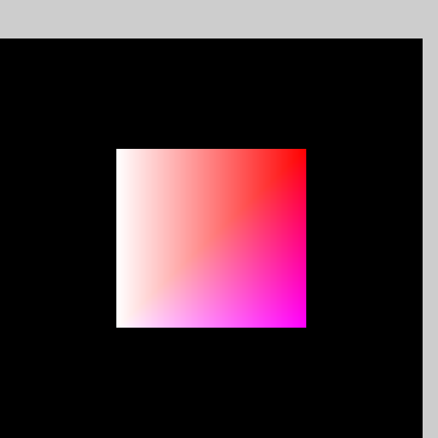
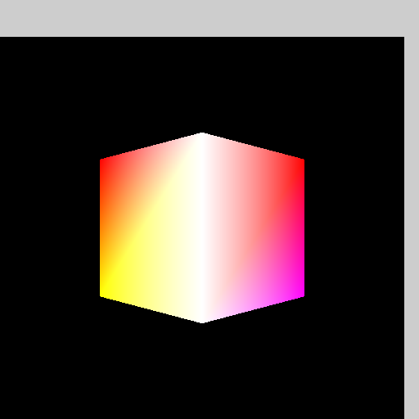
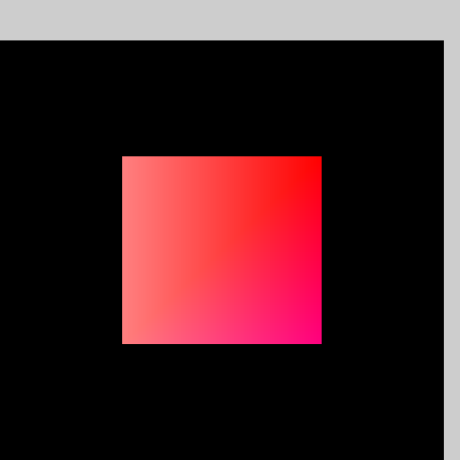
Shader and shading lanuage
Vertex effect sample
Fragment effect sample
Original | Rotate 45
Original | Less green / blue

Slide 7
Shader and shading lanuage
A shading language is …
  A special programming language adapted to map on shader programming.

Slide 8
Shader and shading lanuage
Desktop vs. Embedded
  OpenGL Shading language(GLSL)
OpenGL Version | GLSL Version
2.0 | 110
… | …
4.3 | 430

Slide 9
Shader and shading lanuage
Desktop vs. Embedded(cont.)
  OpenGL ES Shading language(GLSL ES)
    ES is for embedded system
The following chapter would focus on ESSL version 100.
  Mali 400 series support opengl es 2.0
OpenGL ES Version | GLSL ES Version
2.0 | 100
3.0 | 300

Slide 10
Shader and shading lanuage
A example of vertex shader
#define OPENGL_MEDIUMP mediump
attribute vec4 av4position;
attribute vec3 av3colour;
uniform mat4 mvp;
varying vec3 vv3colour;
void main() { vv3colour = av3colour;
gl_Position = mvp * av4position;}
Attribute vec4 av4position
[qualifier] [type] [name]
Notes:
定義關鍵字/qualifier/

Slide 11
Preprocessors
The list of preprocessor(1/2)
    #
    #define
    #undef
    #if
    #ifdef
    #ifndef
    #else
    #elif
    #endif

Slide 12
Preprocessors
The list of preprocessor(2/2)
    #error
    #pragma
      #pragma optimize(on)
      #pragma optimize(off)
    #extension
    #version
      #version number //number must be 100
    #line

Slide 13
Variables and Types
Variables
  Basic types
  Qualifiers

Slide 14
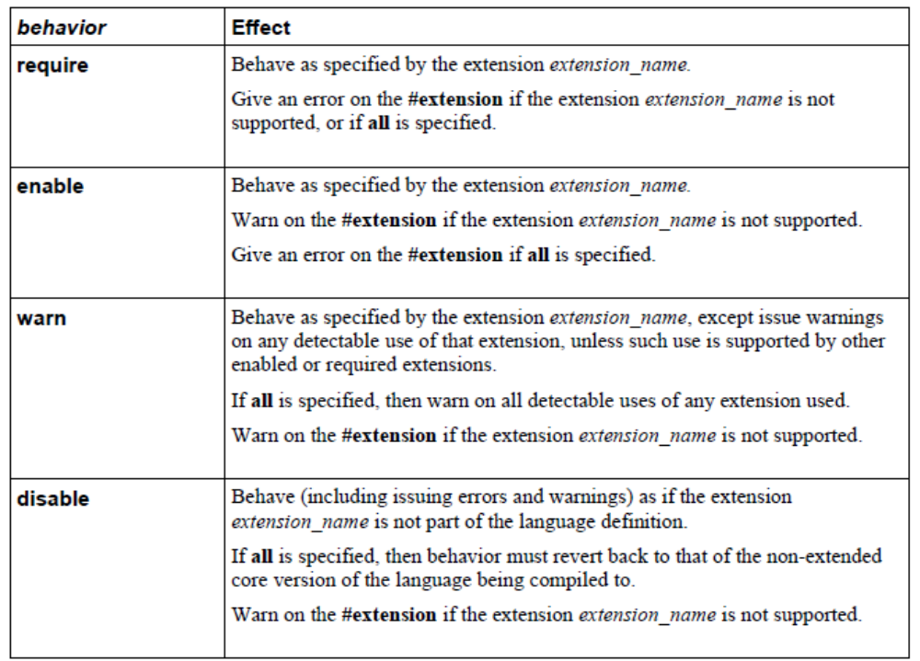
Basics – Preprocessor (3/3)
The behavior of #extension:

Slide 15
Variables and Types - Basic Types
Declaration
  [Qualifier] + Type + name + [ = initilazier]
  Ex. Float x;
How to make sure the declaration is right?
  No printf ! (it needs to get back to CPU)
  Try
    Write the value to a off screen buffer and read back
    Opengl es debugger

Slide 16
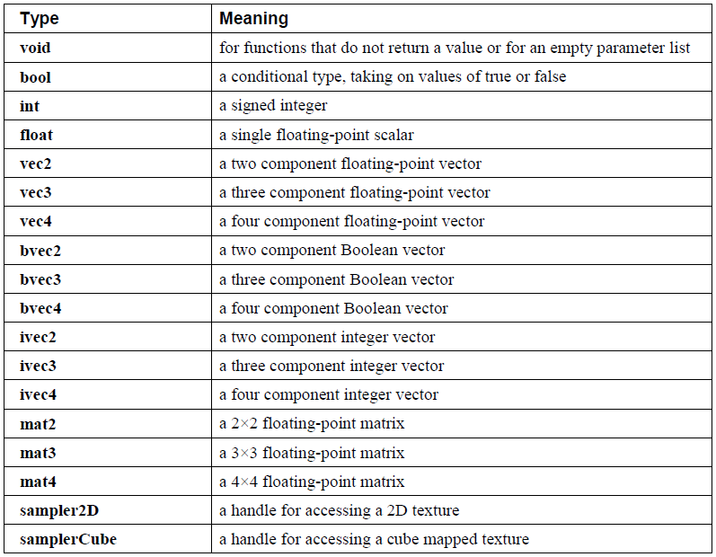
Variables and Types - Basic Types
Type list
Notes:
From the opengl es shader language spec version 100 revision 14

Slide 17
Variables and Types - Basic Types
Vectors
  2-, 3-, and 4-component vectors of floating-point values, integers, or Booleans.
Matrices
  2x2, 3x3, and 4x4 matrices of floating point numbers.
Samplers
  opaque handles to textures.

Slide 18
Variables and Types - Basic Types
Structure
  User-defined types can be created by aggregating other already defined types into a structure using the struct keyword:
    Ex. struct light {
    float intensity;
    vec3 position;
    } lightVar;
    light lightVar2;

Slide 19
Variables and Types - Basic Types
Arrays
  Variables with same type can be aggregated into arrays.
  Arrays and matrices are different!
    Only one-dimension arrays may be declared.
    There is no mechanism for initializing arrays at declaration time from within a shader.
      float x[3] = {1.0f, 1.0f, 1.0f}; //not permitted
    The index must be a integral constant greater than zero.
      Float x[]; //not permitted

Slide 20
Variables and Types - Basic Types – more detail
Structure
  where name becomes the user-defined type, and can be used to declare variables to be of this new type.
  The name shares the same name space as other variables, types and functions. All previously visible variables, types, constructors or functions with that name are hidden.
  The optional qualifiers only apply to any declarators, and are not part of the type being defined for name.

Slide 21
Variables and Types - Basic Types – more detail
Structures
  Structures must have at least one member declaration. Member declarators may contain precision qualifiers, but may not contain any other qualifiers.
  Member types must already be defined.
  Member declarations cannot contain initializers.
  Each level of structure has its own name space for names given in member declarators; such names need only be unique within that name space.

Slide 22
Variables and Types - Basic Types – more detail
Structures
  Anonymous structure declarators are not supported.
  Embedded structure definitions are not supported:
    struct S{
      struct T // error: embedded structure definition is not supported.
      {
      int a;
      } t;
    int b:};
  Structures can be initialized at declaration time using constructors.
  Any restrictions on the usage of a type or qualifier also apply to a structure that contains that type or qualifier.

Slide 23
Variables and Types - Basic Types – more detail
Arrays
  Variables of the same type can be aggregated into arrays by declaring a name followed by brackets ( [ ] ) enclosing a size.
  It is illegal to index an array with an integral constant expression greater than or equal to its declared size.(or with a negative constant expression.)
  Only one-dimensional arrays may be declared.
  All basic types and structures can be formed into arrays.
  There is no mechanism for initializing arrays at declaration time from within a shader.

Slide 24
Variables and Types - Basic Types – more detail
Arrays
  Reading from or writing to an array with a non-constant index that is less than zero or greater than or equal to the array's size results in undefined behavior (platform dependent).

Slide 25
Variables and Types - Qualifiers
There are qualifiers in GLSL ES just like those in C language (ex. static, extern, auto, register).
  Storage Qualifiers
  Precision Qualifiers
  Invariant Qualifiers
  Parameter Qualifiers

Slide 26
Variables and Types - Storage Qualifiers
Summary of Storage Qualfiers
Qualifier | Meaning
< none: default > | local read/write memory, or an input parameter to a function
Const | a compile-time constant, or a function parameter that is read-only
Attribute | linkage between a vertex shader and OpenGL ES for per-vertex data
Uniform | value does not change across the primitive being processed, uniforms form the linkage between a shader, OpenGL ES, and the application
Varying | linkage between a vertex shader and a fragment shader for interpolated data
Notes:
Constant scope?any / storage qualifier 表示變數來自何處/ 流水線中的位置

Slide 27
Variables and Types - Qualifiers
Vertex Data
 | ↓ | attributes (usually position, color, normal vector, and texture coordinates)
Vertex Shader |  |  | ← | uniforms (constants); (optionally texture data but not in most OpenGL ES 2.0 implementations)
 | ↓ | varyings (at vertices), vertex position, and point size
Primitive Assembly
 | ↓ | varyings (at vertices), vertex position, and point size
Rasterization
 | ↓ | varyings (now interpolated at pixels), fragment coordinates, point coordinates, front-facing flag
Fragment Shader |  |  | ← | uniforms (constants) and texture data (images)
 | ↓ | fragment color and fragment depth
Per-Fragment Operations
 | ↓ | fragment color and fragment depth
Framebuffer

Slide 28
Variables and Types - Storage Qualifiers
Summary of Storage Qualfiers
 | Access | Data Type | Scope | Note
Default | r/w | Any | Any
Const | read | Any excepts Array.
Attribute | read | float, vec2, vec3, vec4, mat2, mat3, and mat4,no array nor structure. | global
Uniform | read | Any | Share global
Varying | r/w (vertrex) read(fragment) | float, vec2, vec3, vec4, mat2, mat3, and mat4, or arrays of these,no structure. | global
Notes:
Shared global

Slide 29
Variables and Types - Storage Qualifiers
Scoping
  A specified region of the program where names may be defined and are guaranteed to be visible.
  Shared scope
    Shared globals are variables that can be accessed by multiple compilation units.
    Shared global variables must have same precision / type /name.
  Global scope

Slide 30
Variables and Types - Storage Qualifiers
Varying Qualifier
  The varying qualifier can be used only with the data types float, vec2, vec3, vec4, mat2, mat3, and mat4, or arrays of these. Structures cannot be varying.
  Varying variables are required to have global scope.(because they have to wallk through the pipeline )

Slide 31
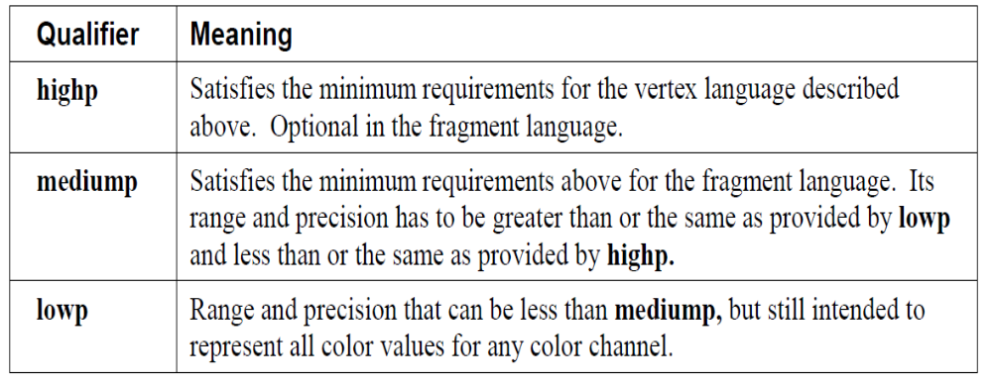
Variables and Types - Precision and Precision Qualifiers
Precision Qualifier
    Any floating point or integer declaration can have the type preceded by one of these precision qualifiers:

Slide 32
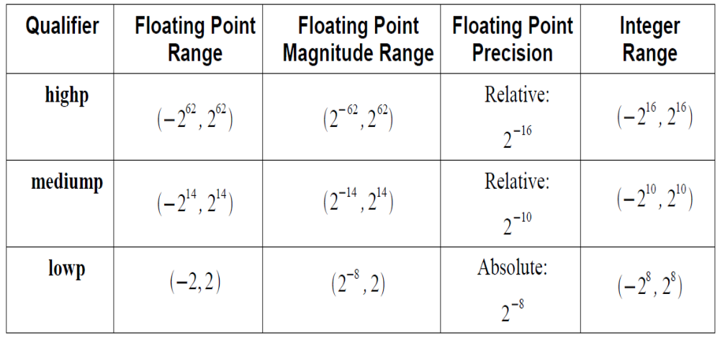
Variables and Types - Precision and Precision Qualifiers
Precision Qualifier
    The required minimum ranges and precisions for precision qualifiers:
Notes:
各級精確度最低需求

Slide 33
Variables and Types - Precision and Precision Qualifiers
Precision Level for Vertex/Fragment Language
  The vertex language requires any uses of lowp, mediump and highp to compile and link without error.
  The fragment language requires any uses of lowp and mediump to compile without error. Support for highp is optional.
  For constant expressions and sub-expressions, where the precision is not defined, the evaluation is performed at or above the highest supported precision of the target (either mediump or highp).

Slide 34
Variables and Types - Precision and Precision Qualifiers
  Case: no Precision Qualification defined
    In other cases where operands do not have a precision qualifier, the precision qualification will come from the other operands.
    If no operands have a precision qualifier, then the precision qualifications of the operands of the next consuming operation in the expression will be used.
    This rule can be applied recursively until a precision qualified operand is found.
    If the precision cannot be determined by this method, then it is evaluated at the default precision of the type or greater.

Slide 35
Variables and Types - Precision and Precision Qualifiers
The Maximum/Minimum Value (floating )
  When the result of a floating point operation is larger (smaller) than what the required precision can store, the result can be either the maximum (minimum) value that that precision can represent, or a representation of infinity (negative infinity).
  wrapping behavior/NaN/exception is not allowed.

Slide 36
Variables and Types - Precision and Precision Qualifiers
The Overflow of integer
  Integer overflow results in an undefined value.
  Wrapping behavior is allowed.

Slide 37
Variables and Types - Precision and Precision Qualifiers
Default Precision Qualifiers
  The precision statement
    precision precision-qualifier type;
    precision-qualifier : lowp,medimump,highp
    Type : int,floating…
  Non-precision qualified declarations will use the precision qualifier specified in the most recent precision statement that is still in scope.

Slide 38
Variables and Types - Precision and Precision Qualifiers
The vertex language has the following predeclared globally scoped default precision statements:
    precision highp float;
    precision highp int;
    precision lowp sampler2D;
    precision lowp samplerCube;

Slide 39
Variables and Types - Precision and Precision Qualifiers
The fragment language has the following predeclared globally scoped default precision statements:
    precision mediump int;
    precision lowp sampler2D;
    precision lowp samplerCube;
    *No default precision for float.

Slide 40
Variables and Types - Precision and Precision Qualifiers
Definition of Supporting highp or not
  The built-in macro GL_FRAGMENT_PRECISION_HIGH is defined to one on systems supporting highp precision in the fragment language.
    #define GL_FRAGMENT_PRECISION_HIGH 1
      * not defined on systems not supporting highp precision .

Slide 41
Variables and Types - Variance and the Invariant Qualifier
Variance
  Values from the same expression in different shaders may differ due to independent compilation.
  To prevent variance, variables can be declared to
  be invariant, either individually or with a global setting.
Notes:
由於優化產生的精確度不同

Slide 42
Variables and Types - Variance and the Invariant Qualifier
The Invariant Qualifier
  To ensure that a particular output variable is invariant, it is necessary to use the invariant qualifier.
      varying mediump vec3 Color;
      invariant Color; // make existing Color be invariant
    OR
      invariant varying mediump vec3 Color;

Slide 43
Variables and Types - Variance and the Invariant Qualifier
Only the following variables may be declared as invariant:
      Built-in special variables output from the vertex shader
      Varying variables output from the vertex shader
      Built-in special variables input to the fragment shader
      Varying variables input to the fragment shader
      Built-in special variables output from the fragment shader.

Slide 44
Variables and Types - Variance and the Invariant Qualifier
To guarantee invariance of a particular output variable in two shaders, the following must also be true:
  The output variable is declared as invariant in both shaders.
  The same values must be input to all shader input variables .
  The texture formats, texel values, and texture filtering are set the same way.
  All input values are all operated on in the same way. All operations in the consuming expressions and any intermediate expressions must be the same, and any expressions consumed to determine this control flow must also follow these invariance rules.

Slide 45
Variables and Types - Variance and the Invariant Qualifier
  Initially, by default, all output variables are allowed to be variant. To force all output variables to be invariant, use the pragma
    #pragma STDGL invariant(all)

Slide 46
Variables and Types - Variance and the Invariant Qualifier
Invariance Within Shaders
  during the process of optimization, it is possible that the compiler may choose to recompute a value rather than store it in a register.
  Since the precision of operations is not completely specified, it would be possible for the recomputed value to be different from the original value.

Slide 47
Variables and Types - Variance and the Invariant Qualifier
Invariance Within Shaders
  Example 1:
      precision mediump;
      vec4 col;
      vec2 a = ...
      ...
      col = texture2D(tex, a); // a has a value a1
      ...
      col = texture2D(tex, a); // a has a value a2 where possibly a1 ≠ a2
  To enforce invariance in this example use:
      #pragma STDGL invariant(all)
Notes:
優化所造成

Slide 48
Variables and Types - Variance and the Invariant Qualifier
Invariance Within Shaders
  Example 2:
      vec2 m = ...;
      vec2 n = ...;
      vec2 a = m + n;
      vec2 b = m + n; // a and b are not guaranteed to be exactly equal
  There is no mechanism to enforce invariance between a and b.

Slide 49
Variables and Types - Variance and the Invariant Qualifier*
Invariance of Constant Expressions
  Invariance must be guaranteed for constant expressions.
  Constant expressions must evaluate to the same result when all the following are true:
    The inputs to the expression have the same value.
    The operations performed are the same and are applied in the same order.
    The operations are performed at the same precision.

Slide 50
Variables and Types - Variance and the Invariant Qualifier
Invariance and Linkage
  The invariance of varyings that are declared in both the vertex and fragment shaders must match.
  For the built-in special variables:
    gl_FragCoord can only be declared invariant if and only if gl_Position is declared invariant.
    gl_PointCoord can only be declared invariant if and only if gl_PointSize is declared invariant.
    The invariance of gl_FrontFacingis the same as the invariance of gl_Position.

Slide 51
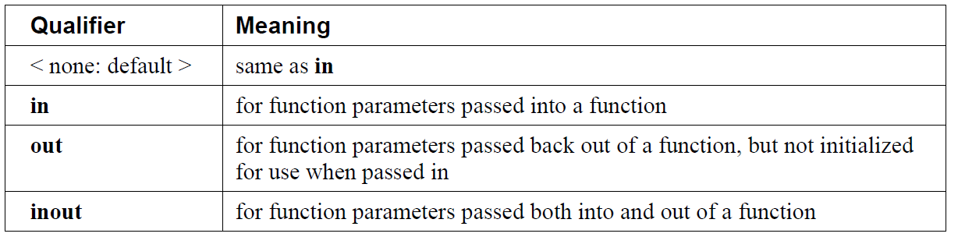
Variables and Types – Parameter Qualifiers
Parameters can have these qualifiers.
    Parameter qualifiers are discussed in more detail in Section 6.1.1 “Function Calling Conventions” .

Slide 52
Variables and Types - Variance and the Invariant Qualifier
Order of Qualification
    invariant-qualifier storage-qualifier precision-qualifier
    storage-qualifier parameter-qualifier precision-qualifier

Slide 53
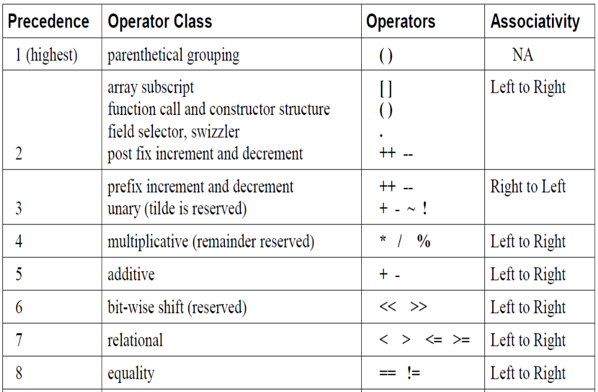
Operators and Expressions
Operators
*All the reserved is illegal

Slide 54
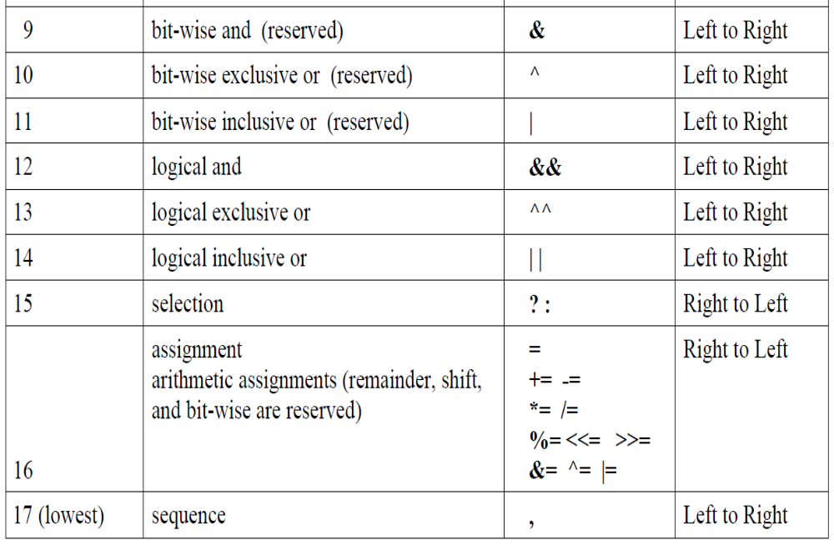
Operators and Expressions
Operators(cont.)
*All the reserved is illegal

Slide 55
Operators and Expressions
Array Subscripting
  Array elements are accessed using the array subscript operator ( [ ] ). This is the only operator that operates on arrays.
      diffuseColor += lightIntensity[3] * NdotL;
Function Calls
  If a function returns a value, then a call to that function may be used as an expression.

Slide 56
Operators and Expressions - Constructors
Constructors
  Constructors use the function call syntax, where the function name is a basic-type keyword or structure name, to make values of the desired type for use in an initializer or an expression.

Slide 57
Operators and Expressions - Constructors
Conversion and Constructors
  Converting between scalar types
    int(bool) // converts a Boolean value to an int
    int(float) // converts a float value to an int
    float(bool) // converts a Boolean value to a float
    float(int) // converts an integer value to a float
    bool(float) // converts a float value to a Boolean
    bool(int) // converts an integer value to a Boolean
      When constructors are used to convert a float to an int, the fractional part of the floating-point value is dropped.
      When a constructor is used to convert an int or a float to bool, 0 and 0.0 are converted to false.

Slide 58
Operators and Expressions - Constructors
Conversion and Constructors
  Vector and Matrix Constructor
    If there is a single scalar parameter to a vector constructor, it is used to initialize all components of the constructed vector to that scalar’s value.
    If there is a single scalar parameter to a matrix constructor, it is used to initialize all the components on the matrix’s diagonal, with the remaining components initialized to 0.0.

Slide 59
Operators and Expressions - Constructors
Some useful vector constructors are as follows:
  vec3(float) // initializes each component of with the float
  vec4(ivec4) // makes a vec4 with component-wise conversion
  vec2(float, float) // initializes a vec2 with 2 floats
  ivec3(int, int, int) // initializes an ivec3 with 3 ints
  bvec4(int, int, float, float) // uses 4 Boolean conversions
  vec2(vec3) // drops the third component of a vec3
  vec3(vec4) // drops the fourth component of a vec4
  vec3(vec2, float) // vec3.x = vec2.x, vec3.y = vec2.y, vec3.z = float
  vec3(float, vec2) // vec3.x = float, vec3.y = vec2.x, vec3.z = vec2.y
  vec4(vec3, float)
  vec4(float, vec3)
  vec4(vec2, vec2)

Slide 60
Operators and Expressions - Constructorss
To initialize the diagonal of a matrix with all other elements set to zero:
  mat2(float)
  mat3(float)
  mat4(float)
To initialize a matrix by specifying vectors, or by all 4, 9, or 16 floats for mat2, mat3 and mat4 respectively. The floats are assigned to elements in column major order.
  mat2(vec2, vec2);
  mat3(vec3, vec3, vec3);
  mat4(vec4, vec4, vec4, vec4);
  mat2(float, float,
  float, float);
  mat3(float, float, float,
  float, float, float,
  float, float, float);

Slide 61
Operators and Expressions - Constructorss
Structure Constructor
  struct light {
    float intensity;
    vec3 position;
  };
  light lightVar = light(3.0, vec3(1.0, 2.0, 3.0));

Slide 62
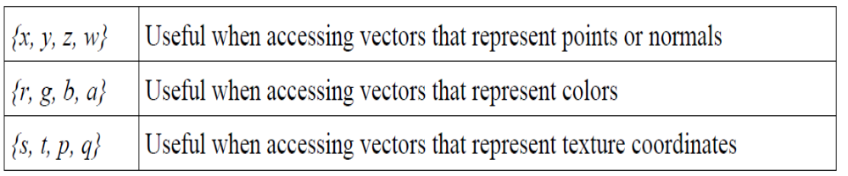
Operators and Expressions - Vector Components
Vector Components
  The individual components of a vector can be selected by following the variable name with period ( . ) and then the component name.
  The component names supported are:
Notes:
多組代號/快速尋找

Slide 63
Operators and Expressions - Vector Components
Vector Components
  Accessing components beyond those declared for the vector type is an error so, for example:
    vec2 pos;
    pos.x // is legal
    pos.z // is illegal

Slide 64
Operators and Expressions - Vector Components
Vector Components
  The component selection syntax allows multiple components to be selected by appending their names(from the same name set) after the period ( . ).
    vec4 v4;
    v4.rgba; // is a vec4 and the same as just using v4,
    v4.rgb; // is a vec3,
    v4.b; // is a float,
    v4.xy; // is a vec2,
    v4.xgba; // is illegal - the component names do not come from
    // the same set.
Notes:
高維度->低維度

Slide 65
Operators and Expressions - Vector Components
Vector Components
  The order of the components can be different to swizzle them, or replicated:
    vec4 pos = vec4(1.0, 2.0, 3.0, 4.0);
    vec4 swiz= pos.wzyx; // swiz = (4.0, 3.0, 2.0, 1.0)
    vec4 dup = pos.xxyy; // dup = (1.0, 1.0, 2.0, 2.0)
Notes:
依序/顛倒

Slide 66
Operators and Expressions - Vector Components
Vector Components
  The component group notation can occur on the left hand side of an expression.
    vec4 pos = vec4(1.0, 2.0, 3.0, 4.0);
    pos.xw = vec2(5.0, 6.0); // pos = (5.0, 2.0, 3.0, 6.0)
    pos.wx = vec2(7.0, 8.0); // pos = (8.0, 2.0, 3.0, 7.0)
    pos.xx = vec2(3.0, 4.0); // illegal - 'x' used twice
    pos.xy = vec3(1.0, 2.0, 3.0); // illegal - mismatch between vec2 and vec3

Slide 67
Operators and Expressions - Vector Components
Vector Components
  Array subscripting syntax can also be applied to vectors to provide numeric indexing. So in
    vec4 pos;
  pos[2] refers to the third element of pos and is equivalent to pos.z.

Slide 68
Operators and Expressions - Matrix Components
Matrix Components
  Example to set matrix components:
    mat4 m;
    m[1] = vec4(2.0); // sets the second column to all 2.0
    m[0][0] = 1.0; // sets the upper left element to 1.0
    m[2][3] = 2.0; // sets the 4th element of the third column to 2.0

Slide 69
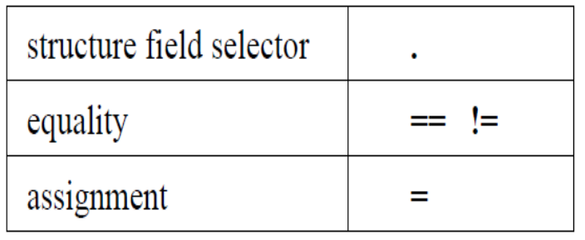
Operators and Expressions – Structures and Fields
Operators on structure
  As with vector components and swizzling, the fields of a structure are also selected using the period ( . ).

Slide 70
Operators and Expressions – Structures and Fields
Operators on structure
  The equality and assignment operators are only valid if the two operands’ types are of the same declared structure.
      Struct S {int x;};
      S a;
      {
      struct S {int x;};
      S b;
      a = b; // error: type mismatch
      }

Slide 71
Operators and Expressions – Assignments
Assignments of values to variable names
  Assignments of values to variable names are done with the assignment operator ( = ), like
    lvalue-expression = expression
  lvalue-expression evaluates to an l-value and the assignment operator stores the value of expression into the l-value. It will compile only if expression and lvalue-expression have the same type.

Slide 72
Operators and Expressions – Assignments
L-value assignments
  L-values must be writable.
  Other binary or unary expressions, nondereferenced arrays, function names, swizzles with repeated fields, and constants cannot be l-values. The ternary operator (?:) is also not allowed as an l-value.

Slide 73
Operators and Expressions – Assignments
Expressions before Assignments
  Expressions on the left of an assignment are evaluated before expressions on the right of the assignment.
  Other assignment operators are:
    The arithmetic assignments add into (+=), subtract from (-=), multiply into (*=), and divide into (/=).
    The expression
      lvalue-expression op= expression
    is equivalent to
      lvalue = lvalue op expression
    The assignments remainder into (%=), left shift by (<<=), right shift by (>>=), inclusive or into ( |=), and exclusive or into ( ^=) are reserved for future use.

Slide 74
Operators and Expressions - Expressions
  Expressions in the shading language are built from the following:
    Constants of type bool, int, float, all vector types, and all matrix types.
    Constructors of all types.
    Variable names of all types, except array names not followed by a subscript.
    Subscripted array names.
    Unsubscripted array names.
    Function calls that return values.
    Component field selectors and array subscript results.
    Parenthesized expression.

Slide 75
Operators and Expressions - Expressions
  The arithmetic binary operators in expressions:
    add (+), subtract (-), multiply (*), and divide (/).
    If one operand is scalar and the other is a vector or matrix, the scalar is applied component-wise to the vector or matrix.
    Multiply (*) applied to two vectors yields a component-wise multiply.
    Multiply (*) applied to two matrices yields a linear algebraic matrix multiply, not a component-wise multiply.
    Multiply of a matrix and a vector yields a linear algebraic transform.
    Use the built-in functions dot, cross, and matrixCompMult to get,respectively, vector dot product, vector cross product, and matrix component-wise multiplication.

Slide 76
Operators and Expressions - Expressions
  The arithmetic binary operators in expressions(mutiply):
    the left argument is a floating-point vector and the right is a matrix with a compatible dimension in which case the * operator will do a row vector matrix multiplication.
    the left argument is a matrix and the right is a floating-point vector with a compatible dimension inwhich case the * operator will do a column vector matrix multiplication.

Slide 77
Operators and Expressions - Expressions
  The operators in expressions:
    The operator remainder (%) is reserved for future use.
    The arithmetic unary operators negate (-), post- and pre-increment and decrement (-- and ++) operate on integer or floating-point values (including vectors and matrices).
    The relational operators :>, <, >= and <= operate only on scalar integer and scalar floating-point expressions.
      To do component-wise comparisons on vectors, use the built-in functions lessThan, lessThanEqual, greaterThan, and greaterThanEqual.

Slide 78
Operators and Expressions - Expressions
  The operators in expressions:
    The equality operators equal (==), and not equal (!=) operate on all types except arrays, structures containing arrays, sampler types and structures containing sampler types.
      To get component-wise equality results for vectors, use the built-in functions equal and notEqual.

Slide 79
Operators and Expressions - Expressions
  The logical binary operators in expressions:
    The logical binary operators and (&&), or ( | | ), and exclusive or (^^) operate only on two Boolean expressions and result in a Boolean expression.
    And (&&) will only evaluate the right hand operand if the left hand operand evaluated to true.
    Or ( | | ) will only evaluate the right hand operand if the left hand operand evaluated to false.
    Exclusive or (^^) will always evaluate both operands.

Slide 80
Operators and Expressions - Expressions
  The logical unary operators in expressions:
    The logical unary operator not (!). It operates only on a Boolean expression and results in a Boolean expression.
      To operate on a vector, use the built-in function not.

Slide 81
Operators and Expressions - Expressions
  The ternary selection operator (?:)
    It operates on three expressions (exp1 ? exp2 : exp3).
    Only one of the second and third expressions is evaluated.
    The second and third expressions must be the same type, but can be of any type other than an array.

Slide 82
Operators and Expressions - Expressions
  Others and note about operators in expression
    Operators and (&), or ( | ), exclusive or (^), not (~), right-shift (>>), left-shift (<<). These operators are reserved for future use.

Slide 83
Operators and Expressions – Constant Expressions
A constant expression is one of
  a literal value (e.g., 5 or true)
  a global or local variable qualified as const excluding function parameters
  an expression formed by an operator on operands that are constant expressions, including getting an element of a constant vector or a constant matrix, or a field of a constant structure
  a constructor whose arguments are all constant expressions
  a built-in function call whose arguments are all constant expressions, with the exception of the texture lookup functions.

Slide 84
Operators and Expressions – Constant Expressions
  The following may not be used in constant expressions:
    User-defined functions
    Uniforms, attributes and varyings.
  Array variables cannot be constant expressions .
  Constant expressions must be invariant.

Slide 85
Operators and Expressions – Vector and Matrix Operations
  Examples for operations on a vector:
      vec3 v, u;
      float f;
      v = u + f;
    will be equivalent to:
      v.x = u.x + f;
      v.y = u.y + f;
      v.z = u.z + f;

Slide 86
Operators and Expressions – Vector and Matrix Operations
  Examples for operations on a vector:
      vec3 v, u, w;
      w = v + u;
    will be equivalent to:
      w.x = v.x + u.x;
      w.y = v.y + u.y;
      w.z = v.z + u.z;

Slide 87
Operators and Expressions – Vector and Matrix Operations
  Examples for operations on a matrix:
      vec3 v, u;
      mat3 m;
      u = v * m;
    is equivalent to
      u.x = dot(v, m[0]); // m[0] is the left column of m
      u.y = dot(v, m[1]); // dot(a,b) is the inner (dot) product of a and b
      u.z = dot(v, m[2]);

Slide 88
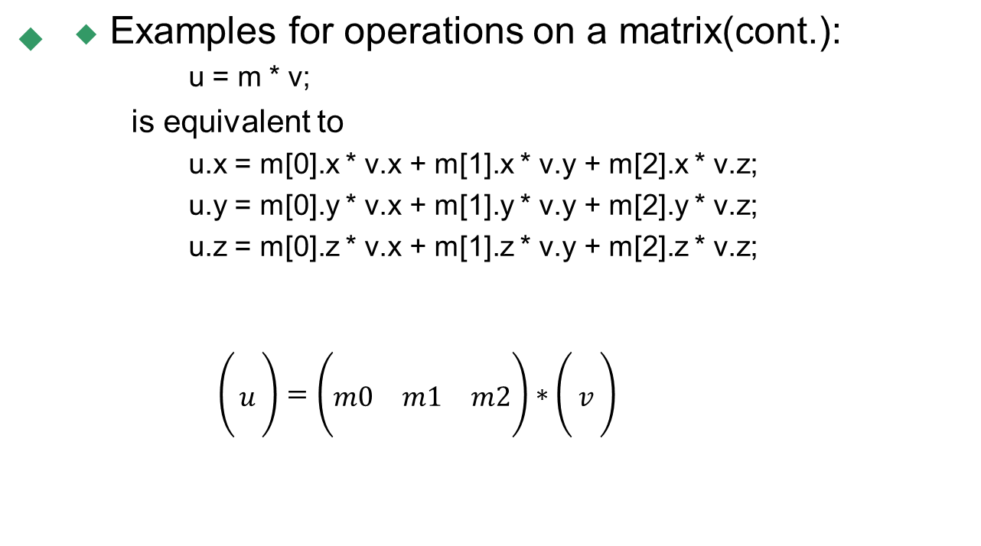
Operators and Expressions – Vector and Matrix Operations
Notes:
矩陣相乘列向量

Slide 89
Statements and Structure
The fundamental building blocks of the OpenGL ES Shading Language are:
  statements and declarations
  function definitions
  selection (if-else)
  iteration (for, while, and do-while)
  jumps (discard, return, break, and continue)

Slide 90
Statements and Structure
The overall structure of a shader is as follows
  translation-unit:
    global-declaration
      function-definition
      declaration
    translation-unit global-declaration

Slide 91
Statements and Structure – Function Definition
A function is declared as the following example shows:
  // prototype
  returnType functionName (type0 arg0, type1 arg1, ..., typen argn);
and a function is defined like
  // definition
    returnType functionName (type0 arg0, type1 arg1, ..., typen argn)
    {
  // do some computation
  return returnValue;
  }
  where returnType must be present and include a type.

Slide 92
Statements and Structure – Selection
  Conditional control flow in the shading language is done by either if, or if-else:
      if (bool-expression)
        true-statement
  or
      if (bool-expression)
        true-statement
      else
        false-statement

Slide 93
Statements and Structure – Iteration
  do loops are allowed as follows:
    for (for-init-statement; condition(opt); expression)
      statement-no-new-scope
    while (condition)
      statement-no-new-scope
    do
      statement
    while (expression)

Slide 94
Statements and Structure – Jumps
  These are the jumps:
    jump_statement:
    continue;
    break;
    return;
    return expression;
    discard; // in the fragment shader language only

Slide 95
Example
  Vertex shader:
  attribute vec4 av4position;
  attribute vec3 av3colour;
  uniform mat4 mvp;
  varying vec3 vv3colour;
  void main() {
  vv3colour = av3colour;
  gl_Position = mvp * av4position;}
Draw a cube!
In Application:
vertex[] = {-0.5, 0.5, -0.5/* Bottom left */
…}
color[]={1.0, 0.0, 0.0, /* red */
…}
mat[]={1,0,0,0,…} /*identity 4*4 */
link_to_program_attr(vertex, “av4position”);
link_to_program_attr(color, “av3colour”);
link_to_program_uniform(mat, “mvp”);
  Fragment shader:
  precision lowp float;
  varying vec3 vv3colour;
  void main() {
  vec3 paintColor = vec3(1.0, 0.5 , 0.5);
  gl_FragColor = vec4(vv3colour, 1.0);
  gl_FragColor.rgb = gl_FragColor.rgb * paintColor;}
Notes:
Normalized cord.

Slide 96
Reference Links
http://www.khronos.org/files/opengles_shading_language.pdf
http://en.wikibooks.org/wiki/OpenGL_Programming/OpenGL_ES_Overview
http://en.wikibooks.org/wiki/GLSL_Programming/OpenGL_ES_2.0_Pipeline
http://www.opengl.org/sdk/docs/tutorials/ClockworkCoders/lighting.php
http://en.wikipedia.org/wiki/Fragment_(computer_graphics)

Slide 97
Q & A

