Slide 1
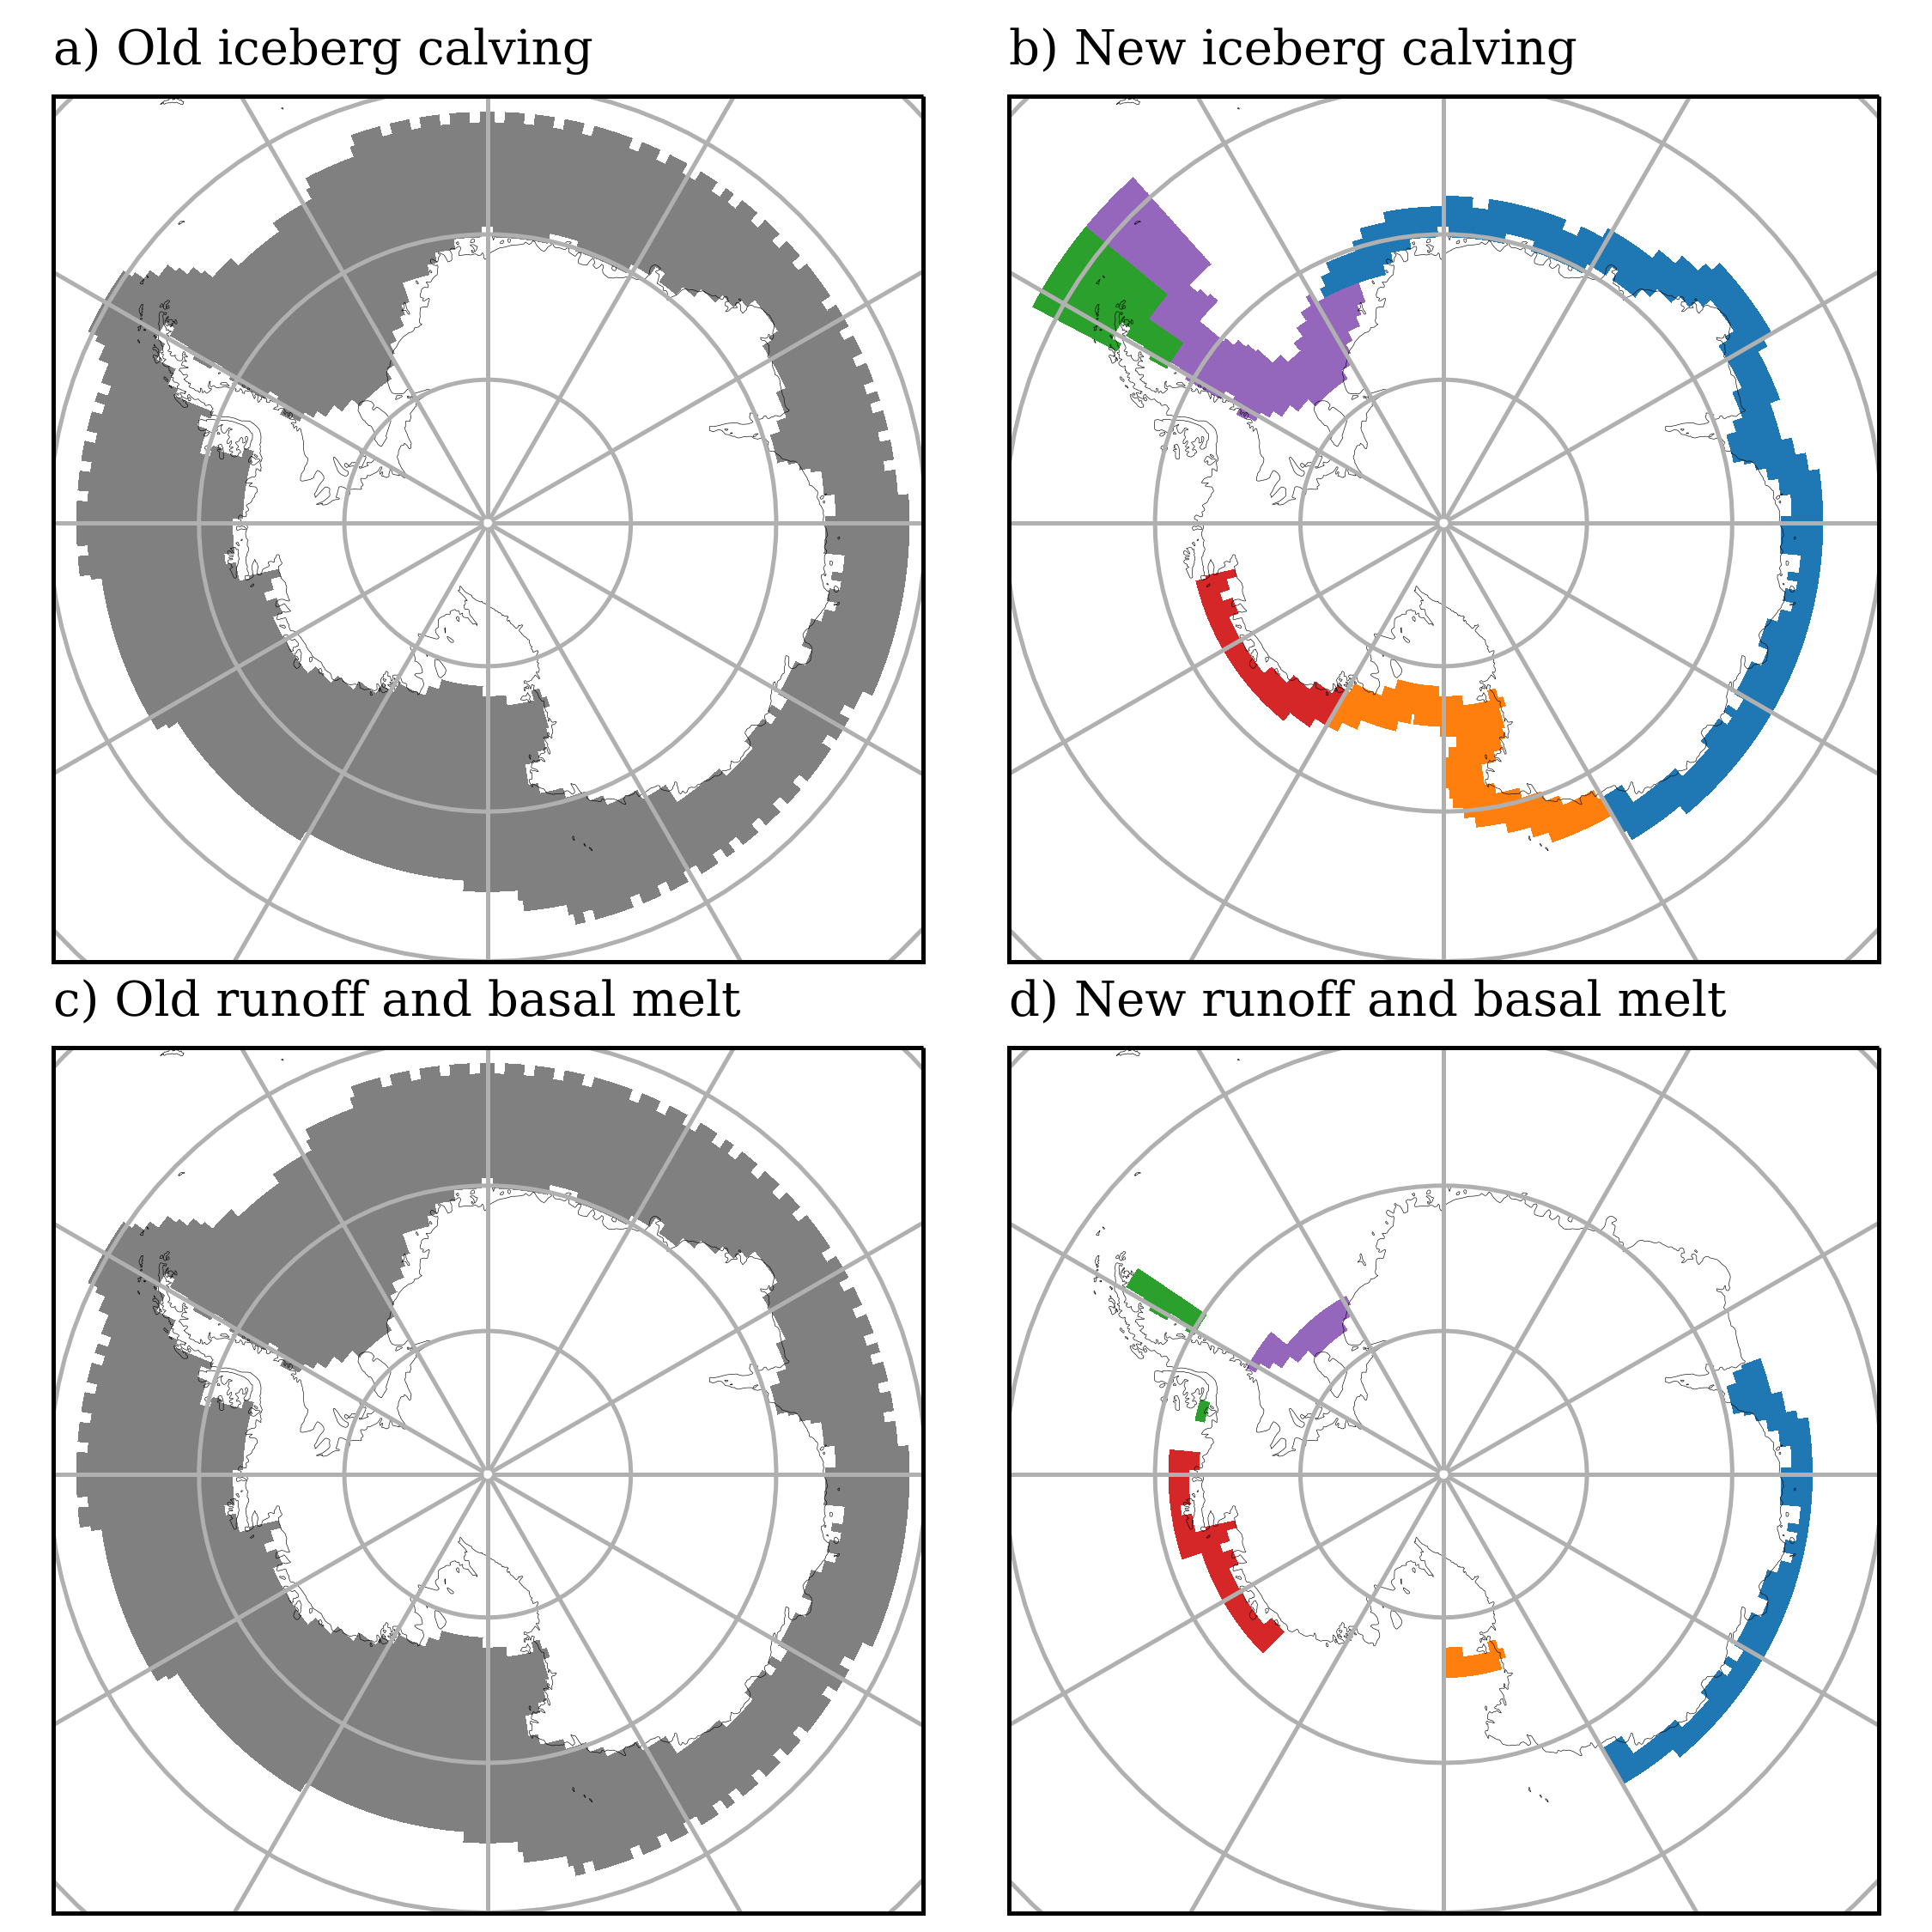
Iceberg source
Meltwater sink
Amundsen
30%
Amundsen
30%
30%
Ross
Ross
40%
20%
20%
East Ant.
East Ant.
60%
50%
20%
Weddell
Weddell
100%
Peninsula
Peninsula
100%

