Slide 1
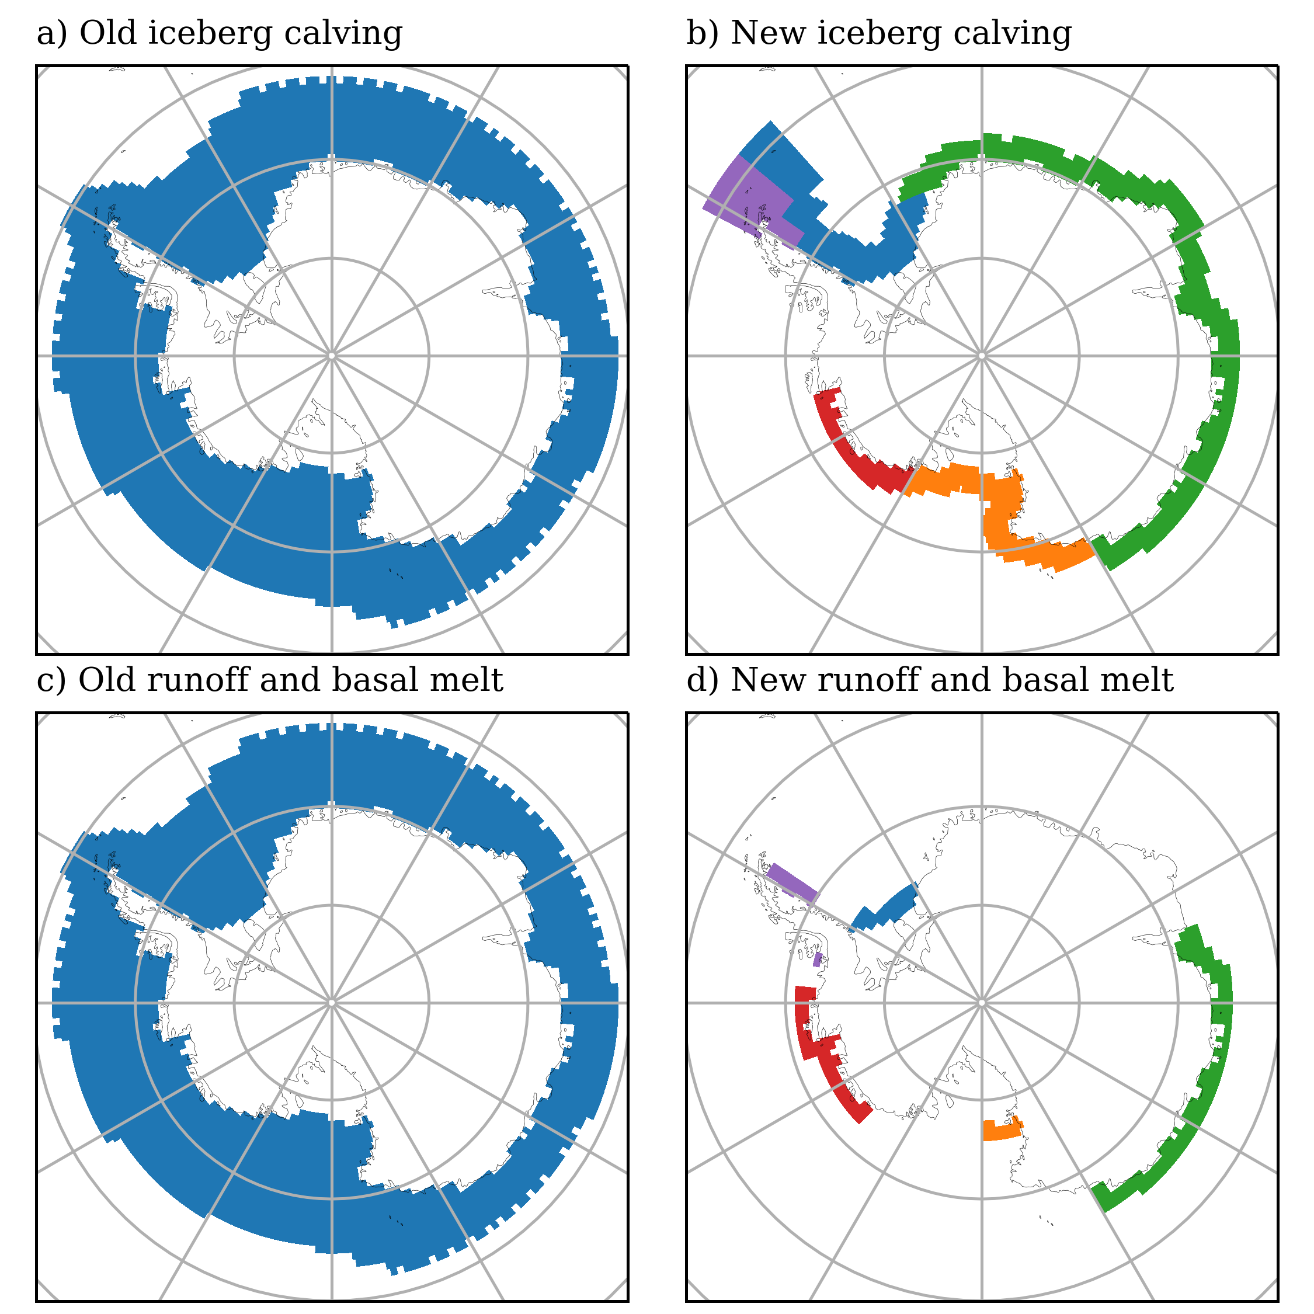
Iceberg source
Meltwater sink
AMUN
30%
AMUN
30%
30%
ROSS
ROSS
40%
20%
20%
EAIS
EAIS
60%
50%
20%
WEDD
WEDD
100%
PENS
PENS
100%

