Slide 1
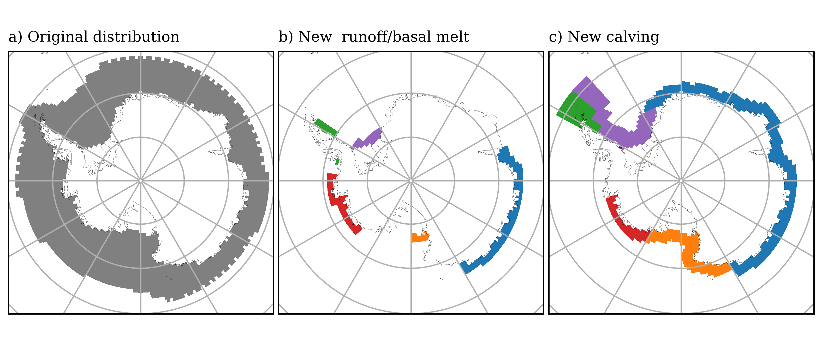
d) Iceberg rerouting
Iceberg source
Meltwater sink
Amundsen
30%
Amundsen
30%
30%
Ross
Ross
East Ant.
40%
20%
20%
East Ant.
60%
50%
20%
Weddell
100%
Weddell
Peninsula
100%
Peninsula

