Slide 1


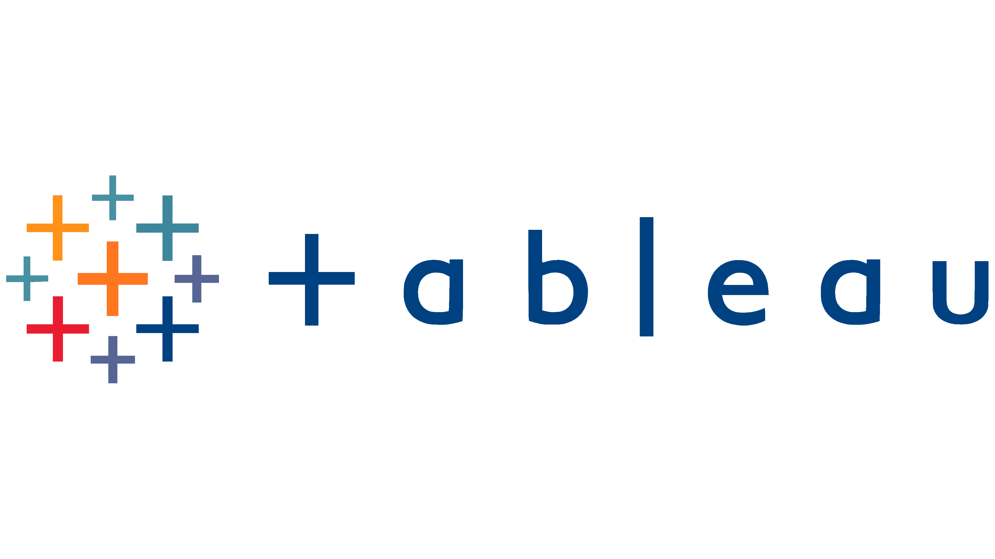
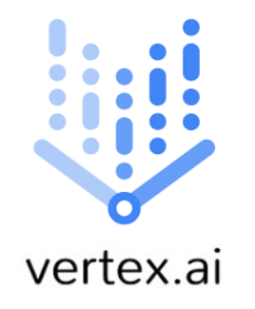
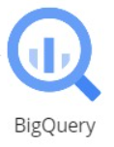


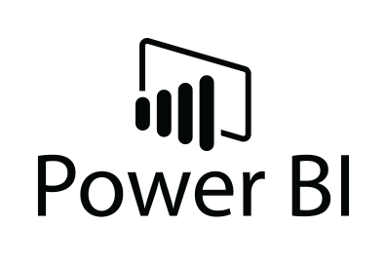




Analytics and Reporting
Data Sources
Data Lake
Batch Processing
Web App 1
(Receiving Uploaded Images from Customers)
Analytical Data Storage
Machine Learning
Google Cloud Storage
Web App 2
(Providing a stream of images to Customer)
Real Time Data Ingestion
Stream Processing
Kafka data streaming
Spark Streaming
Workflow Orchestration
Infrastructure as codes
Continuous Integration & Deployment

