Slide 1
Alternative Entwicklungstools zu Qiskit - Cirq
Googles Quantum Computing Bibliothek für Python
Referent: Eric Brunk

Slide 2
Inhalt

Slide 3
Installation und Import
pip install cirq
import cirq

Slide 4
Hello World
# pick a qubit
qubit = cirq.LineQubit(0) # position 0
# create a circuit
circuit = cirq.Circuit()
circuit.append(cirq.measure(qubit))
print("Circuit")
print(circuit)

Slide 5

Hello World

Slide 6
NOT
# pick up a qubit
qubit = cirq.LineQubit(0) # position 0
# create a circuit
circuit = cirq.Circuit()
circuit.append(cirq.X(qubit)),
circuit.append(cirq.measure(qubit))
print("Circuit")
print(circuit)

Slide 7

Hello World

Slide 8
CNOT
# pick up qubits
qubit0 = cirq.LineQubit(0) # position 0
qubit1 = cirq.LineQubit(1) # position 1
# create a circuit
circuit = cirq.Circuit()
circuit.append(cirq.CNOT(control=qubit0, target=qubit1)),
circuit.append(cirq.measure(qubit1))
print("Circuit")
print(circuit)

Slide 9
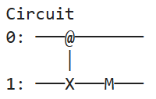
CNOT

Slide 10
Hadamard
# pick a qubit
qubit = cirq.LineQubit(0) # position 0
# create a circuit
circuit = cirq.Circuit(
cirq.H(qubit),
cirq.measure(qubit)
)
print("Circuit")
print(circuit)

Slide 11

Hadamard

Slide 12
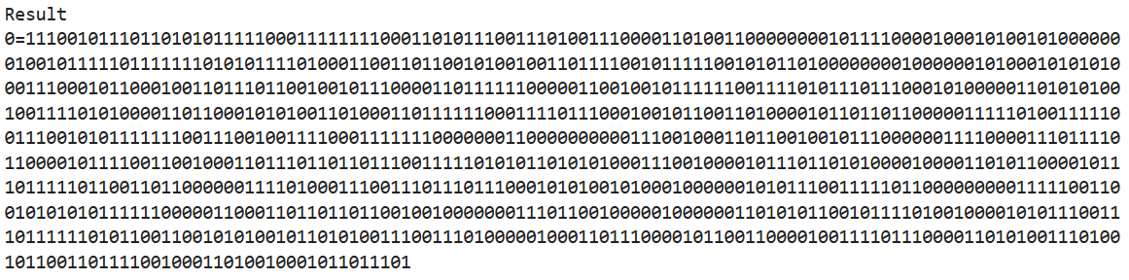
Hadamard
# simulate
simulator = cirq.Simulator()
result = simulator.run(circuit, repetitions=1000)
print("Result")
print(result)

Slide 13
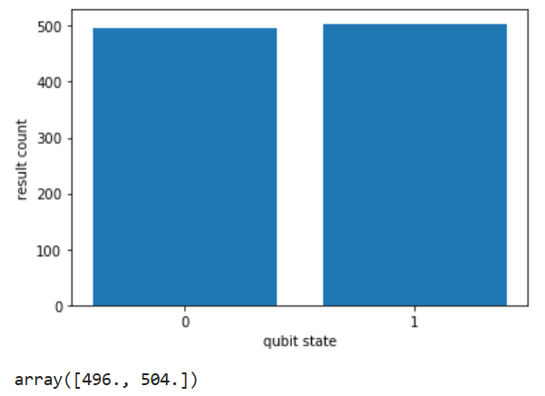
Hadamard
# histogram
cirq.plot_state_histogram(result)

Slide 14
Algorithmus

