Slide 1
Alternative Entwicklungstools zu Qiskit - Cirq
Googles Quantum Computing Bibliothek für Python
Referent: Eric Brunk, 867437

Slide 2
Inhalt
Was ist Cirq?
Installation und Import
NOT, CNOT und Hadamard
Deutsch-Algorithmus
Deutsch-Jozsa-Algorithmus

Slide 3
Was ist Cirq?
Python Bibliothek von Google
Aufbau und Optimierung von Quantenschaltkreisen
Schaltkreise können auf Quantencomputern oder im Simulator ausgeführt werden
Quelle: [1]

Slide 4
Installation und Import
pip install cirq
import cirq

Slide 5
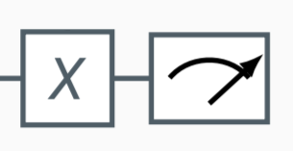
NOT
Quelle: [2]

Slide 6
NOT - Qiskit
# create Quantum Circuit with one Qubit
circuit = qiskit.QuantumCircuit(1,1)
# not gate and measure
circuit.x(0)
circuit.measure([0], [0])
print("Circuit")
circuit.draw()

Slide 7
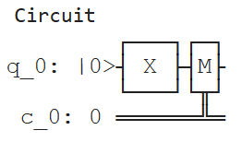
NOT - Qiskit

Slide 8
NOT - Cirq
# pick up a qubit
qubit = cirq.LineQubit(0) # position 0
# create a circuit
circuit = cirq.Circuit()
circuit.append(cirq.X(qubit)),
circuit.append(cirq.measure(qubit))
print("Circuit")
print(circuit)

Slide 9

NOT - Cirq

Slide 10
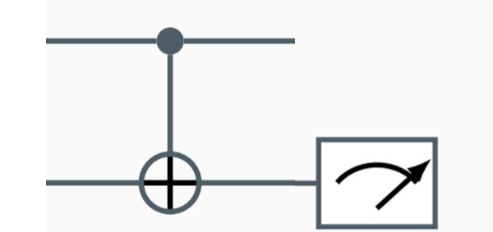
CNOT
Quelle: [2]

Slide 11
CNOT - Qiskit
# create Quantum Circuit with two Qubits
circuit = qiskit.QuantumCircuit(2,1)
# cnot gate and measure
circuit.cx(0, 1)
circuit.measure([1], [0])
print("Circuit")
circuit.draw()

Slide 12
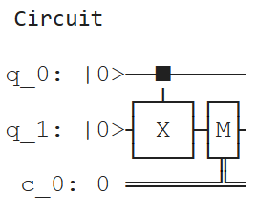
CNOT - Qiskit

Slide 13
CNOT - Cirq
# pick up qubits
qubit0 = cirq.LineQubit(0) # position 0
qubit1 = cirq.LineQubit(1) # position 1
# create a circuit
circuit = cirq.Circuit()
circuit.append(cirq.CNOT(control=qubit0, target=qubit1)),
circuit.append(cirq.measure(qubit1))
print("Circuit")
print(circuit)

Slide 14
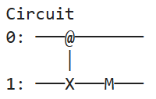
CNOT - Cirq

Slide 15
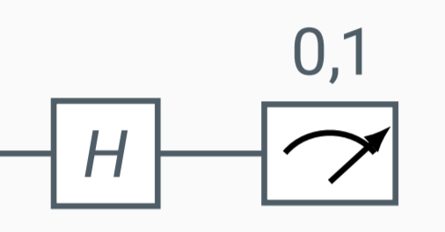
Hadamard
Quelle: [2]

Slide 16
Hadamard - Cirq
# pick a qubit
qubit = cirq.LineQubit(0) # position 0
# create a circuit
circuit = cirq.Circuit(
cirq.H(qubit),
cirq.measure(qubit)
)
print("Circuit")
print(circuit)

Slide 17

Hadamard - Cirq

Slide 18
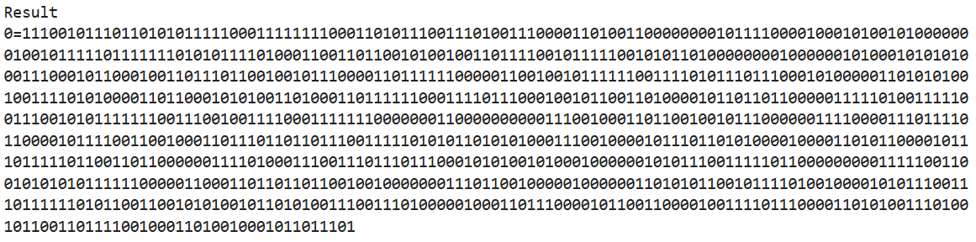
Hadamard - Cirq
# simulate
simulator = cirq.Simulator()
result = simulator.run(circuit, repetitions=1000)
print("Result")
print(result)

Slide 19
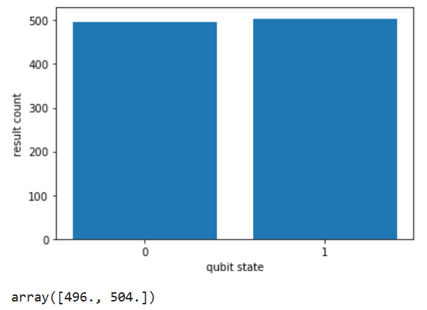
Hadamard - Cirq
# histogram
cirq.plot_state_histogram(result)

Slide 20
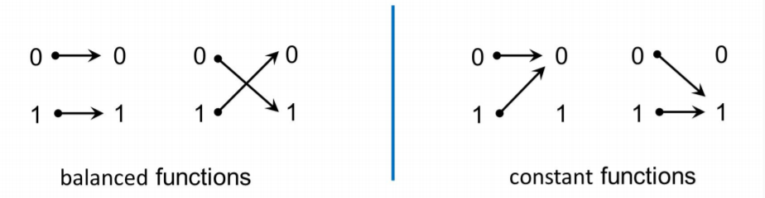
Deutsch Algorithmus
Quelle: [2]

Slide 21
Schaltkreise
Moment
Operation
0:
1:
2:

Slide 22
Deutsch Algorithmus
H
Oracle
H
|0 >
H
H
|1 >

Slide 23
Deutsch Algorithmus
H
Oracle
H
|0 >
H
H
|1 >

Slide 24
Deutsch Algorithmus
|0 >
H
H
|1 >
# create hadamard moment
moment_h_all = cirq.Moment( [cirq.H(qubit0), cirq.H(qubit1)] )

Slide 25
Deutsch Algorithmus
H
Oracle
H
|0 >
H
H
|1 >

Slide 26
Deutsch Algorithmus – Oracle Gatter
# oracle gate
def get_oracle_gate(oracle):
# if oracle is constant
if oracle == "c":
c = np.random.randint(2)
if c == 1:
return [cirq.I(qubit0), cirq.X(qubit1)]
else:
return [cirq.I(qubit0), cirq.I(qubit1)]
# if oracle is balanced
else:
return cirq.CNOT(control=qubit0, target=qubit1)

Slide 27
Deutsch Algorithmus
H
Oracle
H
|0 >
H
H
|1 >

Slide 28
Deutsch Algorithmus
|0 >
H
H
|1 >
# create measure moment
moment_m_all = cirq.Moment( [cirq.measure(qubit0), cirq.measure(qubit1)] )

Slide 29
Deutsch Algorithmus – Schaltkreis
# circuit
circuit = cirq.Circuit()
circuit.append(cirq.X(qubit1))
circuit.append(moment_h_all)
# insert oracle gate
circuit.append(get_oracle_gate("b"))
circuit.append(moment_h_all)
circuit.append(moment_m_all)
print("Result")
print(result)

Slide 30
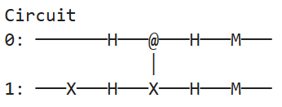
Deutsch Algorithmus – Schaltkreis
|0 >
H
Oracle
H
|1 >
H
H

Slide 31
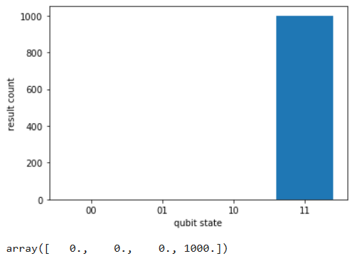
Deutsch Algorithmus – Schaltkreis
# simulate and plot
simulator = cirq.Simulator()
result = simulator.run(circuit, repetitions=1000)
cirq.plot_state_histogram(result)

Slide 32
Deutsch-Jozsa Algorithmus
Oracle
|0 >
H
H
|0 >
H
H
|1 >
H
H

Slide 33
Deutsch-Jozsa Algorithmus – Gatter
# n qubits
n_qubits = 5
# pick up qubits
qubits = [cirq.LineQubit(x) for x in range(n_qubits+1)]
# gates
gate_x_last = cirq.X(qubits[n_qubits])
gate_h_all = [cirq.H(qubit) for qubit in qubits]
gate_m_all = [cirq.measure(qubit) for qubit in qubits]
gate_h_all_ex_last = [cirq.H(qubit) for qubit in qubits[:-1]]
gate_m_all_ex_last = [cirq.measure(qubit) for qubit in qubits[:-1]]

Slide 34
Deutsch-Jozsa Algorithmus – Oracle Gatter
# oracle gate
def get_oracle_gate(oracle):
rnd = np.random.randint(2)
# if oracle is constant
if oracle == "c":
if rnd == 1:
gate = [cirq.I(qubit) for qubit in qubits[:-1]]
gate.append(cirq.X(qubits[n_qubits]))
return gate
else:
return [cirq.I(qubit) for qubit in qubits]
# if oracle is balanced
else:
if rnd == 1:
gate = [cirq.CNOT(control=qubit, target=qubits[n_qubits]) for qubit in qubits[:-1]]
gate.append(cirq.X(qubits[n_qubits]))
return gate
else:
return [cirq.CNOT(control=qubit, target=qubits[n_qubits]) for qubit in qubits[:-1]]

Slide 35
Deutsch-Jozsa Algorithmus – Schaltkreis
# circuit
circuit = cirq.Circuit()
circuit.append(moment_x_last)
circuit.append(moment_h_all)
circuit.append(get_oracle_gate("b"))
circuit.append(moment_h_all_ex_last)
circuit.append(moment_m_all_ex_last)
print("Result")
print(result)

Slide 36
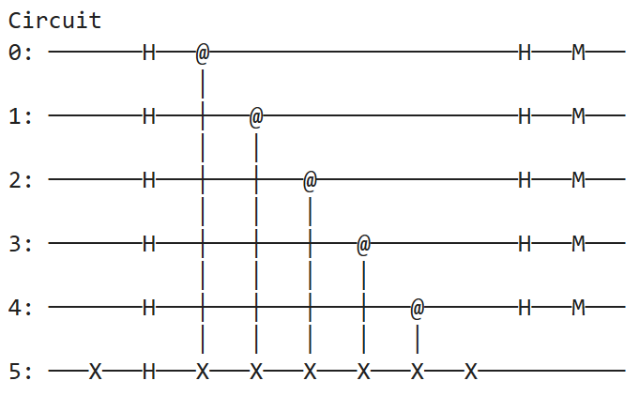
Deutsch-Jozsa Algorithmus – Schaltkreis

Slide 37
Quellen
Literatur:
[1] – Cirq Documentation, url: https://cirq.readthedocs.io/en/stable/
Bilder:
[2] – Prof. Dr. Jörg Hettel, Quantum Computing and Information An Introduction for Computer Scientists – Quantum Algorithms

Slide 38
Fragen?

