Slide 1
Alternative Entwicklungstools zu Qiskit - Cirq
Googles Quantum Computing Bibliothek für Python
Referent: Eric Brunk

Slide 2
Inhalt

Slide 3
Cirq
Python Bibliothek
Aufbau und Optimierung von Quantenschaltkreisen
Schaltkreise können auf Quantencomputern oder im Simulator ausgeführt werden

Slide 4
Installation und Import
pip install cirq
import cirq

Slide 5
Hello World
import cirq
# pick a qubit
qubit = cirq.LineQubit(0) # position 0
# create a circuit
circuit = cirq.Circuit()
circuit.append(cirq.measure(qubit))
print("Circuit")
print(circuit)

Slide 6

Hello World

Slide 7
NOT
# pick up a qubit
qubit = cirq.LineQubit(0) # position 0
# create a circuit
circuit = cirq.Circuit()
circuit.append(cirq.X(qubit)),
circuit.append(cirq.measure(qubit))
print("Circuit")
print(circuit)

Slide 8

Hello World

Slide 9
CNOT
# pick up qubits
qubit0 = cirq.LineQubit(0) # position 0
qubit1 = cirq.LineQubit(1) # position 1
# create a circuit
circuit = cirq.Circuit()
circuit.append(cirq.CNOT(control=qubit0, target=qubit1)),
circuit.append(cirq.measure(qubit1))
print("Circuit")
print(circuit)

Slide 10
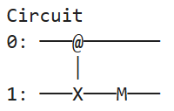
CNOT

Slide 11
Hadamard
# pick a qubit
qubit = cirq.LineQubit(0) # position 0
# create a circuit
circuit = cirq.Circuit(
cirq.H(qubit),
cirq.measure(qubit)
)
print("Circuit")
print(circuit)

Slide 12

Hadamard

Slide 13
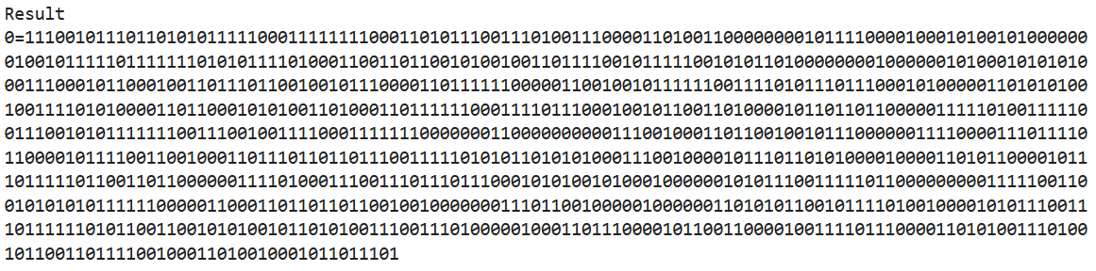
Hadamard
# simulate
simulator = cirq.Simulator()
result = simulator.run(circuit, repetitions=1000)
print("Result")
print(result)

Slide 14
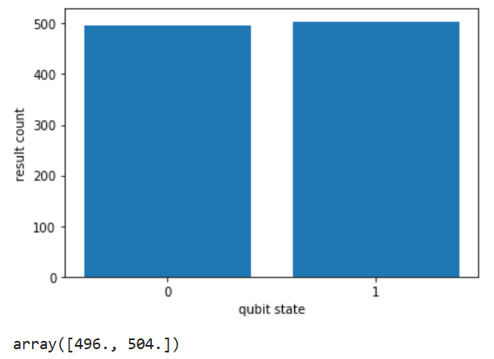
Hadamard
# histogram
cirq.plot_state_histogram(result)

Slide 15
Schaltkreise
Moment
Operation
0:
1:
2:

Slide 16
Deutsch Algorithmus
H
Oracle
H
|0 >
H
H
|1 >

Slide 17
Deutsch Algorithmus
H
Oracle
H
|0 >
H
H
|1 >

Slide 18
Deutsch Algorithmus
|0 >
H
H
|1 >
# create hadamard moment
moment_h_all = cirq.Moment( [cirq.H(qubit0), cirq.H(qubit1)] )

Slide 19
Deutsch Algorithmus
H
Oracle
H
|0 >
H
H
|1 >

Slide 20
Deutsch Algorithmus – Oracle Gatter
# oracle gate
def get_oracle_gate(oracle):
# if oracle is constant
if oracle == "c":
c = np.random.randint(2)
if c == 1:
return [cirq.I(qubit0), cirq.X(qubit1)]
else:
return [cirq.I(qubit0), cirq.I(qubit1)]
# if oracle is balanced
else:
return cirq.CNOT(control=qubit0, target=qubit1)

Slide 21
Deutsch Algorithmus
H
Oracle
H
|0 >
H
H
|1 >

Slide 22
Deutsch Algorithmus
|0 >
H
H
|1 >
# create measure moment
moment_m_all = cirq.Moment( [cirq.measure(qubit0), cirq.measure(qubit1)] )

Slide 23
Deutsch Algorithmus – Schaltkreis
# circuit
circuit = cirq.Circuit()
circuit.append(cirq.X(qubit1))
circuit.append(moment_h_all)
# insert oracle gate
circuit.append(get_oracle_gate("b"))
circuit.append(moment_h_all)
circuit.append(moment_m_all)
print("Result")
print(result)

Slide 24
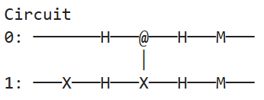
Deutsch Algorithmus – Schaltkreis
|0 >
H
Oracle
H
|1 >
H
H

Slide 25
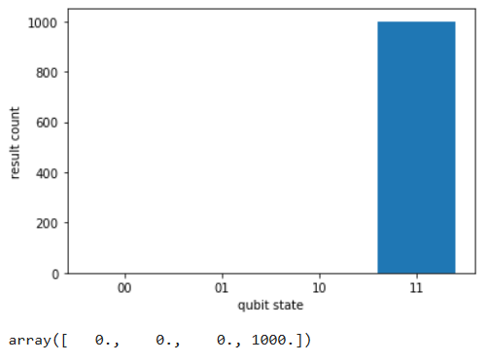
Deutsch Algorithmus – Schaltkreis
# simulate and plot
simulator = cirq.Simulator()
result = simulator.run(circuit, repetitions=1000)
cirq.plot_state_histogram(result)

Slide 26
Deutsch-Jozsa Algorithmus

