Slide 1
The Trans Community and Discrimination
Eugene Gato Nsengamungu, Ernesto Ye Luo, Kathleen Cimino

Slide 2
Background
Transgender Community is not Homogenous
Other studies looking at race, gender, AGAB, and socioeconomic status
Evidence that different trans people experience different forms of discrimination
Counting Ourselves
2015 US Transgender Survey
Can we meaningfully cluster trans people using the TransPop survey, and do these clusters have different experiences with discrimination?

Slide 3
Data Set (Source)
Collected through survey over the phone, mail questionnaire, and online questionnaire in 2016 and 2018.
Participants were recruited through and screened by Gallup to only include individuals who identify as transgender.
Final sample size of 274; only used 214 for our analysis after accounting for missing values using list-wise deletion.
99 variables of interest by two categories:
experiences with interpersonal and institutional discrimination.
demographic information.
5 interval data types.
94 nominal/ordinal data types.

Slide 4
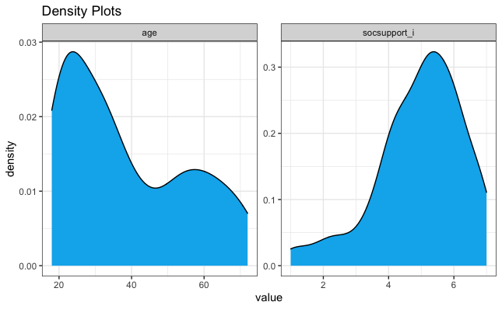
Data Set (Univariate Analysis)
Age
Mean value: 38.
Bimodal: participants tend to be either young or old.
Social Support
Mean value: 4.9
Skewed-left: participants tend to feel they have received adequate social support.
Other three interval data type variables are normally distributed.

Slide 5
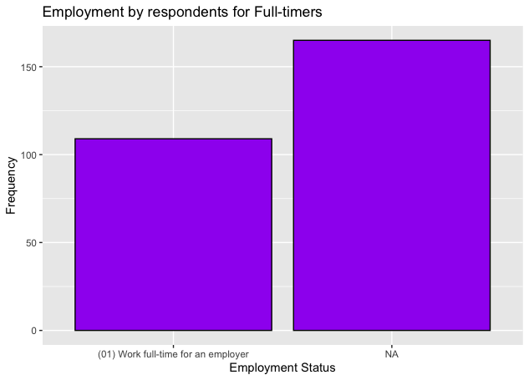
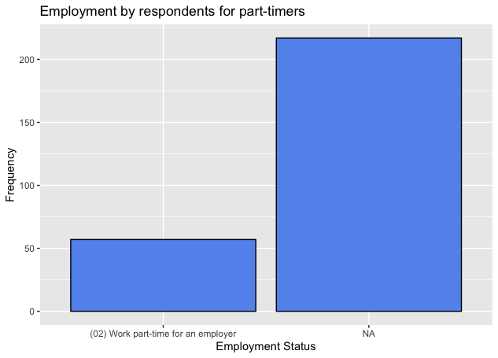
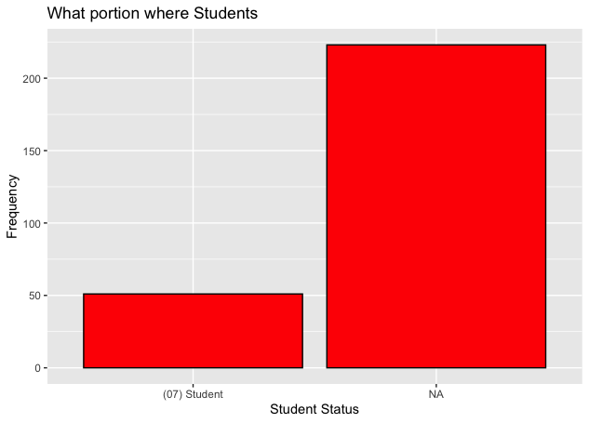
Data Set (Univariate Analysis)
Employment status variables whose pattern deviates from others of the same categories

Slide 6
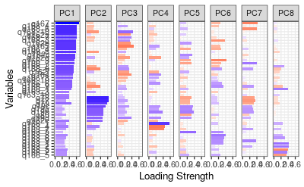
PCA
No meaningful components.
Tried using 3, 4, and 8 components (scree plot).
Tried 23, 15 components (minimum 80% variance and Kaiser Rule).

Slide 7
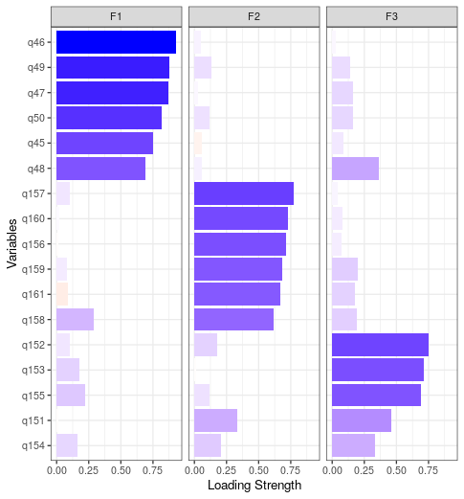
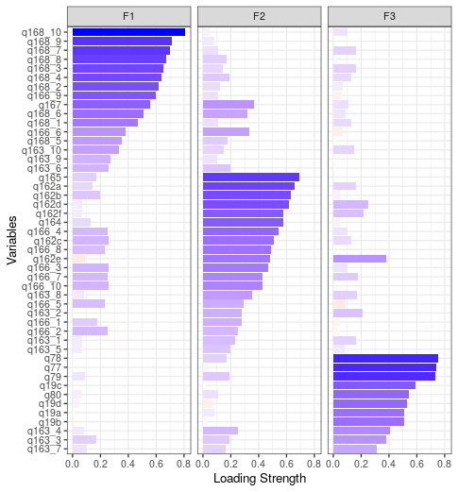
EFA
General EFA
Housing
Direct violence
Healthcare
Trans EFA
Legibility of Gender
Internalized transphobia
Hiding trans identity

Slide 8
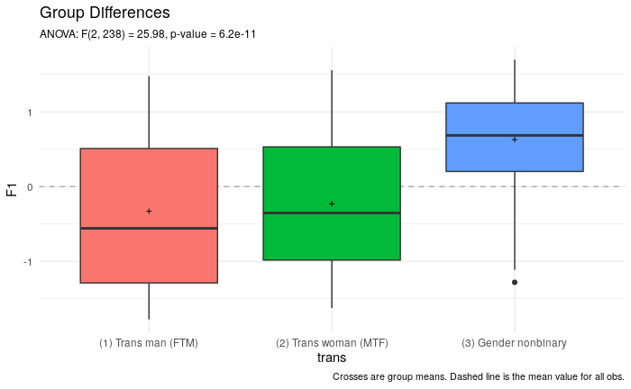
EFA
General Discrimination
Healthcare (visibility, disability, and gender identity)
Direct violence (disability)
Housing (visibility)
Trans Specific Discrimination
Legibility of Gender
Internalized transphobia
Hiding trans identity
Notes:
Sexual orientation, gender identity, presentation on a scale from masc to fem, disability, and visibility affected predominantly

Slide 9
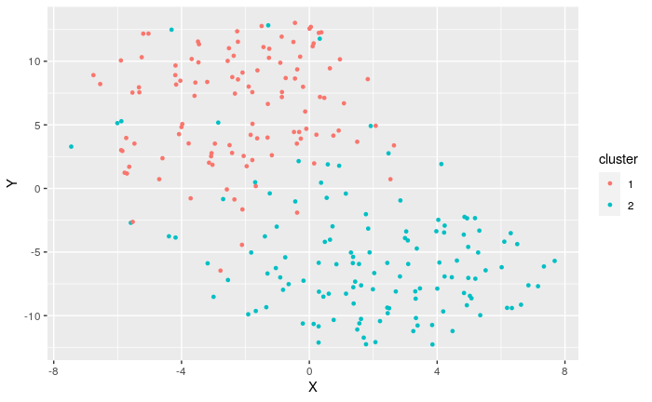
Clustering
Methods: Gower distance and PAM.
Tried clustering on both general discrimination and demographic data, just discrimination data alone, demographic data alone, and on targeted demographic data alone.
No meaningful clusters; no clear spatial separation between clusters.
Ultimately, we decided to show CA graph on targeted demographic data.
Notes:
Targeted demographic data is a subset of our general demographic dataset, but they include demographic information that are most associated with discrimination based on our literature review.

Slide 10
Findings, Implications, and Limitations
Findings
No clear clusters
No good PCA
EFA revealed six factors after dividing
Implications
Need to conduct studies designed to study intersections of discrimination
Trans people’s experiences with discrimination are complicated and should be studied more
Limitations
Survey not designed for this
Only 274 participants
Many demographic variables had little variation
Transgender community still changing
Increased visibility has led to more people realizing they’re trans, and changes in discrimination

