Slide 1

以REACT架設網站
陳偉洺 資管四
黃冠麟 資工四

Slide 2
這堂課程預計你已學會:
網頁設計(JavaScript, HTML, CSS)
如果學過ES6和ES7更佳(課程上會簡單帶過ES6)

Slide 3
這堂課程需要:
NPM(https://nodejs.org/en/download/)
Visual Studio Code(https://code.visualstudio.com/Download)
GitHub 帳號(https://github.com/join)

Slide 4
課程內容:
簡略帶過ES6
什麼是前端框架(指令式編程 -> 宣告式編程)
什麼是React
Render, JSX, Component,
React Hook(functional-based component)
套用API來做一個簡易的資料
總結
下堂課程的大綱

Slide 5
簡略帶過ES6

Slide 6
EcmaScript
Javascript 的標準
目前已來到第11版本(2020)
React 運用ES6 建立
目前各大網站都運用最少ES6

Slide 7
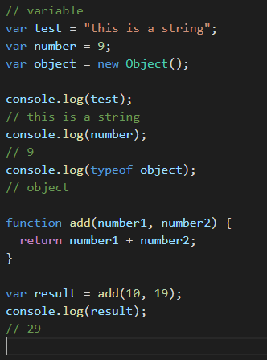
大家所學到的JavaScript

Slide 8
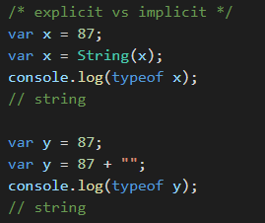
課堂上沒教的JavaScript
顯示類型轉換 vs 隱含類型轉換
== vs ===

Slide 9
const / let
const : 內容不會變動, let :內容可變動
; 可以不用打

Slide 10
Arrow Function
不能用在class裡
(https://medium.com/@charpeni/arrow-functions-in-class-properties-might-not-be-as-great-as-we-think-3b3551c440b1)
雖然只會傳一行時可以省略掉 () 和 { return } ,不過不推薦,為了增加程式碼的閱讀性

Slide 11
Classes
在JavaScript Classes 並非物件, 而是物件的模板
( `special` function )
https://developer.mozilla.org/en-US/docs/Web/JavaScript/Reference/Classes

Slide 12
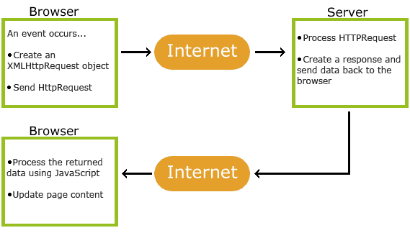
Ajax 解釋
後面實作時有需要同學在自己的React網站運用API

Slide 13
處理Ajax: Fetch()
Javascript Promise物件(https://developer.mozilla.org/en-US/docs/Web/JavaScript/Reference/Global_Objects/Promise)
其他方式
Async/Await(ES7)(https://javascript.info/async-await), Axios(https://github.com/axios/axios),SuperAgent(https://visionmedia.github.io/superagent/), 等等
純個人喜好,可以用你喜歡的

Slide 14
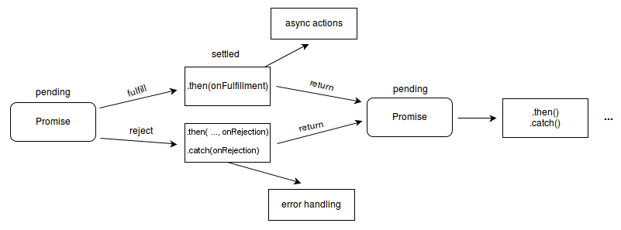
Promise物件

Slide 15
Promise物件處理方式
clone() - Creates a clone of a Response object.
error() - Returns a new Response object associated with a network error.
redirect() - Creates a new response with a different URL.
arrayBuffer() - Returns a promise that resolves with an ArrayBuffer.
blob() - Returns a promise that resolves with a Blob.
formData() - Returns a promise that resolves with a FormData object.
json() - Returns a promise that resolves with a JSON object.
text() - Returns a promise that resolves with a USVString (text).

Slide 16
Conditional Operator
condition ? if true : if false
https://developer.mozilla.org/en-US/docs/Web/JavaScript/Reference/Operators/Conditional_Operator

Slide 17
DOM (Document Object Modal)

Slide 18
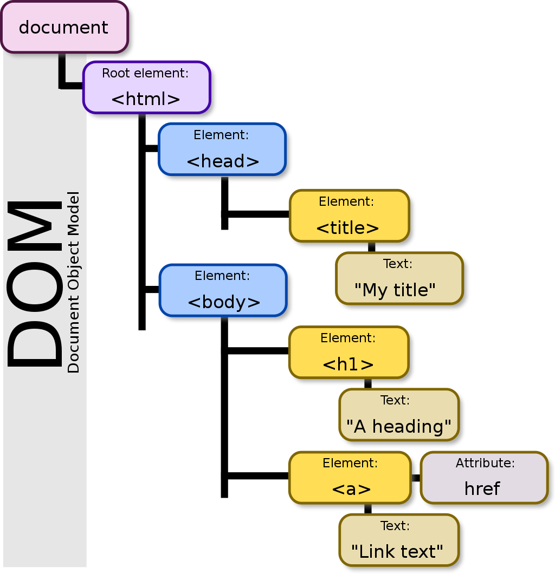

Slide 19
指令式編程 vs 宣告式編程
imperative vs declarative

Slide 20
指令式編程
HTML
<h1 id= “h1-number” >0<h1>
<button onclick="AddNumber()">Add 1 list</button>
JavaScript
const AddNumber = () => {
let number = parseInt(document.getElementById(“h1-number").innerHTML);
number += 1;
document.getElementById("list-number").innerHTML = number;
return console.log(number);
};

Slide 21
宣告式編程
HTML+JSX
<h1>{number}<h1>
<button onclick{( ) => setNumber (number + 1)}<button>
JavaScript

Slide 22
前端框架
(https://developer.mozilla.org/en-US/docs/Learn/Tools_and_testing/Client-side_JavaScript_frameworks/Introduction)

Slide 23



前端框架 - 三大
AngularJS
Vue.js
React

Slide 24
React
https://reactjs.org/
由Facebook開發
它不算框架, 它算是一個UI library
這趟課程我們會以functional component
我們會用Facebook提供的template來嘗試開發
(https://github.com/facebook/create-react-app)

Slide 25
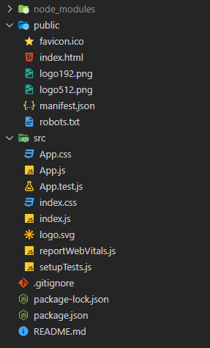
檔案架構
( https://dev.to/iggredible/what-the-heck-are-cjs-amd-umd-and-esm-ikm )

Slide 26
Render, JSX, Component

Slide 27
React Hook

Slide 28
useState()
Array Deconstructing(接es6)
https://developer.mozilla.org/en-US/docs/Web/JavaScript/Reference/Operators/Destructuring_assignment
const [state名稱, 更改state的function名稱] = useState(state的初始值)

Slide 29

useEffect()

Slide 30

useEffect() (update 底下)

Slide 31
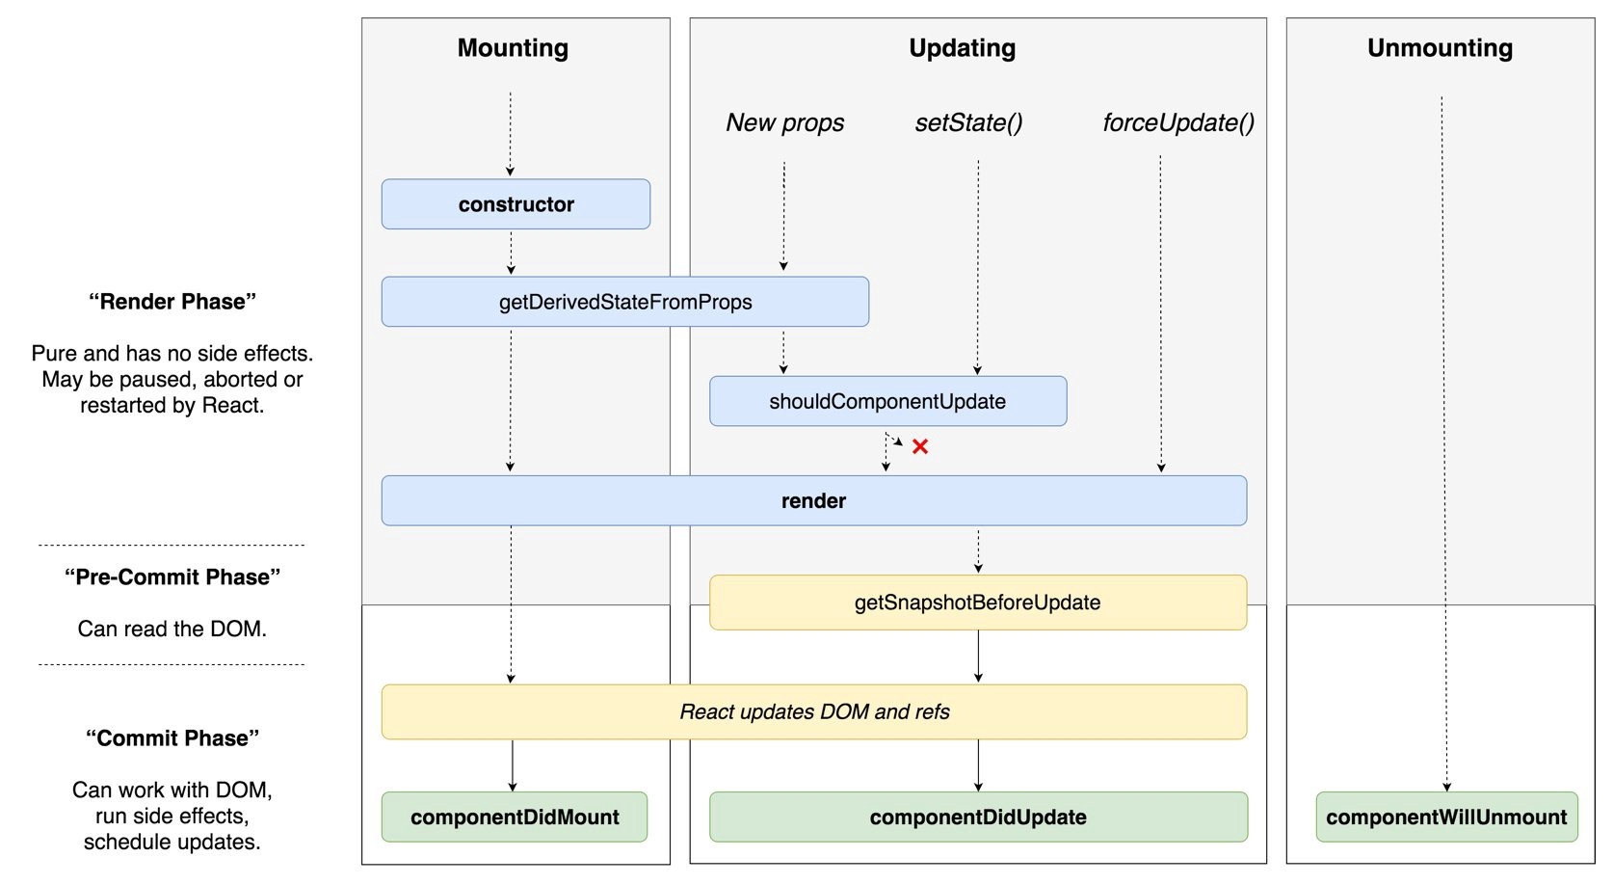
Class Component

Slide 32
Class Component vs Functional Component
個人喜好
可以合併一起用
通常Functional都會比Class少程式碼
想運用Class需要對this和bind()熟悉
建議學起來,很多React相關的library都有Class和Functional混合用,方便自己讀程式碼
現在的趨勢是Funtional + TypeScript

Slide 33
總結
Component 只不過是個會傳JSX的function
Component 只不過是function的props
明白Closure的概念 ( https://dev.to/spukas/what-do-you-know-about-javasscript-closures-4725 )

Slide 34
React相關的實用library
@material-ui/styles (https://material-ui.com/styles/basics/#material-ui-styles)
Redux( https://redux.js.org/ )( https://reactjs.org/docs/hooks-reference.html#usereducer )
React Router( https://reactrouter.com/ )
PropsType( https://reactjs.org/docs/typechecking-with-proptypes.html )
React Developer Tools( https://chrome.google.com/webstore/detail/react-developer-tools/fmkadmapgofadopljbjfkapdkoienihi?hl=en )

Slide 35
我有問題哪裡問?
Google
Reactiflux ( Discord ) ( https://www.reactiflux.com/ )
Reddit 社群( https://www.reddit.com/r/reactjs/ )
台灣社群( https://www.facebook.com/groups/reactjs.tw/ )
我 ( https://www.reddit.com/user/EryetChen )

Slide 36
下禮拜的React Native (Andriod為主 )
開發環境(https://reactnative.dev/docs/environment-setup )
Expo(React)
React Native 的 core component
React Native props 的處理
React Native 如何debug
Andriod 和 IOS 在 React Native的區別
做個簡易的app
CodeBase 的轉換

