Slide 1
CSC 480
Artificial Intelligence
Instructor: Daniel Kauffman
Summer 2021 - Cal Poly, San Luis Obispo

Slide 2
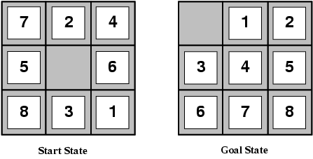
Sliding Tile Puzzle
Also called N-Puzzle
Goal: Get tiles in numerical order
Actions: Move tile horizontally or vertically into empty space
Complexity: WIDTH²!/2 configurations

Slide 3
State
Meaningful representation of environment or object in environment
In N-Puzzle, each tile configuration is one state
Ease with which tiles move or their color, etc. are not part of the state

Slide 4
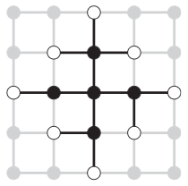
State Space
All reachable states from initial state make up the state space
Explored States
States already visited by search algorithm
Frontier States
Unexplored states adjacent to at least one explored state
Black: Explored
White: Frontier

Slide 5
Problem Solving
Components of a Problem
Initial State
Action Set
Transition Model
Goal Test
Path Cost

Slide 6
Problem Solving: Initial State
Components of a Problem
Initial State
Action Set
Transition Model
Goal Test
Path Cost
Starting point of problem
Simplified description of state
Only relevant properties used

Slide 7
Problem Solving: Action Set
Components of a Problem
Initial State
Action Set
Transition Model
Goal Test
Path Cost
From any state, some set of actions must be available to proceed
Actions available may differ for different states

Slide 8
Problem Solving: Transition Model
Components of a Problem
Initial State
Action Set
Transition Model
Goal Test
Path Cost
Problem must define outcome of an action in a particular state
Model represented as function:
Result(s, a) = s'

Slide 9
Problem Solving: Goal Test
Components of a Problem
Initial State
Action Set
Transition Model
Goal Test
Path Cost
Determine whether solution found
Test may be applied to frontier or explored states (depending on problem requirements)

Slide 10
Problem Solving: Path Cost
Components of a Problem
Initial State
Action Set
Transition Model
Goal Test
Path Cost
Cost of solution, from initial state to goal state

Slide 11
Search
Find sequence of actions to go from initial state to goal state
Path may or may not be relevant to solution
Optimality may not be feasible
State space may have cycles
Tree Search: Assume no cycles in state space
Graph Search: Keep set of explored states to avoid cycles
"Algorithms that forget their history are doomed to repeat it."
Searches may be informed or uninformed

Slide 12
Solution Metrics
Search strategies may be compared by following criteria
Completeness
Solution always found
Optimality
Top solution always found
Time Complexity
Varies by processor
Alternative: # states used
Space Complexity
Max # states in memory
Time/Space Complexity Metrics
b Max branching factor
d Depth of shallowest goal
m Max depth of state space
Usually represented with Big-O (worst case) notation

Slide 13
Uninformed Search

Slide 14
Uninformed Search
Search problems involve finding sequence of actions that reach goal state
In uninformed search, only definition of the problem is provided
Unable to assess proximity to goal at any point
Only knows distance traversed thus far
May solve any solvable problem
Solution may be too inefficient

Slide 15
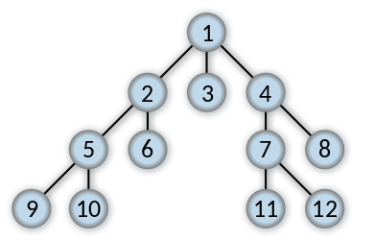
Breadth-First Search (BFS)
Explore one level at a time
Uses FIFO queue
BFS Properties
Complete | if b is finite
Optimal | if all edges equal
Time | O(b^{d})
Space | O(b^{d})

Slide 16

Depth-First Search (DFS)
Explore to leaf before backtracking
Uses LIFO stack or recursion
DFS Properties
Complete | if m is finite
Optimal | false
Time | O(b^{m})
Space | O(bm)

Slide 17
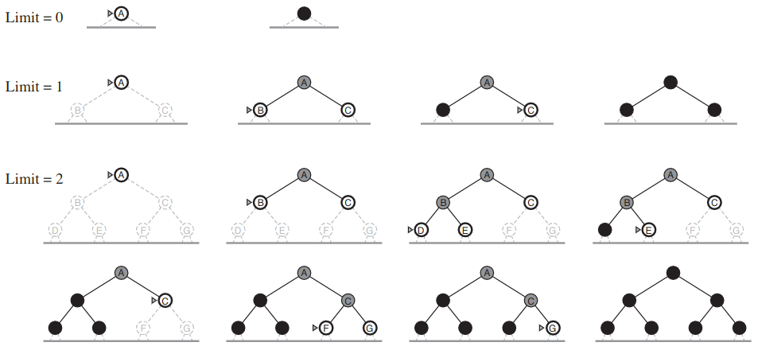
Iterative Deepening DFS (ID-DFS)
DFS until level limit reached
Increase limit, restart DFS
Standard DFS is ID-DFS with limit set to infinity
ID-DFS Properties
Complete | if b is finite
Optimal | if all edges equal
Time | O(b^{d})
Space | O(bd)

Slide 18
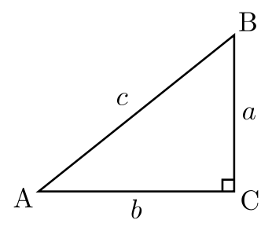
Uniform Cost Search (UCS)
Explore to state with least total cost from initial state
Uses priority queue
From A to B:
AC then AB
UCS Properties
Complete | if b is finite
Optimal | true
Time | varies
Space | varies

Slide 19
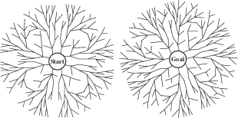
Bidirectional Search
Perform 2 simultaneous BFS
At initial and goal states
Goal test: Searches meet
Requires knowing goal state
UCS Properties
Complete | if b is finite
Optimal | if all edges equal
Time | O(b^{d/2})
Space | O(b^{d/2})

Slide 20
Informed Search

Slide 21
Informed Search
With informed search, quality of frontier states may be evaluated
Uses search heuristic to estimate distance to goal
h(n): Estimated distance between state n and goal
May be combined in evaluation function f(n) to measure overall quality of frontier state n

Slide 22
Defining Heuristics
Search Heuristic: Estimate of distance between states
Heuristic chosen depends on search problem
Often developed by relaxing constraints of problem
Allows actions not permissible in problem definition
Example heuristics from initial state to goal state for the N-Puzzle:
# of misplaced tiles (tiles can be picked up and moved)
Manhattan distance of tiles (tiles can move over other tiles)

Slide 23
Greedy Search
Select node with lowest h(n)
h(n):
estimated distance to goal from state n
Absolute Error: |h(n) - h*(n)|
h*(n): Actual distance
Minimizing can improve performance
Greedy Search Properties
Complete | if m is finite
Optimal | false
Time | O(b^{m})
Space | O(b^{m})

Slide 24
A* Search
Uniform Cost Search keeps track of cost from start to node n
g(n): cost to n
Greedy Search selects next node closest to goal
h(n): est. cost from n
A* Search combines both
f(n) = g(n) + h(n)
A* Search Properties
Complete | true
Optimal | true
Time | based on error
Space | based on error

Slide 25
Admissible Heuristics
A heuristic h(n) is admissible if for every node n:
h(n) ≤ h*(n)
where h*(n) is the true cost to reach goal state from n
An admissible heuristic never overestimates cost to reach goal
Always "optimistic"
Example: Straight-line distance for travel distance
If h(n) is admissible and each state explored only once then A* is optimal

Slide 26
Admissible Heuristic Example
h(n) = 1
h(n) is admissible
Never overestimates
Optimal path SBG will always be found
True for any non-overestimating value of h(n)
h(n) upper-bounded by actual path cost
A
1
5
S
G
h(n) = 4
B
1
4

Slide 27
Inadmissible Heuristic Example
h(n) = 5
h(n) is not admissible
May overestimate
Suboptimal path SAG will be chosen as solution
Optimal path SBG will not be considered
If inadmissible, h(n) may show optimal path cost to be > non-optimal path cost
A
1
2
S
G
h(n) = 10
B
1
1

Slide 28
Consistent Heuristics
Consistency is a stronger heuristic requirement for A* efficiency
Any consistent heuristic is admissible
f(n) must be monotonically non-decreasing toward goal
g(n) is accurate and h(n) is admissible (non-overestimating)
Thus, g(n) + h(n) should not get smaller approaching goal
Identical to triangle inequality:
h(A) ≤ |AB| + h(B)
B
A
C

Slide 29
Inconsistent Heuristic Example
h(n) is admissible but inconsistent
SAC will be explored prior to SBC
Unnecessary paths may be expanded
h(n) = 1
A
1
2
h(n) = 1
S
C
10
G
h(n) = 10
B
1
1

Slide 30
Dominance
Admissible heuristics can often be found by relaxing problem constraints
Sliding Tile Puzzle:
h₁(n): # of misplaced tiles (tiles can be picked up and moved)
h₂(n): Manhattan distance of tiles (tiles can move over other tiles)
Both heuristics are admissible (they never overestimate the distance)
h₂(n) ≥ h₁(n) for any node in the graph
h₂(n) dominates h₁(n) and is a more accurate heuristic

Slide 31
Combining Heuristics
Many heuristics may seem promising or difficult to measure
h_{i}(n) may perform better than h_{j}(n) in some cases and vice versa
Difficult to compare h_{i}(n) and h_{j}(n) in all cases
Assuming all such heuristics are admissible, they can be combined as:
h(n) = max(h₁(n), h₂(n), ..., h_{m}(n))
Since each heuristic is individually admissible:
h(n) must be admissible and closest to actual distance

Slide 32
A* Memory Optimizations
Memory is usually bottleneck of A* search performance
IDA* (Iterative Deepening A*): Perform DFS using cost of state f(n) as depth limit
Fewer states in memory
May require many iterations
Like BFS, A* states kept in memory (frontier and explored states)
SMA*: Force limit on number of simultaneous active states
When limit reached, prune highest-cost states from graph
States may need to be re-generated later

Slide 33
Local Search

Slide 34
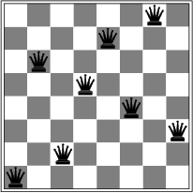
Problem: N-Queens
N-Queens
Objective: No attacking pairs
Queens attack horizontally, vertically, diagonally
Queens may be placed on any empty square

Slide 35
Local Search Algorithms
For optimization problems, optimal goal state often not known
Search tries to find best state possible given time (or other) constraints
Path from initial state to goal state usually not relevant
In local search methods, a constant amount of memory is used
Only successors of current state(s) available at any time
No frontier and explored sets
Memory efficient but unable to reproduce an optimal path

Slide 36
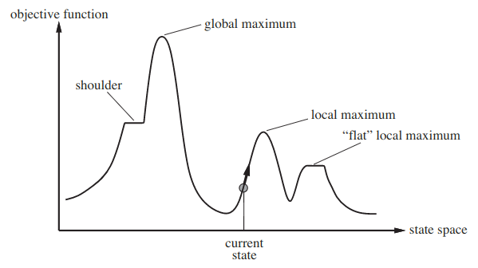
State Space Landscape
Objective Function:
Evaluates quality of a state WRT problem-specific criteria
Global Optimum:
State that evaluates to best result
Local Optimum:
States better than all neighboring states but not globally optimal

Slide 37
Hill Climbing Search
Use greedy approach of exploring best successor states
If costs are not uniform, select steepest (best) successor state
If all best successor states are equal to current state:
Traverse "plateau" for n iterations
Halt search if no better state found
If no successor states are better, stop search
This strategy is highly prone to becoming trapped in local optima
"[Hill Climbing Search] resembles trying to find the top of Mount Everest in a thick fog while suffering from amnesia."

Slide 38
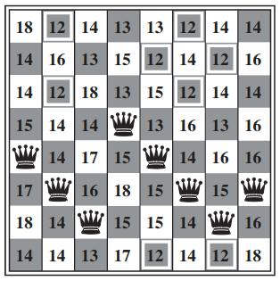
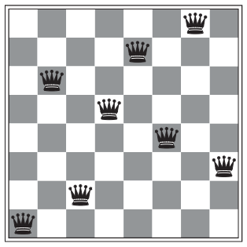
Hill Climbing: N-Queens
f(n): # attacking pairs
In state below: f(n) = 17
Local Minimum: f(n) = 1
All successor states are worse

Slide 39
Variants of Hill Climbing
Random Restart Hill Climbing
Repeat hill climb, restarting with new initial state each time
Stochastic Hill Climbing
For multiple uphill successor states, choose one at random
Probability of uphill state being chosen depends on its "steepness"
First Choice Hill Climbing
Generate random successors until better state found
Useful if number of successor states too great to generate in full

Slide 40
Simulated Annealing Search
Let optimal state be the global minimum
In Simulated Annealing, random successor state selected each iteration
If state has better f(n) value, it is explored
Otherwise, state is explored with probability P
P decreases during search according to predefined schedule
P may be weighted by degree successor state is worse than current
Toward end of search, fewer worse states chosen
Simulates "heated" materials cooling over time
As rate of schedule decreases, probability of completeness approaches 1

Slide 41
Local Beam Search
Some local search strategies use one current state
In Local Beam Search k current states exist at any time
On each iteration, all successor states to all k states are generated
For branching factor b number of successor states is kb
Only k best states chosen for next iteration
Selected states may start to "cluster" in one area of search space
May result in lower state "diversity"
Solution: Choose some successor states at random

Slide 42
Genetic Algorithms

Slide 43
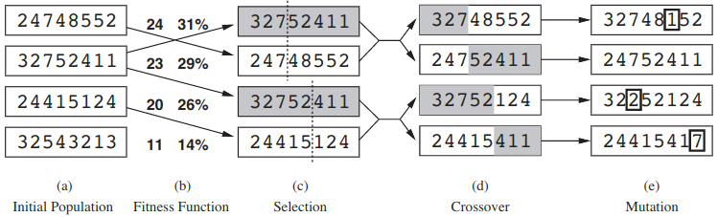
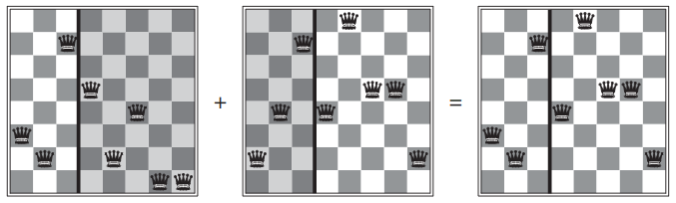
Genetic Algorithm: Intuition

Slide 44
Genetic Algorithm Terminology
Individual: Sequence of values, usually array or (bit) string
Population: Set of individuals
Generation: Current population, replaced on each iteration
Crossover: Process of creating a new individual from two existing individuals
Mutation: Randomly altering values in an individual's sequence
Fitness Function: Procedure that evaluates an individual by given criteria

Slide 45
Terminating Conditions
Methods of stopping a Genetic Algorithm:
Time/Generations
Fitness Score: Individual found with sufficiently high score
May not be optimal if optimal solution not known
One Remaining: Return last remaining individual
Applicable only if population decreases with each generation
Convergence: All individuals very similar or identical
Similarity requires distance metric
Requires sufficiently low mutation rate

Slide 46
Fitness Functions
Quality of an individual is defined by a fitness function
Different problems will require different fitness functions
Based on what makes individuals good or bad
Similar to state's cost in other search methods
Often most expensive aspect of Genetic Algorithm
May not be linear or even polynomial in run time
Calculated independently of other individuals
Allows function to evaluate on GPU or distributed system

Slide 47
Selection
Individuals are selected for crossover based on results of fitness function
Those with scores below threshold may not be considered
Given a random number R:
After all members of population are scored:
Scores are added to a running total until total ≥ R
Individual whose score caused total to reach threshold is selected
R = 0.4 | 0.05 | 0.25 | 0.2 | 0.15 | 0.35

Slide 48
Crossover
Creates a "child" individual from two "parent" individuals
Randomly partitions parents
Uses opposing sides of partition from each parent to create child
Parent₁ | 0 | 2 | 4 | 6 | 8
Parent₂ | 1 | 3 | 5 | 7 | 9
Child₁ | 0 | 2 | 4 | 7 | 9
Child₂ | 1 | 3 | 5 | 6 | 8

Slide 49
Mutation
Goal: Keep population diverse
Prevents stagnating in local optima
Allow small chance crossover child will have element(s) altered
Add: Insert item in sequence
Remove: Delete item from sequence
Edit: Modify item in sequence
Rate of each type of modification may vary

Slide 50
Generational Complexity of a Genetic Algorithm
Let N be population size and F be the run time of fitness function
For each of G generations produced:
Fitness: O(F∙N)
For each new individual created from this generation:
Selection + Crossover + Mutation: O(N) or less
Since N individuals created per generation, G runs in O(N²+F∙N)
Number of generations based on algorithm's terminating condition

Slide 51
Agents & Environments

Slide 52
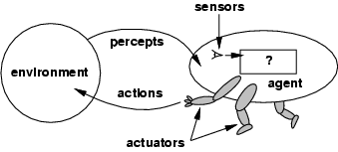
Agent Model
In Artificial Intelligence:
An agent is an abstraction
Agents should be rational
Agent is evaluated by a performance measure
Agent Properties
Exists in an environment
Sensors perceive environment
Actuators manipulate environment

Slide 53
Agent Intelligence
Human intelligence is the most sophisticated intelligence we know
Humans often make decisions against their interests
May be a poor benchmark for intelligent systems
Rationality: Choose best action (based on problem)
Action should (appear to) maximize an expected outcome
Uncertainty: Outcome of rational action may not be known in advance

Slide 54
Rational Agent Requirements
Rational agents do the "right thing" under uncertainty
Given what an agent knows about its environment:
Select actions expected to maximize performance measure
Expectation based on percepts and pre-defined knowledge
Rationality considerations:
Computation limitation may render absolute rationality unachievable
Rationality distinct from omniscience (infinite knowledge)
Rationality includes exploring environment to gather more information

Slide 55
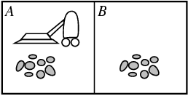
Vacuum Cleaner World
Environment:
Rooms: {A, B, ...}
Rooms can be clean or dirty
Percepts:
Current location
Presence of dirt
Actions:
Move left or right
Vacuum

Slide 56
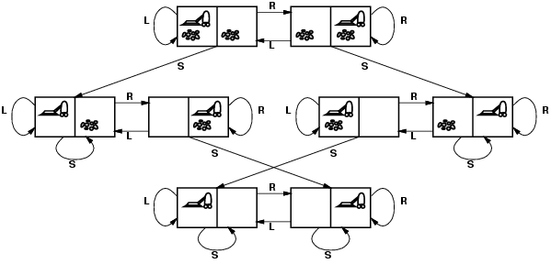
Vacuum World State Space

Slide 57
Performance Measure [1/2]
Objective criterion to judge agent behavior
Based on state of environment, not state of agent
Prevents agent from "deluding" itself
Vacuum Cleaner Agent performance measures:
Amount of dirt cleaned

Slide 58
Performance Measure [2/2]
Objective criterion to judge agent behavior
Based on state of environment, not state of agent
Prevents agent from "deluding" itself
Vacuum Cleaner Agent performance measures:
Amount of dirt cleaned
Number of clean rooms
Time taken
Power consumed
Noise Generated

Slide 59

Automated Taxi Driver
Performance Measure | safe, legal, profitable
Environment | road, cars, pedestrians
Actuators | steering, signals, accelerator
Sensors | cameras, GPS, speedometer

Slide 60
Environment Types
Observability | Full | Partial | What sensors can detect
Determinism | Deterministic | Stochastic | Whether actions have predictable consequences
Continuity | Episodic | Sequential | Whether consequences persist across multiple tasks
Transitivity | Static | Dynamic | Whether state changes while agent selects action
Precision | Discrete | Continuous | How granular are state attributes
Agent | Single | Multi | Whether agent must account for other agents
Knowledge | Known | Unknown | Whether environment mechanics understood

Slide 61
Contingency Plans

Slide 62
Contingency Plans
In some types of environments, outcomes are not known
Stochastic: Actions may produce unintended outcomes
Partially Observable: Some aspects of state not perceived
Adversarial (Multi-Agent): Other agents may impede progress
Agents in these environments must develop a contingency plan
Requires analyzing possible outcomes for each action
Allows rational response to any successor state

Slide 63
Contingencies: Stochastic Environments
Result of an action may not always be the same
Possible causes of unknown action outcome:
Known stochastic process (e.g. rolling dice)
Stochasticity of environment (e.g. weather)
Faulty agent hardware (e.g. broken actuator)
If action outcomes are stochastic:
Many successor states may be possible
Solutions must account for all such successor states

Slide 64
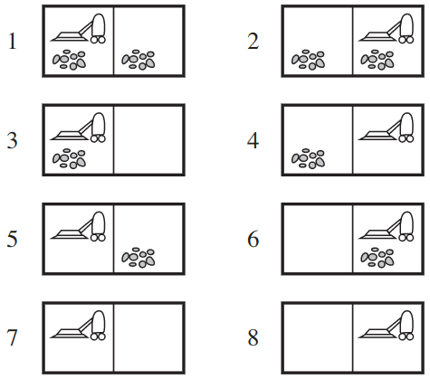
Stochastic Vacuum World
Stochasticity adds complexity
Actions may not work as planned
Requires contingency plan
Vacuum World Actions:
Move, Clean
Actions can be made stochastic
Movement might fail (no-op)
Cleaning might dump dirt

Slide 65
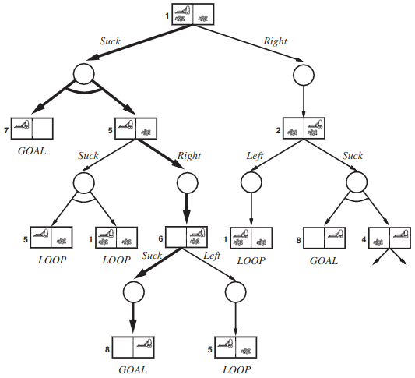
AND-OR Tree: Stochastic Vacuum
Contingencies can be represented as trees
OR nodes have one branch for each action agent may select in state
AND nodes encompass all successors that may occur from an action
Solution AND-OR subtree contains:
a goal at every leaf
one action at each OR node
every outcome at each AND node
Suck may deposit dirt or clean both rooms

Slide 66
Contingencies: Partially Observable Environments
If an agent cannot perceive entire environment:
Use environment knowledge to predict action outcomes
Make assumptions based on percept history
Instead of using actual states, agent can use belief states

Slide 67
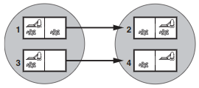
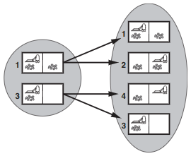
Belief States
Standard Vacuum World
Each belief state contains all possible actual states
Each state either is or is not in the belief state
For N states, there can be 2^{N} belief states
Valid actions in a belief state are:
Union of actual states' actions
If illegal actions permitted
Intersection of actual states' actions
If illegal actions not permitted
Agent knows it has reached a goal belief state when all actual states are goal states
Stochastic
Movement Vacuum World

Slide 68
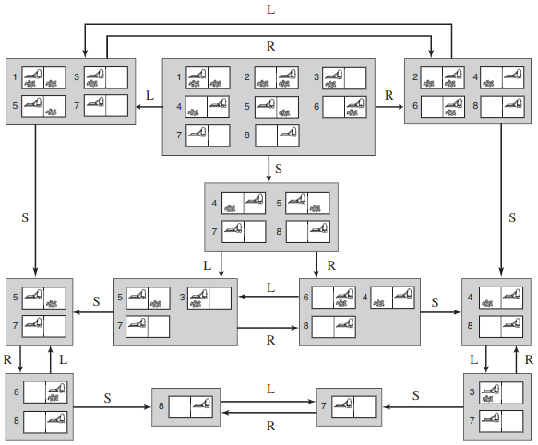

Slide 69
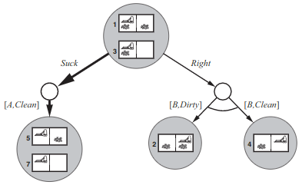
AND-OR Tree: Partial Observability
To find solutions in partial observability:
Use AND-OR trees with belief states
Action chosen at OR node can reduce actual states in belief state
Each AND node captures all possible states that may result from action
Local-Sensing Vacuum Bot

Slide 70
Constraint Satisfaction

Slide 71
Constraint Satisfaction Problems
In Constraint Satisfaction Problems (CSPs):
Variables in a state may be assigned values from a domain
CSP goal state: No variable assigned value that violates constraints
CSPs can be solved by searching state space of variable assignments
A single assignment that does not violate any constraint is consistent
An assignment of all variables within a state is complete
CSP solution state must be consistent and complete

Slide 72
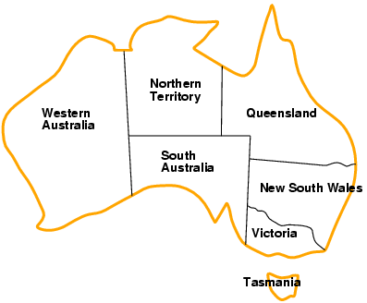
Example: Map Coloring [1/2]
For each territory variable:
Assign exactly one color
Ensure adjacent territories do not have same color
Problem components:
Variables: {WA,NT,SA,Q,NSW,V,T}
Domain: {Red,Green,Blue}
Constraint: Adjacent regions must differ (e.g. WA ≠ NT)

Slide 73
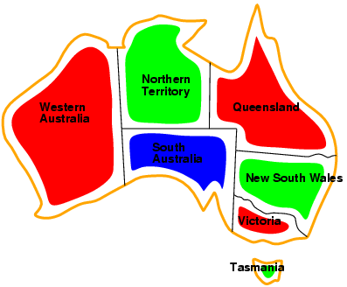
Example: Map Coloring [2/2]
For each territory variable:
Assign exactly one color
Ensure adjacent territories do not have same color
Problem components:
Variables: {WA,NT,SA,Q,NSW,V,T}
Domain: {Red,Green,Blue}
Constraint: Adjacent regions must differ (e.g. WA ≠ NT)

Slide 74
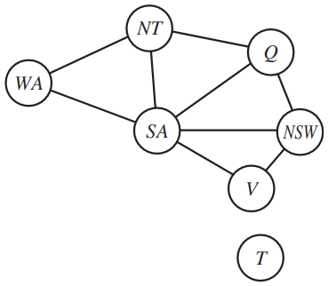
Constraint Graph
Using an undirected graph:
Vertices: Variables
Edges: Constraints
Each edge refers to same type of constraint
Multiple constraint types require a more complex graph

Slide 75
Constraint Types
Unary Constraints
Specifies which value(s) cannot be assigned to a variable
Represented as variable's domain
Binary Constraints
Required relationship between two variables
e.g. WA ≠ NT
Constraints can also be N-ary
Requirements apply to any number of variables

Slide 76
Consistency Types
Node Consistency
All unary constraints satisfied
Variables only assigned values from domain
Arc Consistency
All binary constraints satisfied
No pair of assignments conflict
Higher order consistencies:
Path Consistency: All ternary constraints satisfied
K-Consistency: All K-ary constraints satisfied

Slide 77
CSP Inference: Constraint Propagation
Simply searching CSP state space might be inefficient
Given constraints for a problem:
Some variable assignments may be inferred
Some domains may be reduced in size
By inferring variable assignments or domain reductions:
States may be pruned from search space
Search for CSP solution will be faster
Constraint Propagation may be preprocessing step or done during search

Slide 78
CSP Search: Backtracking [1/2]
CSP state space can be searched with DFS
Each level provides assignment of one variable
Leaf represents assignment of all variables
Search backtracks if constraints prevent any assignment to variable
Improvements for backtracking
What order should variables be chosen for assignment?
What order should values be attempted?

Slide 79
CSP Search: Backtracking [2/2]
CSP state space can be searched with DFS
Each level provides assignment of one variable
Leaf represents assignment of all variables
Search backtracks if constraints prevent any assignment to variable
Improvements for backtracking
Variable selection heuristics:
Minimum Remaining Values
Highest Degree (tie breaker)
Value selection heuristic: Least Constraining Value

Slide 80
Adversarial Search

Slide 81
Adversarial Search
All search problems thus far have been in single-agent environments
No other agents existed to solicit assistance or information
No agents existed to thwart the plans of another for its own gain
In adversarial multi-agent environments, the outcome is often zero-sum
Overall outcome is constant while individual outcomes are opposite

Slide 82
Games Definition
Components of Adversarial Search Problems
Initial State
Action Set
Transition Model
Goal Test (or Terminal Test)
Player Test
Determine whose turn it is
Utility
Defines value of each terminal state
With 2 players, utility is absolute: +1 if P1 wins and -1 if P2 wins
With 3+ players, utility is relative to player that made move

Slide 83
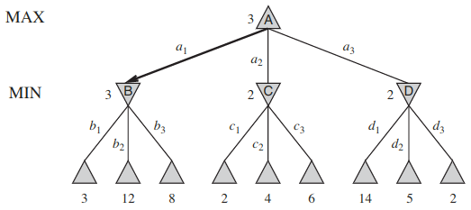
Game Trees
Game trees represent all possible ways a game can be played from initial state
Each decision by a player is a ply
Utility values of each leaf may be found through search (DFS)
Parent states given utility by "backing up" best utility of children
Usually too big to compute in full

Slide 84
Games Complexity
Game | Board Size | State Space Upper Bound | Game Tree Upper Bound | Average Number of Plies | Average Branching Factor
Tic-Tac-Toe | 9 | 10³ | 10⁵ | 9 | 4
Connect Four | 42 | 10¹³ | 10²¹ | 36 | 4
Checkers | 32 | 10²⁰ | 10³¹ | 70 | 2.8
Chess | 64 | 10⁴⁷ | 10¹²³ | 70 | 35
Shogi | 81 | 10⁷¹ | 10²²⁶ | 115 | 92
Go | 361 | 10¹⁷⁰ | 10³⁶⁰ | 150 | 250
https://en.wikipedia.org/wiki/Game_complexity

Slide 85
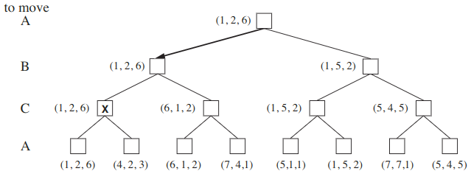
Games with 3+ Players
With n players (where n > 2):
Utility expressed as a n-dimensional vector
Each value in vector represents utility of one player
Vector "backed-up" to current state is one with highest utility for current player
Each vector represents utility for each player (ordered A, B, C)

Slide 86
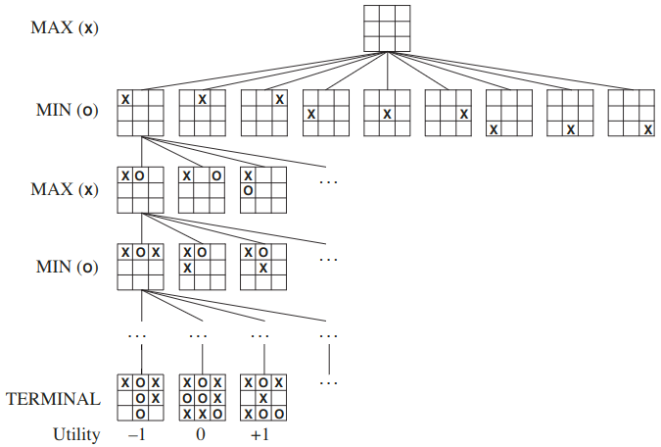
Tic-Tac-Toe State Space
Each branch represents a move taken by X or O
Leaves of tree are terminal states (win/loss or tie)
Utility represents game result
-1: MIN (O) wins
0: Tie game
1: MAX (X) wins

Slide 87
The Minimax Algorithm
Traverse game tree by recursively "taking turns" to find terminal states
Utility values are backtracked toward game tree root (current state)
Minimax Properties:
Complete (if b and m finite)
Optimal
Time: O(b^{m})
Space: O(bm)

Slide 88
Transposition Tables
Many game states can be reached via multiple paths through game tree
Transposition tables map a collection of states to one utility value
Spares algorithm from calculating utility of transposed states
Transpositions may include various combinations of rotations and reflections
x |  |  | ➜ | X |  |  | ➜ | X |  | X
 |  |  |  |  | O |  |  |  | O
 |  | X | ➜ |  |  | X | ➜ | X |  | X
 |  |  |  |  | O |  |  |  | O

Slide 89
Estimating Utility
Game trees are usually too large to traverse completely
Time constraints may require stopping before reaching terminal state
Use heuristic to estimate likely utility of deepest state traversed
Heuristic should provide utility values that:
Align with actual utility (e.g. high values for MAX)
Correlate with player's actual chance of winning
Iterative Deepening DFS allows for incrementally increasing subtrees to be explored until move time limit is reached

Slide 90
Game Features
States in game tree can be estimated with an evaluation function
Utility(s) = w₁f₁(s) + ... + w_{n}f_{n}(s)
Uses weighted linear combination of features
Each feature represents an outcome-relevant attribute of the game state
Features are specific to a particular game

Slide 91
Monte Carlo Tree Search (MCTS)
Minimax suffers from having to explore entire game tree
Alternative is to explore partial game tree and estimate utility
Heuristic necessarily game-dependent and does not generalize
Monte Carlo Tree Search finds probable winning move sequences
"Simulate" play by making random moves from current state
Record wins versus attempts for each state on selected path
With sufficient stats from random moves, start selecting "intelligently"
Revert to random selection if successor states have insufficient stats
When time limit reached, choose move with best win ratio

Slide 92
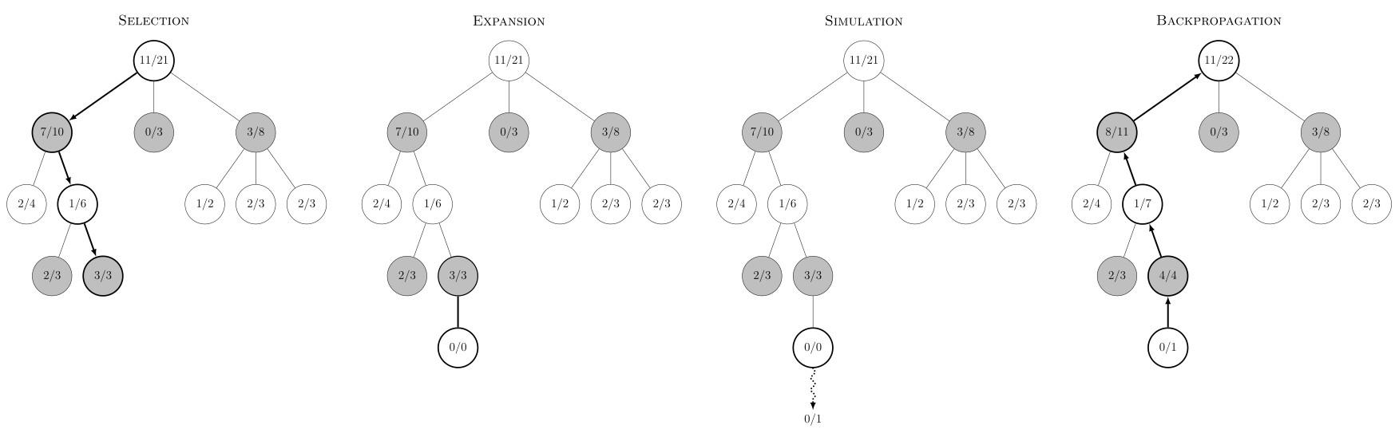
MCTS Phases

Slide 93
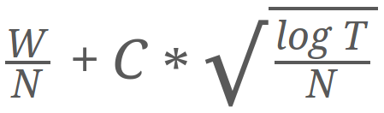
Upper Confidence Bound (UCB)
Initially, MCTS selects at random
Random playthroughs provide initial stats for game states
Use UCB if state has sufficient stats
Determines which successor state (next move) to select
Balances exploration and exploitation
Requires storing # wins and attempts per explored state
Per selection of moves:
W: # Wins
N: # Attempts
T: Total Attempts (All)
C: Exploration Bias (usually √2)

Slide 94
Reinforcement Learning

Slide 95
Reinforcement Learning
In an environment:
Agent learns optimal actions to take
Learning is carried out with rewards (positive or negative)
Rewards: Inform agent of a state's usefulness
Utility: Encapsulates all rewards from a state onward (long-term reward)
Policy: Function learned that maps states to actions
Optimal policies provide best action in a given state
Notes:
Utitlity: Looks many states ahead to see what action will be most favorable in the long run

Slide 96
Markov Decision Process: Concepts
A Markov Decision Process (MDP) is a model for decision making
Finite number of discrete states
Transitions are stochastic – not guaranteed what the successor state is going to be given a state-action pair
Probability of a transition follows the Markov assumption
Depends only on current state, not previous states
Looks at most immediate probability, not a sequence of them
Stochastic transition model represented as P(s'|s, a)
Probabilty that we will end up in s’, from state s, given we perform action a

Slide 97
Markov Decision Process: Definition
Initial State
Action Set
Outcome of performing an action is stochastic
Transition Model: P(s'|s, a)
Probability of each outcome given state and action
Reward: R(s)
Function that maps positive or negative value of a state
Policy: π(s) = a
Learned, not part of MDP
Function that decides an action given a state
π* represents an optimal policy

Slide 98
Simple MDP: Problem
In this MDP:
Agent starts at (1, 1)
Black square is a barrier
States have (short-term) rewards:
R(green) = 1
R(red) = -1
R(others) = -0.04
Agent movement:
← ↑ → ↓
P(90°) = 0.1, P(270°) = 0.1
 |  |  | +1
 |  |  | -1
start
Find optimal policy π(s)
Provides best actions to take
Agent can maximize utility (long-term reward) from any s

Slide 99
Simple MDP: Optimal Solution
In this MDP:
Agent starts at (1, 1)
Black square is a barrier
States have (short-term) rewards:
R(green) = 1
R(red) = -1
R(others) = -0.04
Agent movement:
← ↑ → ↓
P(90°) = 0.1, P(270°) = 0.1
→ | → | → | +1
↑ |  | ↑ | -1
↑ | ← | ← | ←
Find optimal policy π(s)
Provides best actions to take
Agent can maximize utility (long-term reward) from any s

Slide 100
Simple MDP: Utilities
In this MDP:
Agent starts at (1, 1)
Black square is a barrier
States have (short-term) rewards:
R(green) = 1
R(red) = -1
R(others) = -0.04
Agent movement:
← ↑ → ↓
P(90°) = 0.1, P(270°) = 0.1
0.812 | 0.868 | 0.918 | +1
0.762 |  | 0.606 | -1
0.705 | 0.655 | 0.611 | 0.388
Find optimal policy π(s)
Provides best actions to take
Agent can maximize utility (long-term reward) from any s

Slide 101
Greedy Solutions
This policy was learned greedily
Policy itself is not greedy
Learning method was greedy
Learning method problems:
Early discovered utilities were exploited almost exclusively
States were not explored enough to learn all utilities
Greedy solutions are rarely optimal
→ | → | → | +1
↓ |  | ↑ | -1
→ | → | ↑ | ↓
To prevent greedy solutions:
Other squares must be explored with some probability ε
Should still exploit often

Slide 102
Agent Heaven MDP: Problem
In this MDP:
Agent starts at (1, 1)
Black square is a barrier
States have (short-term) rewards:
R(green) = 1
R(red) = -1
R(others) = 2
Agent movement:
← ↑ → ↓
P(90°) = 0.1, P(270°) = 0.1
 |  |  | +1
 |  |  | -1
start
Find optimal policy π(s)
Provides best actions to take
Agent can maximize utility (long-term reward) from any s

Slide 103
Agent Heaven MDP: Solution
In this MDP:
Agent starts at (1, 1)
Black square is a barrier
States have (short-term) rewards:
R(green) = 1
R(red) = -1
R(others) = 2
Agent movement:
← ↑ → ↓
P(90°) = 0.1, P(270°) = 0.1
* | * | ← | +1
* |  | ← | -1
* | * | * | ↓
Find optimal policy π(s)
Provides best actions to take
Agent can maximize utility (long-term reward) from any s

Slide 104
Agent Hell MDP: Problem
In this MDP:
Agent starts at (1, 1)
Black square is a barrier
States have (short-term) rewards:
R(green) = 1
R(red) = -1
R(others) = -2
Agent movement:
← ↑ → ↓
P(90°) = 0.1, P(270°) = 0.1
 |  |  | +1
 |  |  | -1
start
Find optimal policy π(s)
Provides best actions to take
Agent can maximize utility (long-term reward) from any s

Slide 105
Agent Hell MDP: Solution
In this MDP:
Agent starts at (1, 1)
Black square is a barrier
States have (short-term) rewards:
R(green) = 1
R(red) = -1
R(others) = -2
Agent movement:
← ↑ → ↓
P(90°) = 0.1, P(270°) = 0.1
→ | → | → | +1
↑ |  | → | -1
→ | → | → | ↑
Find optimal policy π(s)
Provides best actions to take
Agent can maximize utility (long-term reward) from any s

Slide 106
Value Iteration

Slide 107
Discounting Factor
Utility represents the long-term reward
If task has terminal states, utility could be sum of rewards
If no terminal states, utility would be ∞
Optimal policy cannot be found if all utilities are ∞
Discounting factor Ɣ:
Reduces reward values further in the future
Does not affect immediate rewards
0 ≤ Ɣ < 1 (usually close to 1)

Slide 108
Finding an Optimal Policy
Optimal policy
π*(s) = argmax_{a}{Σ_{s'}(P(s'|s, a) * U^{π*}(s'))}
Utility function using optimal policy
U^{π*}(s) = R(s) + Ɣ * max_{a}{Σ_{s'}(P(s' | s, a) * U^{π*}(s'))}
Value Iteration algorithm finds U^{π*}
Initialize states with arbitrary (e.g. zero-valued) utilities
Update utilities based on neighboring states
Repeat Step 2 until convergence

Slide 109
Value Iteration: Example
In this MDP:
Find utility of start square
Use Value Iteration
Perform 2 iterations
Discount Factor: 0.5
Initialize utilities
Terminal states use R(s)
Set all others to zero
 |  | start | +1
 |  |  | -1

Slide 110
Value Iteration: Example [1/4]
U_{t+1}(s) = R(s) + Ɣ * max_{a}{Σ_{s'}(P(s'|s, a) * U_{t}(s'))}
Given: U₀(s) = 0, Ɣ = 0.5
U₁(s) = ?

Slide 111
Value Iteration: Example [2/4]
U_{t+1}(s) = R(s) + Ɣ * max_{a}{Σ_{s'}(P(s'|s, a) * U_{t}(s'))}
Given: U₀(s) = 0, Ɣ = 0.5
U₁(s) = -0.04 + 0.5(0.8 * 1 + 0.1 * 0 + 0.1 * 0)
₀= -0.04 + 0.4 = 0.36

Slide 112
Value Iteration: Example [3/4]
U_{t+1}(s) = R(s) + Ɣ * max_{a}{Σ_{s'}(P(s'|s, a) * U_{t}(s'))}
Given: U₀(s) = 0, Ɣ = 0.5
U₁(s) = -0.04 + 0.5(0.8 * 1 + 0.1 * 0 + 0.1 * 0)
₀= -0.04 + 0.4 = 0.36
U₂(s) = -0.04 + 0.5(0.8 * U₁(S_{RIGHT}) + 0.1 * U₁(S_{UP}) + 0.1 * U₁(S_{DOWN}))
₁= ?

Slide 113
Value Iteration: Example [4/4]
U_{t+1}(s) = R(s) + Ɣ * max_{a}{Σ_{s'}(P(s'|s, a) * U_{t}(s'))}
Given: U₀(s) = 0, Ɣ = 0.5
U₁(s) = -0.04 + 0.5(0.8 * 1 + 0.1 * 0 + 0.1 * 0)
₀= -0.04 + 0.4 = 0.36
U₂(s) = -0.04 + 0.5(0.8 * U₁(S_{RIGHT}) + 0.1 * U₁(S_{UP}) + 0.1 * U₁(S_{DOWN}))
₁= -0.04 + 0.5(0.8 * 1 + 0.1 * 0.36 + 0.1 * -0.04)
₁= -0.04 + 0.5(0.8 + 0.036 - 0.004)
₁= -0.04 + 0.5(0.832) = -0.04 + 0.416 = 0.376

Slide 114
Q-Learning

Slide 115
Simple MDP: Model-Free
In this MDP:
Agent starts at (1, 1)
Black square is a barrier
States have (short-term) rewards:
R(green) = 1
R(red) = -1
Agent movement:
← ↑ → ↓
 |  |  | +1
 |  |  | -1
start
Find optimal policy π(s)

Slide 116
Q-Learning: Definition
Often transition model and reward function are not provided
Agent needs to explore environment to perceive its properties
Utilities must be learned from observations
Q-Learning seeks to learn a function that provides accurate utilities
Model-free: Does not require MDP transition model
Any approach must define how to:
Initialize utilities
Select actions
Update learning rate

Slide 117
Learning from Transitions
Observations can be defined in terms of recorded transitions:
Transition: <s, a, r, s'>
s: Previous state
a: Action chosen
r: Reward received in next state
s': Next state
Values in vector are information agent knows, even without transition model
Goal: Given many observations, learn a function that approximates utilities for each state to be used for a policy

Slide 118
Q-Function
Q-Learning results in a Q-Function that maps a state-action pair to a utility
During training, Q is updated iteratively:
Q(s, a) ← (1 - α) * Q(s, a) + α(R(s) + Ɣ * max_{a'}{Q(s', a')})
α is the learning rate, where 0 ≤ α ≤ 1
lower values emphasize past observations
higher values emphasize current observation
Q-Function can be defined in terms of π as:
π(s) = argmax_{a}{Q(s, a)}

Slide 119
Q-Learning: Implementation
If state space is small, Q-Learning can use a table to store utilities
Set table to be indexed by <s, a> pair
Initialize utilities to some value (e.g. zero)
Update table for each transition observation
Tables do not generalize
Requires finite number of entries
New entries need to be learned
Function approximation methods provide a model that generalizes
Often accomplished using a neural network

