Slide 1
Welcome to Biol 5081
Intro to Bio Stats!
Eryn McFarlane (she/her), emcfar@yorku.ca, https://github.com/erynmcfarlane
Notes:
PANOPTO!

Slide 2
Today we’re going to:
Generalized Linear Regressions, specifically:
Logistic Regression
Poisson Regression
Negative Binomial Regression

Slide 3
Logistic Regression
Slides thanks to Shirley Chen

Slide 4
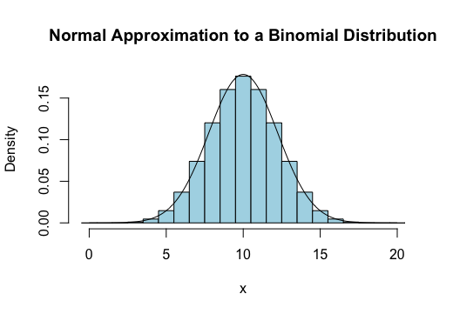
Normal: Continuous
Binomial: Discrete
Slides thanks to Shirley Chen

Slide 5
Normal: Continuous
Binomial: Discrete
Logistic Regression:
Models the probability of a discrete outcome y
“Probability”
Outcome y
Slides thanks to Shirley Chen

Slide 6
Normal: Continuous
Binomial: Discrete
Logistic Regression:
Models the probability of a discrete outcome y
Binary
“Probability”
e.g. 1/0, success/failure
“Number of successes”
Slides thanks to Shirley Chen

Slide 7
p = probability of successes
1-p = probability of failures
p/1-p = successes/failures
Linear Regression:
y = β₀ + β₁x + e
Logistic Regression:
ln(p/1-p) = β₀ + β₁x + e
Slides thanks to Shirley Chen

Slide 8
p = probability of successes
1-p = probability of failures
p/1-p = successes/failures
Linear Regression:
y = β₀ + β₁x + e
Logistic Regression:
ln(p/1-p) = β₀ + β₁x + e
“Odds” of an outcome y
ln(p/1-p) = “log odds” of y
Slides thanks to Shirley Chen

Slide 9
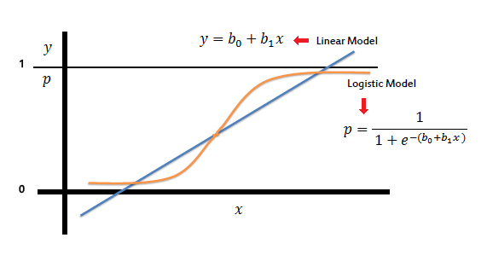
…when rearranging the logistic regression equation to solve for “probability” of y
Slides thanks to Shirley Chen

Slide 10
…when rearranging the logistic regression equation to solve for “probability” of y
A logistic curve is a sigmoid function (“S” curve) that limits the value of y between 0 and 1 where the inflection point defines the threshold for the probability of belonging to either binary outcome
Slides thanks to Shirley Chen

Slide 11
Effect size: Odds ratio (OR) = e^{β1}
Increased or decreased odds of outcome y per unit increase of x
NOTE: we back transform because it would not be fun to interpret a “log-odds increase or decrease of outcome y” if we used β₁ directly!
Slides thanks to Shirley Chen

Slide 12
Effect size: Odds ratio (OR) = e^{β1}
Increased or decreased odds of outcome y per unit increase of x
e.g. if OR = 1.74 when modelling the relationship between
x = medicine dosage (ml)
y = recovery (success/failure)
the odds of recovering is 1.74x higher for every 1 ml increase in medicine dosed
Slides thanks to Shirley Chen

Slide 13
Effect size: Odds ratio (OR) = e^{β1}
Increased or decreased odds of outcome y per unit increase of x
e.g. if OR = 1.74 when modelling the relationship between
x = medicine dosage (ml)
y = recovery (success/failure)
the odds of recovering is 1.74x higher for every 1 ml increase in medicine dosed
OR = 1 is the null outcome
…which makes sense because if (1) = e^{β1}
then β₁ = 0 (slope)
No change in slope is the same as an odds of 1x higher or lower
Slides thanks to Shirley Chen

Slide 14
COFFEE!!

Slide 15

Poisson Regression
Reminder: Best used when outcomes are counts!
Also transforming the non-linear relationship to linear form
Using the log link function
Log(y) =
$$α+β\left(x\right)+e$$

Slide 16
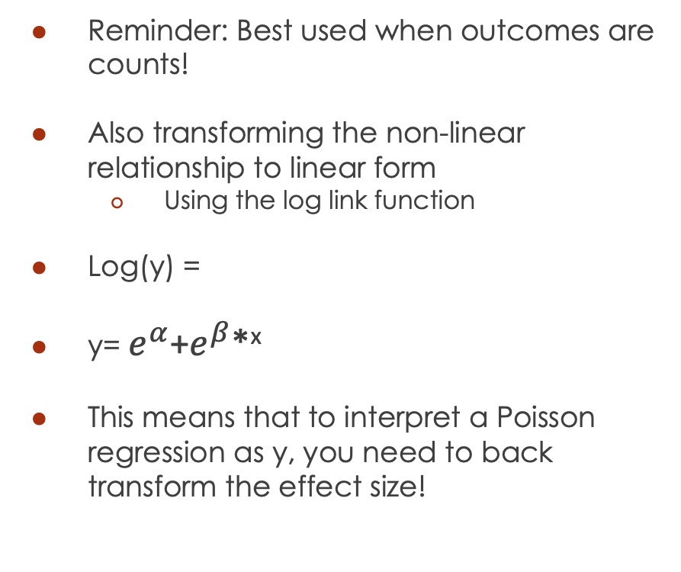
Poisson Regression
Reminder: Best used when outcomes are counts!
Also transforming the non-linear relationship to linear form
Using the log link function
Log(y) =
y= $e^{α}$+$e^{β}$*^{x}
This means that to interpret a Poisson regression as y, you need to back transform the effect size!
$$α+β\left(x\right)+e$$
Notes:
Mention variance = mean!
What happens if this isn’t true?
If it’s because of 0’s, you can use a zero inflated poisson.
If it’s not, consider negative binomial

Slide 17
Negative Binomial Regression
Is really similar to Poisson!
It’s just more flexible because the mean does not have to equal to the variance (allows for overdispersion)
Also needs to be back transformed to the biological scale

Slide 18
Inclass is on eclass and github!

Slide 20
Why don’t we just use odds ratio for analyses if it’s more directly interpretable?
e.g. meta-analysis
Slides thanks to Shirley Chen

Slide 21
Not symmetrical!
0
1
+ ∞
Natural log transformation
Slides thanks to Shirley Chen

Slide 22
Not symmetrical!
0
1
+ ∞
Natural log transformation
- ∞
0
+ ∞
…and now it is
Slides thanks to Shirley Chen

Slide 23
Confidence intervals easier to calculate when symmetrical
95% CI of the log odds ratio = (ln(OR) - 1.96(SE), ln(OR) + 1.96(SE))
…assuming a 1 unit increase
Slides thanks to Shirley Chen

Slide 24
Confidence intervals easier to calculate when symmetrical
95% CI of the log odds ratio = (ln(OR) - 1.96(SE), ln(OR) + 1.96(SE))
…assuming a 1 unit increase
“Upper and lower boundaries are the log odds ratio +/- the standard error of the log odds ratio scaled to the selected confidence interval (95%)”
NOTE: once again, log odds ratio are not very useful for interpretation!
Slides thanks to Shirley Chen

Slide 25
Confidence intervals easier to calculate when symmetrical
95% CI of the log odds ratio = (ln(OR) - 1.96(SE), ln(OR) + 1.96(SE))
…assuming a 1 unit increase
Back transform
95% CI of the odds ratio = (e^{(ln(OR) - 1.96(SE)}, e^{ln(OR) + 1.96(SE)})
Slides thanks to Shirley Chen

