Slide 1
Welcome to Biol 5081
Intro to Bio Stats!
Eryn McFarlane (she/her), emcfar@yorku.ca, https://github.com/erynmcfarlane

Slide 2
Today we’re going to:
Talk about version control for a beat
Talk about methods and writing methods for a beat
Talk about distributions
Discuss how to decide on a distribution
Talk about likelihood
Talk about probability
Connect likelihood and/or probability to distributions
Simulate different distributions

Slide 3
What is version control, why is it useful?

Slide 4
What is version control, why is it useful?
Git (software), github or bitbucket are the websites
History of work done!
How to ‘go back’ if it ‘used to work’

Slide 5
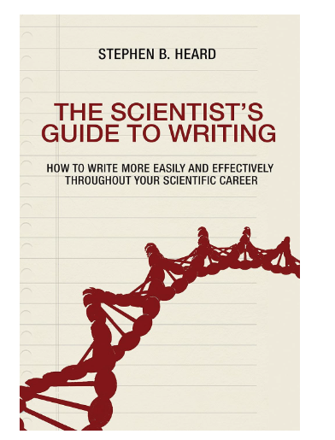
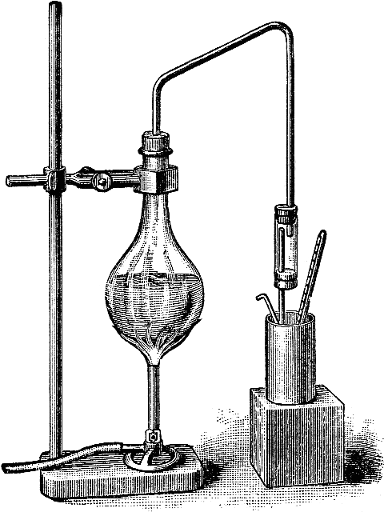
Lecture 5: Methods
Stephen’s Book is: The Scientist’s Guide to Writing
THANK YOU STEVE HEARD FOR THESE SLIDES!
Methods

Slide 6
Methods: basics
What you studied, how you studied it, and how you analyzed the data
Materials, reagents, study species, field sites, etc.
Experimental/observational methods
Data analysis (statistics) -> NB, we’re going to split this out!
More complex papers may involve multiple experiments, and may therefore repeat the materials-experiment-analysis structure
THANK YOU STEVE HEARD FOR THESE SLIDES!
Methods

Slide 7
Active and passive voice
Active voice: “We added 10 mL of phosphate buffer and shook the solution.”
Passive voice: “10 mL of phosphate buffer was added to the solution, which was then shaken.”
Students are often told to write in the passive voice and to avoid using “I” and “we”.
This is terrible advice. Do not follow it.
Active voice is shorter, simpler, more engaging, and more honest.
Active voice was standard until the mid-19th century; then use of the passive voice became widespread because it projected objectivity.
In the last 20 years, journals have shifted their preference back to active. However, teaching has not caught up.
THANK YOU STEVE HEARD FOR THESE SLIDES!
Methods

Slide 8
Active and passive voice (continued)
There are reasons to retain some use of passive voice.
Vary voice to vary rhythm.
Occasional passive can call attention to something:
“Beetles were identified to species, but other taxa only to genus.”
Passive can obscure an irrelevant actor
“Non-parametric methods are preferred when data violate assumptions of ANOVA.”
Passive can help avoid need for a complex subject.
“Buprestid and cerambycid beetles, woodwasps, and several other taxa that damage trees or that vector pathogenic fungi attacked the wounded trees.”
versus
“The wounded trees were attacked by buprestid and cerambycid beetles, woodwasps, and several other taxa that damage trees or that vector pathogenic fungi.”
THANK YOU STEVE HEARD FOR THESE SLIDES!
Methods

Slide 9
Detail
What goes into a Methods section?
Enough detail to allow a reader to repeat your work?
Enough detail to allow a reader to understand your Results?
Enough detail to establish your credibility as a scientist?
My (controversial) recommendation: a detail goes in if it:
establishes your credibility as a researcher
shows you know how to use standard methods appropriately
establishes plausibility of your approach to the problem
shows you are gathering relevant data and analyzing it to shed light on the research problem
establishes your sequence of investigative steps
lets reader understand claims to come in Results and Discussion
Include a detail only if it could influence reader’s interpretation of Results.
THANK YOU STEVE HEARD FOR THESE SLIDES!
Methods

Slide 10
Detail
What about detailed methods for replication?
Certainly matters in Methods papers.
Otherwise, true replications are very, very rare.
Detail harasses the 99% of readers who do not want to repeat your experiment!
If you’re philosophically devoted to replicability, consider a “Methods details” online supplement.
THANK YOU STEVE HEARD FOR THESE SLIDES!
Methods

Slide 11
Self-plagiarism
When you use the same methods twice, you shouldn’t cut-and-paste Methods text
Reuse may not be legal – often, the journal owns the copyright
Even if reuse is legal, rephrasing keeps writing fresh and ensures a good fit to the problem at hand.
English is a rich language. There is never just one way to write something!
See blog posts:
American Naturalist editor Dan Bolnick: http://bit.ly/2E2oRgi
Me: https://wp.me/p5x2kS-Of
THANK YOU STEVE HEARD FOR THESE SLIDES!
Methods

Slide 12
Registered Report Assignment 1 (due Week 4)
* Full description of proposed sample characteristics, including criteria for data inclusion and exclusion (e.g. outlier extraction). Procedures for objectively defining exclusion criteria due to technical errors or for any other reasons must be specified, including details of how and under what conditions data would be replaced.
* A description of experimental procedures, including randomization and blinding procedures, in sufficient detail to allow another researcher to repeat the methodology exactly.
Notes:
**These can be handed in in point form!**

Slide 13
COFFEE?!

Slide 14
What distributions have you heard of?

Slide 15
Why do we need to know about distributions?
Where does your null expectation come from?

Slide 16
Why do we need to know about distributions?
Where does your null expectation come from?
What is the question that we’re typically asking in frequentist statistics?
Notes:
Ask them here, what is a pvalue?!?

Slide 17
Grab some paper, draw your response variable!
As a distribution, if you like
In a confusion matrix, if that helps you
Doodles of focal species are always welcome!

Slide 18
Grab some paper, draw your response variable!
As a distribution, if you like
In a confusion matrix, if that helps you
Doodles of focal species are always welcome!
Now, draw a prediction graph – what do you think your final graph in the results part of your paper/chapter will look like
Notes:
We will draw these prediction graphs more than once during this class – we’re not going for perfect, we’re going for learning.

Slide 19
Notes:
What did everyone draw? Let’s talk about it!

Slide 20
Continuous
Asking ‘How much?’

Slide 21
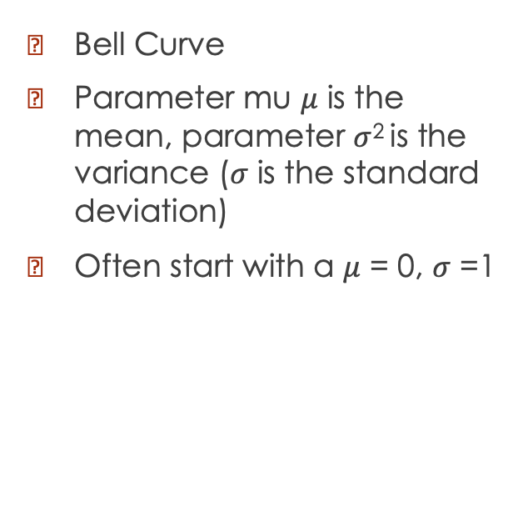
Normal/Gaussian
Bell Curve
Parameter mu $μ$ is the mean, parameter $σ$² is the variance ($σ$ is the standard deviation)
Often start with a $μ$ = 0, $σ$ =1

Slide 22
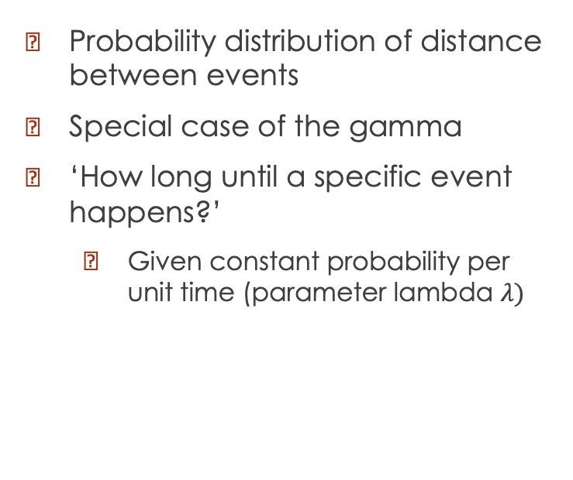
Exponential
Probability distribution of distance between events
Special case of the gamma
‘How long until a specific event happens?’
Given constant probability per unit time (parameter lambda $λ)$

Slide 23
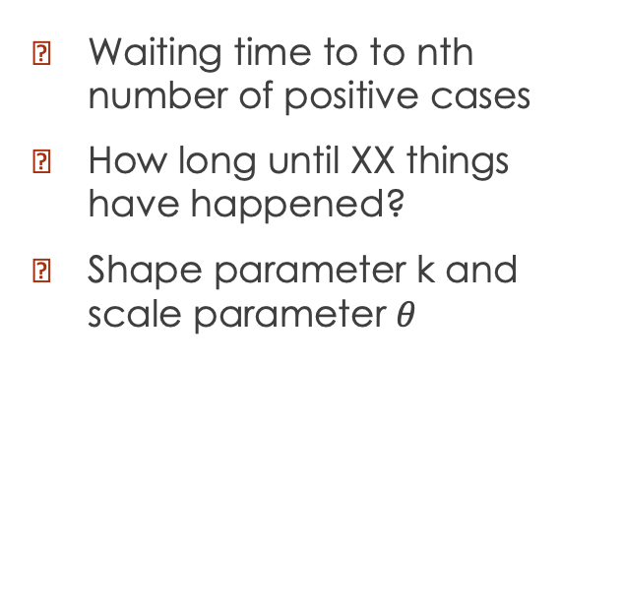
Gamma
Waiting time to to nth number of positive cases
How long until XX things have happened?
Shape parameter k and scale parameter $θ$
Notes:
For example, how many days until we've had 20 eggs laid in the population.
In contrast to the exponential where it’s how many days until 1.
Gamma with k=100, theta = 0.5

Slide 24
Discrete
Asking ‘how many?’

Slide 25
Bernoulli and Binomial
Bernoulli = Number of successes of a single trial. Special case of binomial, n=1
Probability of 1 (vs 0)
One parameter – probability of success
Binomial = Multiple Bernoulli trials
Probability of xx/20 times?
Notes:
0 or 1 – does this seed germinate (this one!!). Does this individual have covid etc. Binomial: How many patients in this ER have covid? How many fledglings survive? How many seeds germinate? How many students pass the test?

Slide 26
Geometric
Discrete analogue of the exponential
Number of Bernoulli trials needed to get one success.
How many time units until the first success?
Notes:
How many mice do I have to test before someone who has lyme disease?
How many students do I need to survey before someone feels super excited about distributions

Slide 27
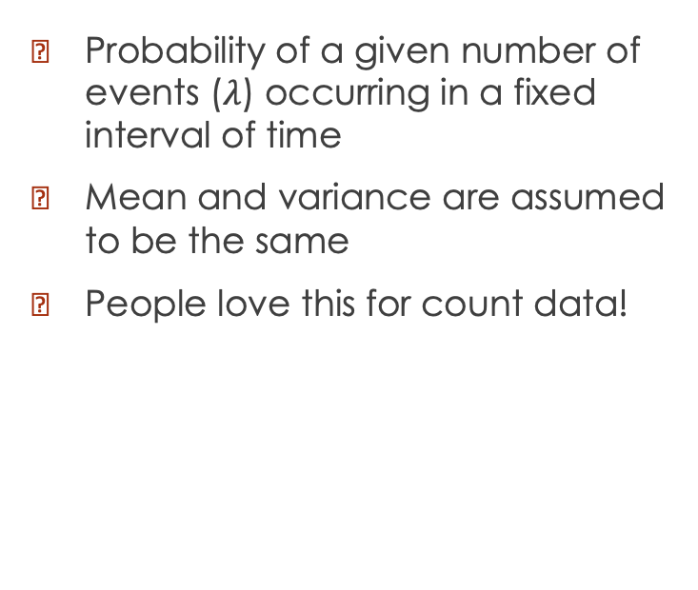
Poisson
Probability of a given number of events ($λ$) occurring in a fixed interval of time
Mean and variance are assumed to be the same
People love this for count data!

Slide 28
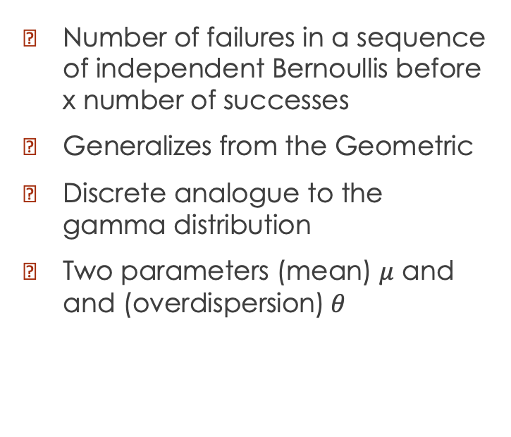
Negative Binomial
Number of failures in a sequence of independent Bernoullis before x number of successes
Generalizes from the Geometric
Discrete analogue to the gamma distribution
Two parameters (mean) $μ$ and and (overdispersion)$θ$

Slide 29
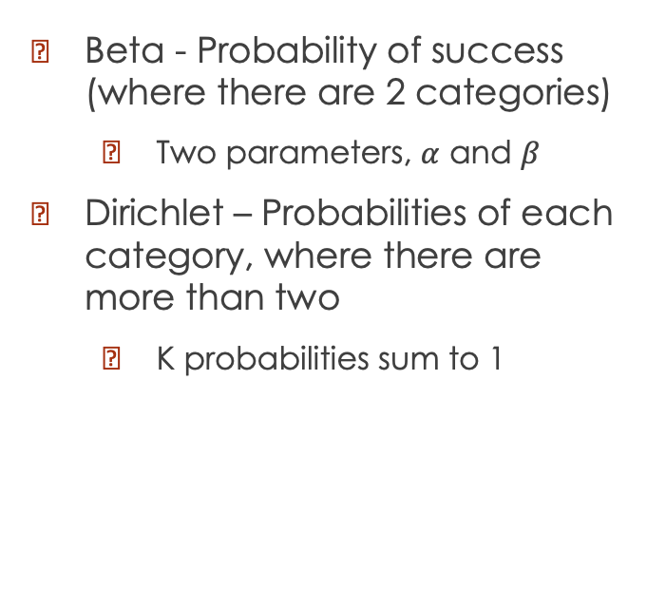
Beta and Dirichlet
Beta - Probability of success (where there are 2 categories)
Two parameters, $α$ and $β$
Dirichlet – Probabilities of each category, where there are more than two
K probabilities sum to 1

Slide 30
COFFEE?!

Slide 31
Likelihood
How does a model explain the observed data?
Calculate the probability of seeing this data under a variety of parameters for the model.
How do we understand this, given all the distributions we’ve seen today?

Slide 32
What are our statistical tests really doing?

Slide 33
What is a p value?
Probability of observing the data, given a null hypothesis.
What is a pvalue not?!
Given the distributions that we’ve been talking about today, what is does a null hypothesis look like? Let’s draw some.
Notes:
Let’s talk about this for a while!

Slide 34
Simulation Activities (grab the code from eclass!)
What distribution are your data likely from?
Why do you think this?
Using the distribution that you've chosen, change the different parameters. What happens when you change the parameters for the distribution? Describe how the shape changes.
Can you simulate data that looks like what you expect your data looks like? What are the parameters for that?
Get into a group with a peer. Listen to them describe their response variable. What do you think the appropriate distribution would be? Can you simulate data that resembles what your partner has done?

