Slide 1
Welcome to Biol 5081
Intro to Bio Stats!
Eryn McFarlane (she/her), emcfar@yorku.ca, https://github.com/erynmcfarlane

Slide 2
Today we’re going to:
Discuss some common, parametric tests
t test
ANOVA
Linear regression
Pearson rank correlation

Slide 3
Today we’re going to:
Discuss some common, parametric tests
t test
ANOVA
Linear regression
Pearson rank correlation
Assumptions of these test, and how robust these tests are to the assumptions

Slide 4
Today we’re going to:
Discuss some common, parametric tests
t test
ANOVA
Linear regression
Pearson rank correlation
Assumptions of these test, and how robust these tests are to the assumptions
Simulate data to use these tests (with backstories!), and see what happens when 1) reducible error is extremely high vs extremely low and 2) what happens when assumptions are broken

Slide 5
Today we’re going to:
Discuss some common, parametric tests
t test
ANOVA
Linear regression
Pearson rank correlation
Assumptions of these test, and how robust these tests are to the assumptions
Simulate data to use these tests (with backstories!), and see what happens when 1) reducible error is extremely high vs extremely low and 2) what happens when assumptions are broken
Remember, these are all inferential statistics, we’re not doing prediction

Slide 6
t test
T distribution – probability distribution used to calculate population parameters when the sample size is small, and variance is unknown.
How is this different from a normal distribution?
Only difference – it’s a bit flatter, shorter, generalized standard normal
As N increases, t approximates normal distribution
Usually, we don’t worry about this for a t test (but you can do a z test if you know more about your distribution for a one sided test!)
One sample test, independent two sample test, paired t test

Slide 7
One sample t test
Is the sample more than the population (more than 0, more than another specific number)?
Notes:
What is the null hypothesis?

Slide 8
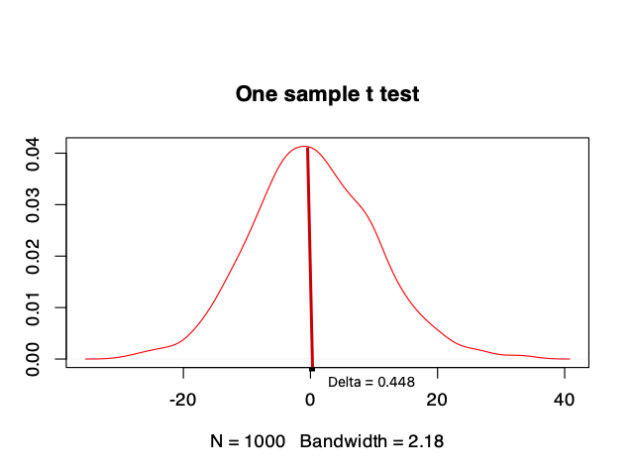
One sample t test
Is the sample more than the population (more than 0, more than another specific number)?
Notes:
What is the null hypothesis?

Slide 9
Two sample t test
Are these samples different from each other?
Notes:
What is the null hypothesis?

Slide 10
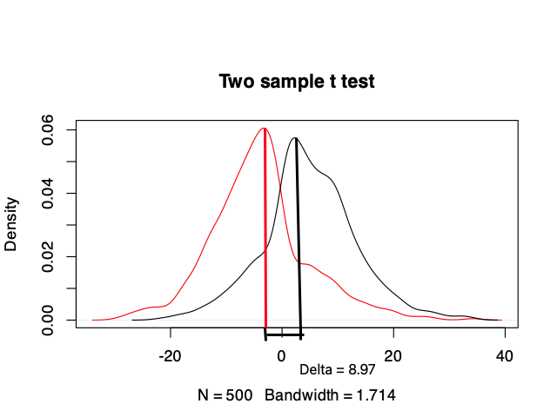
Two sample t test
Are these samples different from each other?
Is this difference greater than we would expect given the null distribution?
Notes:
What is the null hypothesis?
A paired t test is basically the same, but takes into account non-independence between ssamples. For example, if it’s the same individual, or siblings, over two time points.

Slide 11
ANOVA
Can be used for more than 2 samples!
Asks the same question – is there a difference between the mean of these 3+ groups?
Notes:
What is the nu

Slide 12
Linear regression
We’ve thought about this before!
y=mx+b+error!

Slide 13
Pearson Rank Correlation
What is the difference between a linear regression and a correlation?
When do we use each?

