Slide 1
Welcome to Biol 5081
Intro to Bio Stats!
Eryn McFarlane (she/her), emcfar@yorku.ca, https://github.com/erynmcfarlane

Slide 2
Today we’re going to:
Go over learning objectives of the class
Talk about the basic philosophy of (frequentist) statistics
Talk about the use of simulations, and the summative assessment
Interpret some methods sections of scientific papers in groups

Slide 3
All models are wrong, but some are useful – George Box
When do we use statistics?
What can they tell us?
When do they lead us astray?

Slide 4
Lies, damned lies and statistics – Mark Twain (or possibly Benjamin Disraeli)
Why are you in this class?
What do you hope to gain?
What are your concerns about this class?
What are your concerns about statistics generally?

Slide 5
Learning Objectives
General statistical literacy - can you read a paper and feel confident that you know what they did, or even better, how to do what they did?
Phenomenological understanding of how distributions come to be. Why do we expect data to look this way? How do you expect your data to look?
Writing skills - how do we describe statistical methods? How should we report results?
Some level of comfort coding in R, or, finding R code and applying it.
The application of specific statistical methods, and R, to a question you would like to answer

Slide 6
This course is not:
Where you’re going to memorize all the different tests, parametric and non-parametric.
Where you’re going to have to do any statistics *by hand*
Where you’re going to be asked to write any code without the use of the internet, or even chatGPT (although we will definitely talk about reasons to be cautious with this!)
A place where you’re expected to be perfect, know all the things, or be right all the time – I’m just hoping to move the distribution of your knowledge

Slide 7
What is a model?

Slide 8
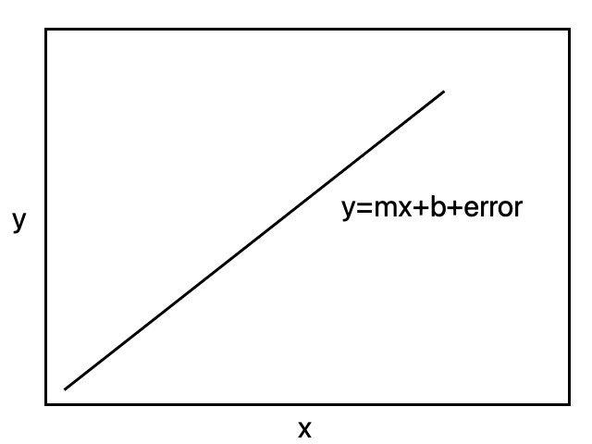
Linear models
Most statistical tests are special cases of a linear model
Once you understand a linear model, you can work out the appropriate test

Slide 9
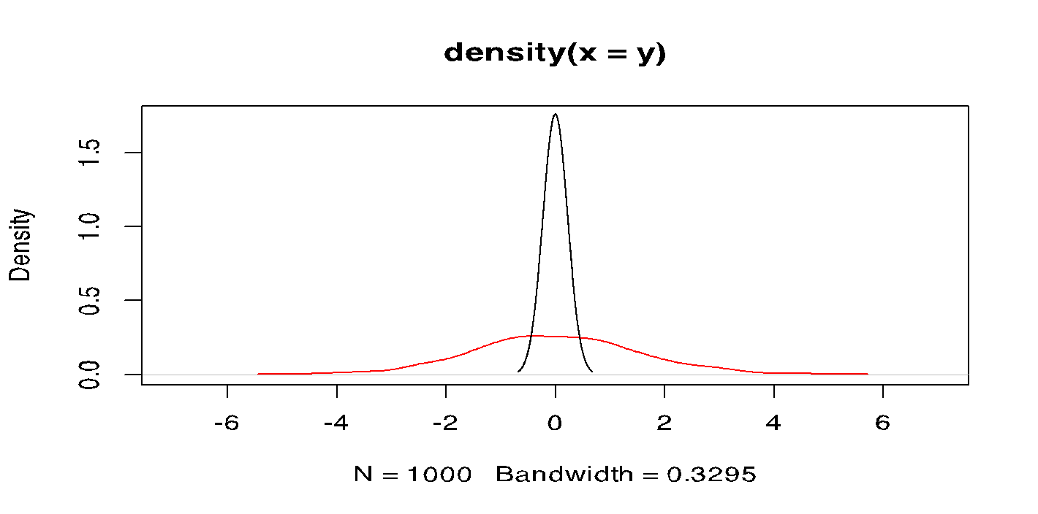
Linear models
Another way to think about this is, what do I think the underlying distributions of each data set is here?
Notes:
Density plots, where the red plot is where I’m simulated an effect, and black plot where there’s no effect of x on y. So these are distributions of y

Slide 10
Linear models

Slide 11
Linear models
Another way to think about this is, what do I think the underlying distributions of each data set is here?
Notes:
Density plots, where the red plot is where I’m simulated an effect, and black plot where there’s no effect of x on y. So these are distributions of y

Slide 12
Linear models
Most statistical tests are special cases of a linear model
Once you understand a linear model, you can work out the appropriate test

Slide 13
What is a simulation, and why do I think it’s a good idea to know how to do these?
We are going to make up data.

Slide 14
What is a simulation, and why do I think it’s a good idea to know how to do these?
We are going to make up data.
We’re actually going to make up tons of data.

Slide 15
What is a simulation, and why do I think it’s a good idea to know how to do these?
We are going to make up data.
We’re actually going to make up tons of data.
Why is this okay?

Slide 16
What is a simulation, and why do I think it’s a good idea to know how to do these?
We are going to make up data.
We’re actually going to make up tons of data.
Why is this okay?
What can we do with these data?

Slide 17
What is a simulation, and why do I think it’s a good idea to know how to do these?
We are going to make up data.
We’re actually going to make up tons of data.
Why is this okay?
What can we do with these data?
Power analyses, description of expectations, null distributions, trials of analyses before we get the data

Slide 18
What is a simulation, and why do I think it’s a good idea to know how to do these?
We are going to make up data.
We’re actually going to make up tons of data.
Why is this okay?
What can we do with these data?
Power analyses, description of expectations, null distributions, trials of analyses before we get the data
What can’t we do with these data?!

Slide 19
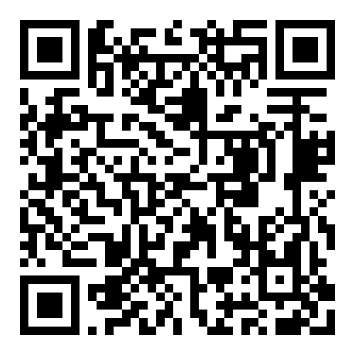
How to read a methods section (which is a good intro to how to write one!)
We’re going to spend an hour doing this:
You can work in groups if you like, or alone if you like.
I want you to read this paper https://onlinelibrary.wiley.com/doi/full/10.1002/ece3.3987 (surprise, it’s one of my papers!) and write out, step by step (approximately 10 steps) what we did and how.
You don’t need to understand every step, but some will be more universal than others!
This will be an assignment (on a paper of your choosing) due week 7.
Find the paper here!

