Slide 1
Welcome to Biol 5081
Intro to Bio Stats!
Eryn McFarlane (she/her), emcfar@yorku.ca, https://github.com/erynmcfarlane

Slide 2
Today we’re going to:
Talk about version control for a beat
Talk about distributions
Discuss how to decide on a distribution
Talk about likelihood
Talk about probability
Connect likelihood and/or probability to distributions
Simulate different distributions

Slide 3
What is version control, why is it useful?

Slide 4
What distributions have you heard of?

Slide 5
Why do we need to know about distributions?
Where does your null expectation come from?

Slide 6
Why do we need to know about distributions?
Where does your null expectation come from?
What is the question that we’re typically asking in frequentist statistics?
Notes:
Ask them here, what is a pvalue?!?

Slide 7
Grab some paper, draw your response variable!
As a distribution, if you like
In a confusion matrix, if that helps you
Doodles of focal species are always welcome!

Slide 8
Grab some paper, draw your response variable!
As a distribution, if you like
In a confusion matrix, if that helps you
Doodles of focal species are always welcome!
Now, draw a prediction graph – what do you think your final graph in the results part of your paper/chapter will look like
Notes:
We will draw these prediction graphs more than once during this class – we’re not going for perfect, we’re going for learning.

Slide 9
Notes:
What did everyone draw? Let’s talk about it!

Slide 10
Continuous
Asking ‘How much?’

Slide 11
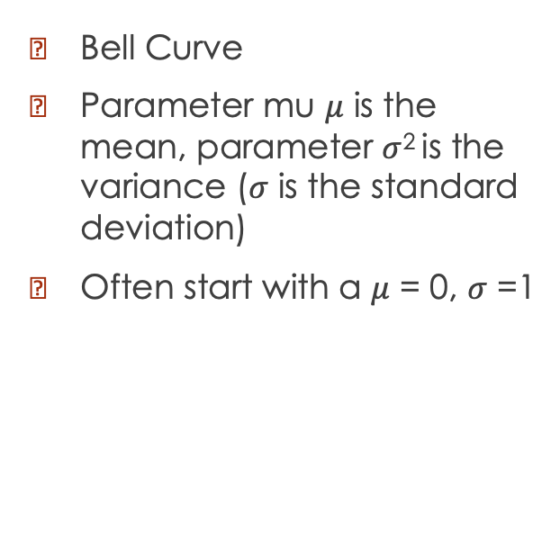
Normal/Gaussian
Bell Curve
Parameter mu $μ$ is the mean, parameter $σ$² is the variance ($σ$ is the standard deviation)
Often start with a $μ$ = 0, $σ$ =1

Slide 12
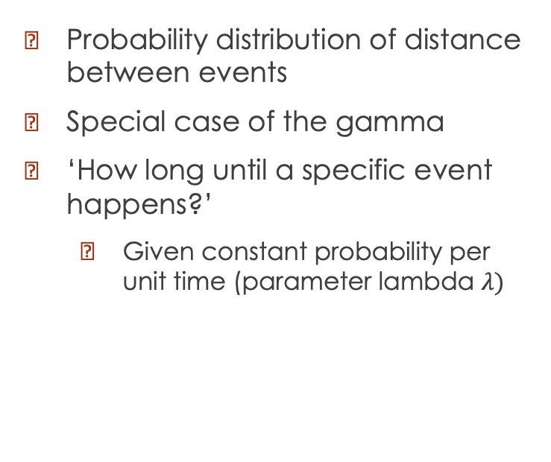
Exponential
Probability distribution of distance between events
Special case of the gamma
‘How long until a specific event happens?’
Given constant probability per unit time (parameter lambda $λ)$

Slide 13
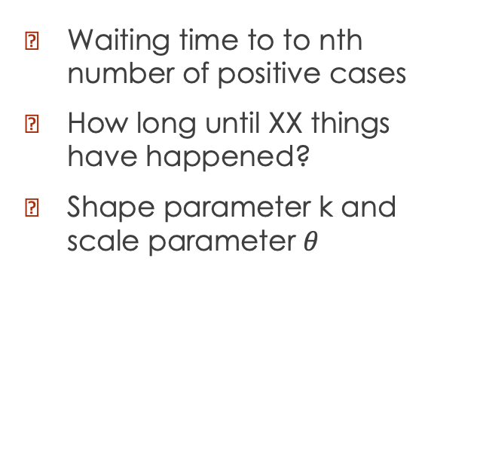
Gamma
Waiting time to to nth number of positive cases
How long until XX things have happened?
Shape parameter k and scale parameter $θ$
Notes:
For example, how many days until we've had 20 eggs laid in the population.
In contrast to the exponential where it’s how many days until 1.
Gamma with k=100, theta = 0.5

Slide 14
Discrete
Asking ‘how many?’

Slide 15
Bernoulli and Binomial
Bernoulli = Number of successes of a single trial. Special case of binomial, n=1
Probability of 1 (vs 0)
One parameter – probability of success
Binomial = Multiple Bernoulli trials
Probability of xx/20 times?
Notes:
0 or 1 – does this seed germinate (this one!!). Does this individual have covid etc. Binomial: How many patients in this ER have covid? How many fledglings survive? How many seeds germinate? How many students pass the test?

Slide 16
Geometric
Discrete analogue of the exponential
Number of Bernoulli trials needed to get one success.
How many time units until the first success?
Notes:
How many mice do I have to test before someone who has lyme disease?
How many students do I need to survey before someone feels super excited about distributions

Slide 17
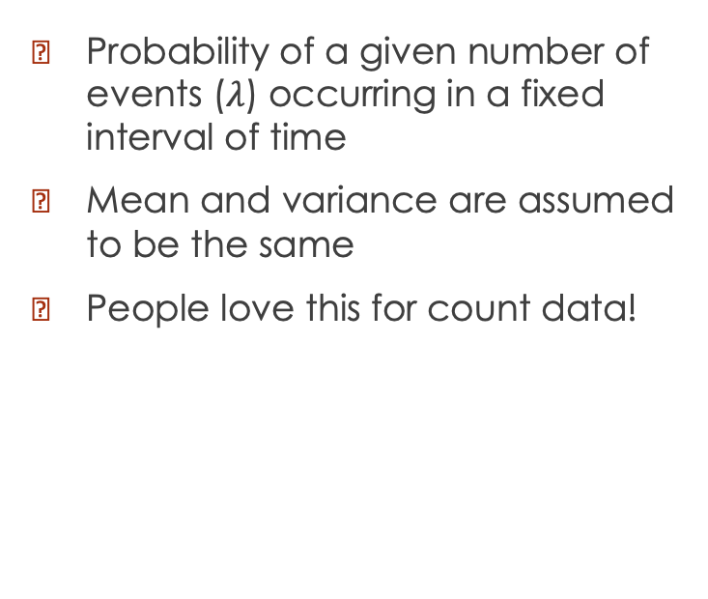
Poisson
Probability of a given number of events ($λ$) occurring in a fixed interval of time
Mean and variance are assumed to be the same
People love this for count data!

Slide 18
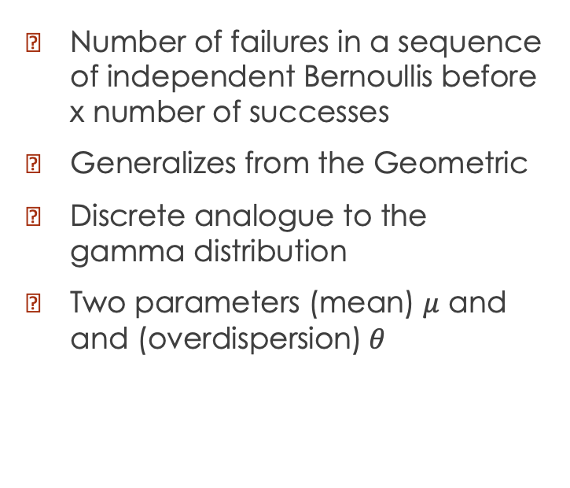
Negative Binomial
Number of failures in a sequence of independent Bernoullis before x number of successes
Generalizes from the Geometric
Discrete analogue to the gamma distribution
Two parameters (mean) $μ$ and and (overdispersion)$θ$

Slide 19
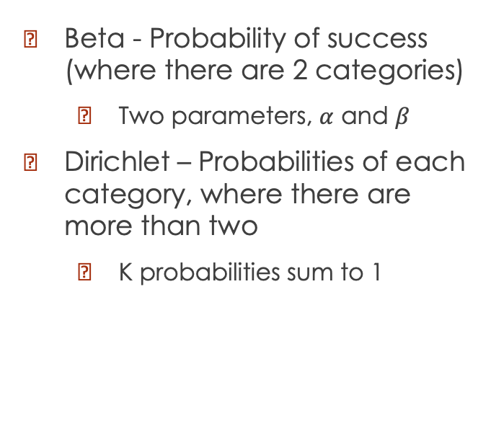
Beta and Dirichlet
Beta - Probability of success (where there are 2 categories)
Two parameters, $α$ and $β$
Dirichlet – Probabilities of each category, where there are more than two
K probabilities sum to 1

Slide 20
COFFEE

Slide 21
Likelihood
How does a model explain the observed data?
Calculate the probability of seeing this data under a variety of parameters for the model.
How do we understand this, given all the distributions we’ve seen today?

Slide 22
What are our statistical tests really doing?

Slide 23
What is a p value?
Probability of observing the data, given a null hypothesis.
What is a pvalue not?!
Given the distributions that we’ve been talking about today, what is does a null hypothesis look like? Let’s draw some.
Notes:
Let’s talk about this for a while!

Slide 24
Simulation Activities (grab the code from eclass!)
What distribution are your data likely from?
Why do you think this?
Using the distribution that you've chosen, change the different parameters. What happens when you change the parameters for the distribution? Describe how the shape changes.
Can you simulate data that looks like what you expect your data looks like? What are the parameters for that?
Get into a group with a peer. Listen to them describe their response variable. What do you think the appropriate distribution would be? Can you simulate data that resembles what your partner has done?

