Slide 1
Welcome to Biol 5081
Intro to Bio Stats!
Eryn McFarlane (she/her), emcfar@yorku.ca, https://github.com/erynmcfarlane
Notes:
PANOPTO!

Slide 2
Resources on Git have been added to week 2!
Notes:
Let’s go through a little bit of how git works, and how you can do it either through Rstudio, or through terminal – switch to sharing your terminal screen!

Slide 3
Today we’re going to:
Rmarkdown
What is it, and why is it great?
Discuss some common, parametric tests
t test
ANOVA
Linear regression
Pearson correlation

Slide 4
Today we’re going to:
Rmarkdown
What is it, and why is it great?
Discuss some common, parametric tests
t test
ANOVA
Linear regression
Pearson correlation

Slide 5
Today we’re going to:
Rmarkdown
What is it, and why is it great?
Discuss some common, parametric tests
t test
ANOVA
Linear regression
Pearson correlation
Assumptions of these test, and how robust these tests are to the assumptions

Slide 6
Today we’re going to:
Rmarkdown
What is it, and why is it great?
Discuss some common, parametric tests
t test
ANOVA
Linear regression
Pearson correlation
Assumptions of these test, and how robust these tests are to the assumptions
Simulate data to use these tests (with backstories!), and see what happens when 1) reducible error is extremely high vs extremely low and 2) what happens when assumptions are broken
Remember, these are all inferential statistics, we’re not doing prediction

Slide 7
t test
T distribution – probability distribution used to calculate population parameters when the sample size is small, and variance is unknown.
How is this different from a normal distribution?
Only difference – it’s a bit flatter, shorter, generalized standard normal
As N increases, t approximates normal distribution
Usually, we don’t worry about this for a t test (but you can do a z test if you know more about your distribution for a one sided test!)
One sample test, independent two sample test, paired t test

Slide 8
One sample t test
Is the sample more than the population (more than 0, more than another specific number)?
Notes:
What is the null hypothesis?

Slide 9
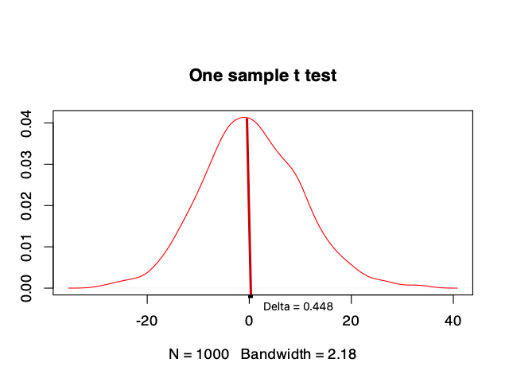
One sample t test
Is the sample more than the population (more than 0, more than another specific number)?
Notes:
What is the null hypothesis?

Slide 10
Two sample t test
Are these samples different from each other?
Notes:
What is the null hypothesis?

Slide 11
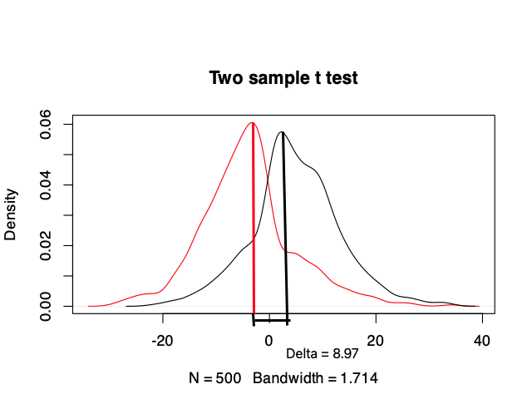
Two sample t test
Are these samples different from each other?
Is this difference greater than we would expect given the null distribution?
Notes:
What is the null hypothesis?
A paired t test is basically the same, but takes into account non-independence between ssamples. For example, if it’s the same individual, or siblings, over two time points.

Slide 12
ANOVA
Can be used for more than 2 samples!
Asks the same question – is there a difference between the mean of these 3+ groups?
Notes:
What is the nu

Slide 13
Linear regression
We’ve thought about this before!
y=mx+b+error!
Assumes linear relationship
Assumes normal residuals
Assumes independence
Assumes normality (for any x normal distribution of y)

Slide 14
Pearson Correlation
What is the difference between a linear regression and a correlation?
When do we use each?
Assumptions of Correlations:
Both variables are continuous
Each ‘individual’ is in both x and y
No outliers (this is basically always a breakable assumption!)
Linear relationship

Slide 15
COFFEE!!

Slide 16
Assumptions of these tests?
Normally distributed residuals
WHAT DOES THIS MEAN?
Underlying expectation of the distribution
But we know that these tests are ‘robust’ to distribution
What does that mean?

Slide 17
Assignment today:
Rmarkdown on eClass
Look for QUESTIONS peppered throughout – really give some thought to answering this.
This is the first time I’m really asking you to simulate data
Think about why this is backwards than we would usually do?

