Slide 1
Welcome to Biol 5081
Intro to Bio Stats!
Eryn McFarlane (she/her), emcfar@yorku.ca, https://github.com/erynmcfarlane

Slide 2
Today we’re going to:
Talk about distributions
Discuss how to decide on a distribution
Talk about likelihood
Talk about probability
Connect likelihood and/or probability to distributions
Simulate different distributions

Slide 3
What distributions have you heard of?

Slide 4
Why do we need to know about distributions?
Where does your null expectation come from?

Slide 5
Why do we need to know about distributions?
Where does your null expectation come from?
What is the question that we’re typically asking in frequentist statistics?
Notes:
Ask them here, what is a pvalue?!?

Slide 6
Grab some paper, draw your response variable!
As a distribution, if you like
In a confusion matrix, if that helps you
Doodles of focal species are always welcome!

Slide 7
Grab some paper, draw your response variable!
As a distribution, if you like
In a confusion matrix, if that helps you
Doodles of focal species are always welcome!
Now, draw a prediction graph – what do you think your final graph in the results part of your paper/chapter will look like
Notes:
We will draw these prediction graphs more than once during this class – we’re not going for perfect, we’re going for learning.

Slide 9
Continuous
Asking ‘How much?’

Slide 10
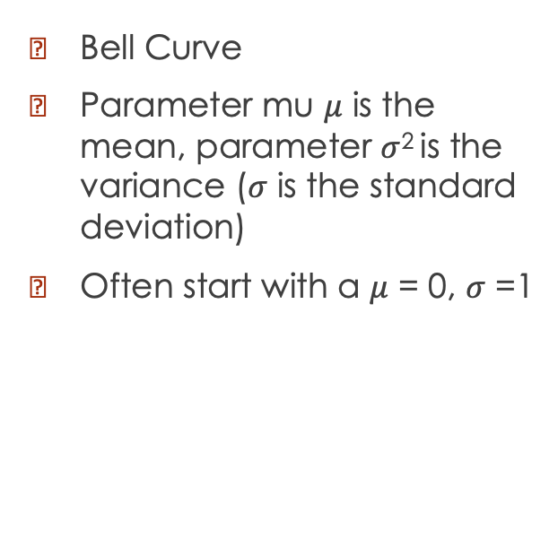
Normal/Gaussian
Bell Curve
Parameter mu $μ$ is the mean, parameter $σ$² is the variance ($σ$ is the standard deviation)
Often start with a $μ$ = 0, $σ$ =1

Slide 11
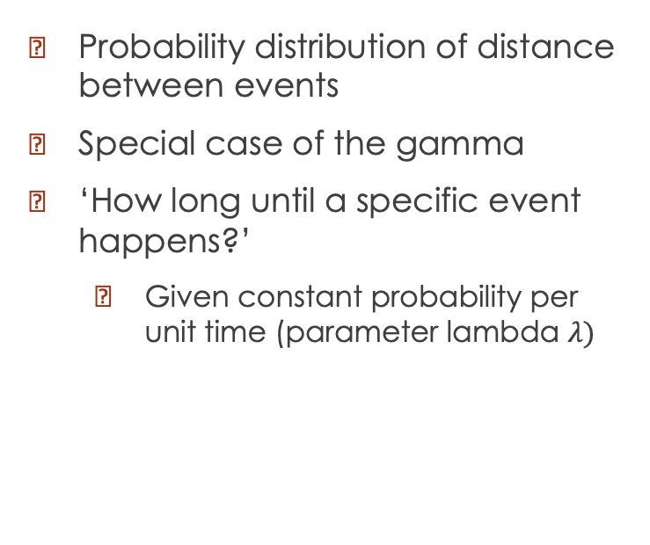
Exponential
Probability distribution of distance between events
Special case of the gamma
‘How long until a specific event happens?’
Given constant probability per unit time (parameter lambda $λ)$

Slide 12
Gamma

Slide 13
Discrete
Asking ‘how many?’

Slide 14
Bernoulli and Binomial

Slide 15
Geometric
Discrete analogue of the exponential

Slide 16
Negative Binomial
Discrete analogue to the gamma distribution

Slide 17
Poisson

Slide 18
Beta and Dirichlet

Slide 19
Weibull

Slide 20
COFFEE

Slide 21
Likelihood

Slide 22
Probability

Slide 23
What are our statistical tests really doing?

Slide 24
Simulation Activities

