Slide 1
Welcome to Biol 5081
Intro to Bio Stats!
Eryn McFarlane (she/her), emcfar@yorku.ca, https://github.com/erynmcfarlane
Notes:
PANOPTO!

Slide 2
Today we’re going to:
Statistical Methods for RR
Random Forest
PCA
Data Viz
Time to work on Statistical Methods (for RR).

Slide 3
Today we’re going to:
Statistical Methods for RR
Random Forest
PCA
Data Viz
Time to work on Statistical Methods (for RR).

Slide 4
Statistical Methods and Simulated - Due Week 8 (5th November) - for initial review and feedback (10%)

Slide 5
Statistical Methods and Simulated - Due Week 8 (5th November) - for initial review and feedback (10%)
Theses can all be in R, or, a mix of R code for the simulations and analysis with an English methods paragraph Proposed analysis pipeline, including all preprocessing steps, statistical power analyses, and a precise description of all planned analyses, including appropriate correction for multiple comparisons. Any covariates or regressors must be stated. Where analysis decisions are contingent on the outcome of prior analyses, these contingencies must be specified and adhered to. Pre-planned analyses must be reported in the main Results section of Stage 2 submissions. However, unplanned exploratory analyses will be admissible in a separate section of the Results (see below).

Slide 6
Statistical Methods and Simulated - Due Week 8 (5th November) - for initial review and feedback (10%)
Theses can all be in R, or, a mix of R code for the simulations and analysis with an English methods paragraph Proposed analysis pipeline, including all preprocessing steps, statistical power analyses, and a precise description of all planned analyses, including appropriate correction for multiple comparisons. Any covariates or regressors must be stated. Where analysis decisions are contingent on the outcome of prior analyses, these contingencies must be specified and adhered to. Pre-planned analyses must be reported in the main Results section of Stage 2 submissions. However, unplanned exploratory analyses will be admissible in a separate section of the Results (see below).
NOTE: Estimated effect sizes should be justified with reference to the existing literature. Since publication bias overinflates published estimates of effect size, power analysis must be based on the lowest available or meaningful estimate of the effect size based on an a priori power of 0.9 or higher.
THIS REALLY NEEDS TO BE ON TIME, so that your fellow students can give feedback on it next week.

Slide 7
Random Forest
Type of machine learning
Based on decision trees
Often uses a sparse modelling approach – N<p
An alternative to model selection like AIC or drop one pvalues

Slide 8
Random Forest
Uses bootstrap aggregating (bagging)
Makes a whole bunch of decision trees, aggregates them, predicts left out data – this is done internally
Do this 10 times (or something)
Can be for basically any response variable, using either regression or categorical predictors
(i.e. either regression or classification)
Helps to overcome the problem of overfitting
Super popular type of machine learning
Notes:
Random refers to random observations to grow each tree, and random variables selected for splitting at each node.

Slide 9
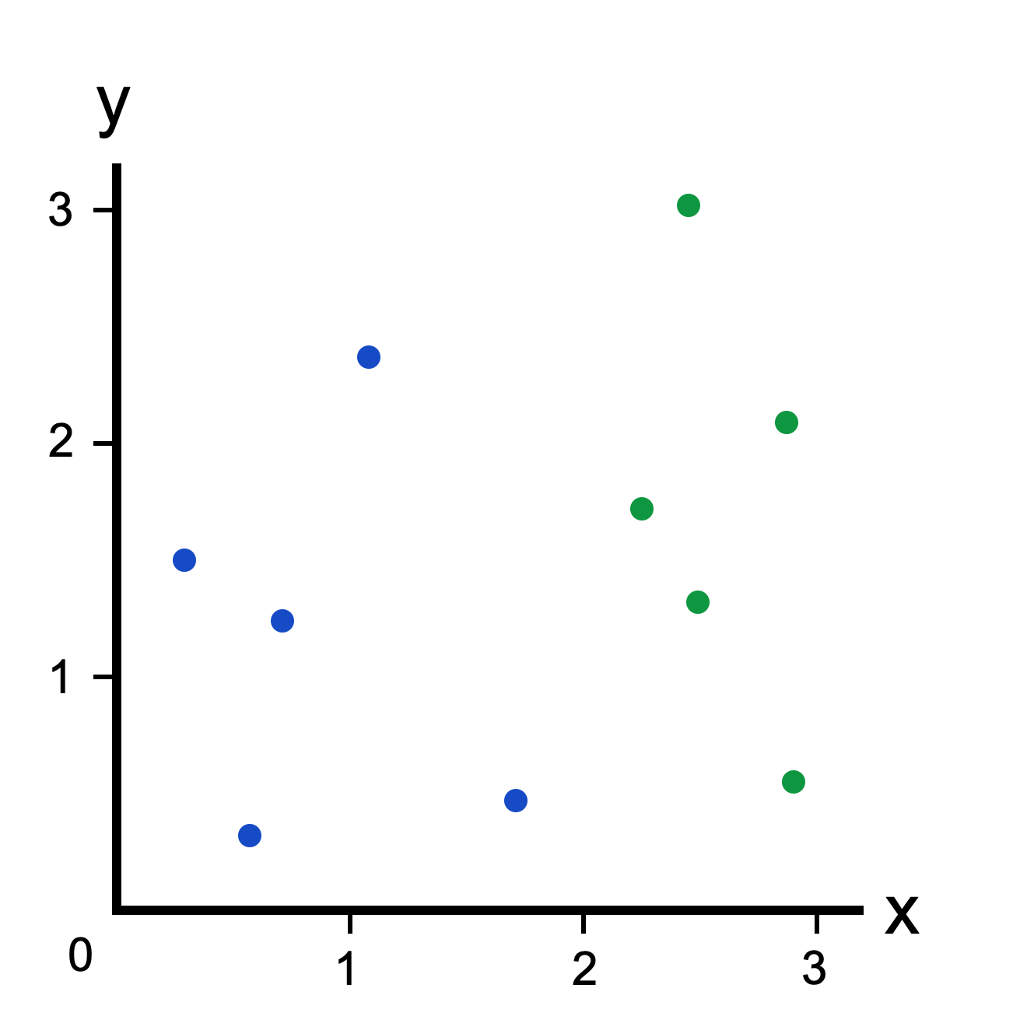
What is a decision tree?
https://victorzhou.com/blog/intro-to-random-forests/

Slide 10
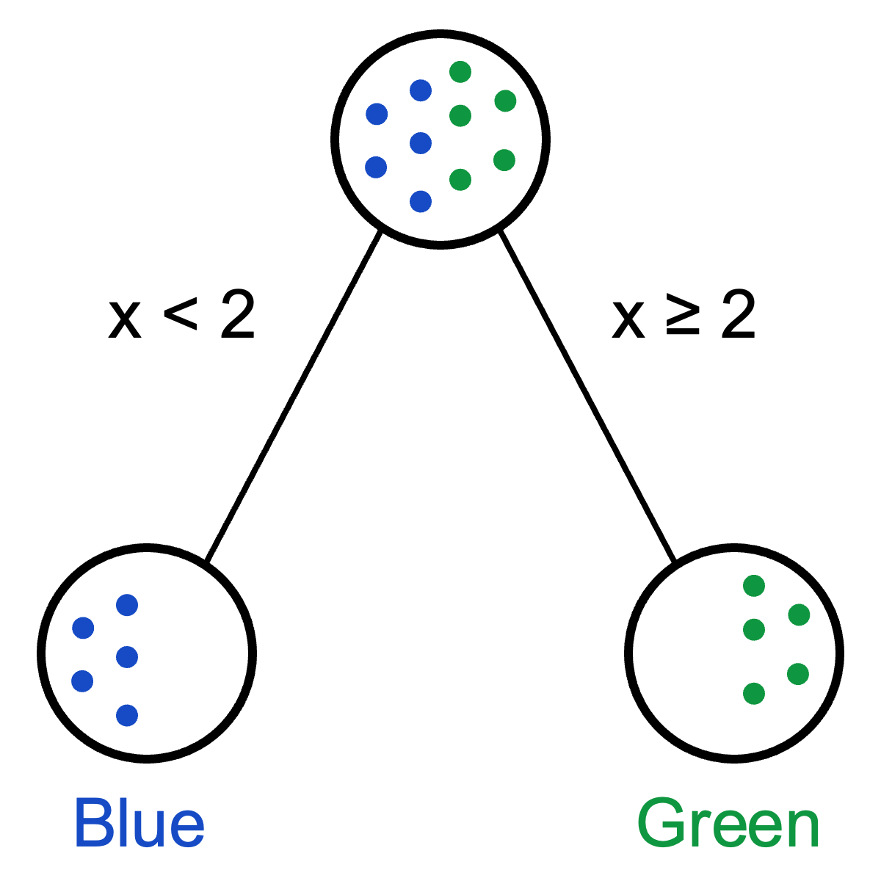
What is a decision tree?
https://victorzhou.com/blog/intro-to-random-forests/

Slide 11

What is a decision tree?
https://victorzhou.com/blog/intro-to-random-forests/

Slide 12
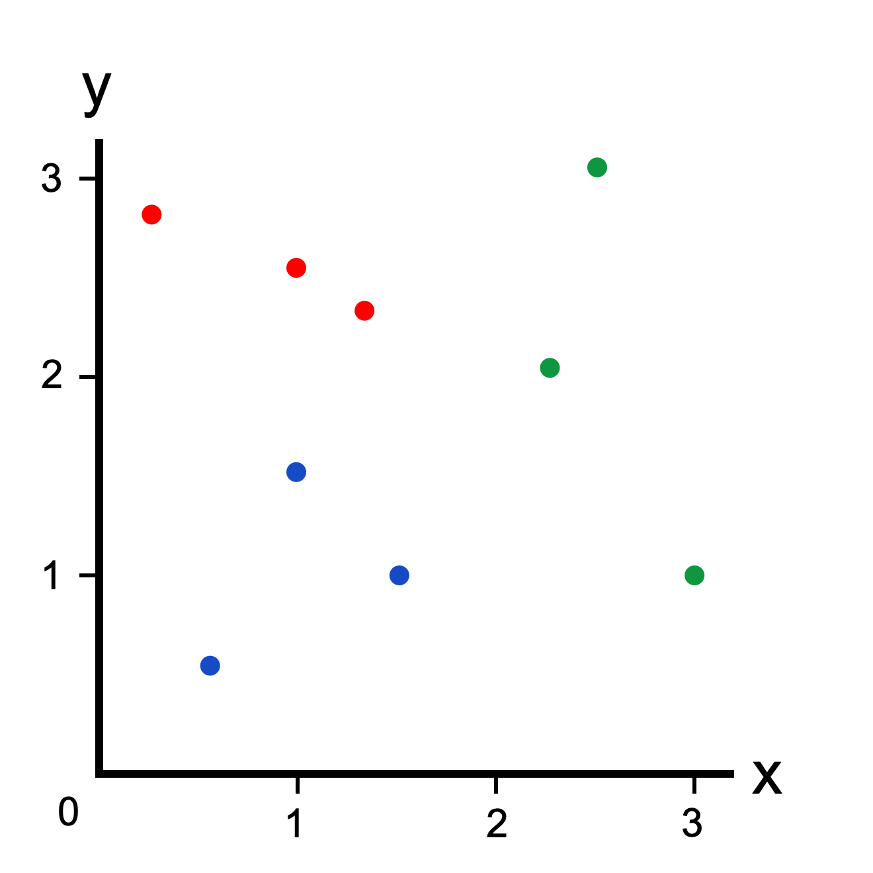
What is a decision tree?
https://victorzhou.com/blog/intro-to-random-forests/

Slide 13
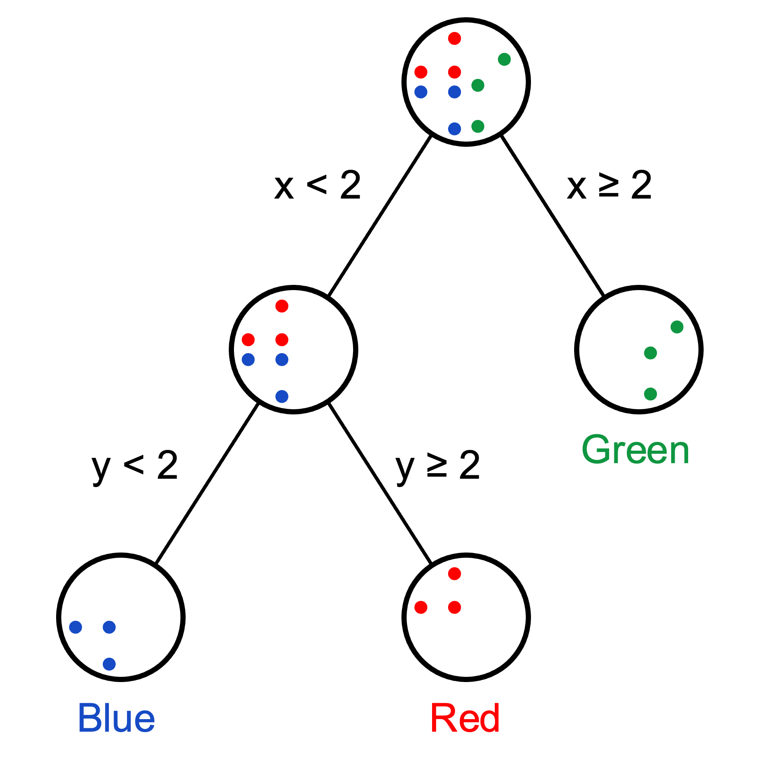
What is a decision tree?
https://victorzhou.com/blog/intro-to-random-forests/

Slide 14

What is a decision tree?
https://victorzhou.com/blog/intro-to-random-forests/

Slide 15
SO WHAT DO WE GET FROM RANDOM FOREST?
Output: Decrease in mean squared error
Variable importance – how much does each parameter matter to explain variation in response variable
Often see the best split based on Gini Impurity
Interpretation:
What is the out of bag error rate for the model against the testing data?
Want to pick the model with the lowest OOB.
Need to worry about shortcut learning (as is always true with machine learning!)

Slide 16
Interpreting Variable Importance Plots

Slide 18
PCA (Principal Component Analysis)
PCA is used to take many parameters and compress them into fewer, synthetic variables
‘dimensionality reduction on multivariate data’
Can only be used with numeric parameters

Slide 19
PCA (Principal Component Analysis)
PCA is used to take many parameters and compress them into fewer, synthetic variables
‘dimensionality reduction on multivariate data’
Can only be used with numeric parameters
Eigendecomposition of the covariance matrix of the parameters
Eigenvectors give us the directions in parameter space
Eigenvalues give the amount of variance captured by each eigenvecture

Slide 20
PCA (Principal Component Analysis)
PCA is used to take many parameters and compress them into fewer, synthetic variables
‘dimensionality reduction on multivariate data’
Can only be used with numeric parameters
Eigendecomposition of the covariance matrix of the parameters
Eigenvectors give us loadings of the PCs
Eigenvalues give the variance explained by each PC

Slide 21
Interpreting biplots
Notes:
Don’t forget to talk about common pitfalls

Slide 22
Time to work on RR – Statistical Methods and Simulations

