Slide 1
SUPERFOODMAX
Data Analysis

Slide 2
Business Questions
SuperfoodMax shareholders objectives were aim to grow revenue by 5% over the next 2 years and gain an understanding of the buying patterns of its current customers, in order to achieve that we raised some questions;
-How to lift average spend of loyal customers?
-How to convert first time customers into regular customer?
-What are the categories/departments are popular?
-How does seasonality affect the revenue?

Slide 3
Data has been extracted from its internal data sources. It contains information about;
1)Transaction information
2)Product information
3)Customer information
In our analysis data from 2017-2020 has been used.

Slide 4
Cleaning
In order to get an accurate analysis, we apply some cleaning techniques on the dataset before starting.
Dataset has been checked for duplicates, Nan values, which did not existed, data entry was on point.
Some data type has been corrected.

Slide 5
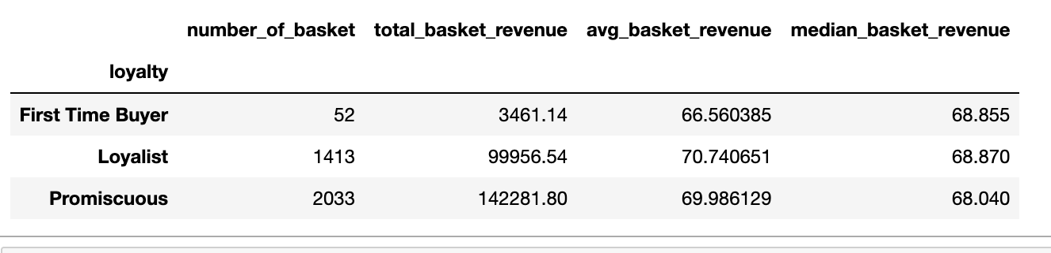
Descriptive Analysis
📊 Key Findings:
First time buyers are significantly less than loyal and promiscuous customers.
Promiscuous customers shopped in the store more than loyal customers and brought %42 more revenue than loyal customers.
Loyal customers average basket spending is similar to first time buyers and promiscuous customers.
💡 Business Insights:
Turning promiscuous customers into loyal customers lift the revenue significantly. Create loyalty rewards and VIP perks.
In order to increase average basket spending of loyal customers, work on upsell and cross sell.

Slide 6
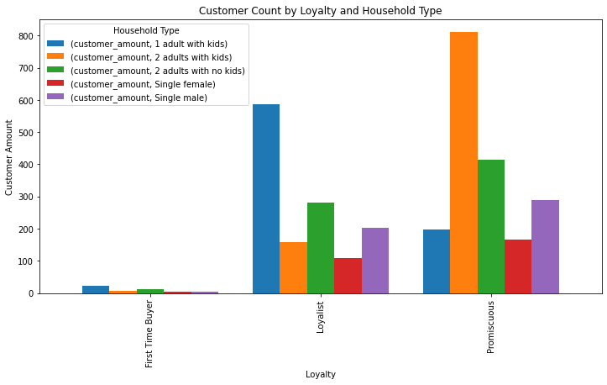
Key Findings:
2 adults with kids significantly is our biggest customer household group with 25%, second comes, single parent with kids 18%. Third is, households with 2 adults with no kids 13%.
55% customer households have children. Time-saving products are important for this segment.
In total 23% of households single-person.
💡 Business Insights:
Loyalty rewards, personalised offers help to create long term retention
Consider implementing online shopping platform and delivery system to bring convenience for the customers.
Create promotions for school seasons

Slide 7
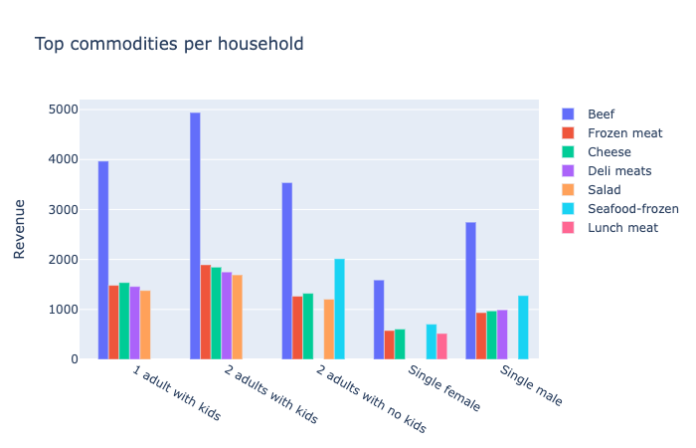
Key Findings:
Beef is the most preferred commodity across all household types, representing the highest share of purchases.
Additionally, frozen meat, and cheese appear to be staple items in shopping baskets.
Households with children show stronger demand for deli meat and salads
Households without children demonstrate relatively higher preference for frozen seafood.
💡 Business Insights:
Analyse basket composition for each household and create personalised offer for different segments.
Use beef in promotions to drive store traffic and reach out more customers.
Offer ‘Lunchbox’ or ‘Family Meal’ bundles

Slide 8
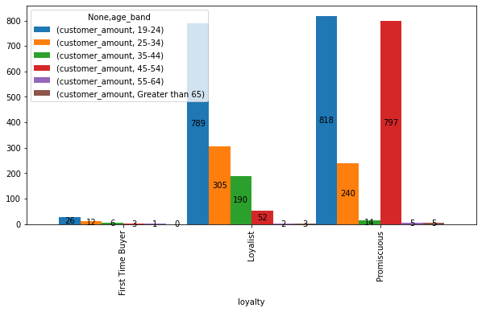
💡 Business Insights:
There is a significant opportunity here to convert promiscuous customer to loyal customers. -Conduct deeper analysis on shopping composition of promiscuous customers aged between 45-54.
-Create offers and invite them to loyalty programs.
-Promote premium value bundles tailored to this segment.
Invest in digital marketing and social media to contribute long term commitment for gen Z.
Key Findings:
Across all different loyalty types, customers who are aged between 19-24 our biggest customer segment.(Gen Z)
The second highest number seen is that in promiscuous loyalty type, aged between 45-54.

Slide 9
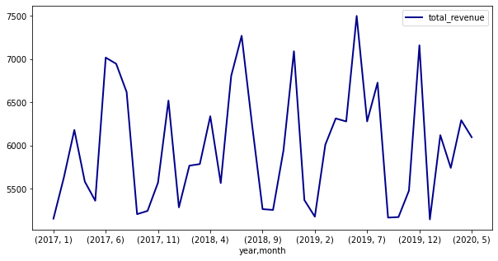
📊 Key Findings:
Uneven cash flow
There is a high fluctuations seen in the last three years revenue.
There are strong revenue peaks in June-July.
The revenues reaches lower levels in January-February
💡 Business Insights:
Implement loyalty/subscription programs to stabilize revenue fluctuations
Ensure stock availability all time during the busy period (June-July)
Implement targeted marketing campaigns and promotional offers for the slow months in order to stabilize revenue

Slide 10
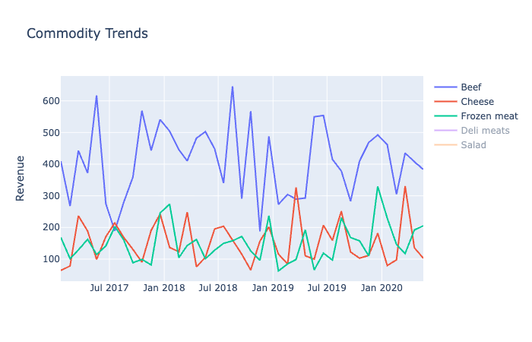
Key Findings:
The business experiences strong seasonal volatility over the all commodities.
Main revenue driver is beef over the last 3 years.
Cheese popularity increases in March every year
Frozen meat revenue increases in December but declines in November
💡 Business Insights:
Investigate the strong beef decline in July 2017 and December 2018
Implement demand forecasting models.
Closely monitor beef performance and work on strategic pricing and supplier negotiations
Promote cross selling initiatives for beef products: such as spices or BBQ products

Slide 11
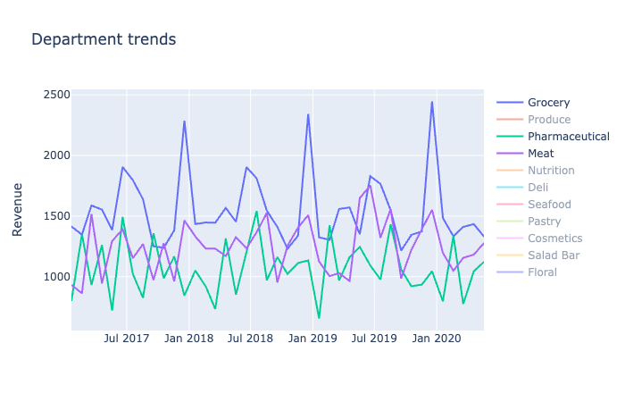
Key Findings:
The business experience strong seasonal volatility over all the departments.
Grocery department contributes %25 of the total revenue and shows strong revenue peaks in January.
The meat department contribute %21 of the total revenue but demonstrates revenue inconsistencies. With September appearing to be slower months.
The pharmaceutical department generates the third highest revenue overall, but performs weakest in January.
💡 Business Insights:
Increase inventory before peak times in order to prevent stockout and lost sales
Implement department specific inventory planning aligned with their seasonal demand patterns.
Considering slow month in pharmaceutical department, create health and wellness campaigns in January

Slide 12
Revenue Growth Strategy (Target: +5% in 2 years)
Focus on Families with Children
Launch “Lunchbox” and “Family Meal” bundles and implement delivery services to increase basket size and attract convenience-driven customers.
Convert Low-Loyalty Customers (45–54)
This segment offers great opportunity to convert them into loyal customers. Analyze shopping behavior to identify key purchase drivers and develop targeted offers, personalized incentives, and premium value bundles to increase retention and lifetime value.
Optimize Beef Performance
As beef significantly influences total revenue, closely monitor demand and apply strategic pricing and cross-selling initiatives. Create promotions where business can attract new customers.
Align Inventory with Seasonality
Given the strong seasonal volatility across departments, implement department-specific inventory planning to prevent stockouts during peak periods.

