Slide 1
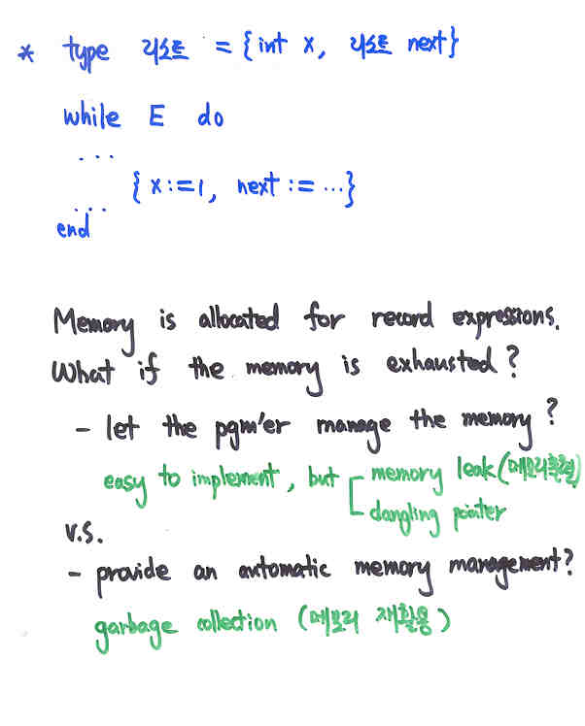
Another
issue:
memory
management

Slide 2
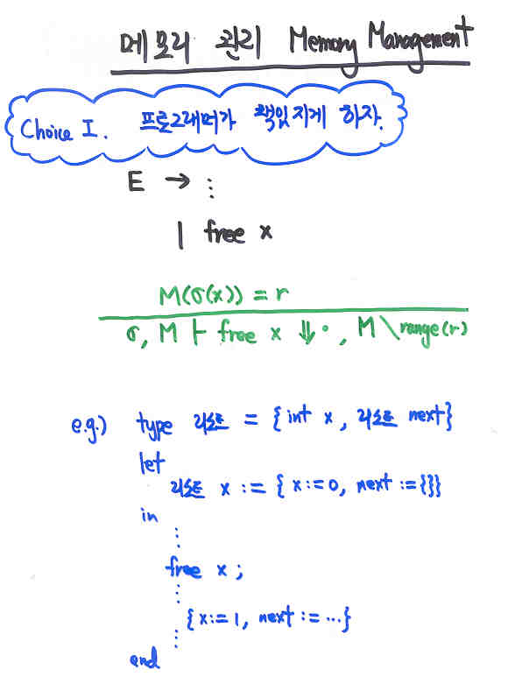

Slide 3
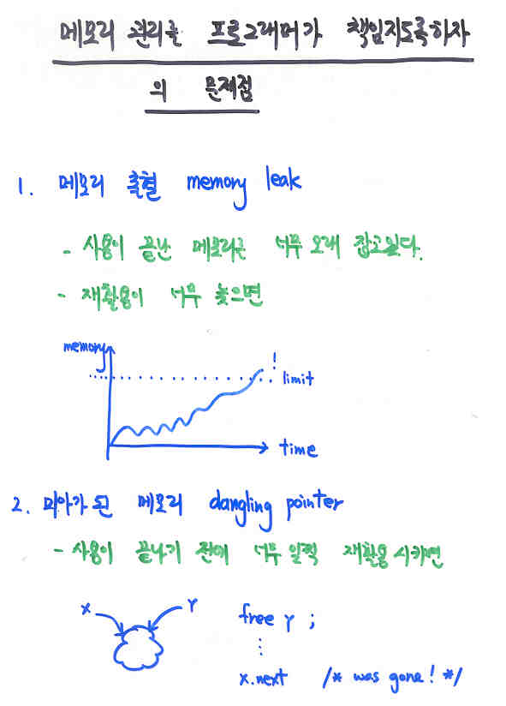

Slide 4
list := {};
for i:=1 to 2**30 do
list := {node := 0, next := list}
list := {};
for i:=1 to 1000 do
list := {node := 0, next := list};
(* use the list *)
free_all(list);
list := {};
for i:= 1 to 1000 do
list := {node := 0, next := list}
what if
memory
is exhausted
here?
Memory leak!
x := list.next.next;
write x.node+1
x is a dangling pointer!

Slide 5
프로그래머에게 맡기지 말고
자동으로 메모리를 재활용해 주자.
Modern programming languages supports
automatic garbage collection;
ML, Java, C#, Haskell, (Scheme,Prolog)
Face the history, dude: GC becomes the main stream!

Slide 6
Garbage Collection 메모리 재활용
Once in a while, memory is automatically recycled.
fun eval(E,M,expr) =
if |M|=too big
then eval’(E,gc(M),expr)
else eval’(E,M,expr)
and eval’(E,M,ADD(e1,e2)) = … eval … eval …
| eval’(E,M,CALL(f,e)) = … eval … eval …
...
How to define such gc?

Slide 7
Garbage Collection 메모리 재활용
How to define such gc?
fun gc(M) = recycle the parts of M that
will not be used in the future
of the program evaluation.
How do we know, at a point of a program evaluation,
whether a memory cell will not be used in the future?
We need a time-machine that travels to the future and
back!
We cannot program the time-machine, sorry.
But we can program an approximate time-machine that
is safe.

Slide 8
Garbage Collection 메모리 재활용
How can we program an approximate time-machine that
is safe?
every memory access is done through names:
M(E(x)) M(E(x)(age))
the contents of names are determined by
the current environment.
memory cells that can be accessed are those
that are reachable from the current
environments.
fun gc(E,M) = recycle M, except for those
that are reachable from E.

Slide 9
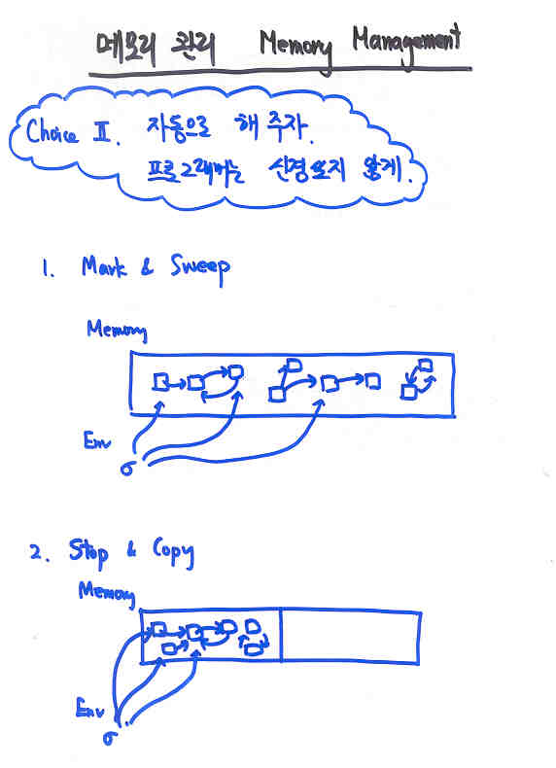
Goal:
GC in 10ms.

Slide 10
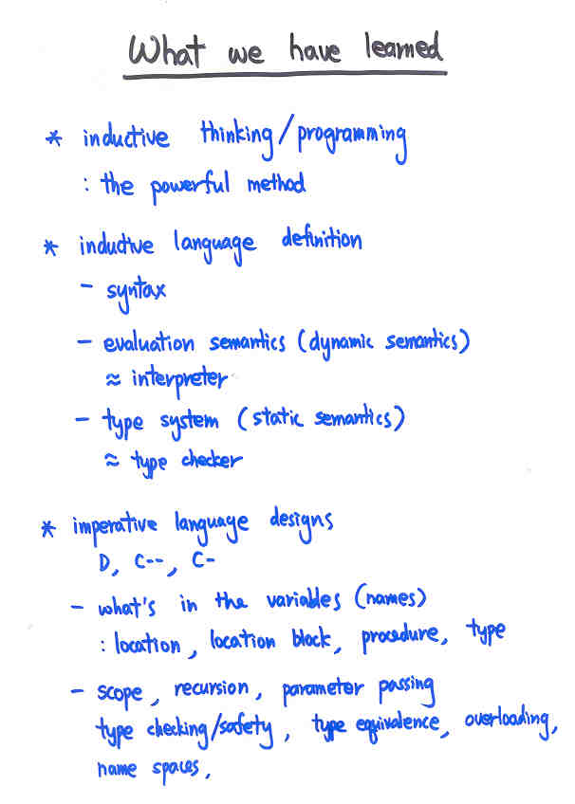
K-, K
and memory management

Slide 11
More to come before Part 2:
translation/virtual machine
foreign-language interoperability

Slide 12
Translation/Virtual Machine
programs in L1
programs in L2
semantics
semantics
interpreter
interpreter
circuits
x86
JVM
SECD
Krivine
C
nML
Java
compilation/compiler

Slide 13
integer expression
stack machine
(S,C)
stack S
command C
E -> n | E+E | E-E
stack = int list
command = cmd list
cmd = {push n, pop,
add, sub}
(S, push n::C) -> (n::S, C)
(n::S, pop::C) -> (S, C)
(n2::n1::S, add::C) -> (n1+n2::S, C)
(n2::n1::S, sub::C) -> (n1-n2::S, C)

Slide 14
Translation = a game of invariant
Expression E’s value appears on
top of the stack
trans: E.expr -> SM.command
such that eval(E) = SM.run(trans(E))
fun trans(n) =
| trans(E1+E2) =
| trans(E1-E2) =
push n
trans(E1)::trans(E2)::add
trans(E1)::trans(E2)::sub

Slide 15
Foreign-language Inter-operability
inter-operability between C- and nML
inter-operability between C- and Java
inter-operability between C- and C#
e.g. C- sorts a int list, nML checks and
prints the result
e.g. C- computes a sum, Java generates a list
of that length

Slide 16
fun callx(f,x) =
x into string s; (* inside C- *)
read s into y; (* inside nML *)
call f with y (* inside nML *)
There must be a protocol between C- and nML
about how to print/read x/s.
x2s(n) = print_int n
x2s(true) = print “TT”
x2s(false) = print “FF”
x2s() = print “UNIT”
x2s(r) = print “{... }”
s2n “n” = n
s2n “TT” = true
s2n “FF” = false
s2n “{... }” = {... }
C- value into string
string to nML value

Slide 17
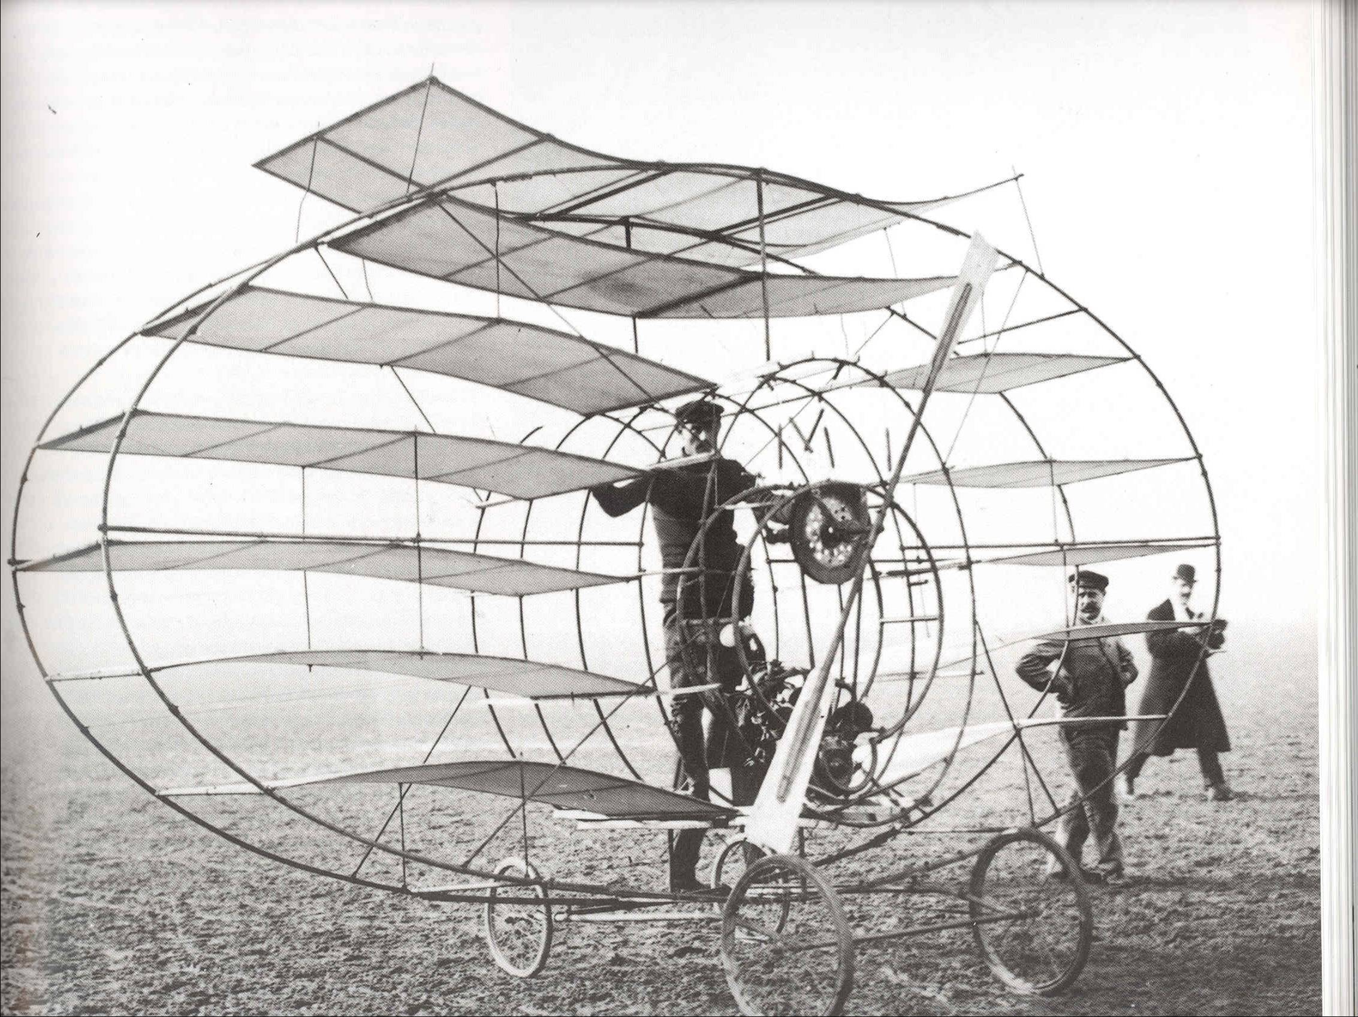

Slide 18
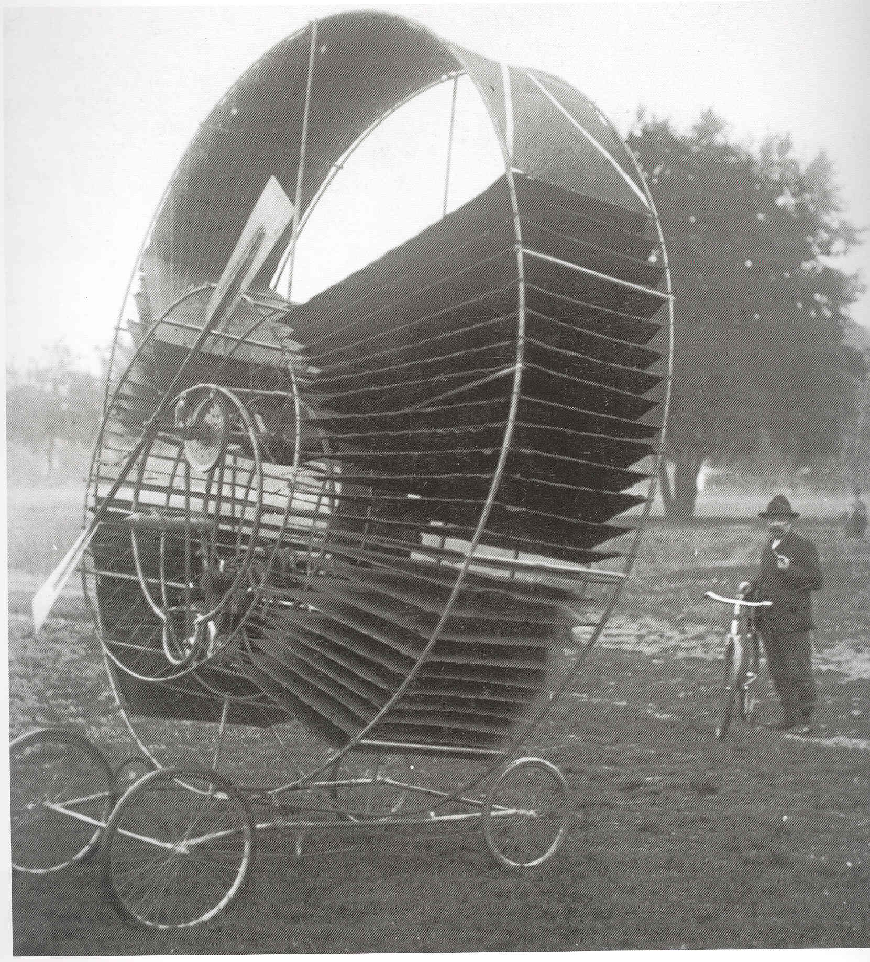

Slide 19
