Slide 1
Minority Carrier Dynamics Probed by Forward Bias Impedance Spectroscopy
Trapping Kinetics and Anomalous Diffusion
5-5-2018

Slide 2
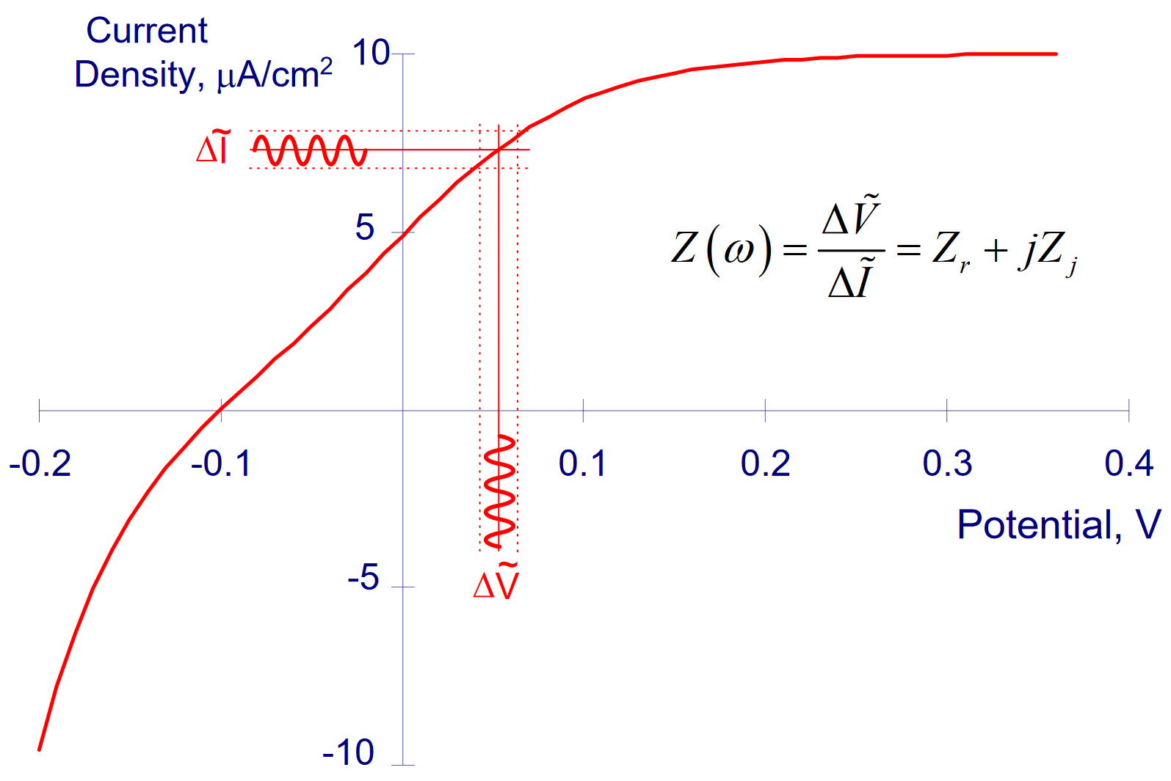
I. Brief Introduction to Impedance Spec
Impedance Spectroscopy (IS) can be used to interrogate the dynamics that make up macroscopic response of a complicated system
When applied to semiconductors, this means we are interrogating the many charge kinetic pathways that, in the DC limit, give us a bulk conductivity
In these applications, like in standard electrochemical IS (EIS), we use a small signal AC perturbation to monitor the overall impedance, Z of our system at a variety of different frequencies
Since Z is determined from the phase difference between applied voltage, V and resulting current, J this results to determining an empirical transfer function that maps this phase difference to the frequency domain
Credit: Orazem, EIS Spring 2008
This map must also be consistent with the physical dynamics we expect from the system, i.e. IS is phenomological tool that can suggest mechanisms

Slide 3
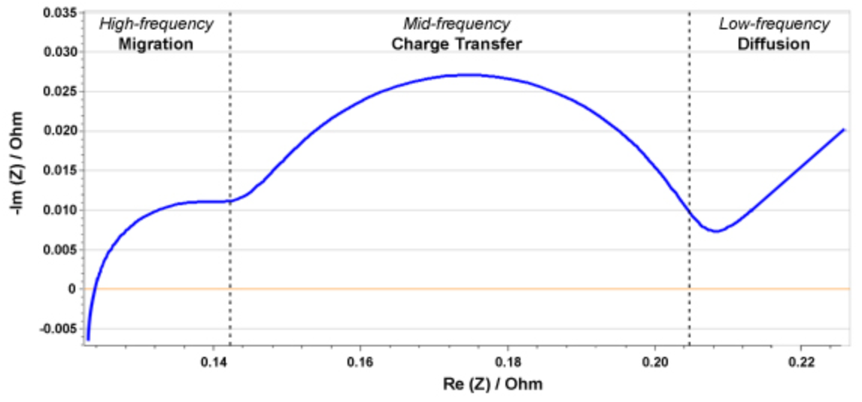
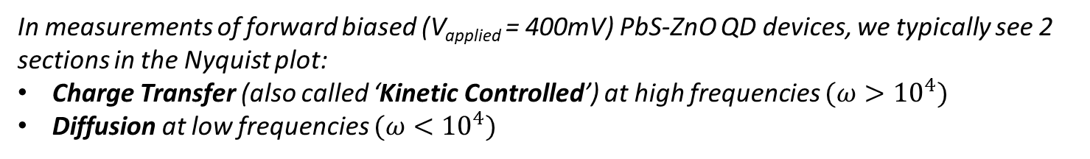

II. Impedance Spec on Semiconductor Diodes
In semiconductor junctions, the charge mechanisms depend on bias:
Reverse bias = depletion ➔ majority carriers (TAS)
Forward bias = diffusion ➔ minority carriers
In forward bias, IS can suggest minority carrier dynamics observable on timescales given by the frequency
Carrier dynamics are determined by analysis of the plots of the magnitude, phase, Re(Z) and Im(Z) vs. frequency (Bode plots), all of which are summarized nicely in the Nyquist plot of Re(Z) vs. Im(Z):
Credit: batteryuniversity.com
In measurements of forward biased (V_{applied} = 400mV) PbS-ZnO QD devices, we typically see 2 sections in the Nyquist plot:
Charge Transfer (also called ‘Kinetic Controlled’) at high frequencies $(ω>{10}^{4})$
Diffusion at low frequencies $(ω<{10}^{4})$
Here, I will demonstrate an analysis of the kinetic, high frequency region to determine the lifetime $τ_{0}$ of minority carrier charges in the PbS film. I will then give a phenomological model of resisitivty that can account for the dynamics observed in IS. Finally, I will comment on my ongoing efforts to analyze the anomlous diffusion kinetics observed at low $ω$

Slide 4
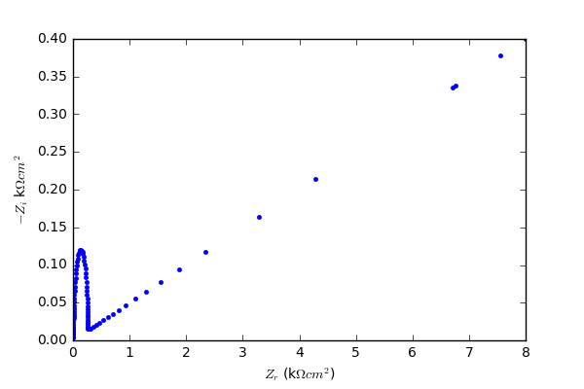
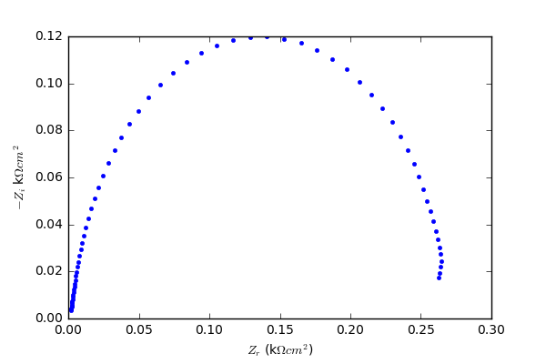

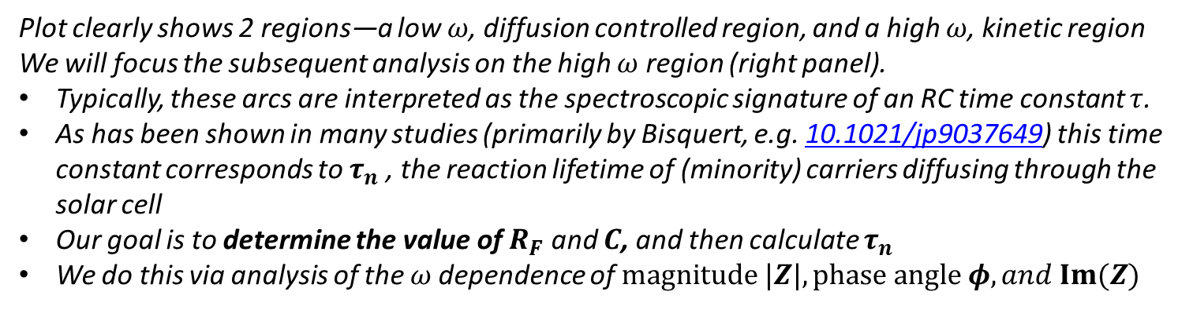
III. Aggregate Nyquist Plot Dynamics
$ω$ increasing
Kinetic
R_{F}
C
Diffusion
Plot clearly shows 2 regions—a low $ω$, diffusion controlled region, and a high $ω$, kinetic region
We will focus the subsequent analysis on the high $ω$ region (right panel).
Typically, these arcs are interpreted as the spectroscopic signature of an RC time constant $τ$.
As has been shown in many studies (primarily by Bisquert, e.g. 10.1021/jp9037649) this time constant corresponds to $τ_{n}$, the reaction lifetime of (minority) carriers diffusing through the solar cell
Our goal is to determine the value of $R_{F}$ and $C$, and then calculate $τ_{n}$
We do this via analysis of the $ω$dependence of $magnitude |Z|, phase angle φ, and Im(Z)$

Slide 5
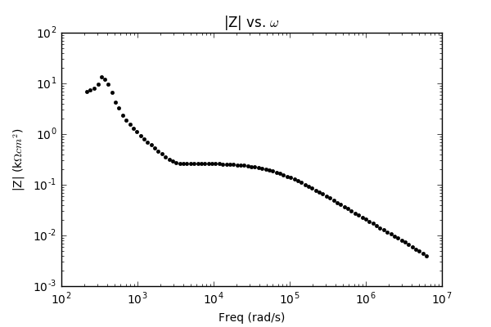
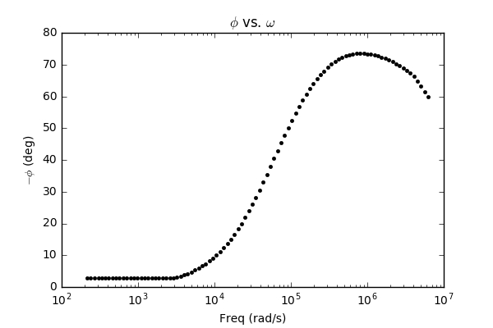
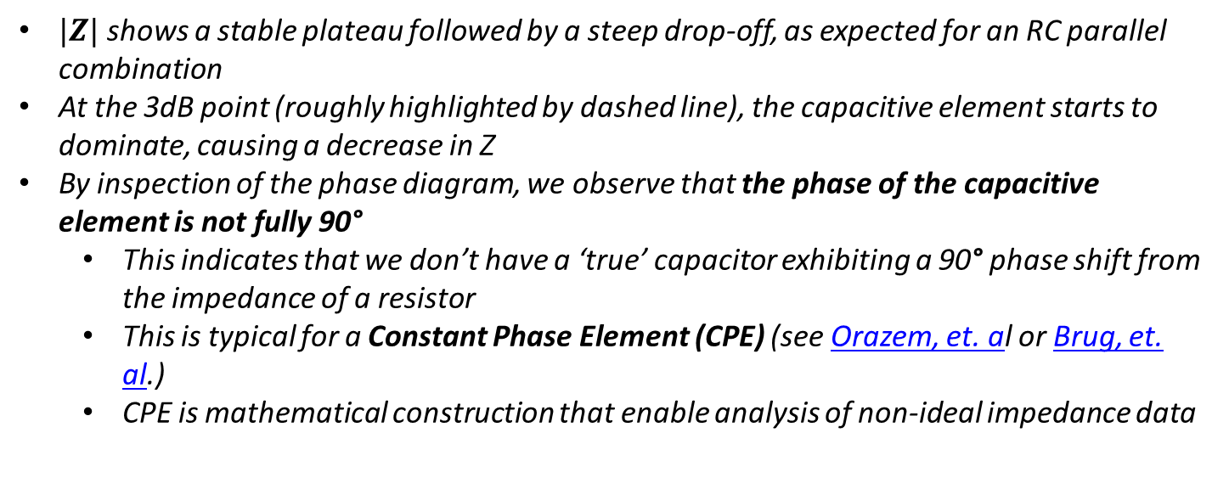
IV. Magnitude and Phase
Note: we are considering only high $ω$ data for now
$|Z|$ shows a stable plateau followed by a steep drop-off, as expected for an RC parallel combination
At the 3dB point (roughly highlighted by dashed line), the capacitive element starts to dominate, causing a decrease in Z
By inspection of the phase diagram, we observe that the phase of the capacitive element is not fully 90°
This indicates that we don’t have a ‘true’ capacitor exhibiting a 90° phase shift from the impedance of a resistor
This is typical for a Constant Phase Element (CPE) (see Orazem, et. al or Brug, et. al.)
CPE is mathematical construction that enable analysis of non-ideal impedance data

Slide 6
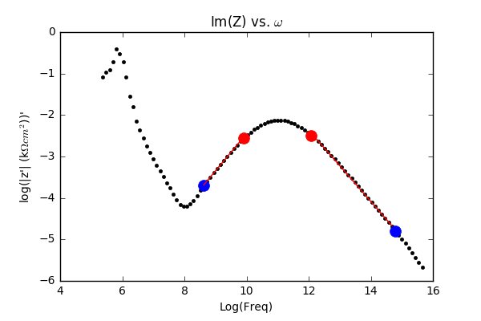
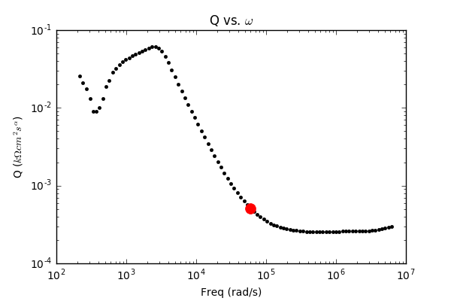



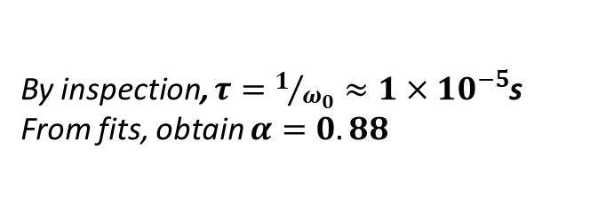
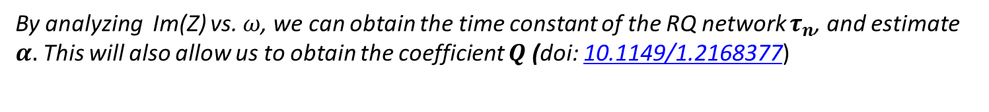

V. Im(Z) vs. $ω$
CPE element Q has the following impedance: $Z_{Q}=\frac{1}{{\left(jω\right)}^{α}Q}$
(interpretation: Q is like a capacitor with a modified complex phase angle $α$
By analyzing Im(Z) vs. $ω$, we can obtain the time constant of the RQ network $τ_{n}$, and estimate $α.$ This will also allow us to obtain the coefficient $Q$ (doi: 10.1149/1.2168377)
1. Estimate $α$ by inspecting slope on either side of the peak
estimated $ω_{0}$
By inspection, $τ=1/{ω_{0}}≈1×{10}^{−5}$s
From fits, obtain $α=0.88$
2. Estimate $Q$ by looking at plateaus in plot of $Q=sin\left(\frac{απ}{2}\right)\frac{−1}{Im\left(Z\left(ω\right)\right)ω^{α}}$
We see that $Q=2.57×{10}^{−4}kΩ^{−1}{cm}^{−2}s^{α}$
estimated $ω_{0}$
Note the funky units of Q. The weird time-dependence means we are going to have to interpret the time constant $τ_{n}$ accordingly

Slide 7
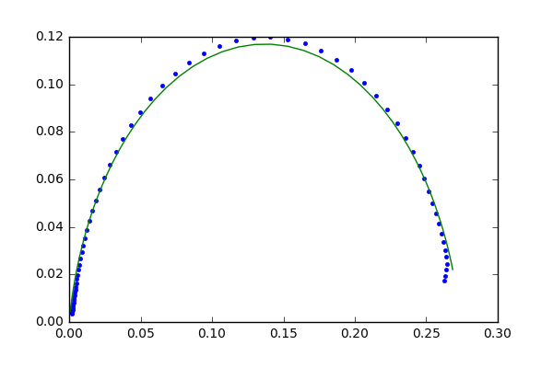
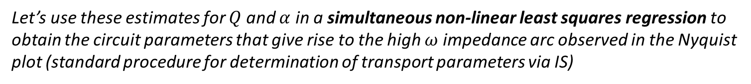
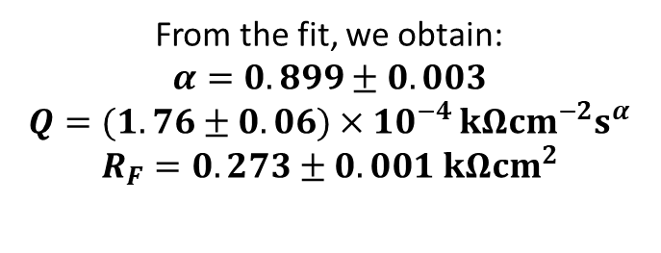
VI. CPE Fitting
Let’s use these estimates for $Q$ and $α$ in a simultaneous non-linear least squares regression to obtain the circuit parameters that give rise to the high $ω$ impedance arc observed in the Nyquist plot (standard procedure for determination of transport parameters via IS)
R_{F}
From the fit, we obtain:
$$α=0.899±0.003$$
$$Q=(1.76±0.06)×10^{−4 }kΩcm^{−2}s^{α}$$
$$R_{F}=0.273±0.001 kΩcm^{2}$$
Q
These parameter values are in excellent agreement with the estimates extracted via literature-accepted methods.
Before we move on to extraction of $τ_{n}$, how are we supposed to make physical sense of this? After all, CPEs are purely mathematical constructs….

Slide 8
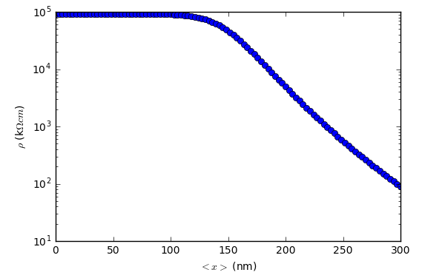
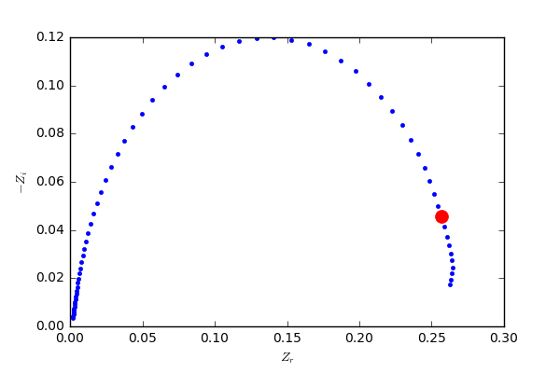
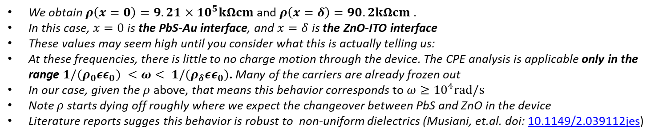
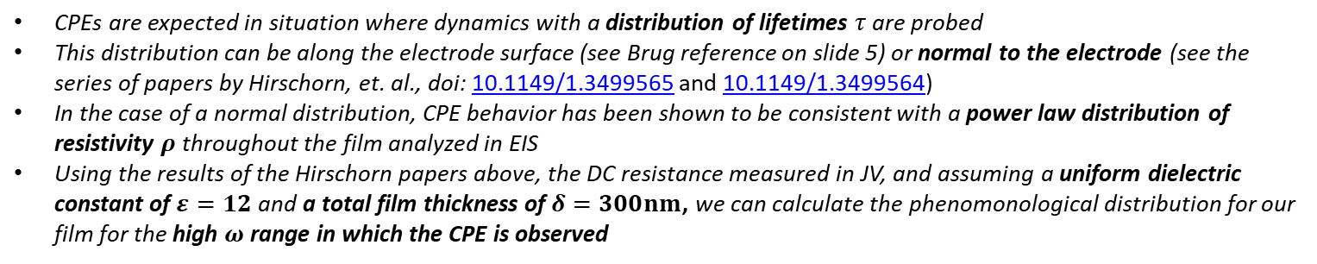
VII. Physical Interpretation
CPEs are expected in situation where dynamics with a distribution of lifetimes $τ$ are probed
This distribution can be along the electrode surface (see Brug reference on slide 5) or normal to the electrode (see the series of papers by Hirschorn, et. al., doi: 10.1149/1.3499565 and 10.1149/1.3499564)
In the case of a normal distribution, CPE behavior has been shown to be consistent with a power law distribution of resistivity $ρ$ throughout the film analyzed in EIS
Using the results of the Hirschorn papers above, the DC resistance measured in JV, and assuming a uniform dielectric constant of $ε=12$ and a total film thickness of $δ=300nm$, we can calculate the phenomonological distribution for our film for the high $ω$ range in which the CPE is observed
We obtain $ρ\left(x=0\right)=9.21×{10}^{5}kΩcm$ and $ρ\left(x=δ\right)=90.2kΩcm$ .
In this case, $x=0$ is the PbS-Au interface, and $x=δ$ is the ZnO-ITO interface
These values may seem high until you consider what this is actually telling us:
At these frequencies, there is little to no charge motion through the device. The CPE analysis is applicable only in the range ${1/(ρ}_{0}εε_{0}) <ω< {1/(ρ}_{δ}εε_{0})$. Many of the carriers are already frozen out
In our case, given the $ρ$ above, that means this behavior corresponds to $ω≥{10}^{4}rad/s$
Note $ρ$ starts dying off roughly where we expect the changeover between PbS and ZnO in the device
Literature reports sugges this behavior is robust to non-uniform dielectrics (Musiani, et.al. doi: 10.1149/2.039112jes)

Slide 9
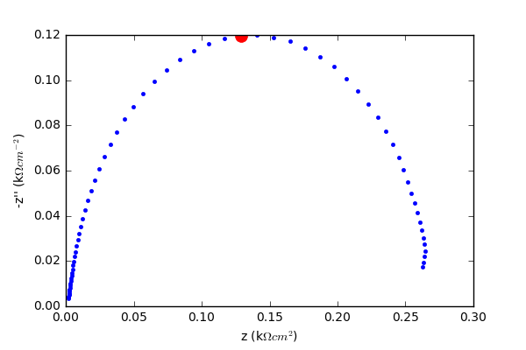
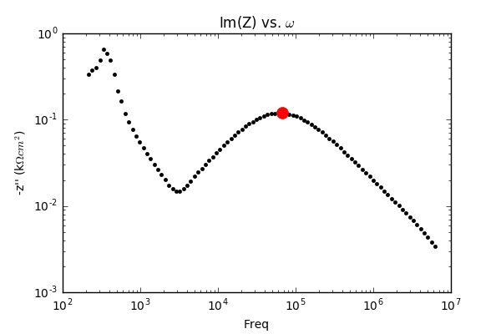

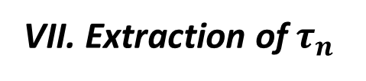
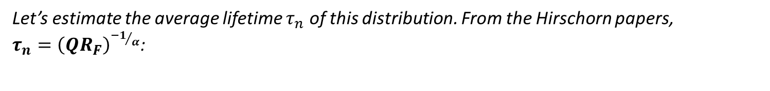
VII. Extraction of $τ_{n}$
Now we have a physical basis for the strange time dependence of the capacitive element $Q$—a distribution of time constants due to the power law distribution of $ρ$ in our film.
This is obviously expected if the electronic states available for occupation in the film are a distribution of shallow and deep traps—at high frequency, deep traps (likely conductive pathways) are frozen out, which gives rise to an imperfect dielectric with a non-ideal frequency dispersion
Let’s estimate the average lifetime $τ_{n}$ of this distribution. From the Hirschorn papers, $τ_{n}={\left(QR_{F}\right)}^{{−1}/α}$:
We obtain $τ_{n}=1.6×{10}^{−5}s$, corresponding to an $ω_{0}=6.68×{10}^{4}rad/s$ (highlighted above)
We have thus been able to extract a reliable, physically reasonable lifetime of minority carriers in the device via IS

Slide 10
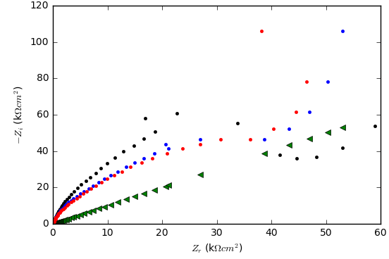
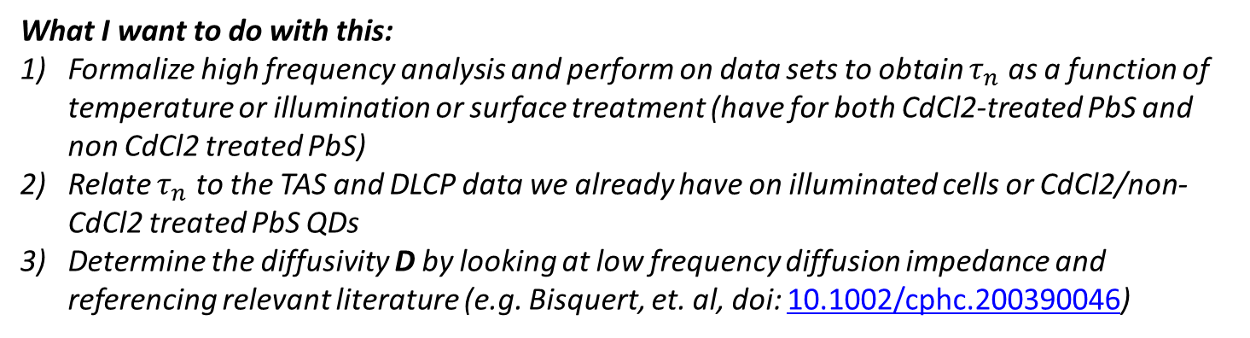
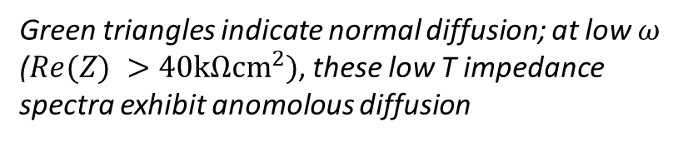
IX. Conclusion and Outlook
IS at high frequency gives us a picture of the recombination kinetics of minority carriers
Via the use of a CPE and an equivalent circuit model, we have been able to both graphically and analytically determine the recombination lifetime $τ_{n}$ of minority carriers
We can relate this lifetime to a power law distribution in $ρ$
Interestingly, power law distributions are also the foundation of anomalous diffusion, which is also observed in the low frequency region of the impedance spectrum
Green triangles indicate normal diffusion; at low $ω$ ($Re(Z) >40kΩcm^{2})$, these low T impedance spectra exhibit anomolous diffusion
What I want to do with this:
Formalize high frequency analysis and perform on data sets to obtain $τ_{n}$ as a function of temperature or illumination or surface treatment (have for both CdCl2-treated PbS and non CdCl2 treated PbS)
Relate $τ_{n}$ to the TAS and DLCP data we already have on illuminated cells or CdCl2/non-CdCl2 treated PbS QDs
Determine the diffusivity D by looking at low frequency diffusion impedance and referencing relevant literature (e.g. Bisquert, et. al, doi: 10.1002/cphc.200390046)

