Slide 1

Final project NAYA Collage Revital Matityahu & Eran Sarid 08/2021
Market Match
revital.matityahu@gmail.com 054-8050636
eransarid@gmail.com 052-8757584

Slide 2
Introduction
A web application for online commercial between consumers and consumers/suppliers.
Consumers can add multiple bids in several categories.
Consumers/Suppliers can make offers
Get enrichment from related web sites

Slide 3





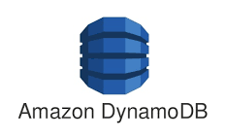






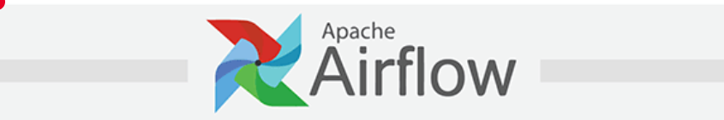
Market Match Architecture
Main data pipeline
(Read r2rTrips)
(Read bids)
START
Stream
Bids
Write Table Bids
Web
bids / offers
Amazon Kinesis Data stream
Dashboard - Bids
Archive
Info - Enrichment
Stream
Trips
Write Table Trips
Amazon Kinesis Data stream
BI
Web Scraping
Dashboard - Trips
List of cities
Archive

Slide 4
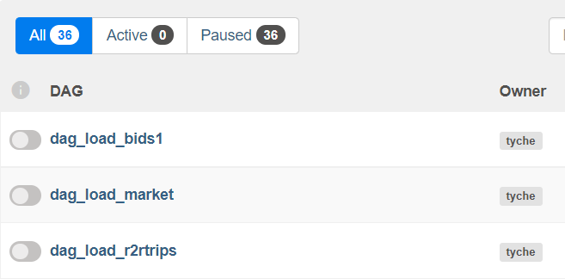
We use EC2 to runs AirfFlow web service and scheduler It executes multiple DAGS that bring up “Market-Match” application and Web Scrapping processes | AiFlow

Slide 5
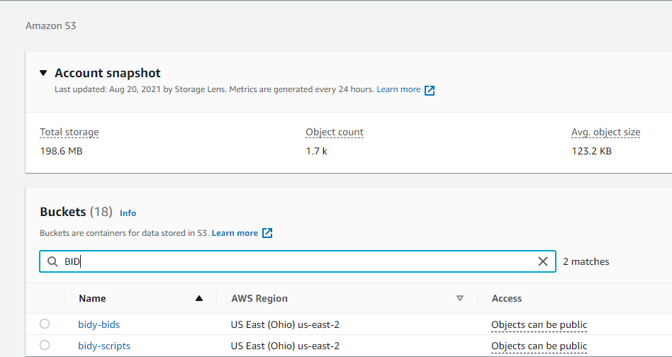
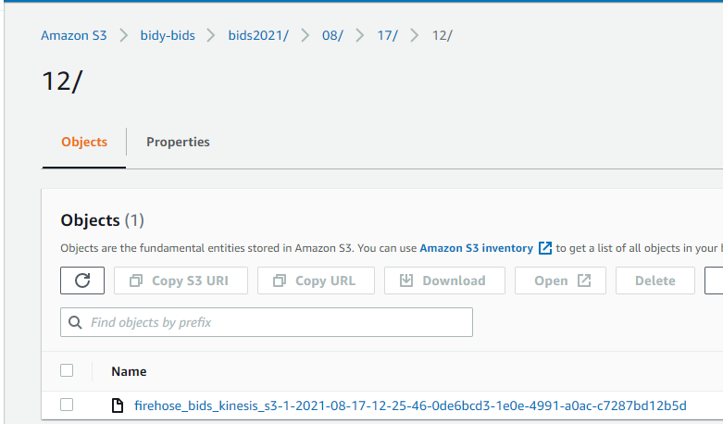
Store json files for archive and analytics | S3

Slide 6
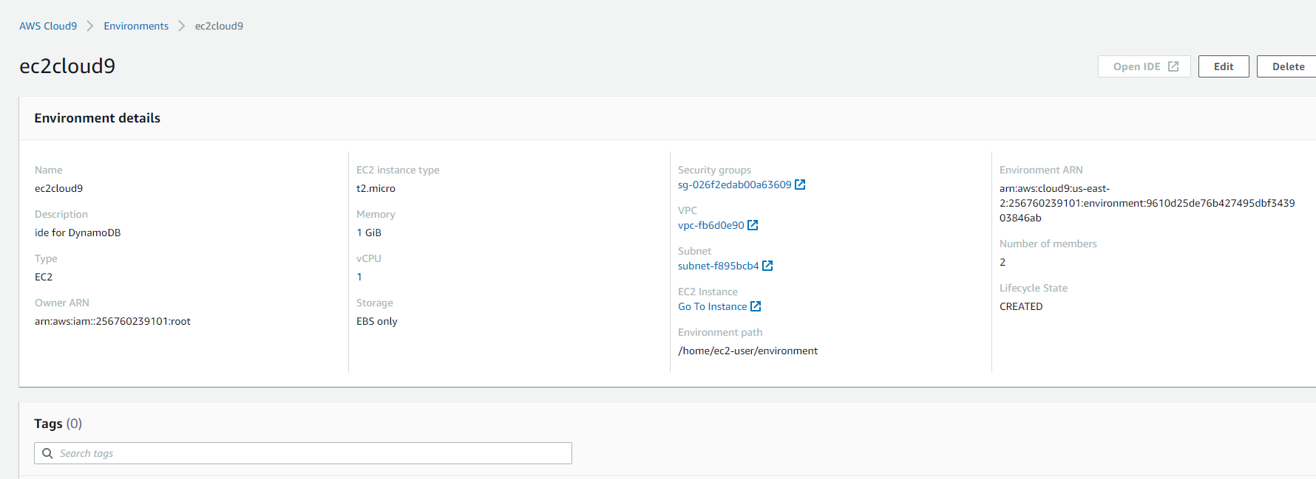
Cloud9

Slide 7
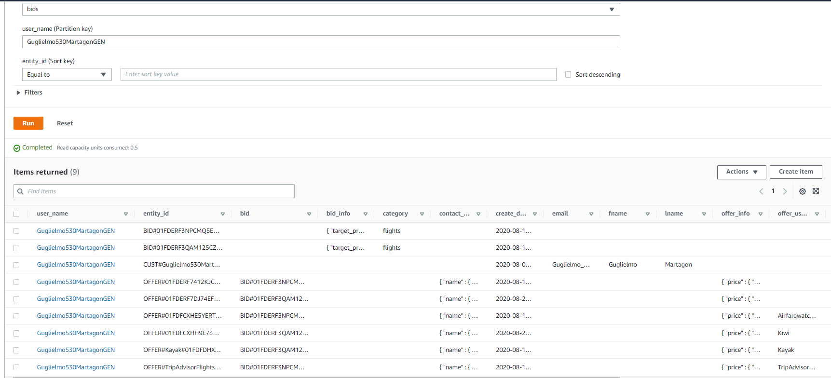
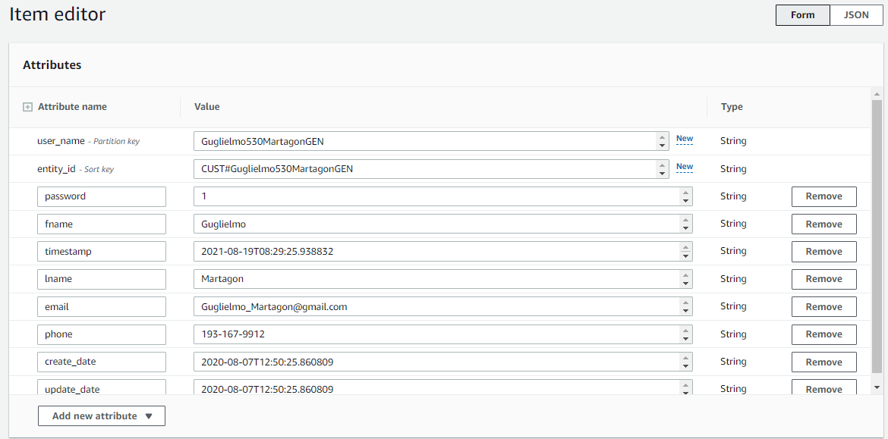
bids table: Users \ Bids \ Offers | DynamoDB

Slide 8
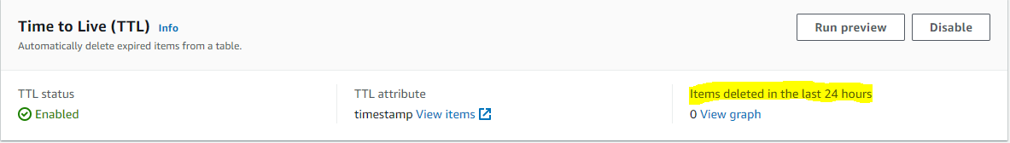
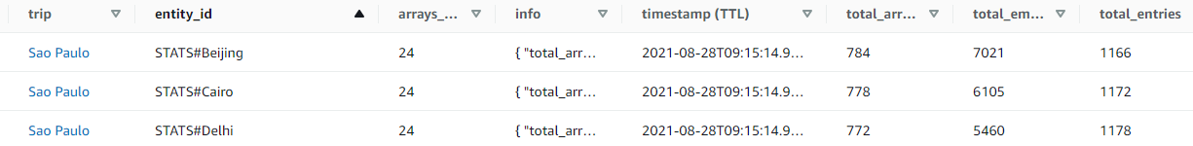
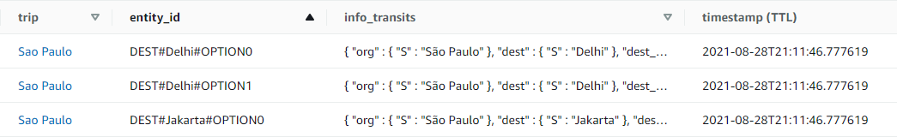
r2rTrips table: trips options-transits enrichment r2rTrips table: hierarchy arrays analysis | DynamoDB

Slide 9
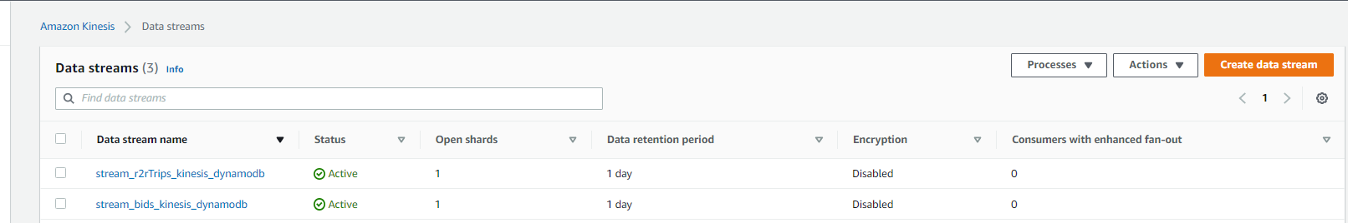
Pipeline for transfer data through Lambda to DynamoDB Bids app data Rome2Rrio scrapping data | Kinesis Data Streams

Slide 10
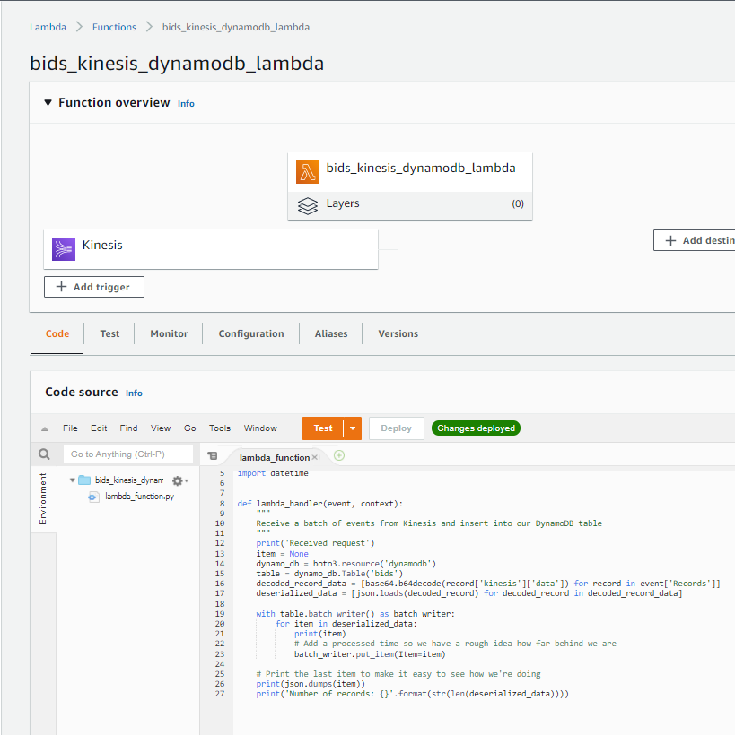
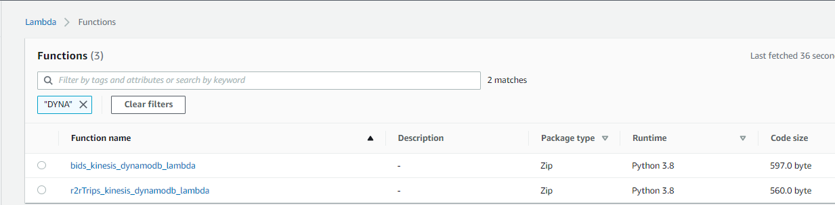
Write bids and trips Items into DynamoDB tables | Lambda

Slide 11
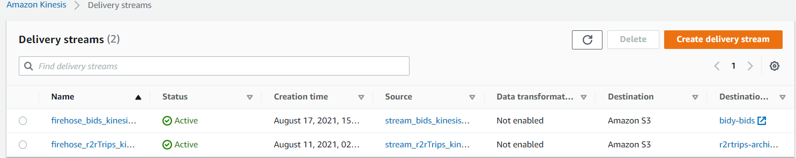
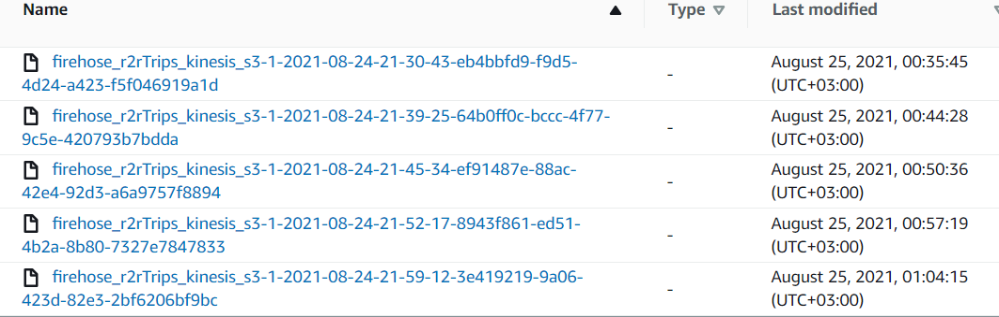
Store data streams events to S3 for archive and analytics | Kinesis Firehose

Slide 12
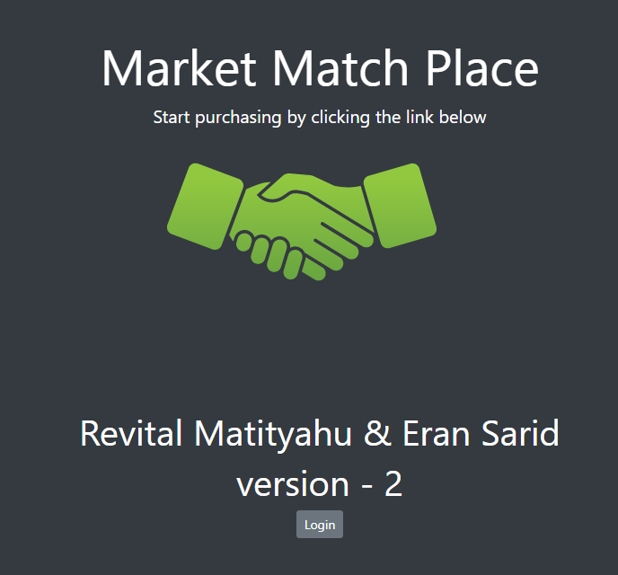
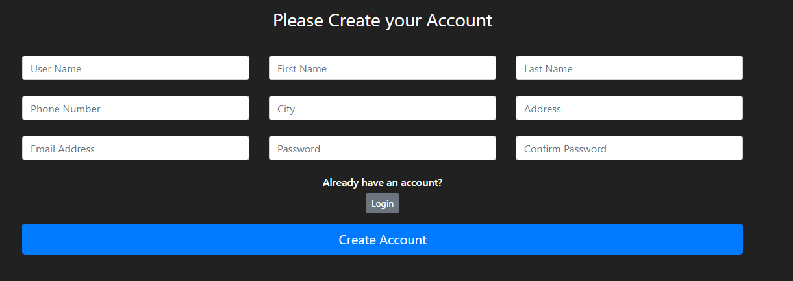
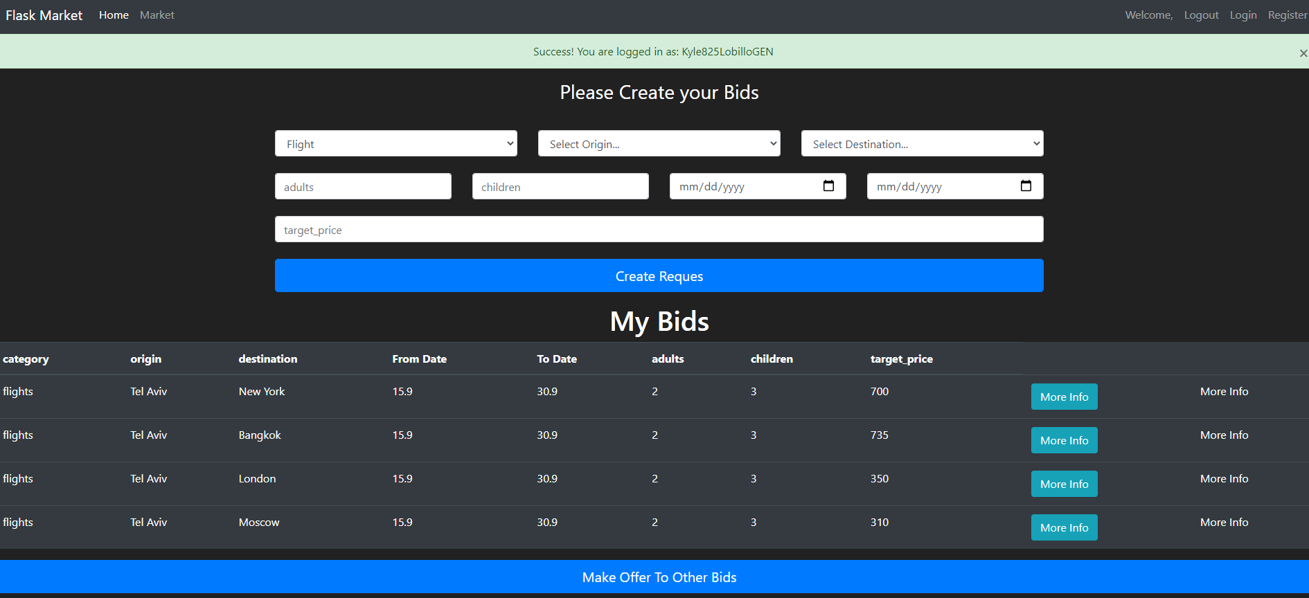
“Market-Match” application | Python - Flask

Slide 13
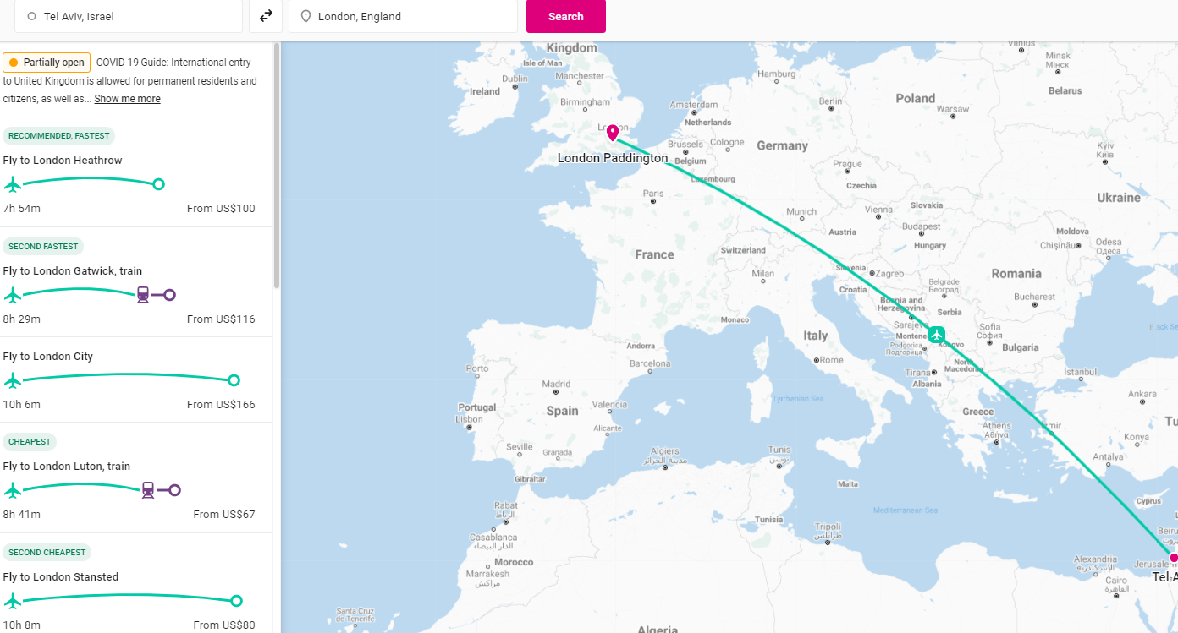
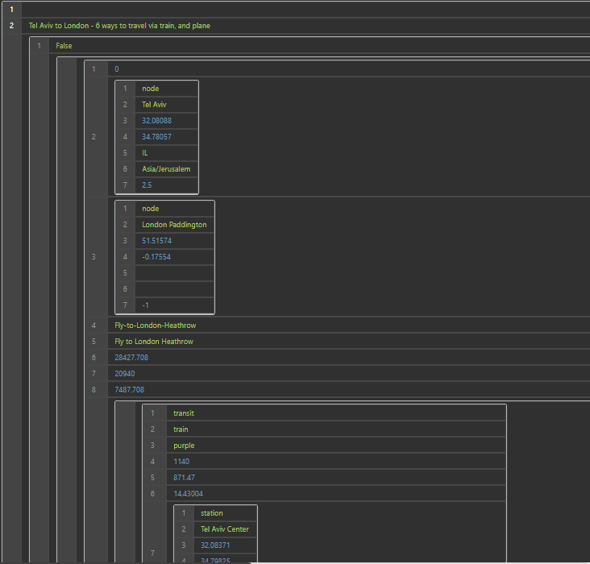
Scrapping rome2rio site for enrichment trips options | Python - Web Scrapping
Extracted original Json from site

Slide 14
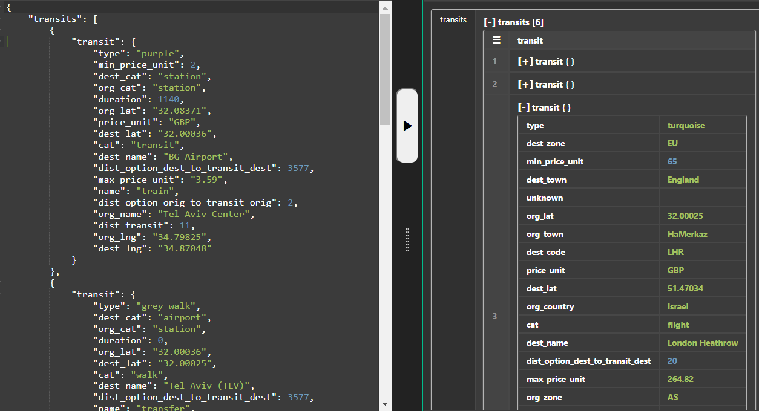
Python - Web Scrapping
Extracted Flight info

Slide 15
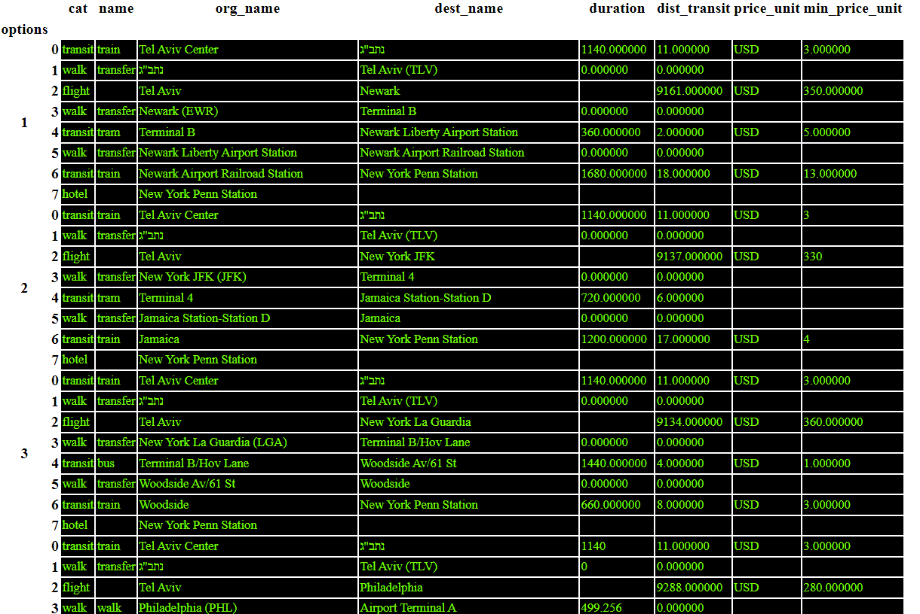
Python - Web Scrapping

Slide 16
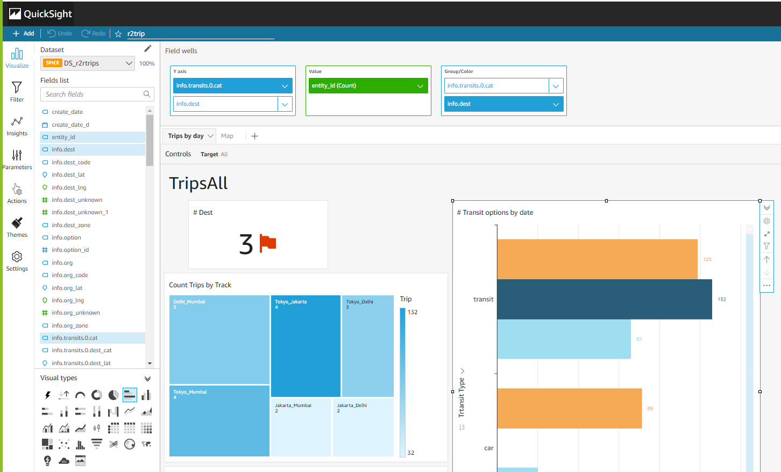
Real time Dashboards | QuickSight

Slide 17
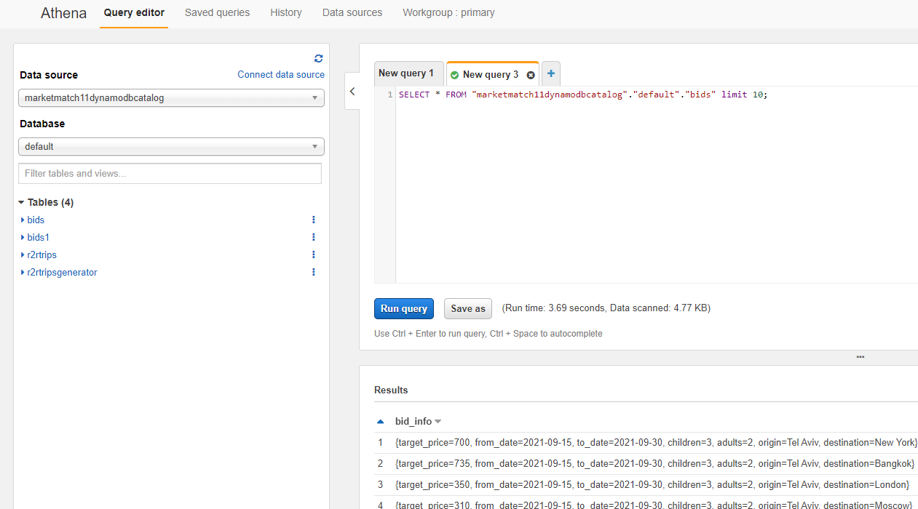
Queries json files from s3 buckets | Athena

Slide 18
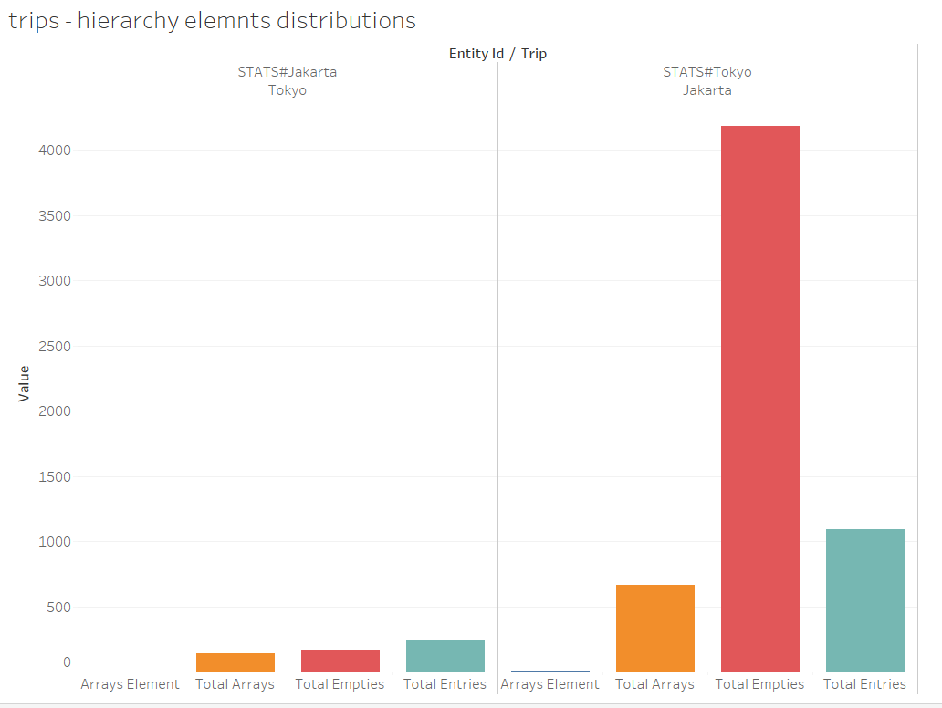
Create Analytics Reports | Tableau

Slide 19
Thank you

