Slide 1
Monitoring Tweets
Revital Matityahu & Eran Sarid
Project Data Engineer Jun 2021

Slide 2
overview
Monitoring and analysis of social network discourse on Twitter.
Get main data from client: User mail, Time to Follow , list of terms to track with the option to select/create dictionary of terms .
Filter Realtime streaming of Tweets statuses
Display Analytics views
Notification to client for some rules

Slide 3





Monitoring Architecture Overview
Data Sources
Data Storage
Load Raw Data
Data cleaning
Create Dataframe
& Relevant Columns
Create pandas Reports
Streaming
Raw Data
API
Audit
Upload clean
df to elastic
Create Kibana Reports
Data Visualization

Slide 4
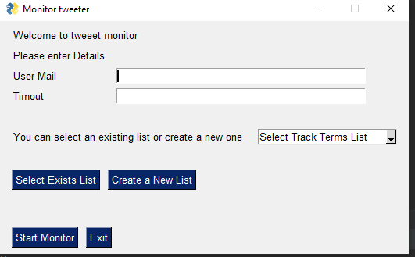
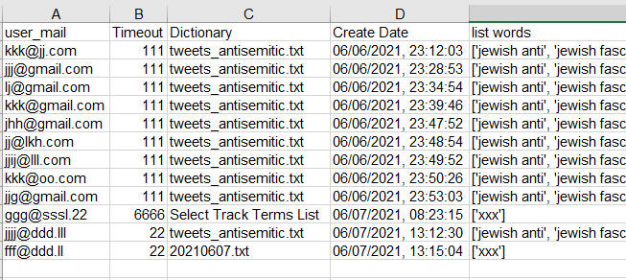
Data Source
Get details from Client – validate the input data & output to CSV file.

Slide 5
Data Source
Set up Authentication token – Connect to Twitter API.
using .env file.
Create twitter Stream Listener– Retrieve JASON data.
Filter only the relevant user events by the following keys:
['id', 'name', 'created_at', 'location', 'url', 'protected', 'verified’,
'followers_count', 'friends_count', 'listed_count', 'favourites_count’,
'statuses_count', 'withheld_in_countries’]

Slide 6
Data Storage
Using Elasticsearch as the main storage
Store streaming raw data
Store clean data
Use as source data for analyze and reports.
Elasticsearch allows you to store, search, and analyze huge volumes of data quickly and in near real-time and give back answers in milliseconds. It's able to achieve fast search responses because instead of searching the text directly, it searches an index.

Slide 7
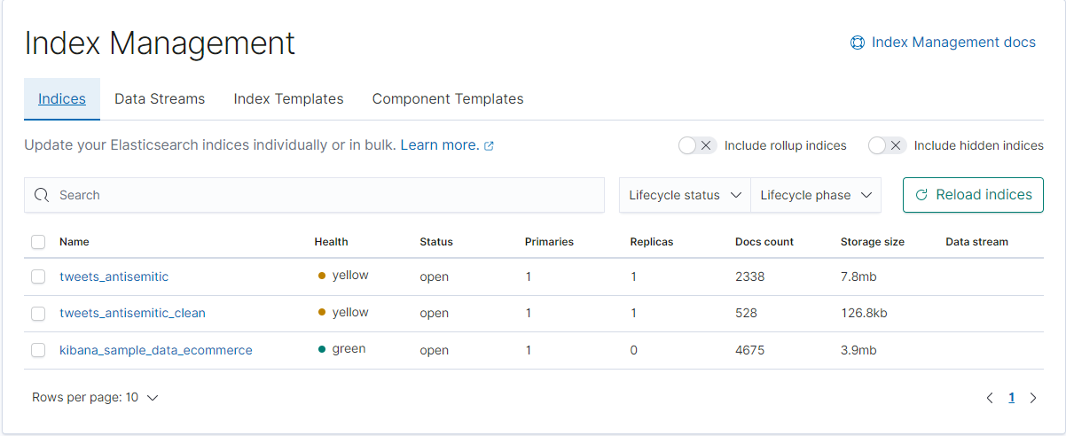
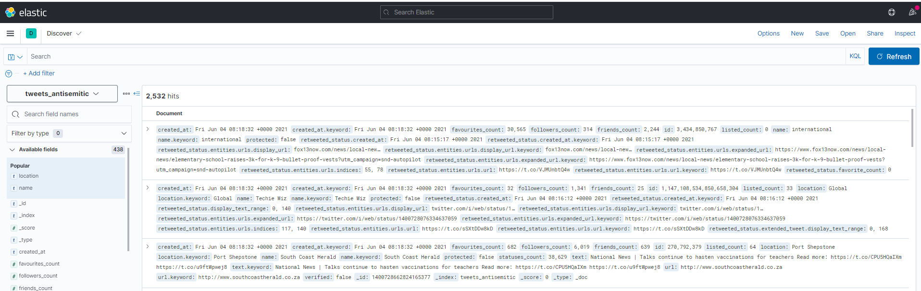

Slide 8
The main process
Connect to the Elasticsearch cluster.
Create a new index if not exists and store there new raw data.
Clean Data – remove retweeted , null locations
Load back bulk clean data into deferent elastic index
Create Data Frames
Output to html file
Monitoring

Slide 9
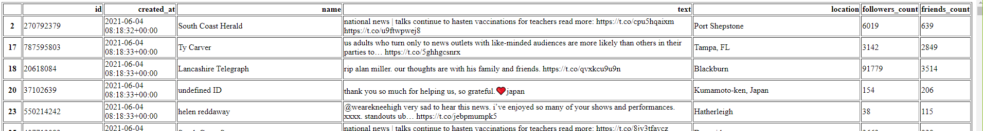
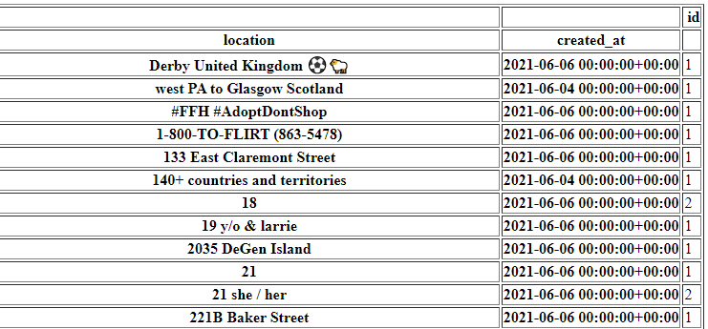
Panda Reports Export to HTML

Slide 10
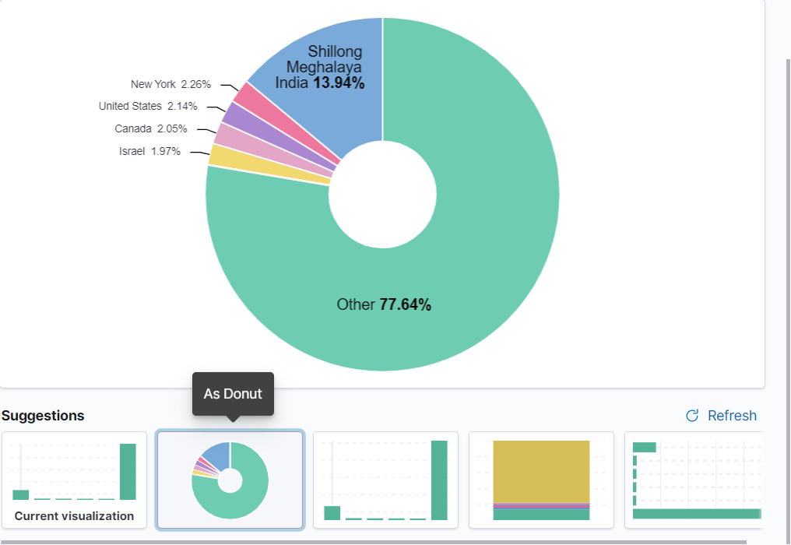
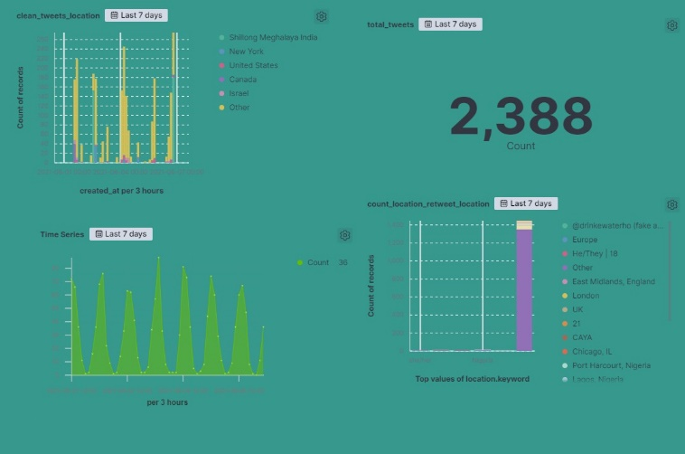
Kibana Reports

