Slide 1
setting

Slide 2
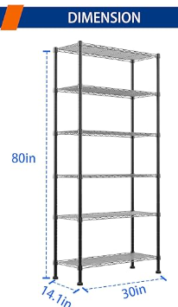
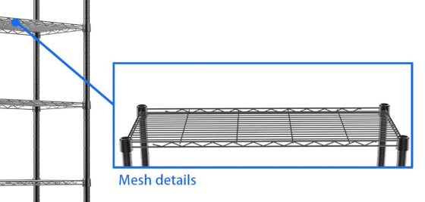
shelf info
Each shelf can support a weight capacity of up to 250lbs,stable and sturdy
SHELF SHELVING UNIT: The shelf is specially coated for protecting it from any water,rust or corrosion

Slide 3
planter info
name | size(l*h*d) | note
Menards Brown | 20*10*8
Blue | 14.5*6.5*5
Circular | (Circular) Diameter 7.5*7
Cube big | 7.5*7.5*7.5
Cube small | 4*4*4.5
Daiso thick | 17*10*7
Daiso long | 25*6.5*7

Slide 4
2.Plants spec
(5)Lettuce, Bok Choy, Spinach, Kale, Swiss Chard

Slide 5
Plants spec
Plant | Variety | Days to Harvest | Depth | Thin To | Plants diameter | Notes
Swiss Chard | Burpee’s Rhubarb Chard | 60 | ½" | 12" apart | 12 | Crimson ribs like rhubarb, sweet leaves. Keep soil moist; seedlings emerge in 7–14 days.
Kale | Premier | 55–65 | ¼" | 18" apart | 12 | Great for baby greens or mature leaves. Nutrient-rich. Seedlings in 10–21 days.
Lettuce | Black Seeded Simpson | 45 | ¼" | 8" apart | 3 | Crisp, frilled leaves with delicate flavor. Sow every 2 weeks for continuous harvest.
Baby Bok Choy | Baby Choi | 50 | ¼" | 10-12" apart | 6-7 | Fast-growing, tender green leaves. Keep soil moist; sprouts in 10–21 days.
Spinach | Salad Sensation Hybrid | 22–55 | ½" | 6" apart | 1.7 | Semi-savoy leaves for salads or freezing. Sow in early spring or late summer.

Slide 6
Plants spec
Plant | Optimal Temperature | Optimal Humidity | Growth Tips
Swiss Chard | 🌤️ 16–24°C | 💧 60–70% | Growth slows and leaves get tough above 30°C. Maintain steady moisture for tender stalks.
Kale | 🌤️ 15–21°C | 💧 50–70% | Prefers cool weather. Leaves become coarse above 25°C. Slightly cooler nights help flavor.
Lettuce | 🌤️ 12–20°C | 💧 60–80% | Very heat-sensitive; bolts easily above 24°C. Cool, moist conditions produce the best leaves.
Baby Bok Choy | 🌤️ 13–22°C | 💧 60–70% | Sudden temperature rises trigger bolting. Keep temperature and moisture consistent.
Spinach | 🌤️ 10–18°C | 💧 55–70% | Thrives in cool weather. Growth slows and leaves taste bitter above 24°C.

Slide 7
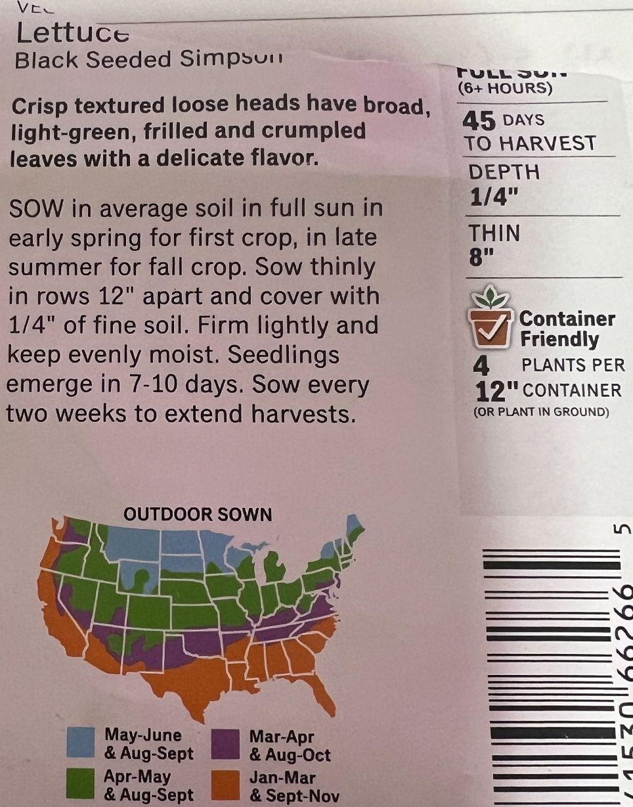
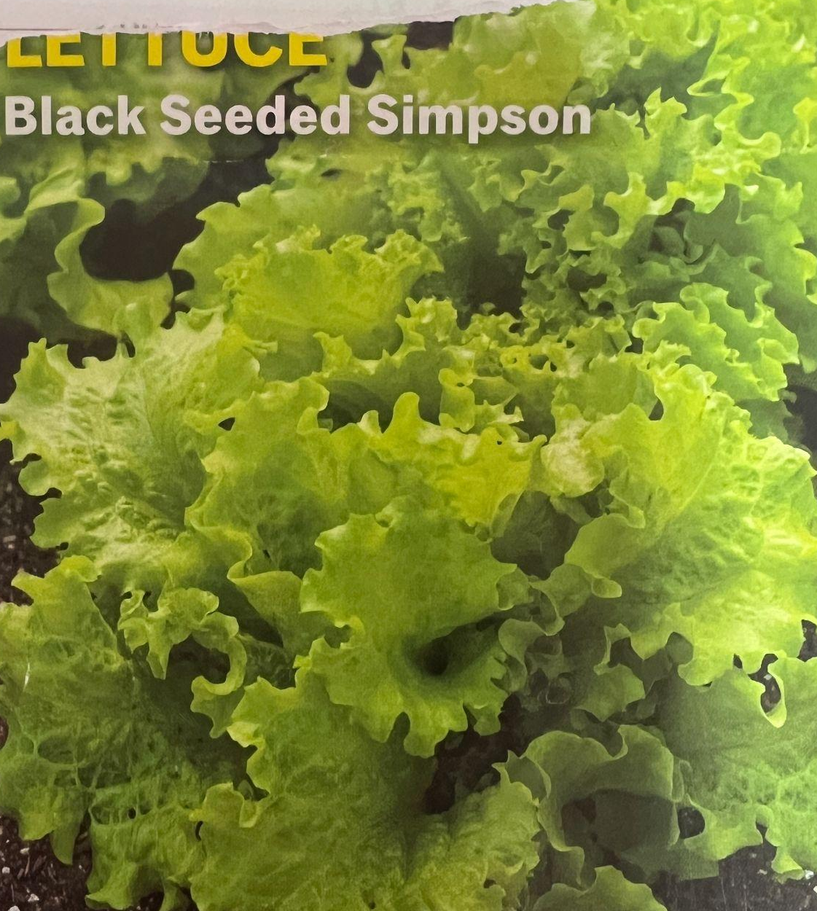
1.Lettuce
DTH : 45
Depth : ¼”
Thin : 8”
12” Container : 4pcs
full sun
seedling emerges in 7-10days
Sow every 2wks for max harvest

Slide 8
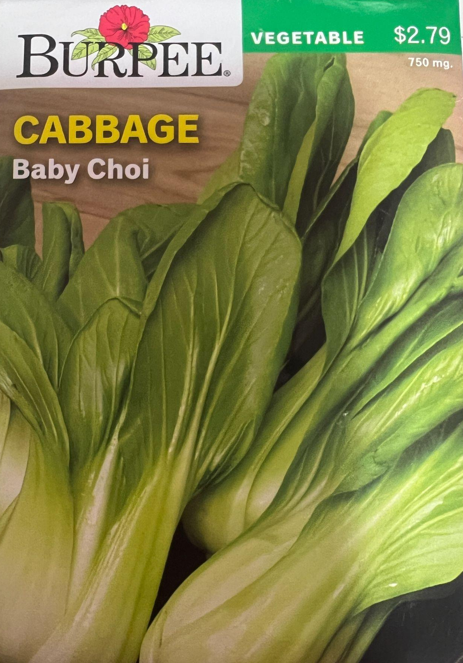
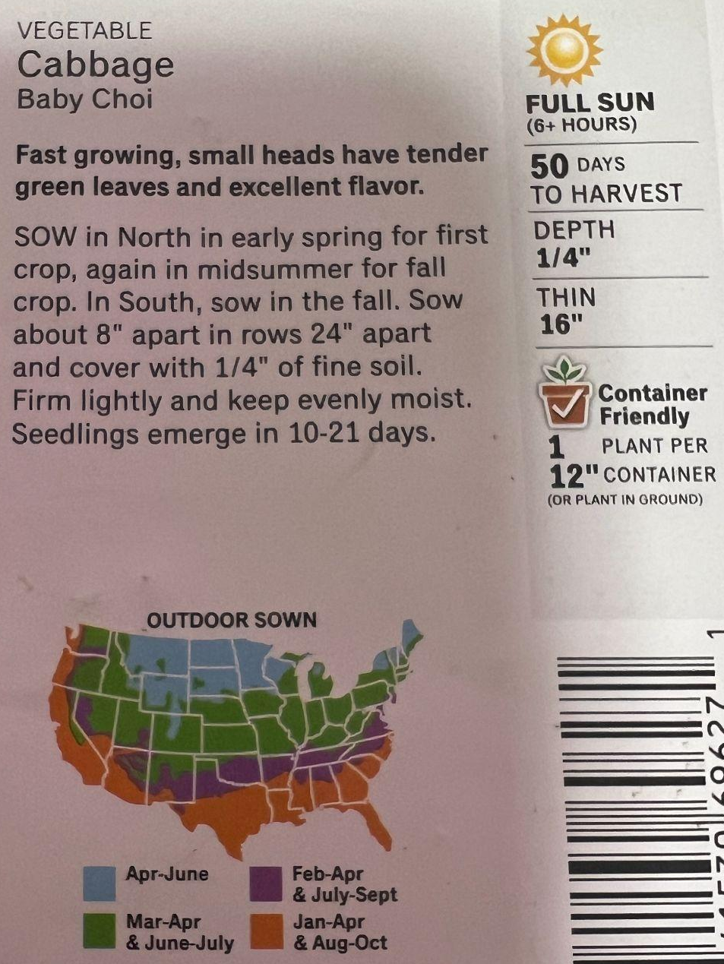
2.Bok Choy

Slide 9
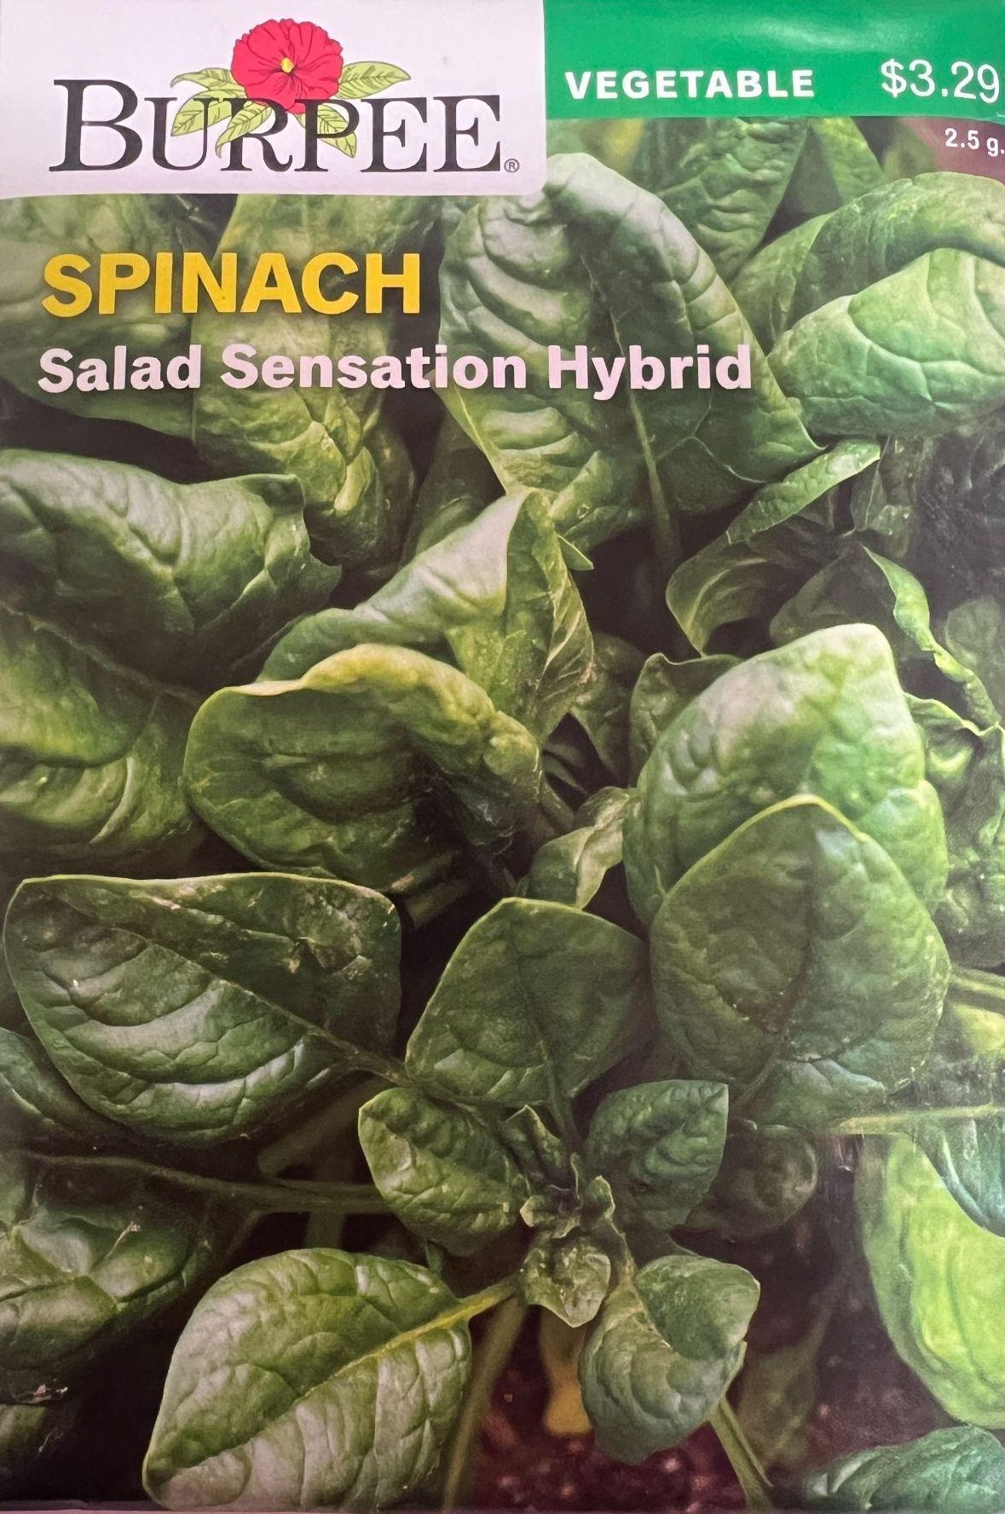
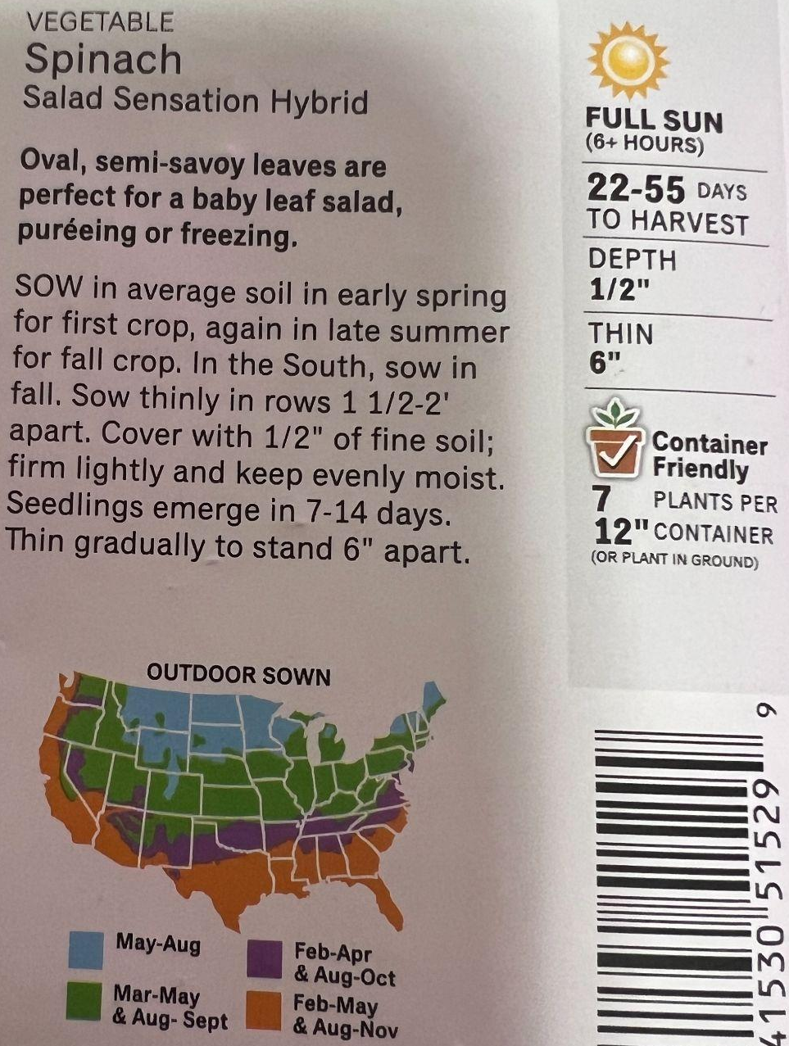
3.Spinach

Slide 10
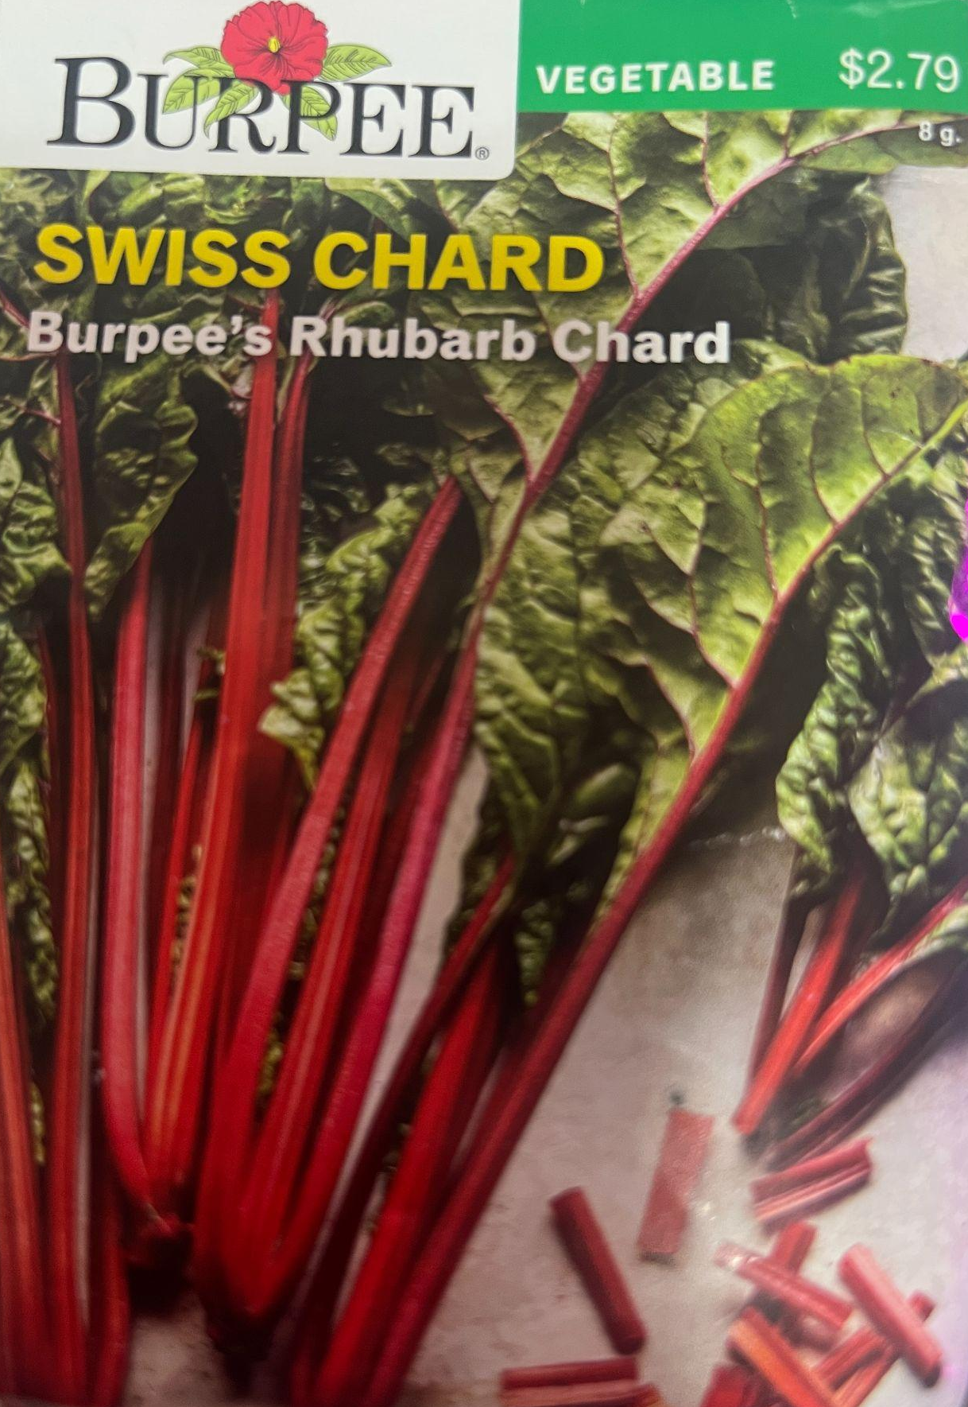
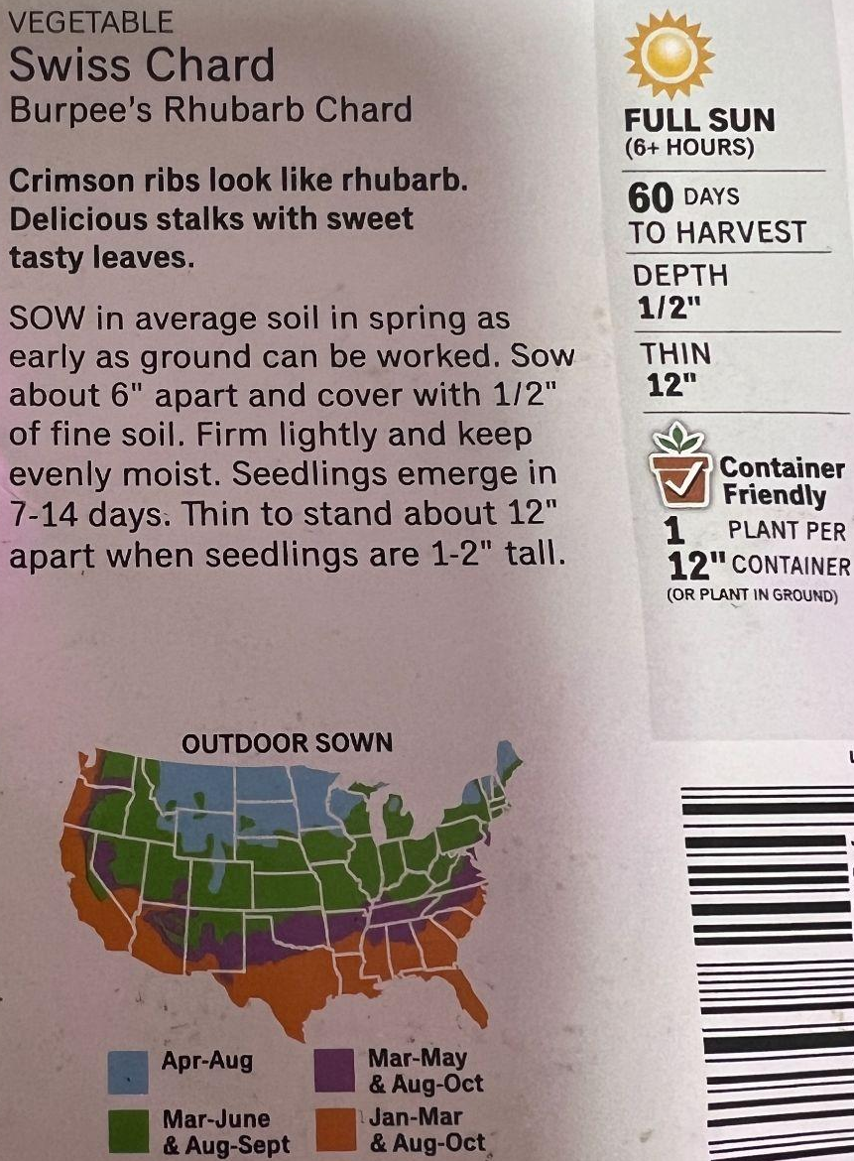
4.Swiss Chard

Slide 11
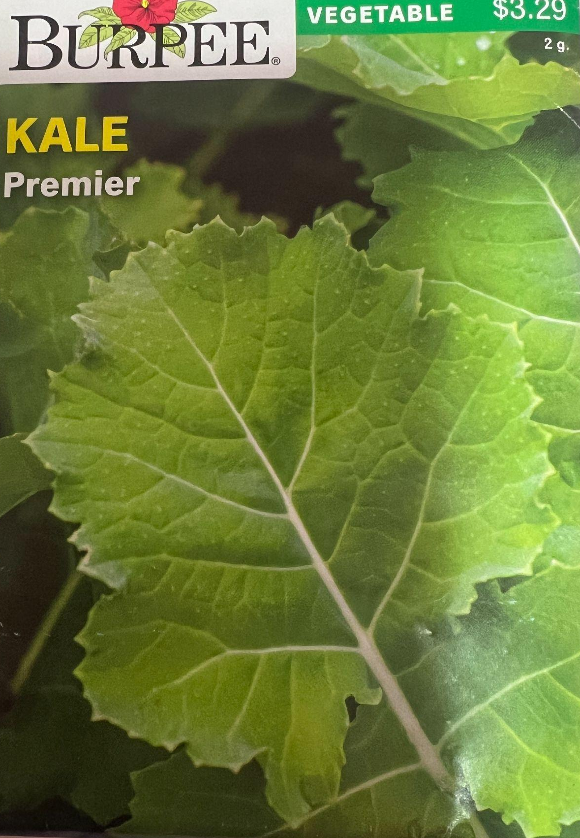
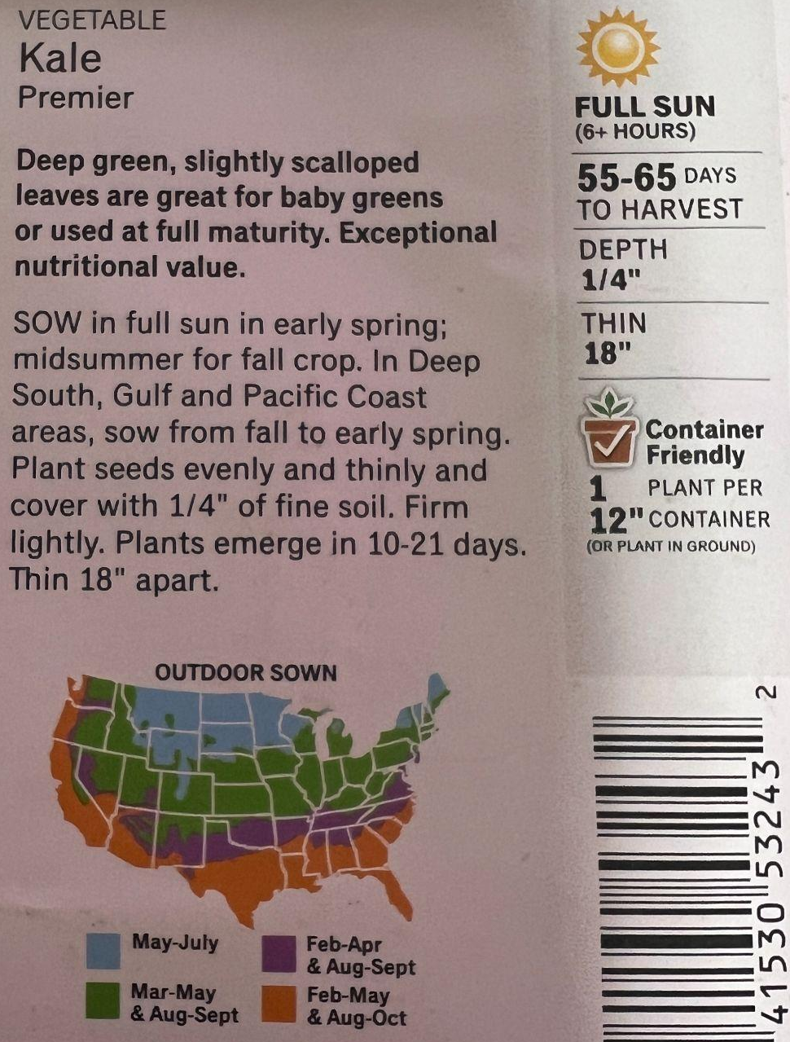
5.Kale

Slide 12
3.Hard ware

Slide 13
Soil sensor
뭍을때 뿌리층 중간 정도 약 ⅔”. 화분 깊이가 12cm면 약 8cm

