Slide 1
System Programming Lab 1 Shell and Tools Exercises
Lecturer：Professor Pao-Ann Hsiung
Teaching Assistant: Tzu-Hsuan Yang
Embedded Systems Laboratory
National Chung Cheng University
Chiayi, Taiwan-62102

Slide 2
Outline
Demo & Requirements
Grading Policies
Turn In

Slide 3
Demo & Requirements

Slide 4
Demo
Demo1
Demo2 (Bonus)

Slide 5
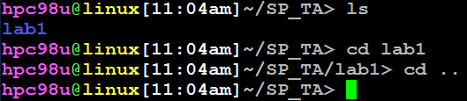
Demo1
You are asked to implement a simple shell and the shell can execute the cd command.
cd
It is a command line argument used to change the current working directory in operating systems.

Slide 6
Demo1 (cont’d)
The program you implement should have the same functionalities as the shell where your program runs.(你的程式必須能夠執行原來Linux shell提供的所有功能)
So, You must use the following two functions.
fork()
exec() – 6 variations, you can use any one.

Slide 7
Demo1 (cont’d)
After executing this shell, it will print “##” to prompt users and wait for input commands.

Slide 8
Result of Demo1
Show the following:
ls
mkdir [directory]
cp [src] [dst]
cd [directory]

Slide 9
Demo2 (Bonus)
Use git clone to get the segmentation fault code on TA’s github.
https://github.com/spta2014/SP2014_lab1.git
Debugging this code with gdb.
Write a Makefile to compile your code.
Commit the modified code.

Slide 10
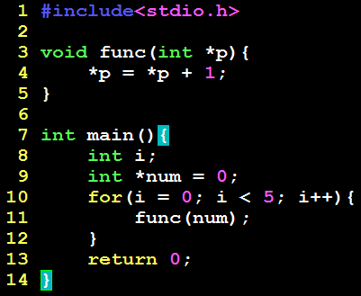
Demo2 (Bonus)
func() can’t be modified.
Show the value of *num with gdb.

Slide 11
Result of Demo2 (Bonus)
Show the following:
Show the value of *num with gdb
Makefile
Commit log

Slide 12
Grading Policies

Slide 13
Grading Policies
Demo1: Depending on the number of students who finish the demo in course.
Demo2 (Bonus): 課後補demo，不扣分
以上兩個Demo都是全對才給分
若共有50人，現場15人交 (也就是30%)，則剩下課後交的打七折 (100-30 = 70%)
若現場只有1人交 (1/50 = 2%)，則剩下的人打九八折 (100-2 = 98%)

Slide 14
Turn In

Slide 15
Turn In
The E-course System
https://ecourse.ccu.edu.tw/
Upload 學號.zip into “Lab 1”
Source files
Makefile
Due date
2016/03/08 23:59:59

Slide 16
Turn In (cont’d)
Demo deadline:
2016/03/07 17:00
Office hour: (Lab 501B)
星期四 13:00~16:00
TA’s email:
spta@embedded.cs.ccu.edu.tw

