Slide 1
HPC Concepts
Queues Schedulers, and workflow design for shared systems.

Slide 2
Overview
Types
Of Computing systems
Of Jobs
Limitations
Compute
I/O
Cluster components
Seperation
Queuing
Queue Partitioning
Queue Filling
Workflow organization as solution
Examples

Slide 3
What is a HPC?

Slide 4
What is a HPC?
a device for turning compute-bound problems into I/O-bound problems.
– Ken Batcher

Slide 5
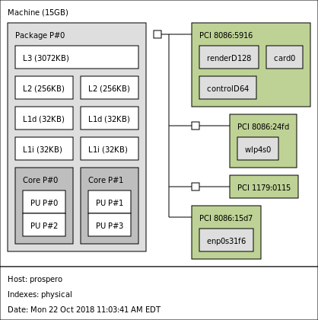
More powerful CPU’s, More Chips Per board
‘Business Laptop’

Slide 6
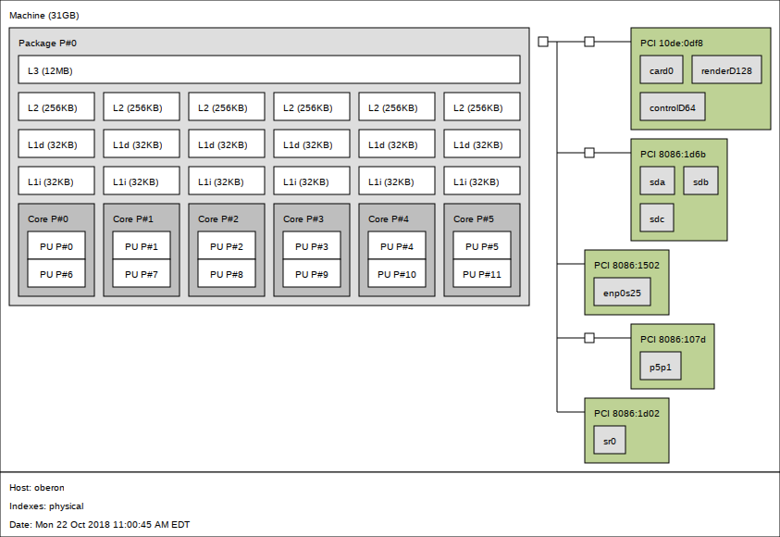
More powerful CPU’s, More Chips Per board
‘Business Laptop’
‘Mid-level Workstation’

Slide 7
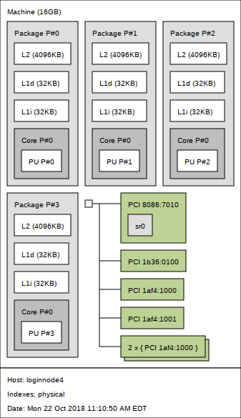
More powerful CPU’s, More Chips Per board - Reorganized
Head node
‘Mid-level Workstation’

Slide 8
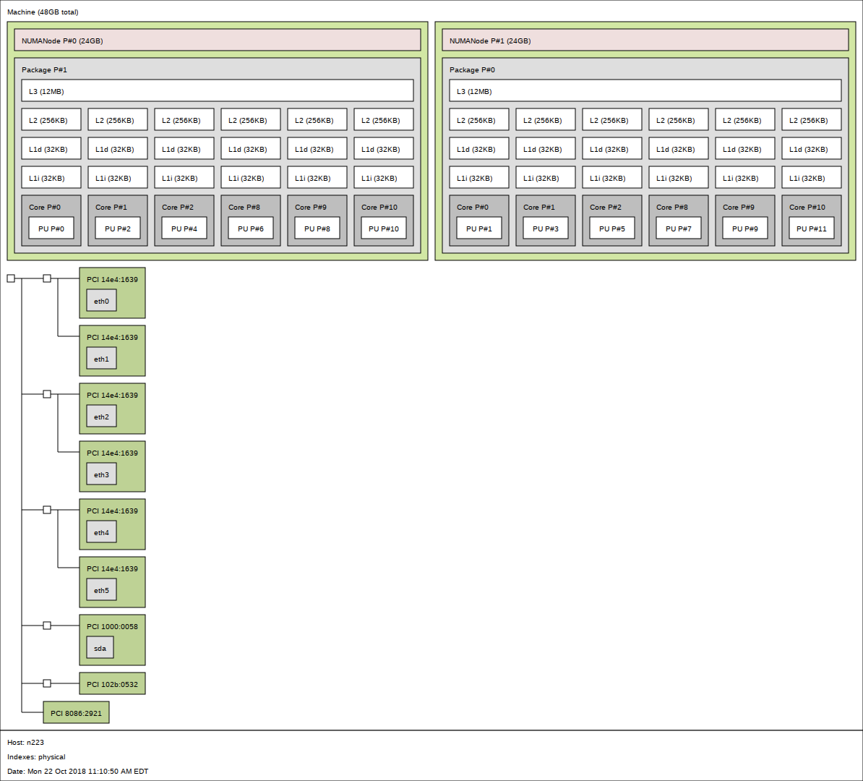
More powerful CPU’s, More Chips Per board - Reorganized
Small worker node
Head node
Same ‘Mid-level Workstation’

Slide 9
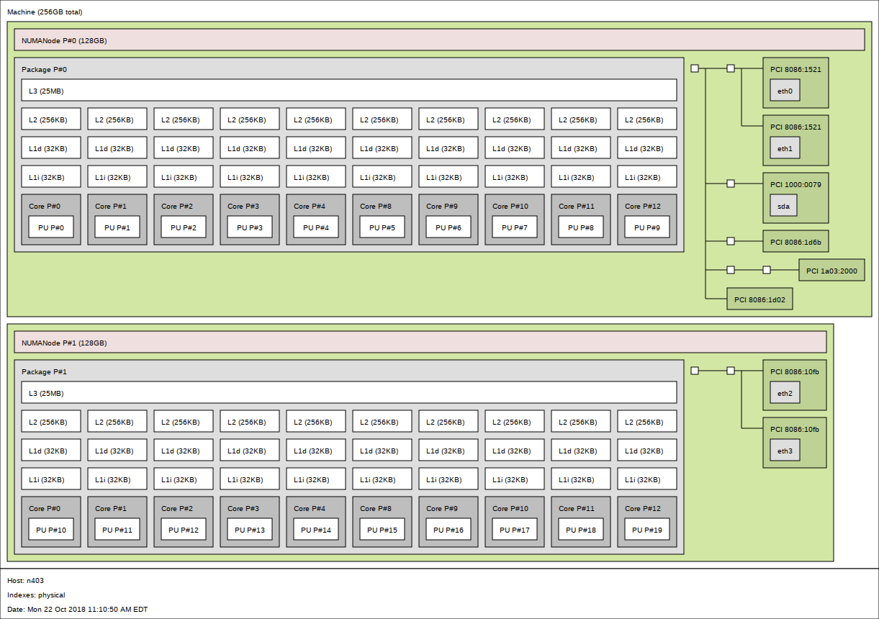
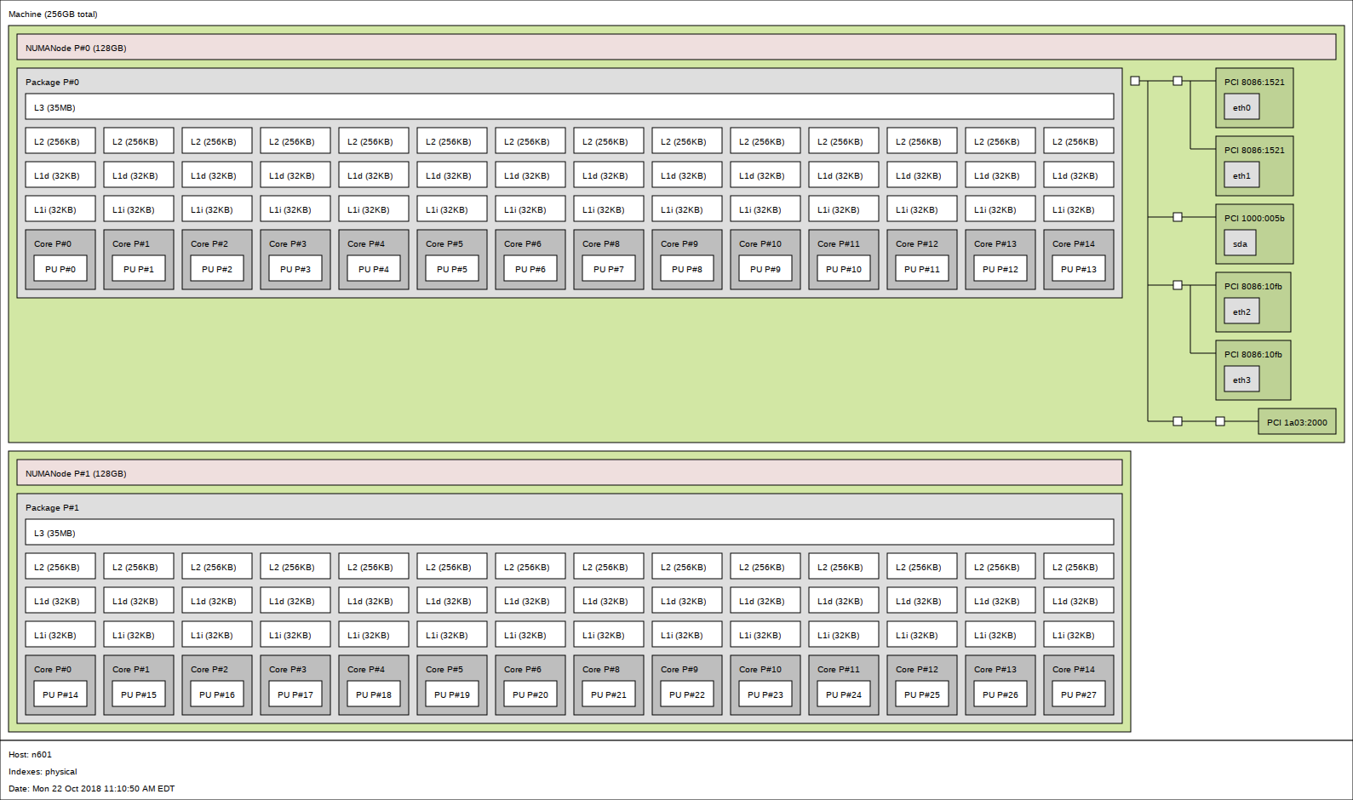
More powerful CPU’s, More Chips Per board - Reorganized
Small worker node
2x 6 cores
2x 24Gb RAM
Mid-size worker node
2x 12 cores
2x 128 Gb RAM
Big-compute worker node
2x 14 cores
2x 128 Gb RAM
Head node

Slide 10
More Interconnects
Headnode(s)
Storage
Worker Node
Private LAN
Worker Node
Worker Node

Slide 11
Types of HPC
More Interconnects
Headnode
Storage
Worker Node
Worker Node
Worker Node

Slide 12
Types of HPC
More Interconnects
Headnode
Storage
Worker Node
“Pleasingly Parallel” Minimal complexity
Worker Node
Worker Node
Initial dataset
Process 0
Process 1
Process 2
Process N
results dataset

Slide 13
Types of HPC
More Interconnects
Headnode
Storage
Worker Node
Loosely coupled workflows
Worker Node
Initial dataset
Worker Node
Process 0
Process 1
Process 2
Intermediate dataset
Process 3a
Process 3b
Process 4
results dataset
Process 3c

Slide 14
Types of HPC
More Interconnects
Headnode
Storage
Worker Node
Loosely coupled workflows
Worker Node
Initial dataset
Worker Node
Process h
Process g
Process a
Process f
Loosely coupled jobs have dependent processes, but distribute the data according to the task the are
Dependent in terms of task order and
Independent internal to the task and its individual data flow
Special setup can improve speed but is not strictly required
Process cntl
Process b
Process e
Process c
Process d

Slide 15
Types of HPC
More Interconnects
Headnode
Storage
Worker Node
Tightly coupled workflows
Worker Node
Worker Node
Process h
Process g
Process a
Process f
Tightly coupled jobs have interdependent processes, and Shared memory.
Process b
Process e
Process c
Process d
Notes:
Like threading over machines

Slide 16
Types of HPC
More Interconnects
Headnode
Storage
Worker Node
Tightly coupled workflows
Worker Node
Worker Node
Process h
Process g
Process a
Process f
Tightly coupled jobs have interdependent processes, and Shared memory.
Requires special physical set up and programing (PVM or MPI)
Process b
Process e
Process c
Process d
Notes:
Like threading over machines

Slide 17
Types of HPC
Acceleration
GPU’s: cssentially a dense tightly bound system.
ARM: Single Instruction Multiple Data (SIMD) vector processors
FPGA: Field Programmable Gate arrays Customizing the physical structure of the chip for specific problem sets.

Slide 18
Staging Storage
Headnode0
Headnode2
Networked storage
GPU Node
Worker
High mem
GPU Node
Worker
High mem
GPU Node
Worker

Slide 19
Staging Storage
Headnode0
Headnode2
Networked storage
GPU Node
Worker
High mem
GPU Node
Worker
High mem
GPU Node
Worker
Parallel Queue
GPU Queue
SMP Queue
High Mem Queue

Slide 20
Staging Storage
Headnode0
Headnode2
Networked storage
GPU Node
Worker
High mem
GPU Node
Worker
High mem
GPU Node
Worker
Parallel Queue
GPU Queue
SMP Queue
High Mem Queue

Slide 21
Staging Storage
Headnode0
Headnode2
Networked storage
GPU Node
Worker
High mem
GPU Node
Worker
High mem
GPU Node
Worker
Parallel Queue
GPU Queue
SMP Queue
High Mem Queue

Slide 22
A mile high View
Solutions are Organizational
Matches the hardware with
Data flow
Computational patterns.

Slide 23
Common Queue Scheduler systems
For distributed work
For localized systems
HTCondor
Yarn
Grid Engine (SGE, UGE)
PBS/torque
Slurm
Notes:
There are several requirements for a partially ordered set. These are formal definitions. The key here is the partiality. The important bit is that the relation is <= not strictly <.

Slide 24
Queue handling
First in First Out FIFO
Priorities (Backfill scheduling)
Preemptions

Slide 25
Queue handling
First in First Out FIFO
NODES
Job2
Job4
Job3
Job1
TIME

Slide 26
Queue handling
First in First Out FIFO BackFill
NODES
Job2
NODES
Job4
Job2
Job4
Job3
Job3
Job1
Job1
TIME
TIME

Slide 27
Queue handling
BackFill Optimizing backfill
NODES
NODES
Job2
Job4
Job2
Job3
Job3
Job4
Job1
Job1
TIME
TIME
Notes:
With naive optimization job 2 will keep being pushed back as long as there are better fitting combinatioons

Slide 28
Fair share
Adds Priorities to backfill scheduling
Weight several factors to generate a priority level for each job
How long it has been waiting
Job Size
Where the job is being run
User’s base priority level

Slide 29
Queue handling
Preemption
New jobs
High priority1
Jobs 1 & 3 are stopped and restarted
High priority 2
now
NODES
NODES
Job2
Job2
Job3
Job3
High priority
Job3
High priority 2
Job1
Job1
Job1
TIME
TIME
Notes:
With naive optimization job 2 will keep being pushed back as long as there are better fitting combinatioons

Slide 30
What is Checkpointing?
Saves a representation of the current state at regular intervals
Allows Automation
Scheduler with automatically restarts
Add a function at the beginning to check for the save state file
If a save state file exists reads it in and starts from there.
If statefile exits:
Startjobat(statefile)
else:
Startjobat(beginning)

Slide 31
When to use Checkpointing
Long running jobs
To not start over if there’s a “hiccup”
Balancing between speed and loss
Writing to a file is much much slower than anything else.
Longer period between checkpoint means faster runs
Potential lost time with a restart is bigger.
Runtime is longer than maximum job time

Slide 32
Planning workflows
Seperate jobs
Identify dependencies
Decided what (if any) intermediate data to keep
Match your pattern to available resources and limitations.

Slide 33
Turning compute-bound problems into I/O-bound problems.
SMP and NUMA
Notes:
The arrow means “happened before”, not “caused” or “implies”

Slide 34
Turning compute-bound problems into I/O-bound problems.
SMP and NUMA
Shared Memory Processing Uniform access
processor
processor
processor
processor
Memory
Memory
Memory
Memory
Notes:
The arrow means “happened before”, not “caused” or “implies”

Slide 35
Turning compute-bound problems into I/O-bound problems.
SMP and NUMA
Shared Memory Uniform access
Shared Memory Non-Uniform Memory Access
processor
processor
processor
processor
Memory
Memory
Memory
Memory
Memory
Memory
Memory
Memory
processor
processor
processor
processor
Notes:
The arrow means “happened before”, not “caused” or “implies”

Slide 36
Turning compute-bound problems into I/O-bound problems.
Everything is a graph
Memory
Memory
processor
processor
processor
processor
processor
processor
processor
processor
Notes:
The arrow means “happened before”, not “caused” or “implies”

Slide 37
Turning compute-bound problems into I/O-bound problems.urning compute-bound problems into I/O-bound problems.
Speed
10s of sec’s
10s of msec’s
10’s of nsec’s
nsec’s
< 0.5 nsec
Tape
Drives
(HDD, SSD)
Memory
L1, L2 Cache
Processor
Register
10s of TB’s
GB to TB
GB’s
100’s bytes
KB to MB
Size
Notes:
The arrow means “happened before”, not “caused” or “implies”

Slide 38
Distance = 1/Speed
Remote networked storage | Slow - not for computing
Nearby networked/warm storage | Pre-staging Completed data
‘Fast scratch’ (or /tmp if not available) | Staging, interprocess holding, bigger than RAM for for worker I/o
Tmpfs (memory as filesystem) | For faster I/o

Slide 39
Distance = 1/Speed Caution every system is different
Remote networked storage | Slow - not for computing
Nearby networked/warm storage | Pre-staging Completed data
‘Fast scratch’ (or /tmp if not available) | Staging, interprocess holding, bigger than RAM for for worker I/o
Tmpfs (memory as filesystem) | For faster I/o
Check with your local systems documentation
Or ask the system folks.

Slide 40
Modules
Modules
modules allow us to keep the working space clean, when there are a lot of installed programs.
$module avail Will list the currently available modules
$module load <modulename> Will make the module available Be explicit!
$module unload <modulename> Will unload the module
$module purge Will unload all modules
$module whatis <modulename> Will show the module information

Slide 41
Examples

Slide 42
SGE basics
#!/bin/bash # bigio_example.sh
# jobname #$ -N example # use this shell #$ -S /bin/bash # how much memory per processor #$ -l h_vmem=1g # maximum run time #$ -l h_rt=00:05:00 # parallel environment SMP, 4 processes #$ -pe smp 4
# email user when done #$ -m me@myemail.com
runscript “$mytmp”

Slide 43
“Big” I/O
mkdir mytemp @
/tmp, or /dev/shm
Copy files into and untar
cp remote/myfiles.tar mytempdir/
tar xf myfiles.tar
Run jobscript
with working output pointed to mytempdir
Tar contents of mytempdir
tar cf myresults.tar myfiles
Copy the results back to storage
cp myresults.tar remote/myresults
(check the move with checksum)
Cleanup (some systems do this for you)
rm -r mytempdir

Slide 44
SGE
Using the /tmp space
#!/bin/bash #$ -N bigIO_example #$ -S /bin/bash #$ -l h_vmem=1g #$ -l h_rt=02:00:00 #$ -pe smp 4 ```startupscript # mydir=”$2” tmploc=”$1” starttar=$3 # mytmp=”$1”/”$2” mkdir “$mytmp” cp “$starttar” “$mytmp” cd $mytmp tar xf ”$startar”
runscript “$mytmp” tar cf results.tar $mytmp cp results.tar <remote system> rm -r “$mytemp”
```

Slide 45
SGE
Array jobs
#!/bin/bash #$ -N bigIO_example #$ -S /bin/bash #$ -l h_vmem=500m #$ -l h_rt=00:015:00 #$ -pe smp 1 #$ -t 1-5
e
# don’t do this

Slide 46
SGE
Array jobs
#!/bin/bash #$ -N bigIO_example #$ -S /bin/bash #$ -l h_vmem=500m #$ -l h_rt=00:015:00 #$ -pe smp 1 #$ -t 1-<number from “wc -l”>
infile=$(sed -n -e "$SGE_TASK_ID p" list.txt)
starttar=”$infile” mytmp=/tmp/”$2” mkdir “$mytmp” cp “$starttar” “$mytmp” cd $mytmp tar xf ”$startar”
runscript “$mytmp”
tar cf “$infile”_results.tar $mytmp cp “$infile”_results.tar <remote system> rm -r “$mytemp”
Split the files into batched directories
Make a file listing those directories
ls -1 * > list.txt
Get a count of files
wc -l list.txt
Use sed or awk to pop from list.txt and use bigIO pattern

Slide 47
HPC resources
With ITsupport at Einstein
XSEDE
Open Science Grid
“The Cloud”
Amazon, Google, Microsoft and others

