Slide 1
A Tour of the CCI STAC Collection
September 2025

Slide 2
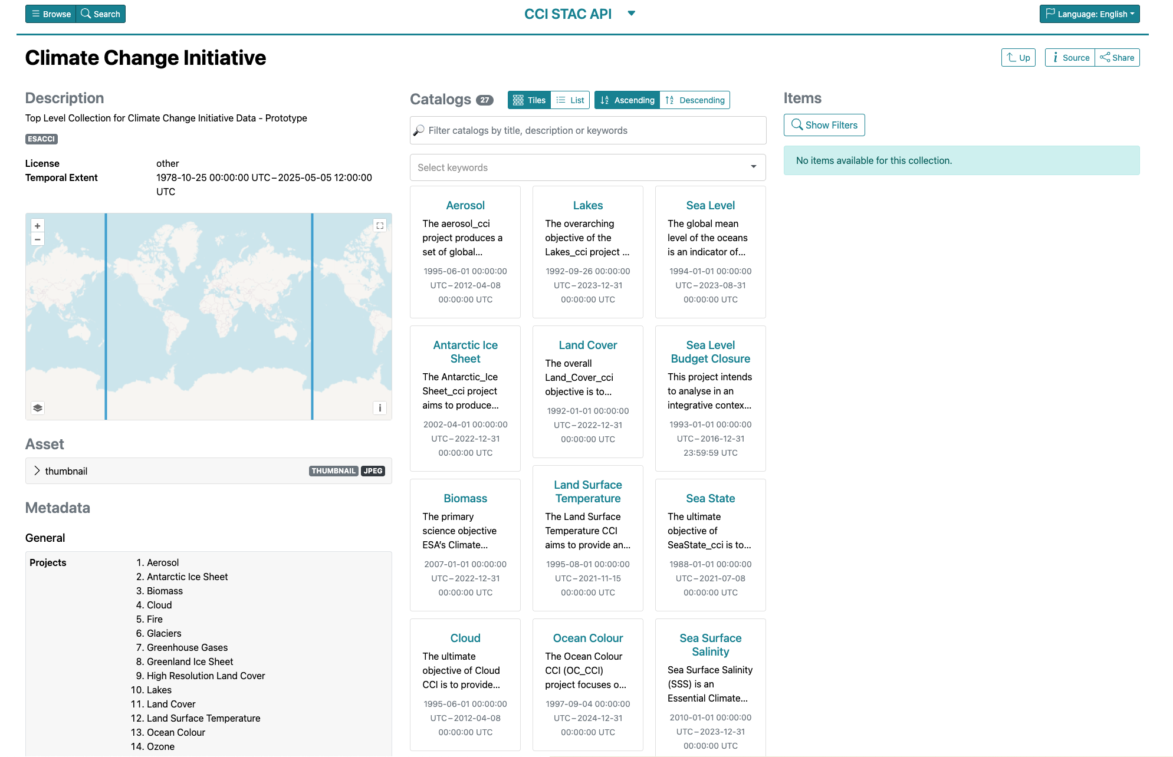
The CCI STAC Index
Browser: https://radiantearth.github.io/stac-browser/#/external/api.stac.164.30.69.113.nip.io/collections/cci
API: https://api.stac.164.30.69.113.nip.io/collections/cci
A Tour of the CCI STAC Collection
Notes:
Started 2015

Slide 3
The CCI STAC Index
Search/Filter at Project Level
Project Level STAC Collections
A Tour of the CCI STAC Collection
Notes:
Started 2015

Slide 4
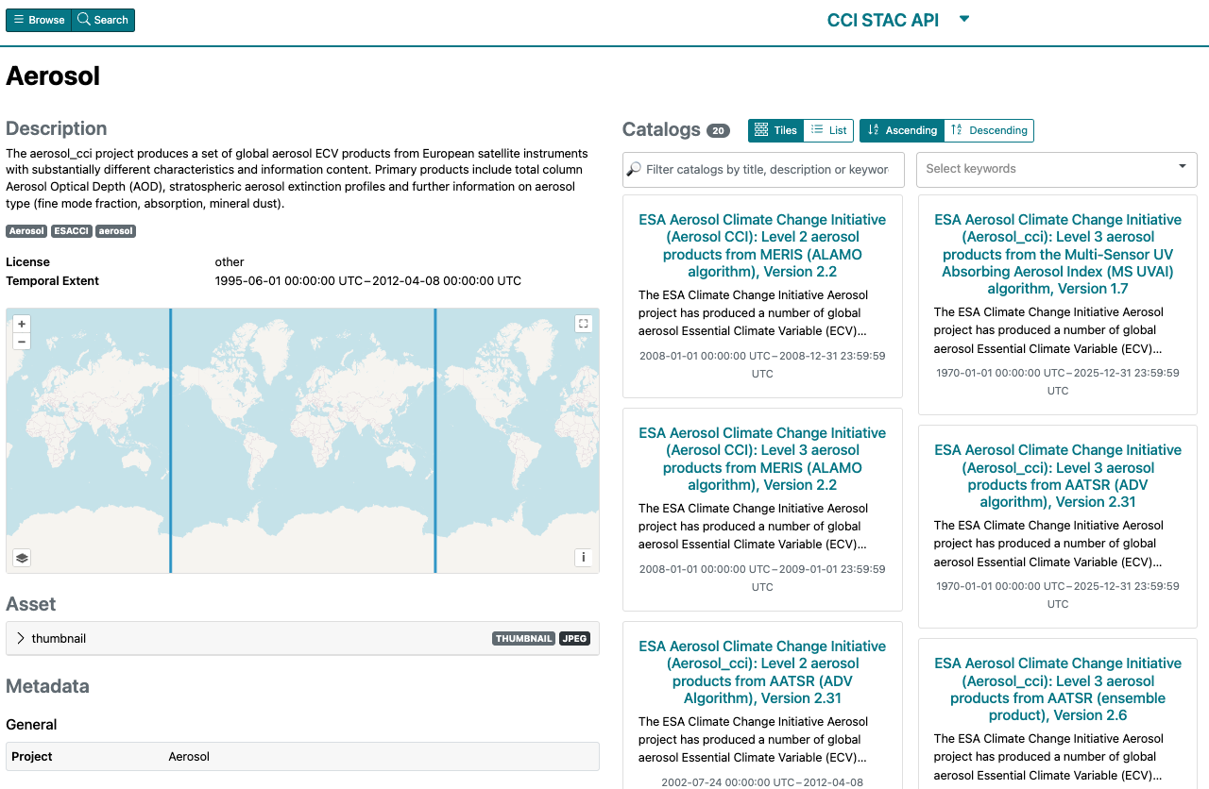
Project-Level Collection: Aerosol
Browser: https://radiantearth.github.io/stac-browser/#/external/api.stac.164.30.69.113.nip.io/collections/aerosol
API: https://api.stac.164.30.69.113.nip.io/collections/aerosol
A Tour of the CCI STAC Collection

Slide 5
Project-Level Collection: Aerosol
Search/Filter by Dataset keywords
Individual Aerosol Datasets
A Tour of the CCI STAC Collection

Slide 6
Project-Level Collection: Aerosol
Search/Filter by Dataset keywords
Note: Datasets that have been superseded with newer versions will be removed from the STAC collections.
Individual Aerosol Datasets
A Tour of the CCI STAC Collection

Slide 7
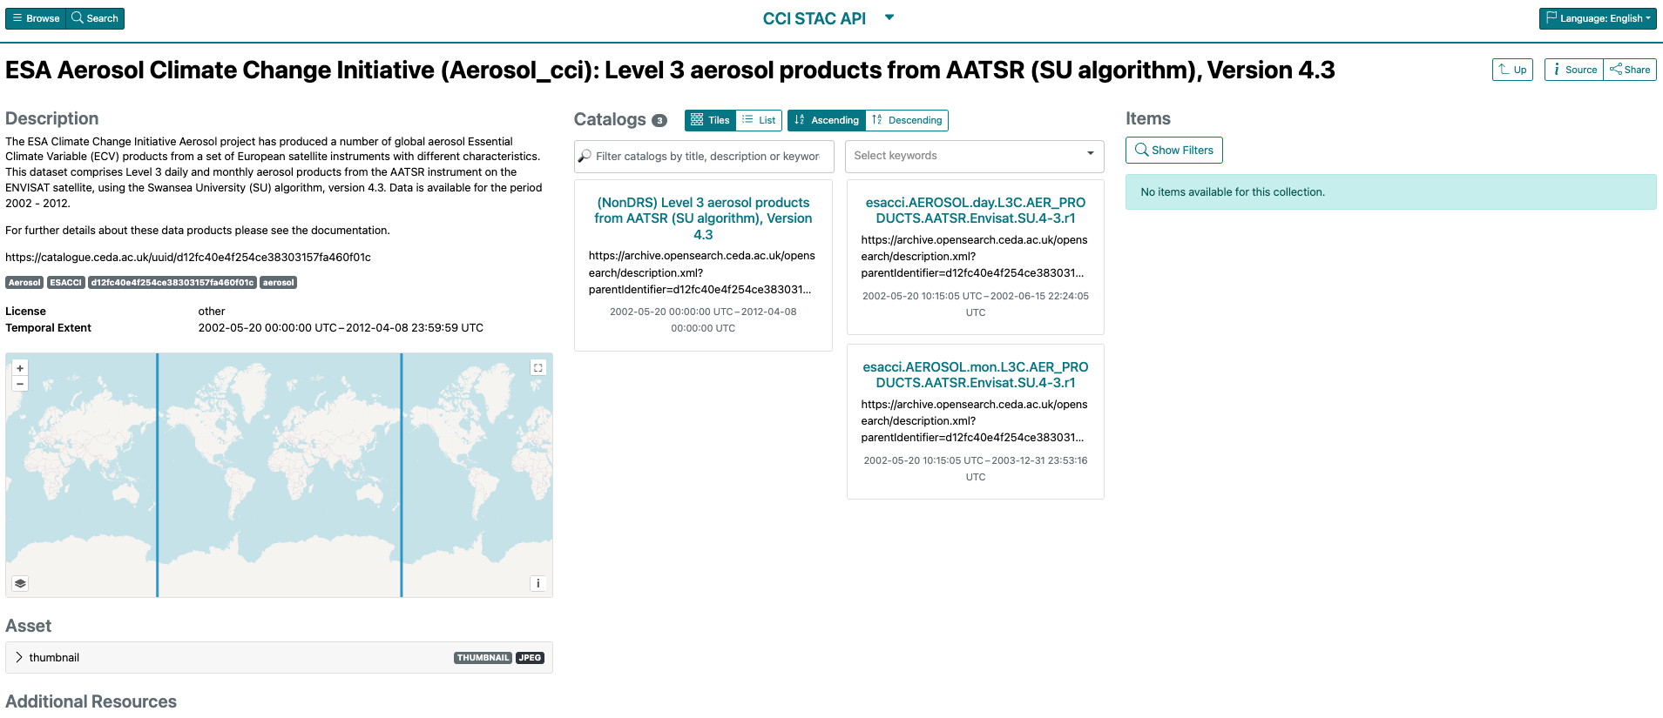
Dataset-Level Collections
Browser: https://radiantearth.github.io/stac-browser/#/external/api.stac.164.30.69.113.nip.io/collections/d12fc40e4f254ce38303157fa460f01c
API: https://api.stac.164.30.69.113.nip.io/collections/d12fc40e4f254ce38303157fa460f01c
A Tour of the CCI STAC Collection

Slide 8
Dataset-Level Collections
DRS-Level: Dataset Resource Syntax. (Further grouping of data within datasets)
Link to CEDA Catalogue Page
A Tour of the CCI STAC Collection

Slide 9
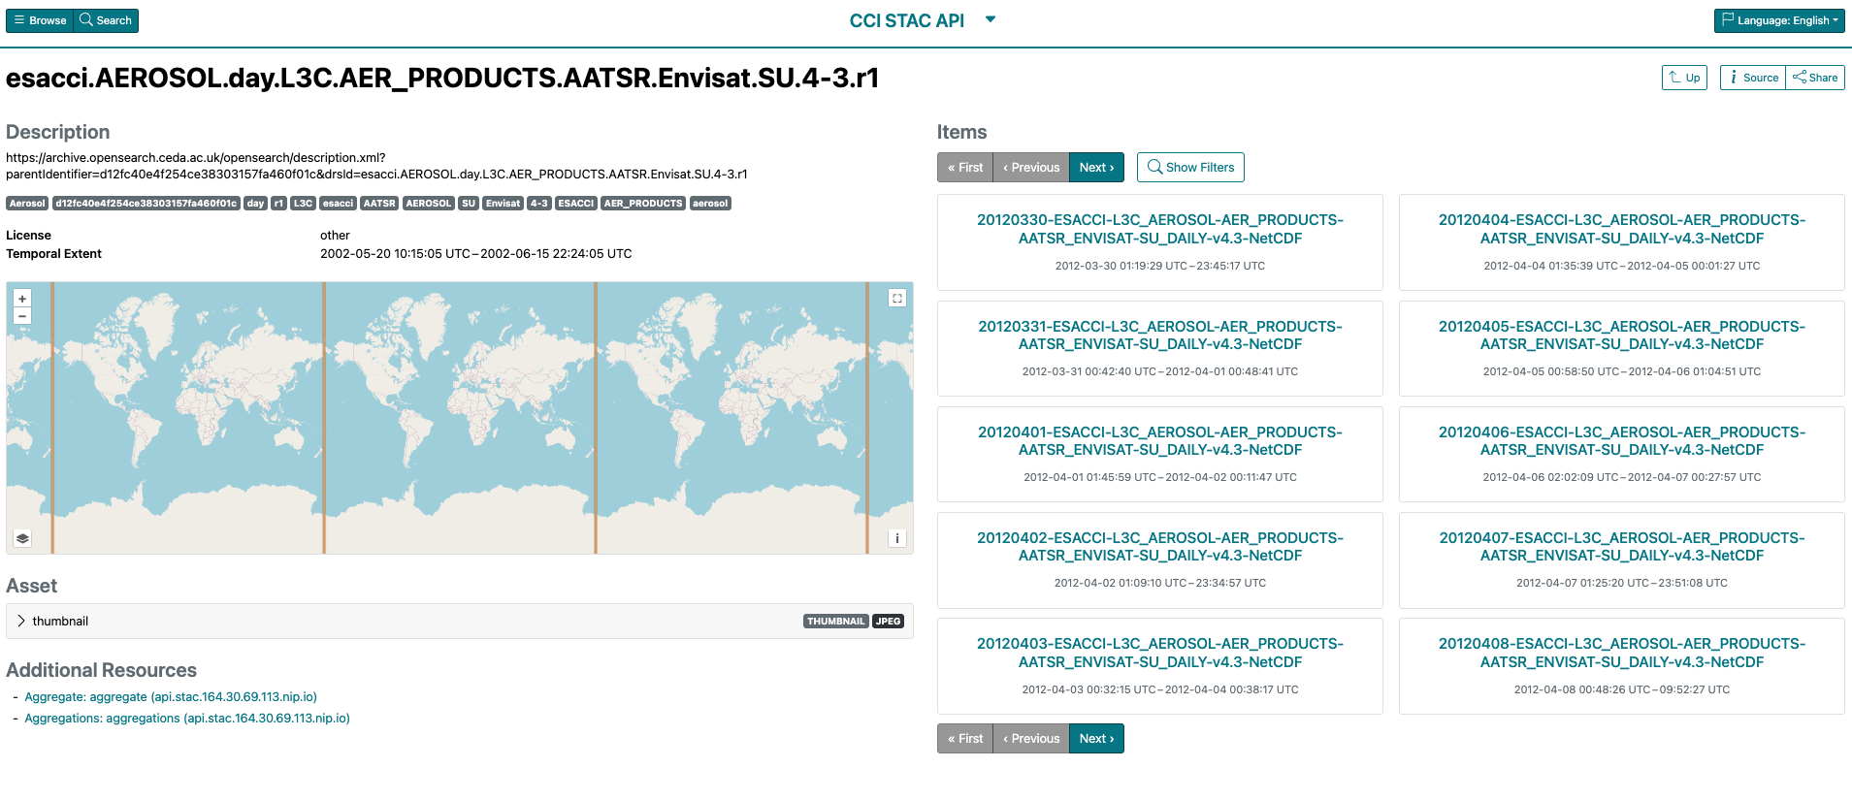
DRS-Level Collections (Item Searchable)
Browser: https://radiantearth.github.io/stac-browser/#/external/api.stac.164.30.69.113.nip.io/collections/esacci.aerosol.day.l3c.aer_products.aatsr.envisat.su.4-3.r1
API: https://api.stac.164.30.69.113.nip.io/collections/esacci.aerosol.day.l3c.aer_products.aatsr.envisat.su.4-3.r1
A Tour of the CCI STAC Collection

Slide 10
DRS-Level Collections (Item Searchable)
STAC Items
Link to Opensearch Service
A Tour of the CCI STAC Collection

Slide 11
CCI Collection Levels
CCI
Navigate STAC browser to locate collections/items of interest.
Locate DRS collections of interest.
Search programmatically using pystac-client for each DRS.
Project: Aerosol
Note: Searching for items using pystac at collection-levels higher than the DRS-level will not display all items. Pystac does not search all nested collections for items.
Dataset
DRS
Dataset-level programmatic access: STAC Collection ID is the UUID of the dataset record in the CEDA Catalogue.
DRS-level programmatic access: All DRS identifiers are lower-case to fit with STAC collection name requirements.
Items
A Tour of the CCI STAC Collection

Slide 12
The CCI OpenEO Collection
September 2025

Slide 13
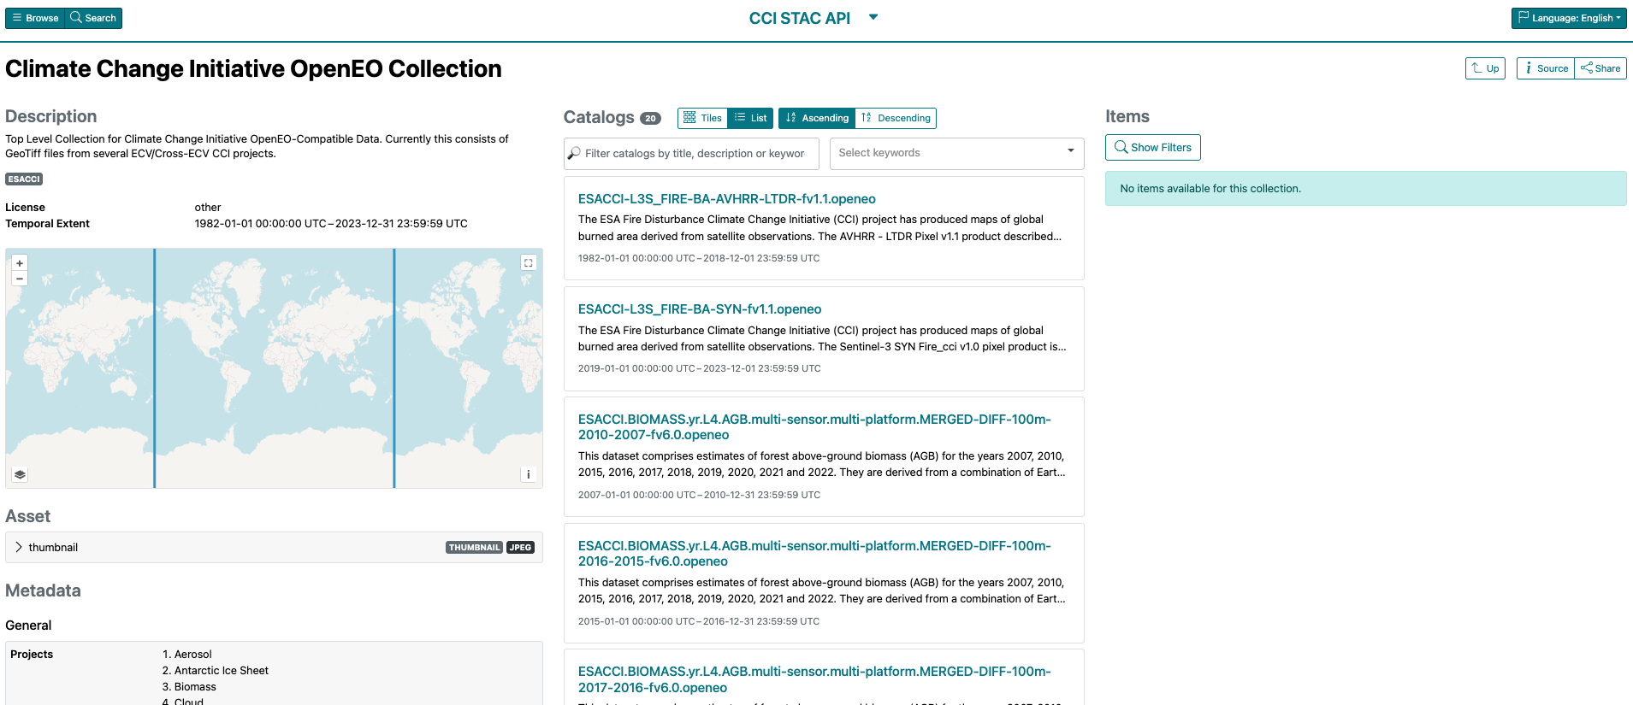
CCI OpenEO Datasets
Browser: https://radiantearth.github.io/stac-browser/#/external/api.stac.164.30.69.113.nip.io/collections/cci_openeo
API: https://api.stac.164.30.69.113.nip.io/collections/cci_openeo
The CCI OpenEO Collection

Slide 14
CCI OpenEO Datasets
Search/Filter by OpenEODataset keywords
ECV/Projects compatible with OpenEO:
Fire
Biomass
Land Cover/HRLC
Greenland Ice Sheets
Browser: https://radiantearth.github.io/stac-browser/#/external/api.stac.164.30.69.113.nip.io/collections/cci_openeo
API: https://api.stac.164.30.69.113.nip.io/collections/cci_openeo
The CCI OpenEO Collection

Slide 15
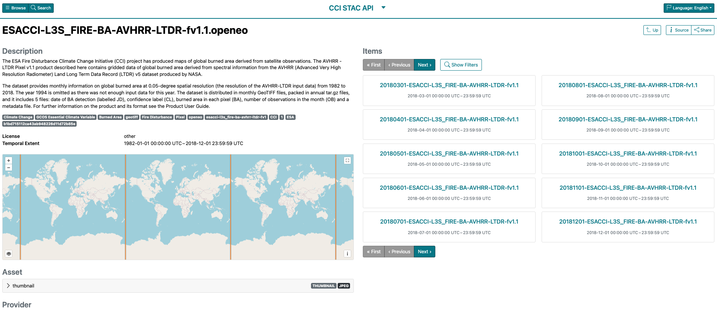
Example OpenEO Dataset
Browser: https://radiantearth.github.io/stac-browser/#/external/api.stac.164.30.69.113.nip.io/collections/esacci-l3s_fire-ba-avhrr-ltdr-fv1.1.openeo
API: https://api.stac.164.30.69.113.nip.io/collections/esacci-l3s_fire-ba-avhrr-ltdr-fv1.1.openeo
The CCI OpenEO Collection

Slide 16
Example OpenEO Dataset
OpenEO-Compliant GeoTiff Items
Collection-level temporal information
Browser: https://radiantearth.github.io/stac-browser/#/external/api.stac.164.30.69.113.nip.io/collections/esacci-l3s_fire-ba-avhrr-ltdr-fv1.1.openeo
API: https://api.stac.164.30.69.113.nip.io/collections/esacci-l3s_fire-ba-avhrr-ltdr-fv1.1.openeo
The CCI OpenEO Collection

Slide 17
Example OpenEO Dataset
Using the OpenEO Python Client: Use the API URL below in the openeo load_stac function to enable local processing of this dataset
Browser: https://radiantearth.github.io/stac-browser/#/external/api.stac.164.30.69.113.nip.io/collections/esacci-l3s_fire-ba-avhrr-ltdr-fv1.1.openeo
API: https://api.stac.164.30.69.113.nip.io/collections/esacci-l3s_fire-ba-avhrr-ltdr-fv1.1.openeo
The CCI OpenEO Collection

Slide 18
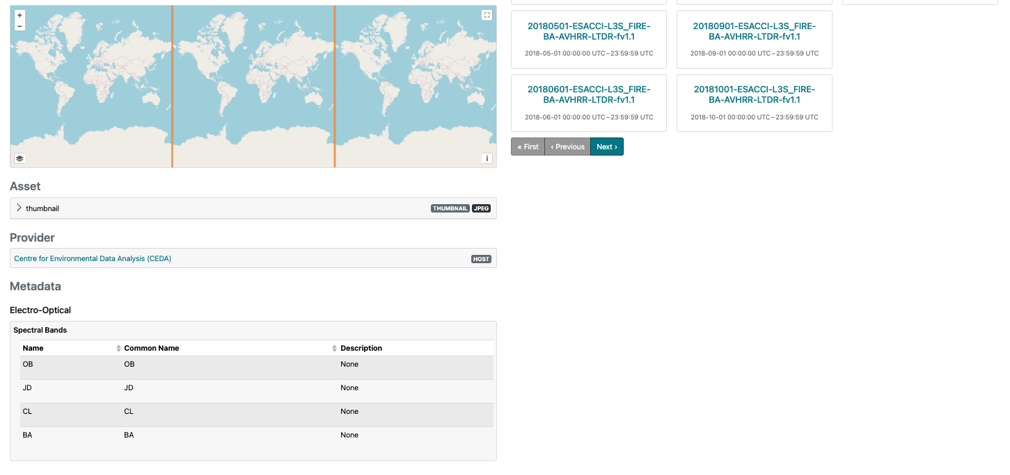
Example OpenEO Dataset: Additional Metadata
Data Provider/Host
OpenEO ”EO Bands”
Browser: https://radiantearth.github.io/stac-browser/#/external/api.stac.164.30.69.113.nip.io/collections/esacci-l3s_fire-ba-avhrr-ltdr-fv1.1.openeo
API: https://api.stac.164.30.69.113.nip.io/collections/esacci-l3s_fire-ba-avhrr-ltdr-fv1.1.openeo
The CCI OpenEO Collection

Slide 19
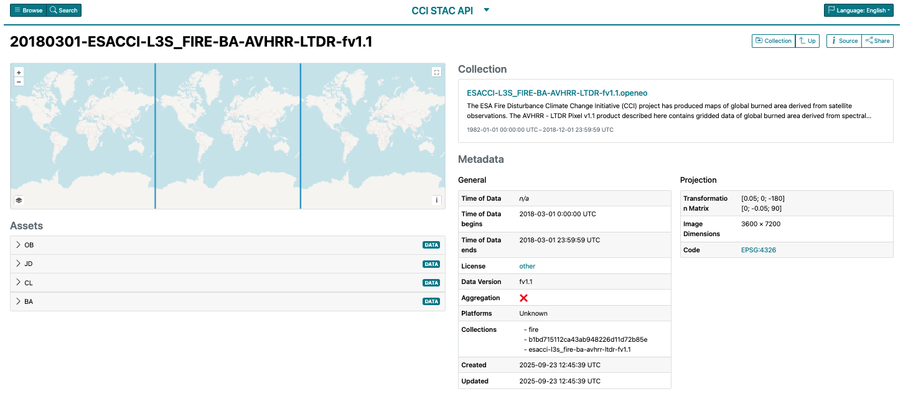
Example OpenEO Item
The CCI OpenEO Collection

Slide 20
Example OpenEO Item
OpenEO Compliant Projection Metadata
EO Bands for OpenEO (See dataset-level summary info) for use with OpenEO client.
Item/file-level properties
The CCI OpenEO Collection

