Slide 1

Spacecraft Imaging
I. Images Are Data
Notes:
Introduce myself

Slide 2
Today’s goals
Learn to think of images as scientific data
Learn some very basic things you can do to make black and white images look prettier:
  Cropping
  Contrast adjustment
  What these mean in terms of the original data
Learn what color images represent
Learn how to compose color images from three grayscale images using either GIMP or Photoshop

Slide 3
Images Are Data
We’re accustomed to thinking of pictures as snapshots of a collection of objects.
To a scientist, an image is a matrix of data.
  The data represents how a physical value (usually albedo or reflectance) varies in two spatial dimensions
  Color is a third dimension (we’ll get to that later)

Slide 4
A Matrix of Data
Albedo varying in two spatial dimensions
The numbers tell us something, but what?
1 | 1 | 2 | 1 | 1 | 1 | 1 | 0 | 0 | 1 | 1 | 0 | 1 | 1 | 1
1 | 1 | 1 | 1 | 1 | 1 | 2 | 1 | 1 | 1 | 1 | 1 | 1 | 1 | 1
1 | 1 | 1 | 1 | 1 | 2 | 1 | 1 | 4 | 9 | 0 | 1 | 2 | 2 | 1
0 | 1 | 1 | 2 | 1 | 1 | 1 | 1 | 2 | 25 | 25 | 0 | 2 | 2 | 2
2 | 2 | 2 | 1 | 2 | 1 | 0 | 1 | 2 | 19 | 53 | 31 | 0 | 1 | 2
2 | 2 | 2 | 1 | 1 | 1 | 1 | 2 | 1 | 22 | 51 | 69 | 11 | 1 | 1
2 | 1 | 1 | 1 | 1 | 1 | 2 | 1 | 2 | 23 | 53 | 83 | 42 | 0 | 1
1 | 0 | 1 | 1 | 2 | 1 | 1 | 1 | 5 | 27 | 57 | 91 | 63 | 4 | 1
1 | 1 | 0 | 1 | 1 | 2 | 1 | 1 | 10 | 34 | 62 | 96 | 76 | 9 | 1
1 | 1 | 2 | 1 | 2 | 1 | 1 | 2 | 16 | 40 | 70 | 105 | 84 | 9 | 1
1 | 1 | 1 | 1 | 1 | 1 | 1 | 5 | 26 | 53 | 83 | 118 | 78 | 3 | 1
1 | 1 | 1 | 1 | 2 | 2 | 3 | 14 | 38 | 66 | 99 | 123 | 54 | 0 | 2
1 | 1 | 1 | 2 | 1 | 2 | 7 | 27 | 54 | 83 | 115 | 113 | 10 | 1 | 1
2 | 1 | 1 | 2 | 1 | 3 | 18 | 44 | 71 | 104 | 129 | 38 | 0 | 1 | 2
0 | 2 | 1 | 1 | 2 | 13 | 39 | 66 | 96 | 113 | 47 | 0 | 2 | 1 | 2
1 | 2 | 2 | 5 | 19 | 43 | 68 | 78 | 70 | 25 | 0 | 2 | 1 | 2 | 2
2 | 1 | 1 | 4 | 14 | 23 | 26 | 19 | 4 | 0 | 1 | 1 | 1 | 1 | 1
2 | 1 | 1 | 1 | 2 | 2 | 1 | 1 | 1 | 1 | 2 | 2 | 1 | 1 | 1

Slide 5
Color By Numbers
Let’s color the table cells in so that higher numbers = lighter colors
A shape begins to emerge!
1 | 1 | 2 | 1 | 1 | 1 | 1 | 0 | 0 | 1 | 1 | 0 | 1 | 1 | 1
1 | 1 | 1 | 1 | 1 | 1 | 2 | 1 | 1 | 1 | 1 | 1 | 1 | 1 | 1
1 | 1 | 1 | 1 | 1 | 2 | 1 | 1 | 4 | 9 | 0 | 1 | 2 | 2 | 1
0 | 1 | 1 | 2 | 1 | 1 | 1 | 1 | 2 | 25 | 25 | 0 | 2 | 2 | 2
2 | 2 | 2 | 1 | 2 | 1 | 0 | 1 | 2 | 19 | 53 | 31 | 0 | 1 | 2
2 | 2 | 2 | 1 | 1 | 1 | 1 | 2 | 1 | 22 | 51 | 69 | 11 | 1 | 1
2 | 1 | 1 | 1 | 1 | 1 | 2 | 1 | 2 | 23 | 53 | 83 | 42 | 0 | 1
1 | 0 | 1 | 1 | 2 | 1 | 1 | 1 | 5 | 27 | 57 | 91 | 63 | 4 | 1
1 | 1 | 0 | 1 | 1 | 2 | 1 | 1 | 10 | 34 | 62 | 96 | 76 | 9 | 1
1 | 1 | 2 | 1 | 2 | 1 | 1 | 2 | 16 | 40 | 70 | 105 | 84 | 9 | 1
1 | 1 | 1 | 1 | 1 | 1 | 1 | 5 | 26 | 53 | 83 | 118 | 78 | 3 | 1
1 | 1 | 1 | 1 | 2 | 2 | 3 | 14 | 38 | 66 | 99 | 123 | 54 | 0 | 2
1 | 1 | 1 | 2 | 1 | 2 | 7 | 27 | 54 | 83 | 115 | 113 | 10 | 1 | 1
2 | 1 | 1 | 2 | 1 | 3 | 18 | 44 | 71 | 104 | 129 | 38 | 0 | 1 | 2
0 | 2 | 1 | 1 | 2 | 13 | 39 | 66 | 96 | 113 | 47 | 0 | 2 | 1 | 2
1 | 2 | 2 | 5 | 19 | 43 | 68 | 78 | 70 | 25 | 0 | 2 | 1 | 2 | 2
2 | 1 | 1 | 4 | 14 | 23 | 26 | 19 | 4 | 0 | 1 | 1 | 1 | 1 | 1
2 | 1 | 1 | 1 | 2 | 2 | 1 | 1 | 1 | 1 | 2 | 2 | 1 | 1 | 1

Slide 6
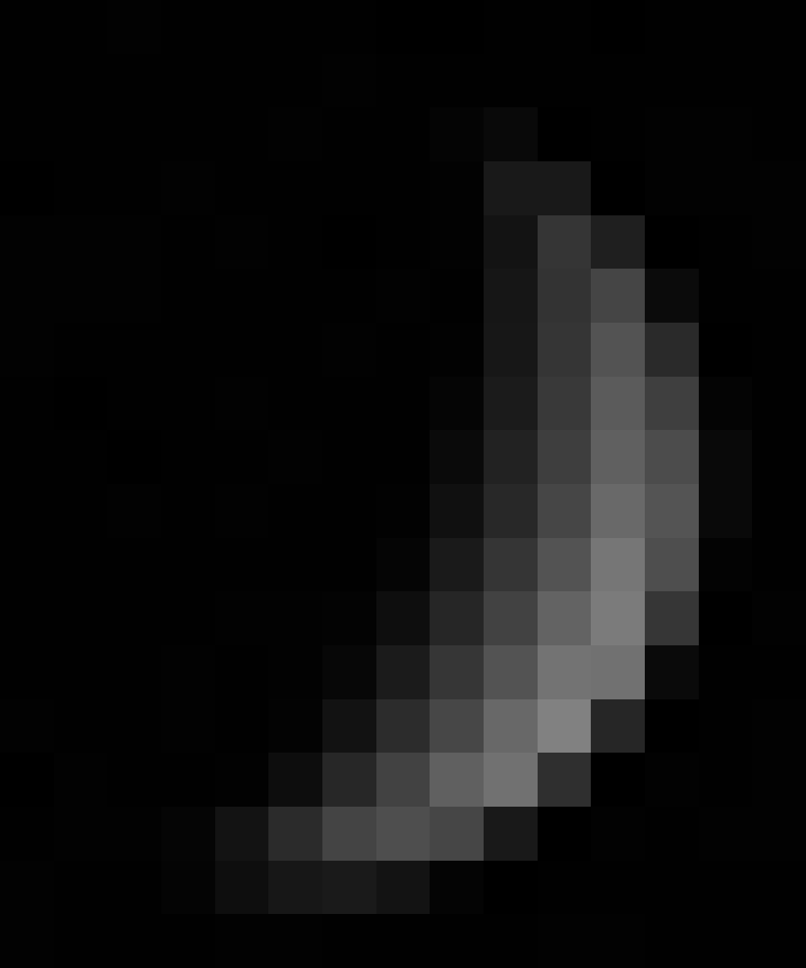
Here’s the Image
To the computer, it’s still a matrix of numbers, it’s just displaying it for us in a way that allows us to take advantage of the power of the human visual system to interpret what the matrix of numbers was telling us.

Slide 7
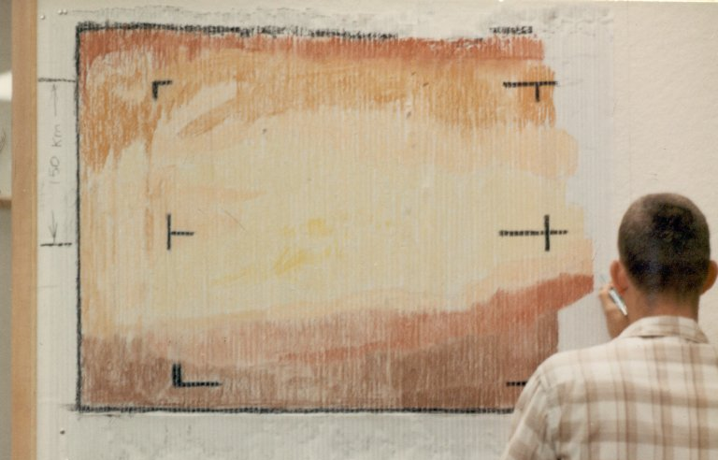
Color By Numbers!
The first image returned to Earth from Mars. A "real-time data translator" machine converted Mariner 4 digital image data into numbers printed on strips of paper. Too anxious to wait for the official processed image, employees from the Voyager Telecommunications Section attached these strips side by side to a display panel and hand colored the numbers like a paint-by-numbers picture.

Slide 8
The numbers
The most familiar image formats display grayscale (black-and-white) images using 8 bits per pixel.
  That means there are 2^8 = 256 different gray levels in the image.
  Pixel values range from 0 (black) to 255 (white) and must be integers.
Higher bit depth is possible.
  Most experienced image processors prefer to work in 16-bit image formats (pixels have integer values ranging from 0 to 2^16 = 65,536)
  Astrophotographers and other professionals often work with 32-bit images, in which pixel values are stored as floating-point numbers, not integers.
We will mostly stick with 8-bit images.

Slide 9
Image Processing
So: An image is a matrix of numbers.
To “process” an image is to perform mathematical operations on those numbers.
Most of the time, we are trying to improve the appearance of the image while retaining fidelity to the original data.
Examples of things that retain fidelity to data, up to a point:
  Adjusting contrast (Multiplying all numbers by a constant)
  Adjusting brightness (Adding a constant to or subtracting a constant from all numbers)

Slide 10
Image Processing
Things that alter original data but in a systematic way:
  Downsampling (reducing number of pixels in an image, for example by averaging some number of them together)
  Upsampling (increasing number of pixels in an image, by interpolating between them)
  Cropping, a.k.a. subframing (cutting out an interesting bit of an image)
  Reprojecting (stretching or warping an image to correct for distortions caused by viewing angle or camera optics)
  Correcting known problems with camera system, for example flatfielding and dark pixel subtraction
Things that don’t retain fidelity to data:
  Painting out blemishes, equivalent to going in and changing one or more values in the matrix of data
  Pasting in bits from other images to cover up missing data
  This can make pictures prettier, but exercise caution!

Slide 11
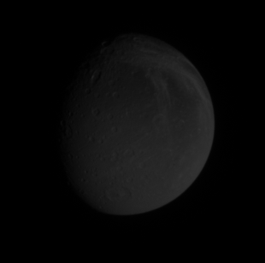

Basic Image Processing: Brightness/Contrast Adjustment
This simple operation can improve many images.
What’s going on “under the hood”?
NASA / JPL / SSI

Slide 12
The Histogram
A histogram is a graphic representation of the distribution of tones within an image. The horizontal axis represents each pixel value possible from black (left) to white (right). The vertical values indicate the number of pixels in the image that occur at each value level
A lot of image processing can be visualized easily by manipulating the image’s histogram
This is true both in GIMP and Photoshop.

Slide 13
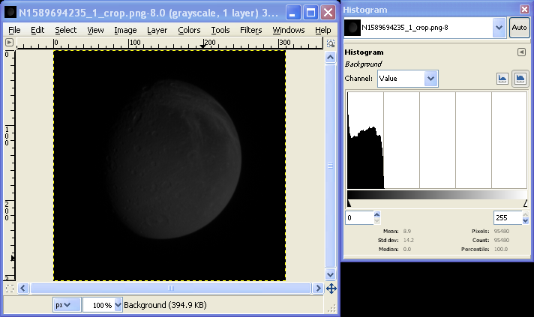
The Histogram
Pixels are all near bottom end of scale. In other words, image is dark!

Slide 14
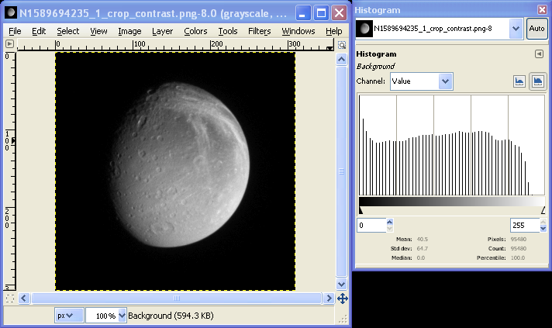
“Stretching” the Histogram
Bars of histogram now occupy whole value range. More detail is visible.

Slide 15
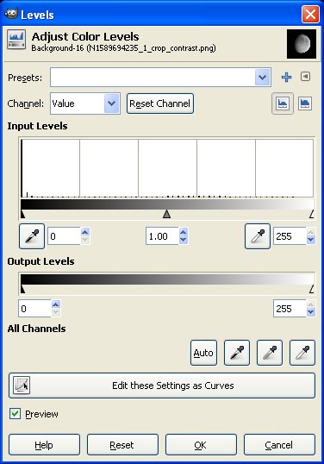
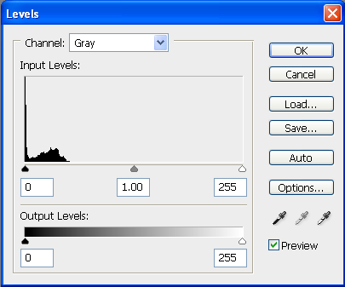
How to Stretch a Histogram
GIMP: Go to Colors -> Levels and fiddle with sliders under “Input Levels”
Photoshop: Go to Image -> Adjustments -> Levels (or Ctrl-L) and fiddle with sliders under “Input Levels”

Slide 16
How to Stretch a Histogram
Demonstration:
  Level adjustment
  Clipping ends of histogram & why this is sometimes desirable
  What the middle slider does
[Emily’s notes to self]
    Use image N00145744.jpg
    Use sample points in GIMP to dynamically demonstrate level changes
    Ctrl-click on ruler to establish sample points
    Also demo in Photoshop

Slide 17
Brightness and contrast, quantitatively
Changing the brightness of an image:
  Qualitatively: you’re moving all the bars of a histogram up or down.
  Quantitatively: you’re adding or subtracting a constant
Changing the contrast of an image:
  Qualitatively: you’re stretching out (or squeezing together) the bars of the histogram
  Quantitatively: you’re running all the numbers in the matrix through a function that changes their values. Function can be linear (multiplying by a constant) or not (“curves”)

Slide 18
A word on bit depth
See how bars in second histogram are spaced out?
Bars are spaced out but there is the same number of bars as before
That is, the number of distinct levels has not changed
If the starting image is dark enough, the stretched version will look “posterized”
This is a common problem with dark 8-bit images.
Solution is to use 16-bit images, but GIMP doesn’t yet support this! Photoshop does.

Slide 19
Saving Your Work
If you don’t want values of pixels to change when you save the file, you need to save in a lossless file format. (That’s the definition of lossless)
  Examples: PNG (my favorite), TIFF, BMP, and if the image is 8-bit black-and-white, GIF.
But when you post to the Web, you may want to keep file sizes small by using a lossy file format.
  JPEG is a very popular lossy format. GIF is lossy if the original image contains more than 256 different colors.
Details of lossless vs lossy formats are beyond the scope of this tutorial; Google will lead you to lots more on this topic.
If you don’t want to have to think about this problem, stick with PNG format for all your images.
  But note file sizes will generally be bigger compared to JPEG.

Slide 20
Color!
Color is a third dimension of data, the first two dimensions being spatial.
Scientifically, color represents spectral information – how a material absorbs more or less electromagnetic radiation depending upon the radiation’s wavelength.
We can take advantage of the human optical system to explore this third data dimension in a limited way.
Human eyes of non-colorblind people (7% of men!) can discriminate among three “channels” of color.

Slide 21
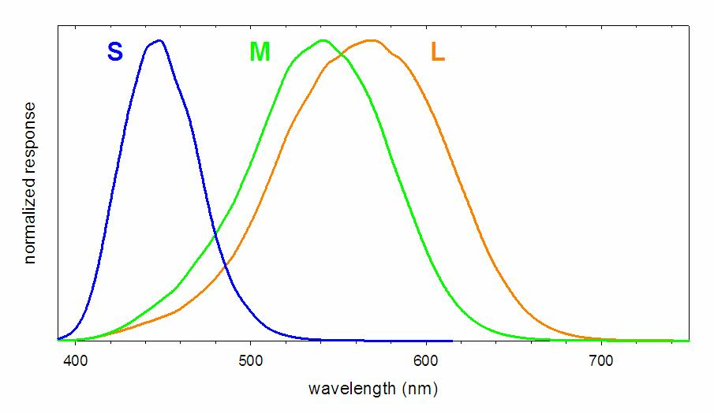
Human visual perception
These curves show the wavelength response of the three different light-sensitive cones of the human eye
S = short wavelength or “blue”; M = medium wavelength or “green”; L = long wavelength or “red” (though peak response is actually at an orange color)
To trick human eye into thinking it’s seeing a full-color scene, a monitor shows three overlapping images, one in red light, one in green light, and one in blue light.

Slide 22






RGB color
Take three images:
Color one red, one green, and one blue:
Now let’s make them overlap…

Slide 23



RGB Color
Green plus blue gives you cyan:
Blue plus red gives you magenta:
And, counterintuitively to artists, green plus red gives you YELLOW.

Slide 24

RGB color
Even more strangely for artists, all three colors together give you WHITE.
Why??
For extended answer to this question, read
http://www.chm.davidson.edu/vce/CoordChem/color.html

Slide 25
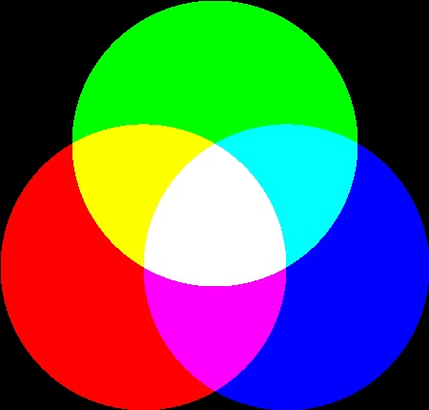
RGB color
Light at 444 nm mostly excites S cones so our brain thinks “blue.”
Light at 526 nm excites M more than L cones so our brain thinks “green.”
Light at 645 nm excites mostly L cones so our brain thinks “red.”
If the computer monitor puts out light at both 645 and 526 nm, both the M and L cones are excited and our brain is tricked into thinking that we are looking at a yellow object (spectrally in between green and red). We are still only seeing green and red light.
Green
526 nm
Red
645 nm
Blue
444 nm

Slide 26
Making color images
So a color image is actually composed of three different images, one showing the brightness of a scene at a red wavelength, one showing its brightness at a green wavelength, and one showing the brightness of a scene at a blue wavelength.
If an object looks red, it’s bright in the red-wavelength image and dark in green and blue.
If an object looks blue, it’s bright in the blue-wavelength image and dark in green and red.
If an object looks yellow, it’s bright in the red and green-wavelength images and dark in blue.
And so on…

Slide 27
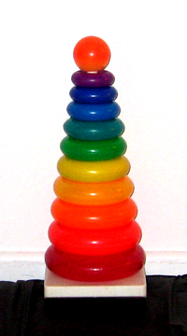
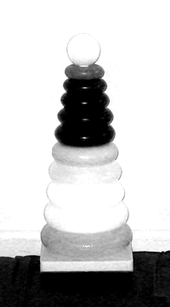
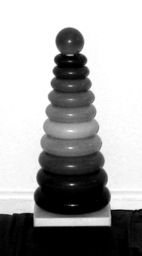
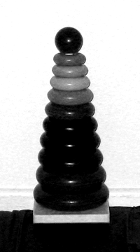
Example color image
RGB
Red
channel
Green
channel
Blue
channel

Slide 28
Color images from space
Nearly all space cameras have detectors sensitive to a wide range of the electromagnetic spectrum, sometimes beyond visible wavelengths
To get color information, filters are placed between the detector and the scene that only allow some colors of light to pass.
To make an approximate true color image, we need the spacecraft to take three separate images, one each through a red, a green, and a blue filter.

Slide 29
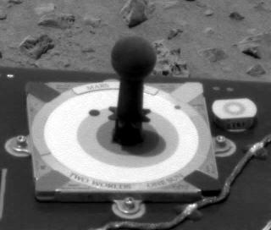
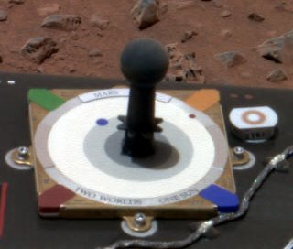
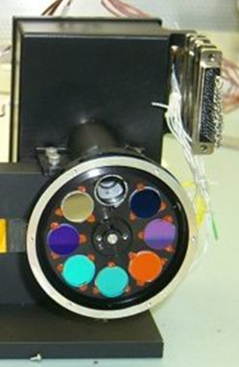
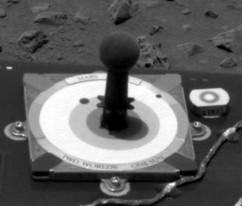
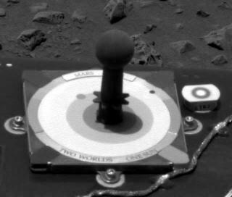
Click! Whirr. Click! Whirr. Click!
Red
channel
Green
channel
Blue
channel
NASA / JPL / Cornell

Slide 30
How to compose RGB images
In GIMP:
  Place each image in a file as a separate layer.
  Make sure the Image > Mode is grayscale.
  Go to Colors > Components > Compose
  Make sure the channel assignments are correct
  Click OK and GIMP will make a new file, an RGB composite.
  If the color image looks wonky, you might not have assigned the channels correctly.
  [NOTE TO SELF: demonstrate RGB values in Sample Points dialog in GIMP.]

Slide 31
How to compose RGB images
In Photoshop, it is slightly trickier.
  Open the three images separately
  We need to copy and paste each image into the appropriate channels.
  Start with Green image, select all and copy (Ctrl-A, Ctrl-C or do through Edit menu)
  Go to Blue image, then to Window > Channels
  In Channels palette, click on Green, then paste (Ctrl-V or do through Edit menu)
  Go to Red image, select all, copy, return to Blue image, click on Red channel and paste
  In Channels palette, click on RGB and you should see color image

Slide 32
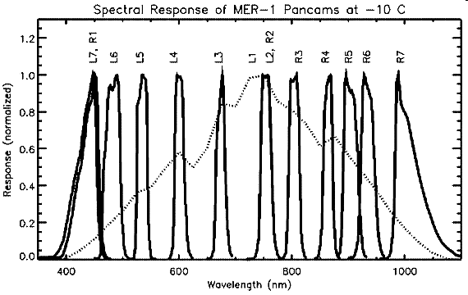
Always “Approximate” true color
Spectral responses of MER camera filters (or any space camera filters) are not the same as that of human cone cells!
Even more approximate: Most MER color images are actually composed of images taken through L2, L5, and L7 filters

Slide 33
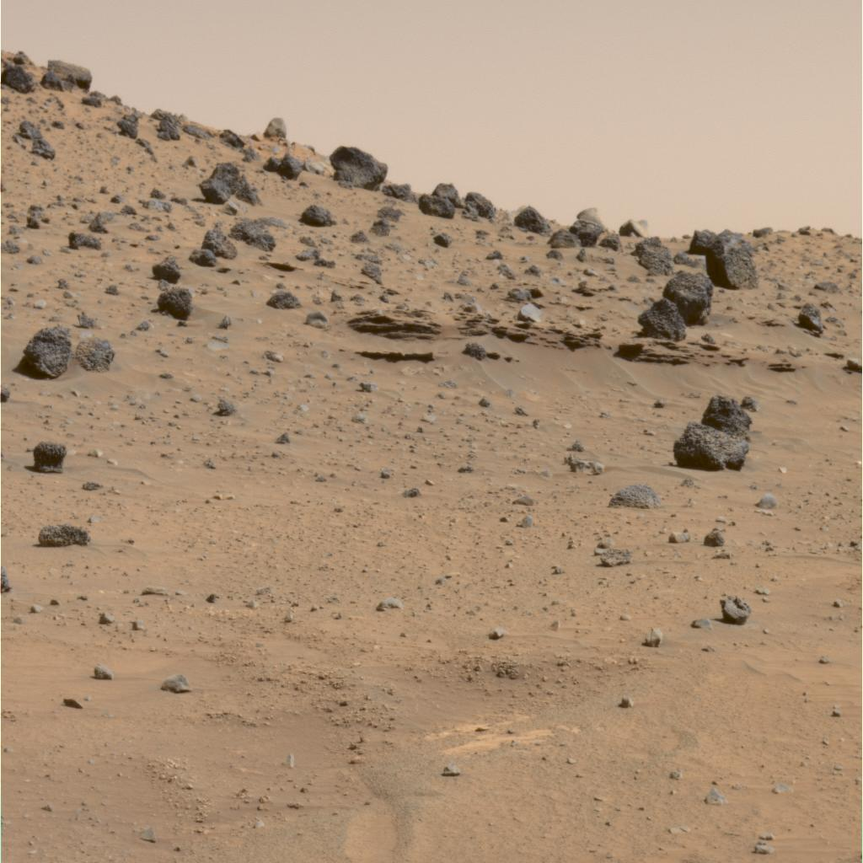
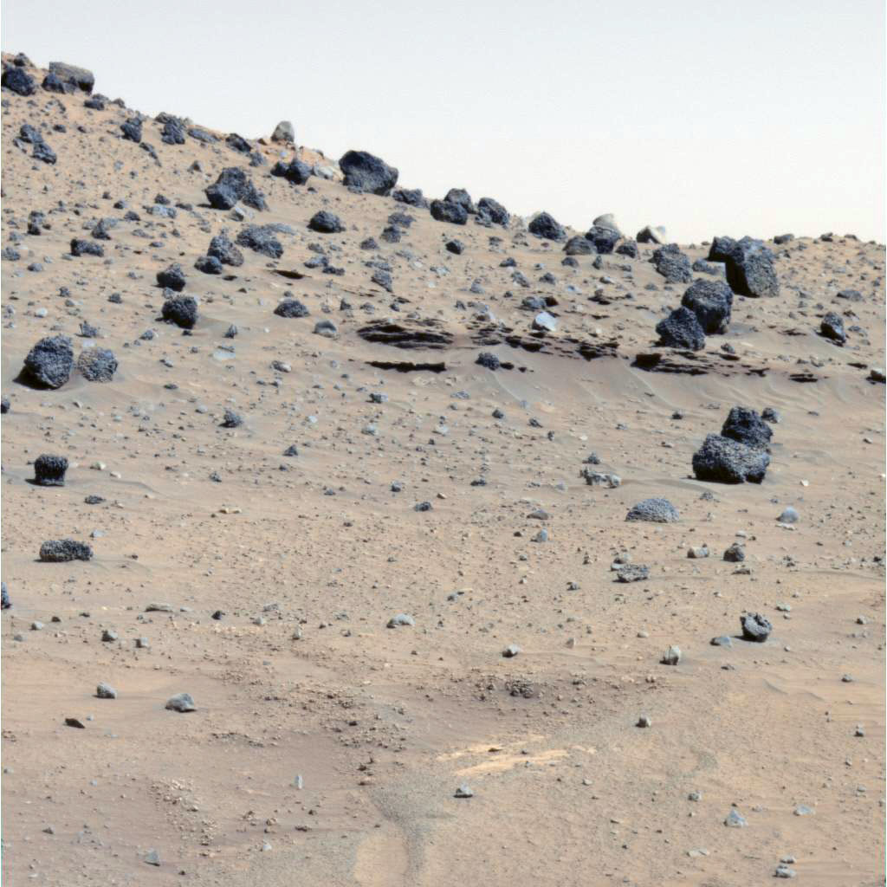
Histogram stretching in color images – a warning
Histogram stretching in color images can produce unexpected results – for example, Mars skies often turn out blue.
But stretching the histogram can help us see more of the natural variation in the image.
Calibrated color
Each channel stretched independently
Data: NASA / JPL / Cornell / color by Daniel Crotty

Slide 34
“False color”
There’s no reason we have to limit ourselves to red, green, and blue filter images to compose color views.
Using other color filters can lead to much deeper insight into spectral variation within a scene.
On Mars, infrared filters are popular because different minerals have different infrared reflectance properties.
In the outer planets, filters may be chosen in “absorption bands” or “spectral windows” of important gases, especially methane, to reveal more detail in a scene.
Each spacecraft has a different and idiosyncratic filter set, so each mission produces different kinds of false color images.

Slide 35
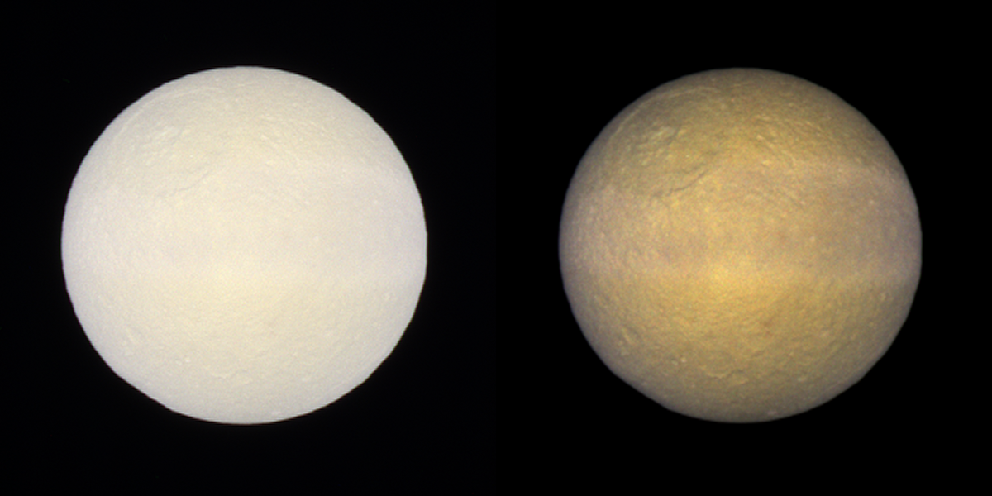
Not too false color
Saturn’s moon Tethys. Left: IR-G-UV. Right: contrast stretched to enhance color variations.
Data: NASA / JPL / SSI / Color by Gordan Ugarkovic

Slide 36
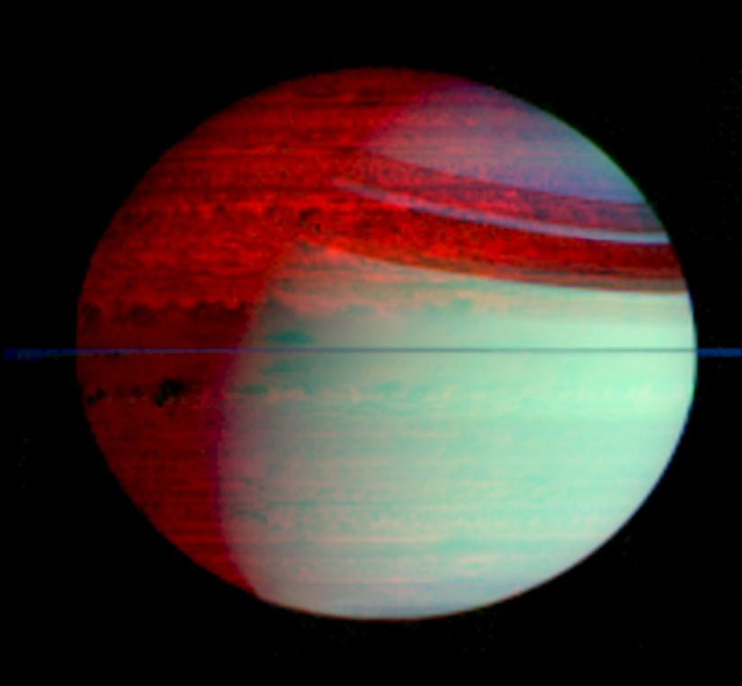
Very false (but illuminating) color
PIA08732
All detail here is in infrared wavelengths, longer than human eye can see: Red = 5.02 microns, Green = 2.71, Blue = 1.07
There’s nothing “false” about the data here; color imaging lets us take advantage of power of human visual cortex to notice spatial variations in reflectance at each wavelength
NASA / JPL / UA

Slide 37
Some approximate definitions
These aren’t official but they roughly correspond to how most amateurs seem to use the terms.
  True color: Image is composed of red, green, and blue filter images, and processed to approximate human color perception.
  Approximate true color: Might substitute an IR or Orange filter image for Red channel or UV or Violet filter image for Blue channel, etc.
  Enhanced color: Contrast is stretched to emphasize color variations, or color is from broader region of electromagnetic spectrum (like IR-G-UV) (yes, this overlaps with “approximate true color” definition)
  False color: Color filter choices may have little to do with human visual perception. (Still, it’s customary to put longest wavleength in red channel, shortest in blue.)

Slide 38
Give credit where it’s due
Data from most space missions belongs to the public and is free for all (even commercial!) use.
However, individual scientists and institutions gave a lot to produce the data.
Accepted format is to credit institutions for the data, then yourself for the processing.
Credit lines are specific to each instrument on each mission
Example credit lines:
  MER image: “NASA / JPL / Cornell / color composite by Daniel Crotty”
  Cassini: “NASA / JPL / SSI / animation by Emily Lakdawalla”

Slide 39
And speaking of credit…
Please join or donate!
Go to https://planetary.org/special/blog/support.html and they’ll know I sent you
To all of you who are already members and/or contributors, THANK YOU!
Next class: We’ll dig in to MER and Cassini raw images. Explore the catalogs:
  http://marsrovers.jpl.nasa.gov/gallery/all/
  http://saturn.jpl.nasa.gov/photos/raw/

Slide 40
The Planetary Society
The Planetary Society was founded in 1980 by Carl Sagan, Bruce Murray, and Louis Friedman to encourage the exploration of our solar system and the search for extraterrestrial life.
We are a nonprofit, nongovernmental organization, funded by dues and donations from individuals around the world. With members from over 140 countries, we are the largest space interest group on Earth. Membership is open to all people interested in our mission.
We encourage all spacefaring nations to explore other worlds; provide public information and support educational activities; and support and fund innovative and novel research and development projects that can seed future projects of planetary exploration.

